Slide 1
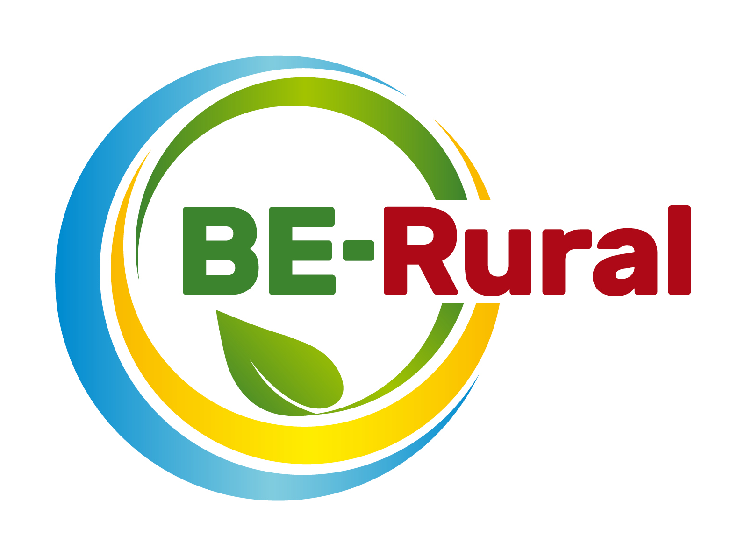
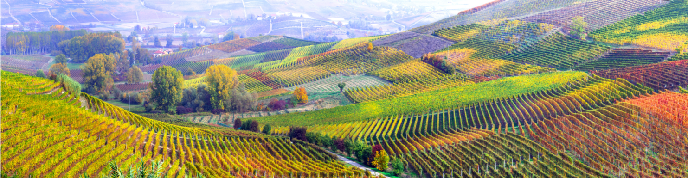
New technologies for processing herbs and producing essential oils for the cosmetics and pharmaceutical industries
Name of presenter
Notes:
Notes to the teacher:
Teacher’s name to go in the space at the bottom left of the slide. Explain that this presentation introduces the new technologies for processing herbs and producing essential oils for the cosmetics and pharmaceutical industries.
Excluding the video, the outline slide and this first slide, there are 13 slides – so these slides should take between 13 and 26 minutes to present, depending of amount of explanation.

Slide 2
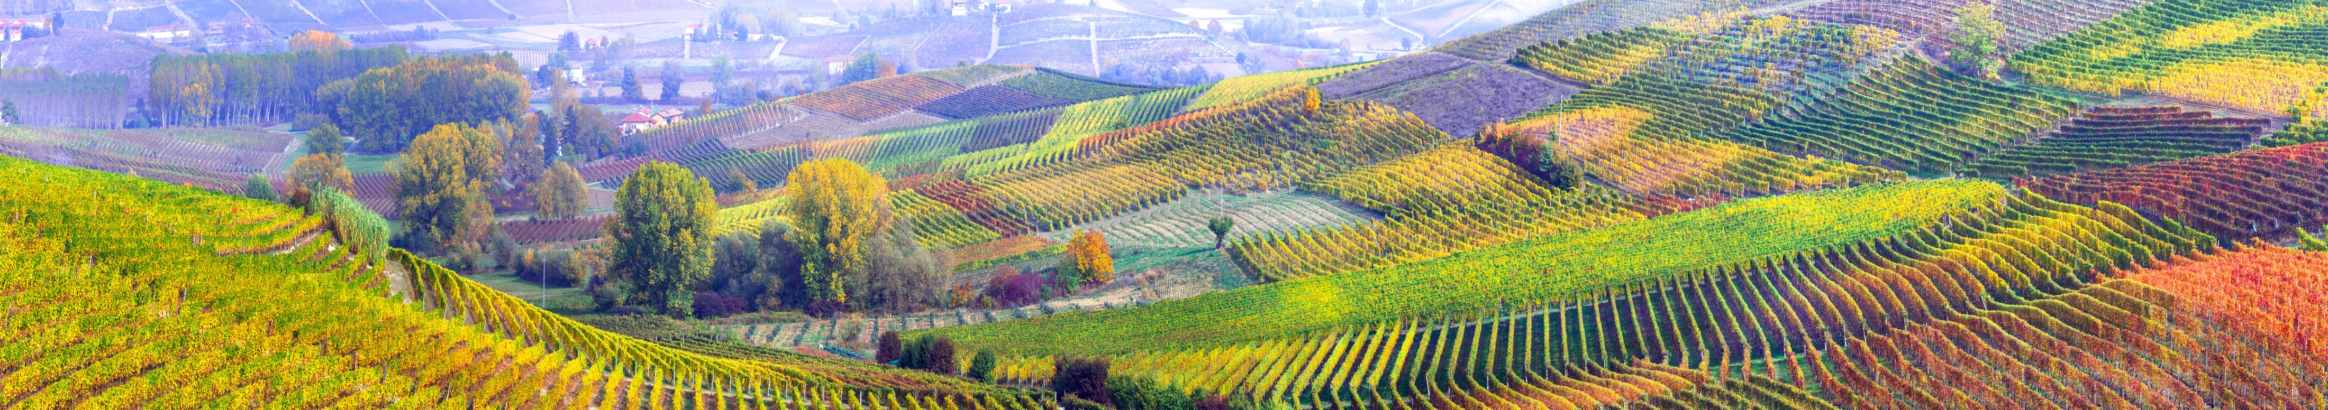
Presentation Content
Bioeconomy overview – what it is, ecological limits and challenges
What are essential oils and herbs and how are they made?
Case study bioproducts
a) Herbs in cosmetics
b) Herbs in pharmaceuticals
c) Essential oils in cosmetics
d) Essential oils in pharmaceuticals
Extracting oils from coffee waste
SDGs applicable to producing bioproducts in the cosmetics and pharmaceuticals industries
Examples of the use of Bulgarian rose and snail oil
Notes:
Notes to teachers:
Explain the structure of the lecture to students to set the scene on what will be covered.
Key Information Summary:
The lecture provides information on the processing of essential oils and herbs for use in the cosmetics industry and gives some examples of how these are currently being used. Links to the Sustainable Development Goals (hereafter SDGs) are also made to highlight the additional socioeconomic benefits which creating bioeconomies in these industries bring.

Slide 3

Bioeconomy overview
European Bioeconomy Strategy
The European Commission is taking steps towards a sustainable bioeconomy and has a bioeconomy strategy to promote the bioeconomy and to avoid reaching ecological limits.
The Bioeconomy…
Is the production of goods, services, or energy from biological material as the main resource.
Is strongly linked to sustainability as biodegradable resources are often used and waste is often completely designed out of the system.
Can avoid the depletion of resources for future generations and protect the stability of the planet.
Notes:
Notes to teacher: Explain to class that in order to take steps towards sustainability and the avoidance of reaching ecological limits the bioeconomy is very important. The bioeconomy is the production of goods, services, or energy from biological material as the main resource. This is strongly linked to sustainability as biodegradable resources are often used and waste is often completely designed out of the system. This can avoid the depletion of resources for future generations and protect the stability of the planet. The European Commission is taking steps towards a sustainable bioeconomy. Turning waste into valuable resources and creating incentives to help retailers and consumers cut food waste. The European Commission has a bioeconomy strategy to promote the bioeconomy and avoid reaching ecological limits.
European Commission (2018), A sustainable Bioeconomy for Europe: strengthening the connection between economy, society and the environment. Updated Bioeconomy Strategy. Directorate-General for Research and Innovation, available at: https://ec.europa.eu/research/bioeconomy/pdf/ec_bioeconomy_strategy_2018.pdf accessed: 22 May 2020].

Slide 4

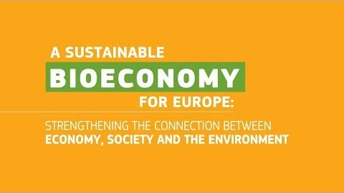
Bioeconomy overview
Bioeconomy and Circular Economy – waste is a valuable resource
Video (2 minutes and 9 seconds): https://www.youtube.com/watch?v=RfRN_hHeIKk
Languages for sub-titles for video include: Bulgarian, Latvian, Macedonian, Polish and Romanian
Notes:
1. Explain bioeconomy to introduce topic and contextualise bioproducts portfolio.
Bioeconomy is defined as the production, utilization and conservation of biological resources to provide information, products, processes and services across all economic sectors aiming towards a sustainable economy (Bell et al., 2018).
“The bioeconomy covers all sectors and systems that their functions and principles. It includes and interlinks: land and marine ecosystems and the services they provide; all primary production sectors rely on biological resources (animals, plants, micro-organisms and derived biomass, including organic waste), that use and produce biological resources (agriculture, forestry, fisheries and aquaculture); and all economic and industrial sectors that use biological resources and processes to produce food, feed, bio-based products, energy and services. To be successful, the European bioeconomy needs to have sustainability and circularity at its heart. This will drive the renewal of our industries, the modernisation of our primary production systems, the protection of the environment and will enhance biodiversity.” (European Commission (2018) ‘A sustainable Bioeconomy for Europe: strengthening the connection between economy, society and the environment’ available at: (https://ec.europa.eu/research/bioeconomy/pdf/ec_bioeconomy_strategy_2018.pdf#view=fit&pagemode=none])
Now we will watch a short video explaining what the bioeconomy is, its potential and challenges.
Play video explaining bioeconomy here: https://www.youtube.com/watch?v=RfRN_hHeIKk&feature=youtu.be
(Languages for sub-titles for video include: Bulgarian, Latvian, Macedonian, Polish and Romanian)
2. Explain circular economy to give context to bioproducts.
Circular Economy is a framework for the development and management of sustainable, waste-as-resource economic system. It aims to keep products, components and materials at the highest utility and value at all times (European Commission, 2018). Moreover, it is designed to process the reduced waste out of the system. The current global economic framework is a linear, this means that we take, produce, use and dispose without fully exploiting all the essential properties of materials. Circular economy seeks to create a more sustainable economic model where no waste is generated, instead it is reutilised as many times as possible. With this, circular economy aims to eliminate all waste and create a closed-loop system purely based on natural resources.
Bell, J., Paula, L., Dodd, T., Németh, S., Nanou, C., Mega, V. and Campos, P. (2018). EU ambition to build the world’s leading bioeconomy—Uncertain times demand innovative and sustainable solutions. New Biotechnology, 40: 25–30.
European Commission (2018), A sustainable Bioeconomy for Europe: strengthening the connection between economy, society and the environment. Updated Bioeconomy Strategy. Directorate-General for Research and Innovation, available at: https://ec.europa.eu/research/bioeconomy/pdf/ec_bioeconomy_strategy_2018.pdf

Slide 5
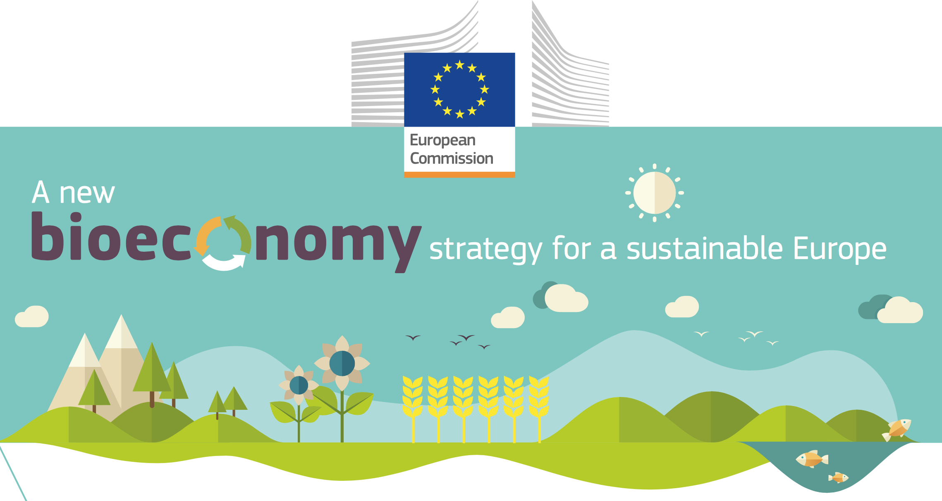
Ecological limits
In addition to links to sustainability and climate change mitigation, it is critical that the bioeconomy operates within safe ecological limits.
With the new bioeconomy strategy, the European Commission supports initiatives at national and regional level to develop an efficient and sustainable bioeconomy and this includes:
implementing an EU-wide monitoring system to track progress towards a sustainable and circular bioeconomy.
providing guidance on how best to operate the bioeconomy within safe ecological limits.
Notes:
Notes to teacher: Explain that to try and tackle the issues surrounding ecological limits: National and international bodies have specific guidelines. An example of this is the European Commission’s 2018 publication; ‘A new bioeconomy strategy for a sustainable Europe.’ Further information available at: https://ec.europa.eu/commission/news/new-bioeconomy-strategy-sustainable-europe-2018-oct-11-0_en
Key reading:
EC (2018), Bioeconomy: A new strategy for a sustainable Europe Restoring healthy ecosystems and enhancing biodiversity. European Commission https://ec.europa.eu/research/bioeconomy/pdf/ec_bioeconomy_actions_2018.pdf
Could also check for more advanced reading:
Giampietro, M. (2019). On the circular bioeconomy and decoupling: implications for sustainable growth. Ecological economics, 162, 143-156. https://www.sciencedirect.com/science/article/pii/S0921800918317178
Vivien, F. D., Nieddu, M., Befort, N., Debref, R., & Giampietro, M. (2019). The hijacking of the bioeconomy. Ecological economics, 159, 189-197. https://www.sciencedirect.com/science/article/abs/pii/S0921800918308115

Slide 6
Bioeconomy challenges: Resource Provision and Biodiversity loss
Bioproducts are derived from renewable biological resources. The bioeconomy makes use of many different biomass resources, from crops to forests to microorganisms. Without these feedstocks, there would be no bioeconomy.
It is critical that the bioeconomy does not compete with food production and does not affect biodiversity. For example, marginal lands may not be used for food production but may be important for biodiversity
It is therefore fundamental to carry a biodiversity assessment.
Notes:
Key reading:
The Bioecomomy Consultants (2018), BIG BIOECONOMY CHALLENGES - PART 2. https://www.nnfcc.co.uk/news-big-bioeconomy-challenges-2
Brownlie, S. (2013), IAIA fast tips No. 5 - Biodiversity Assessment. International Association for Impact Assessment (IAIA). https://www.iaia.org/fasttips.php
See slides “What is the Bioeconomy? Opportunities, challenges and solutions” for information on:
Bioeconomy – links to SDGs and climate change, and bioeconomy resources
The transition to a bioeconomy is complex
Biodiversity assessment
Direct, indirect and cumulative impacts
What are ‘impacts and need for Environmental Impact Assessment (EIA) and/or Strategic Environmental Assessment (SEA).
Net positive outcomes, enhancement and the mitigation hierarchy
Example: the impacts of biofuels

Slide 7
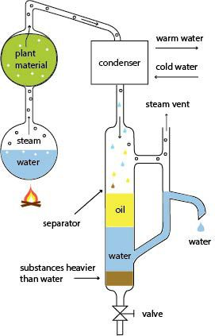
Technologies for processing essential oils
Aromatic plants account for only ~10% of counted plant species globally (rare) e.g. lavender/peppermint
These synthesise a unique essence compound which often have health benefits due to their properties (antibacterial/antimicrobial)
Essential oils are extracted via steam distillation or mechanically through cold pressing
Can be combined to produce natural products such as face creams, medicines and aromatherapy/herbal remedies
Schematic of steam distillation process.
Notes:
Notes to teachers:
Explain to students firstly what essential oils are and then how they are extracted from their plant material to be used in cosmetics and pharmaceutical products. Draw students attention to the schematic which illustrates the steam distillation process by providing an annotated diagram of the equipment used. Particularly highlight the rarity of essential oils and thus their potential to produce cosmetics and pharmaceuticals which can be marketed as luxury products and therefore can be a lucrative business opportunity for local manufacturers.
Key Information Summary:
Plants and herbs which have properties valuable to the cosmetics/pharmaceutical industries (moisturizing, skin strengthening, antimicrobial etc). These can be distilled to access their essential oils which are unique to the plant and are often used in flavouring and perfumes. However, it is now being recognized that these could be used to build cosmetics and pharmaceutical economies in place where these types of plants grow well (for example in Stara Zagora). This is due to the recognition of the health benefits of essential oils and herbs such as reducing inflammation, dermatological benefits and wellbeing aromatherapy applications.
Essential oils are present in small quantities ( only about 10% of counted plant species globally) making them valuable commodities which can bring lucrative business opportunities and be used to create luxury cosmetics and pharmaceuticals products. Common examples of aromatic plants include lavender and peppermint and these are particularly pertinent to the cosmetics and pharmaceuticals industry. These are seen as luxury products, often more expensive but of higher quality and a more natural alternative to synthetic chemicals used in such products. Therefore, utilizing essential oils from plants can reduce the adverse environmental effects associated with producing synthetic chemicals (energy use etc) and disposal of these chemicals (effluent water pollution and ecosystem disruption).
Essential oils are mainly extracted through steam distillation as seen in the schematic on the slide. Plant material is heated by steam and the vapours are passed through a condenser to separate the essential oil from the floral waters by virtue of their different boiling points, allowing the essential oil to be collected and then used to make cosmetics products and pharmaceuticals which are then enhanced with the properties of the natural essential oil. This reduces the need for the manufacturing of essential oils which has environmental benefits in terms of reducing pollution of water systems (not as many potential harmful synthetic chemicals are entering back into the water systems) and reducing resource use (not as much energy, carbon and water is needed for steam distillation of natural materials than producing synthetic chemicals in factories and using local produce reduces the need to transport resources between manufacturing plants).
Key Links to Further Information:
https://techni-pharma.fr/en/essential-oils/
https://www.pharmatutor.org/articles/essential-oil
Rios, J. (2016). ‘Chapter 1 - Essential Oils: What They Are and How the Terms Are Used and Defined.’ In: Preedy, V.R. (Ed). Essential Oils in Food Preservation, Flavour and Safety, Academic Press, London, pp3-10.
Figure source: https://www.pinterest.com/pin/228135537350517432/

Slide 8
New technologies for processing herbs
Drying of Herb
Grinding of herb to powder
Evaporation
Further processing
Notes:
Notes to teachers: Explain to students the way herbs are dried, ground and evaporated to be used in cosmetics and pharmaceuticals, highlighting emerging technology of Supercritical Fluid Extraction (SFE) which could become a more sustainable method, further increasing the benefits of using these biomaterials as opposed to synthetic alternatives. Emphasise the potential market for herbal medicines etc and that this could therefore provide a growth industry for areas where these plants grow well. The slide shows a process of the steps which occur to get to the final pure herb extract (eg peppermint oil etc) and it is important to go through each step so the way in which these products come to be used in cosmetics and pharmaceuticals is understood.
Key Information Summary:
Both researchers and consumers are becoming more aware of the potential of using herbs in medicines due to their health benefitting properties. For example, for 80% of the world’s population, herbal medicines are their first line of health care (correct as of 2003 – may have altered in the years since but no further data can be accessed). Additionally, the botanical dietary supplement market in the U.S. has expanded rapidly from US$ 2.9 billion in 1995 to US$ 4.8 billion in 2008. Therefore, this is a growing global market, as consumers demand less synthetic chemicals which have negative effects in terms of marine pollution and product safety. This shows that there is appetite for natural biomaterials such as herbs in pharmaceutical products such as creams, tablets and other forms of medicines.
Herbs can be processed in several ways to access the health benefitting properties they contain. However, before processing can begin, the herbs must be dried so that bacteria and fungi don’t form if any moisture is present. The dried plants are then ground to increase their surface area, meaning chemical reactions with the added solvents are sped up and extraction yields are increased. The solvents added to the dried herb powders are then subject to heat, pressure or microwave power in order to allow the phytochemicals within the herb cells to diffuse out into the solvent. This either forms a mixed liquid or two layers if an essential oil is produced as this will not mix with the solvent. Evaporation by virtue of their different boiling points allows the separation of the herb extract/essential oil and water. This process is facilitated usually through a rotary evaporator. The herb extract is then processed further to create pure, natural products.
Now, Supercritical Fluid Extraction (SFE) (which uses CO₂ as the solvent) is becoming more popular due to the recognition of the ability to gain a high yield of extraction from herbs at lower temperatures and with less harmful environmental and health impacts than organic solvents since it is non-toxic.
The herb extracts and essential oils produced can then be used in several cosmetic and pharmaceutical products.
Key Links to Further Information:
Quotation source: WHO. (2003) Traditional Medicine, WHO, Geneva, Switzerland.
1995 data: Aarts T. (1998) Industry Overview. Nutrition Business Journal;3(9):1-5.
2008 data: Nahin R.L., Statistics N.C.f.H. (2009) Costs of complementary and alternative medicine (CAM) and frequency of visits to CAM practitioners. US Department of Health and Human Services, Centers for Disease Control and Prevention, National Center for Health Statistics Hyattsville, MD.
Azmin, S.N.H.M., Manan, Z.A., Alwi, S, R, W., Chua, L.S., Mustaffa, A.A., Yunus, N.A. (2016). ‘Herbal Processing and Extraction Technologies.’ Separation and Purification Reviews, Vol 45, pp1-57.
Fornari, T., Vicente, G., Vázquez, E., García-Risco, M.R., Reglero, G. (2012). ‘Isolation of essential oil from different plants and herbs by supercritical fluid extraction.’ Journal of Chromatography, Vol 1250, pp34-48.

Slide 9
Herbal Cosmetics Bioproducts
Algae Face Mask
Peppermint Foot Scrub
Soothing and Healing Benefits
100% brown algae extract (Alginate)
Algal blooms removals as possible source material
Peppermint essential oil and volcanic rock granules
Smooth hard skin while providing cooling effect
Notes:
Notes for teachers: Explain the use of herbs in cosmetics products using the two examples on the slides. Firstly explain how using algal plants can add in soothing and healing properties to skin products such as the face mask shown on the slide. Then, draw students attention to a more familiar herb (peppermint) which also has soothing benefits when used in pampering products such as foot scrubs as shown. Stress that both these products are available to purchase online or in store today and so highlight that these bioproducts which are advocated to be created are not abstract ideas but are available for people to use now. If possible and have physical examples could pass these around the class and let students see the tangible products which can be created from naturally growing herbs.
Key Information Summary:
ALGAE FACE MASK:
Made from Polish based company Bielenda.
Active ingredients: Diatomaceous clay, Alginate (100% brown algae extract).
It calms and soothes the skin after treatments / eliminates redness / intensifies the process of microdamage regeneration and improves skin firmness and elasticity.
Algae grow readily and work as the trees of the oceans (ie undertake photosynthesis), taking in carbon dioxide and producing oxygen. Therefore, utilising these important, abundant herbs can act to reduce the amount of synthetic chemicals which need to be produced.
Algae come in many different species and often build ups called algae blooms are removed from lakes to increase their aesthetic value, particularly in managed parks etc. This removal of algae could serve as a source for the biomaterial’s use within the cosmetics industry to create natural products free from harmful chemicals for the user and the environment once these make their way back into the water system through drains etc.
PEPPERMINT FOOT SCRUB:
Uses essential oil from the peppermint herb.
Mixed with volcanic rock granules to produce a scrub which will smooth hard skin and provide a cooling and soothing effect during and after application.
The herb has many benefits (other than its flavor and fragrance) which can be used in cosmetics products such as its moisturizing effect particularly for lip balms and ability to reduce inflammation of the skin makes it useful in products such as moisturisers and face creams.
Key Links for Futher Information:
https://www.sciencedirect.com/science/article/pii/S0960852414017350
https://bielendaprofessional.pl/en/products/ultra-soothing-algae-face-mask-with-diatomaceous-clay
https://www.thebodyshop.com/en-gb/body/foot-care/peppermint-reviving-pumice-foot-scrub/p/p000737
McKay, D.L., Blumberg, J.B. (2006). ‘A review of the bioactivity and potential health benefits of peppermint tea (Mentha piperita L.’ Phytotherapy Research, Vol 20, pp619-633.

Slide 10
Herbal Pharmaceuticals Bioproducts
Spirulina Nutrional Supplement
Peppermint Oil Capsules
Naturally high in vitamins and minerals
Blue-green algae
66% protein
High in vitamin A (immune system support)
Good calcium source (contributes to healthy bones
Can reduce bloating and help irritable bowel syndrome
When combined with eucalyptus/ clove oil can combat allergies
Notes:
Notes for Teachers: Draw students attention to the Spirulina nutritional supplement which can be used to ensure users are intaking the required amounts of vitamins and minerals to maintain a healthy diet and lifestyle. Then draw attention to peppermint oil capsules, highlighting how one herb can be used in different ways depending on its differing beneficial properties. For example, not only for use in cosmetics but also to reduce bloating etc in herbal medicine remedies. Highlight how herbal medicines are popular on the market currently, but that their increased advertising and use could help reduce use of artificial medicines which may be more harmful both to consumers and the environment if toxic chemicals are released into water and ecosystems.
Key Information Summary:
SPIRULINA NUTRITIONAL SUPPLEMENT:
Nutritious blue-green algae cyanobacteria (66% protein (!) – as well as fibre, B vitamins, manganese, iron and calcium). Spirulina powder is rich in vitamin B1 (thiamine) which contributes to the normal function of the heart, psychological function and immune system.
Spirulina powder is super high in plant-based protein, with 15g providing just under 10g of protein. Protein helps us to maintain muscle mass.
Spirulina powder is bursting with vitamin A, which contributes to a healthy functioning immune system.
Spirulina powder contains lots of iron, which helps the body feel less tired and fatigued as well as transporting oxygen around the body.
Spirulina is a good source of calcium, which contributes to the maintenance of healthy bones.
Again, algae is an abundant natural resource which can be utilised for its particular health benefits.
PEPPERMINT OIL CAPSULES:
Peppermint oil has been proven to have health benefits such as reducing bloating and irritable bowel syndrome.
The oil can also be combined with other oils to have additional effects (e.g. when combined with eucalyptus and clove oil it can reduce symptoms of allergies and so can be used as a natural remedy for conditions like hay fever instead of having to use artificial antihistamines. Additionally, if used with coconut oil, it is said to reduce fever symptoms.
Reducing the need for artificial medicines not only reduces the energy needed to produce these and transport them to labs where the medicines are made. It also means when these medicines are disposed of/dissolved back into the water system, they do not contaminate marine ecosystems as the herb extracts are non-toxic and, thus, not harmful to humans or marine life.
Key Links to Further Information:
https://naturya.com/single-ingredients/spirulina-powder
https://thracianoils.com/peppermint-oil/)
McKay, D.L., Blumberg, J.B. (2006). ‘A review of the bioactivity and potential health benefits of peppermint tea (Mentha piperita L.’ Phytotherapy Research, Vol 20, pp619-633.

Slide 11
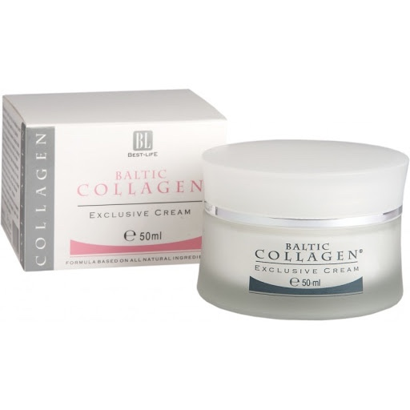
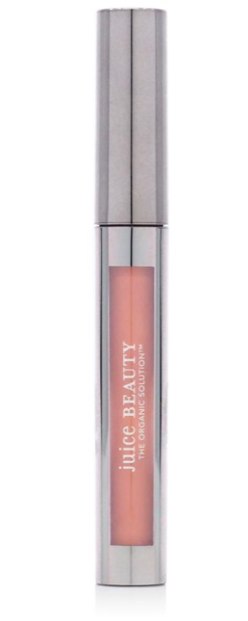
Essential Oils in Cosmetics Products
Increased moisturisation and use of industrial waste
Natural collagen from fish skins
Collagen comprises many essential oils eg rosehip and lemon etc
Using waste from fishery industry
Blend of pomegranate and rose essential oils
Grown organically (increases antioxidant levels)
Juicy Beauty ‘Phyto-Pigments Sheer Lipgloss’
Notes:
Notes for Teachers: Draw students attention to each product which utilises essential oils mostly for added moisturization, giving the cosmetics products an additional dermatological benefit. Highlight that Baltic Collagen cream comprises many different essential oils and uses waste material from the fishery industry so is seen to be circular in the sense that no artificial products need to be manufactured (reducing the energy and resources involved in this) and what was previously viewed as waste material is now formed into high value products. Highlight the opportunities of growing aromatic plants organically to ensure no artificial fertilisers contaminate land and products are naturally safe for human use, especially on sensitive and allergy-prone skin.
Key Information Summary:
BALTIC COLLAGEN EXCLUSIVE CREAM:
Polish based company (Gdynia).
Uses freshwater and saltwater fish skins to retrieve natural collagen.
In contrast to artificial collagen creams, a small amount of gel is enough to moisturize and enrich the skin with valuable substances. Importantly, the products from the Baltic Collagen line do not contain any chemical additives: fragrances or dyes. It is a completely natural hydrate of connective tissue protein obtained from freshwater and marine fish, thus reducing fishery waste whilst creating a dermatologically advantageous product.
JUICY BEAUTY PHYTO-PIGMENTS SHEER LIPGLOSS:
Contains the Juice Beauty exclusive Moisture Plant Blend (glycerin, betaine and phospholipids) to increase skin hydration and the Juice Beauty Phyto-Pigments exclusive blend of pomegranate and rose essential oils.
US based company which grows their own ingredients organically on their own farm in California.
On their company website www.juicybeauty.com, they herald the benefits of growing and using natural and organic products such as rose and pomegranate, as in the lipgloss range. For example, they say “According to a study conducted by The Organic Center, organically farmed fruits and vegetables can increase antioxidant levels by nearly 30 percent compared with produce grown on conventional farms." Therefore, using these naturally occurring essential oils can have dermatological benefits as well as reducing environmental pollution from harmful synthetic chemicals.
They argue essential oils such as rose etc increase the moisturisation of the products too, meaning their cosmetics, such as the lipgloss shown, have additional benefits to conventional cosmetics products.
Key Links to Further Information:
http://balticcollagen.pl/baltic-collagen-en/
https://juicebeauty.com/pages/why-juice
https://juicebeauty.com/collections/makeup-shop-by-category-lips/products/phyto-pigments-sheer-lip-gloss

Slide 12
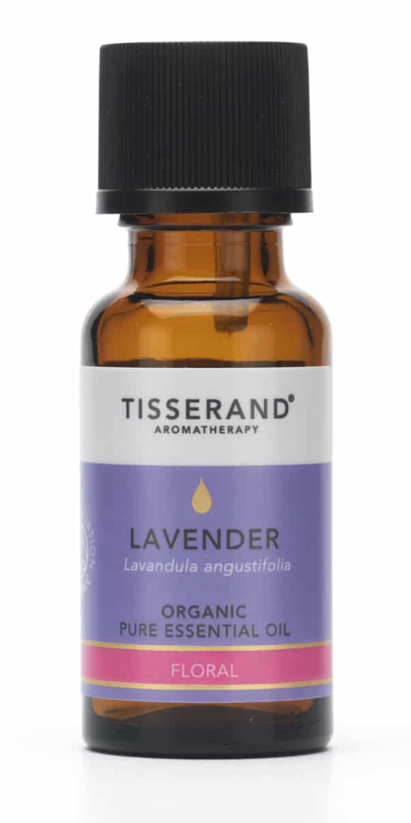
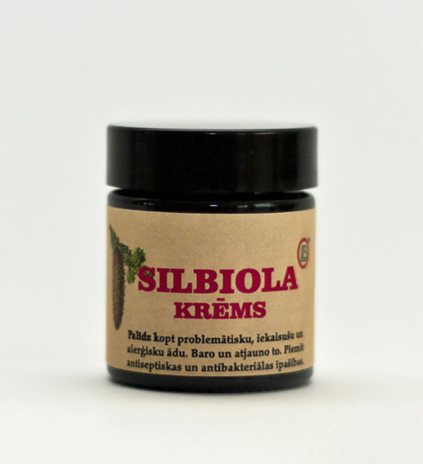
Essential Oils in Pharmaceuticals Products
Soothing / calming properties
Essential oils from confier trees eg pine, spruce
Cream for allergy-prone / inflamed skin due to cooling and healing properties
£12.95 for just 20ml
Organic, pure lavender oil calms anxiety, helps promote a good night’s sleep
Sooth minor cuts and grazes
Tisserand Lavender Essential Oil
Notes:
Notes for Teachers: Highlight how Biolat cream can be used to treat inflamed skin due to the healing properties found in conifer tree essential oils. Draw students attention to the mental health benefits of lavender oil (helps reduce anxiety etc) as well as the conventional physical health benefits (treating cuts and grazes) of the pharmaceutical product.
Key Information Summary:
BIOLAT ‘SILBIOLA CREAM’:
Made from essential oils - Silbiols is an extract of spruce with bio-active compounds containing epimanol, phytosterols etc.
The essential oils are extracted from conifer trees such as spruce and pine trees.
These are used in aromatherapy, body butter and creams as seen here for inflamed or allergic skin as the essential oils have cooling and healing properties.
Also used in health drink Ho-Fi to supplement the diet, especially during winter.
So, Biolat process the raw plant materials in the way previously described (mainly conifer needle foliage) to extract the bio-active substances and turn them into high-quality products that are good for strengthening health, supplementing diet, cosmetic use and plant protection.
LAVENDER ESSENTIAL AROMATHERAPY OIL:
Lavender is one of the most popular essential oils for use in pharmaceuticals, especially aromatherapy applications due to its soothing properties.
It is extracted using steam distillation as explained previously.
Costs £12.95 for just 20ml of the organic pure oil (quite expensive as marketed as a luxury product).
The soothing properties of Lavender essential oil will help calm anxiety, improve relaxation and help to promote a good night’s sleep. Used on the skin, Lavender is effective for soothing minor cuts and grazes and can also provide nourishment to dry or sun-chapped skin.
Key Links for Further Information:
https://www.biolat.lv/en/products/needle-processing-products/
https://www.tisserand.com/aromatherapy/lavender-ethically-harvested-pure-essential-oil-20ml/

Slide 13
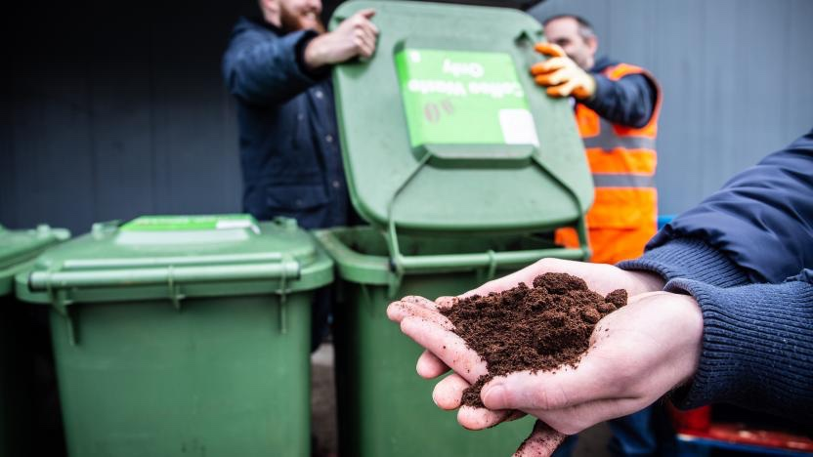
Using waste coffee to extract oils
Example of maximizing value from waste:
Option A – Using coffee waste to condition soil. Low value.
Options B - Extracting oils from waste coffee. High value.
Plus, after extracting the oils, the leftover grains can still be used to condition soil. A cascading of uses – from maximum value to less value.
Click image to play video describing Revive-Eco
https://revive-eco.com/about/
Extracting oils from waste coffee – the work of Revive-Eco
Oils extracted from waste coffee are a sustainable alternative to palm oil.
Palm oil derivatives occur in approximately 70% of cosmetics produced globally (Zuckerman, 2017).
By using waste coffee instead of palm oil, this could reduce the negative environmental impacts from deforestation whilst reducing coffee waste going to landfill.
Notes:
Notes to Teachers:
Play youtube video describing Revive Eco by clicking on image or using the following web link: https://www.youtube.com/watch?v=lc7dYah5CtM&feature=youtu.be (Video duration 1 minute 20 seconds). Use this to highlight the key aspects of Revive Eco, what their company ethos is and how they collect waste coffee grounds to be used to make high value products such as for the cosmetics and pharmaceuticals industries by extracting essential oils from the coffee.
Highlight the importance of finding alternatives to palm oil by explaining the vast environmental damage mass production of this oil is having globally, most widely reported in the Amazon. Finally, draw students attention to the benefits which could be felt by using waste biomaterial as an alternative in cosmetics and pharmaceuticals which rely quite heavily on palm oil for production of many products.
Key Information Summary:
“In the UK, we drink 55 million cups of coffee each day, leading to over half a million tonnes of coffee grounds being generated and wasted” (Revive Eco website). Revive Eco uses these waste coffee grounds, collecting them from local cafes and businesses (with plans to sign contracts with the likes of RBS and Edinburgh Airport).
Revive Eco extract oils from the coffee grounds in a German lab, which provides them with many different essential oils which can be used in the pharmaceuticals/cosmetics/food industries. One of these such essential oils can be an environmentally conscious alternative to palm oil which has the potential to make a big impact on the negative effects of deforestation for the production of palm oil currently ongoing.
Palm oil is extracted from the fruit of the oil palm tree. “Now, Indonesia and Malaysia make up over 85% of global supply but there are 42 other countries that also produce palm oil” according to the WWF website (WWF, 2020). However, there is mass media attention on the effects deforestation from palm oil production is having in the Amazon rainforest. It is a growing industry in parts of the Amazon both for its use in the manufacturing of many different products, but also as a form of biofuel for the region. “From 2010 to 2012, the palm oil sector presented an impressive increase, from 1090 km² to almost 1400 km² in Pará state, the largest producer, due to bioenergy demands.” (Carvhalo et al, 2015: 868). This is having negative environmental effects though, as species such as Orangutans are becoming extinct and reducing tree numbers limits the amount of photosynthesis occurring in a world where greenhouse gas emissions are rising, further contributing to the effects of climate change.
“Palm oil is in nearly everything – it’s in close to 50% of the packaged products we find in supermarkets, everything from pizza, doughnuts and chocolate, to deodorant, shampoo, toothpaste and lipstick.” (WWF, 2020). This is especially true of cosmetics as palm oil derivatives occur in approximately 70% of cosmetics produced globally (Zuckerman, 2017). Therefore, if Revive Eco are able to provide a widely used alternative to palm oil, this could greatly reduce the negative environmental impacts from deforestation whilst reducing coffee waste going to landfill. This is a great example of where the circular economy can be used in cosmetics and pharmaceuticals to solve global environmental issues by using the value of materials viewed as waste.
Key Links To Further Information:
https://revive-eco.com/about/
WWF (2020). ‘8 Things to Know About Palm Oil‘. Available at: https://www.wwf.org.uk/updates/8-things-know-about-palm-oil. Accessed 03/03/20.
Carvhalo, C.M., Silveira, S., Rovere, E.L., Iwama, A.Y. (2015). ‘Deforested and degraded land available for the expansion of palm oil for biodiesel in the state of Pará in the Brazilian Amazon. Renewable and Sustainable Energy Reviews, Vol 44, pp867-876.
Zuckerman (2017). Palm Oil Controversy. Available at: https://www.vogue.com/projects/13535833/palm-oil-controversy-beauty-products-ingredient-sourcing-deforestation-climate-change/. Accessed 03/03/20.

Slide 14

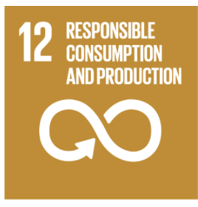


SDGs applicable to producing bioproducts in the cosmetics and pharmaceuticals industries
17 Sustainable Development Goals as adopted in 2015 by UN member countries
Notes:
Notes to Teachers: Explain how the Sustainable Development Goals (SDGs) aim to encourage sustainable development and highlight how these can be related to using essential oils and herbs for cosmetics and pharmaceuticals as explained in the information summary below. Encourage students to look at the SDGs website (https://sustainabledevelopment.un.org/?menu=1300) either in class or in their own time to understand all 17 goals and their targets that were not explained in depth here as other may be applicable and this can encourage critical thinking and wider understanding of how bioeconomies can help to solve global issues such as unemployment and climate change.
Key Information Summary:
The SDGs overall aim is to encourage sustainable development globally in a fair manner. Encouraging the implementation of bioeconomies is key to many of these goals and their targets. For example…
SGD 8 (Decent work and economic growth) – Creating bioeconomies provides jobs in new industries. According to Trading Economics, the unemployment rate in Bulgaria at the end of 2019 was approx. 5.9%, compared to the UK unemployment rate of 3.8%. Therefore, there is scope to reduce the unemployment rate through creating new job opportunities, particularly in the rural region of Stara Zagora, not just in major cities. This works towards Target 8.3 which advocates the need to “Promote development-oriented policies that support productive activities [and] decent job creation…” as well as Target 8.2 which seeks to “achieve full and productive employment and decent work for all women and men, including for young people and persons with disabilities…” by 2030. Creating these value-added products can be seen to stimulate new industry and work towards decreasing the unemployment rate in the area, whilst bringing in new economic prosperity. Target 8.9 also seeks to “devise and implement policies to promote sustainable tourism that creates jobs and promotes local culture and products…” and thus the possibility of advertising a new ‘healing tourism’ in Bulgaria and elsewhere. For example, encouraging people to come on wellness holidays and view the farms where they grow the aromatic plants may add another layer of development to the drive to increase employment and economic prosperity (this is possible with Bulgaria’s reputation as a world leader in rose and lavender growth).
SDG 9 – (Industry, innovation and infrastructure) – The target particularly of concern here is Target 9.4 which states “By 2030, upgrade infrastructure and retrofit industries to make them sustainable, with increased resource-use efficiency and greater adoption of clean and environmentally sound technologies and industrial processes…” Therefore, there is an explicit call for industry to think of new practices in terms of production to minimise their environmental effects, and reducing and reusing waste is a way to do this. Although not explicitly, this target encourages circular economy models which use waste resources and therefore create industries which are sustainable in terms of greenhouse gas emissions and waste disposal. Using essential oils and herbs to create bioproducts for the cosmetics and pharmaceuticals industry can thus be seen to increase economic growth, whilst keeping in line with the environmental values at the heart of the SDG’s.
SDG 11 (Sustainable cities and communities) – Target 11.A aims to “Support positive economic, social and environmental links between urban, peri-urban and rural areas by strengthening national and regional development planning.” Therefore, the BE-Rural project, encouraging the development of sustainable business particularly in rural areas can be seen to increase local culture, and strengthen links between regions within a country by reducing socioeconomic inequalities such as job opportunities and economic prosperity. Through creating bioeconomies in Stara Zagora this aims to create links between this area and industries across not only Bulgaria, but more widely if companies are to export their products and compete in global cosmetics and pharmaceuticals industries.
SDG 12 – (Responsible consumption and production) – Target 12.2 is perhaps the most important to consider here. It states “By 2030, achieve the sustainable management and efficient use of natural resources.” This is an ambitious target and is broken down into material footprint and domestic material consumption indicators. Therefore, by using waste biomaterial, this both reduces material footprints (as less new plastic etc is required to make the same products) and reduces consumption as these biomaterials are reducing waste from other industries.
Other goals are also important but these are, in my opinion, the most relevant for creating bioproducts from essential oils and herbs in the cosmetics and pharmaceuticals industries.
Key Links to Further Information:
https://www.un.org/sustainabledevelopment/sustainable-development-goals/
Unemployment statistics available at:
Bulgaria (https://tradingeconomics.com/bulgaria/unemployment-rate)
UK (https://tradingeconomics.com/united-kingdom/unemployment-rate)

Slide 15
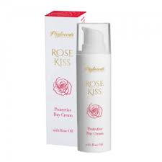
Phytocode
Bulgarian Rose Oil
Beauty Brand based in Bulgaria
Utilises locally grown rose oil
Reduces energy/carbon emissions involved in importing chemicals for production
Increases dermatological benefits for consumer
Uses waste plant material
Picture
Phytocode Rose Kiss Protecting Day Cream
Notes:
Notes to Teachers: Explain how Phytocode are utilising Bulgarian rose oil in cosmetic products currently and the potential for this to be used widely. This helps to illustrate that these are not just abstract ideas but are possible and available, albeit not on industrial scales, right now.
Key Information Summary:
Some examples of Bulgarian use of native oils and herbs for the cosmetics and pharmaceuticals industries already exist, proving the opportunity is viable. Phytocode is a Bulgarian based beauty company utilising naturally grown local oils such as rose oil to create natural beauty products such as the day cream from the Rose Kiss range. The rose oil has good hydrating properties and can eliminate acne inducing bacteria. Thus, as well as meaning local cosmetics industries don’t need the additional cost of importing artificial oils for their products, using local rose oil reduces the carbon footprint of the manufacturing process and increases the dermatological effects of the product, compared to other moisturisers without this essential oil.
Key Links to Further Information:
http://phytocode.net/products/rose-kiss/protective-day-cream/
Danube Transnational Programme (DanuBioValNet), (2019). ‘Top Bio-based products in the Danube Region, page 12. Available at: http://www.interreg-danube.eu/uploads/media/approved_project_output/0001/30/a319626f134bfa2747eab95550024252de5b37c0.pdf

Slide 16
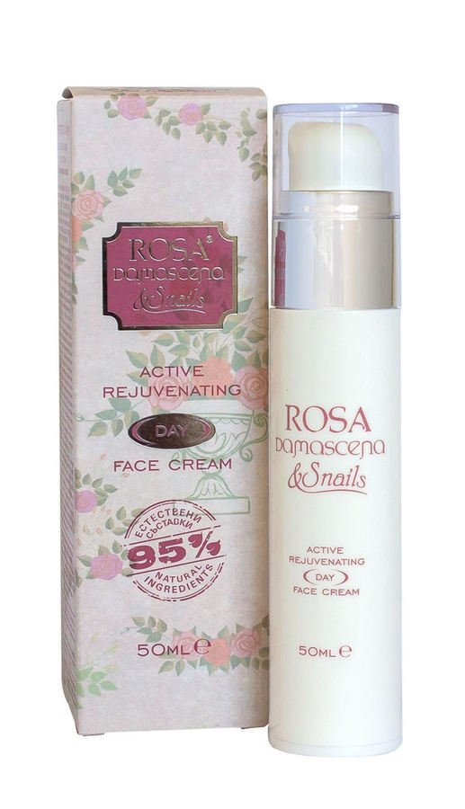
Rosa Damascena
Bulgarian Rose and Snail Oil
Using foreign exchange rates, costs approx. £11.75 for 50ml
Rose oil, Rose absolute, snail extract
Moisturising and rejuvenating qualities
Grown locally
Tourism potential
Notes:
Notes For Teachers:
Explain the Rosa Damascena product putting emphasis on the healing tourism aspect they incorporate through holding tours of their gardens in which they grow the roses to be used to provide dermatological benefits to their products. Highlight how this relates to both the BioStep Report (2018) previously discussed and helps to contribute to achieving the SDGs discussed by creating additional jobs and prosperity within the tourism sector.
Key Information Summary:
Again, this product utlises rose oil grown locally in Bulgaria. Damascena combines this with Rose absolute and 100% snail extract to formulate their intensive day cream. This rejuvinates the skin and strengthens tissue and can be used on sensitive skin as the components are hypoallergenic.
Damascena have their own “complex“ in which they grow over 150 different types of roses to make their different cosmetic products. Additionally, this encourgaes a tourism industry as the company lead tours through their gardens and sell their essential oils (e.g. rose oil) as well as sample of their oils in food stuffs like jams/drinks. This could provide additional jobs and income for the region if utilised as a national point of interest and could encourage tourists to Bulgaria more widely. This, therefore, contributes to the Biostep (2018) report calling for more promotion of healing tourism to increase bioeconomies in the region.
Key Links to Further Information:
https://www.damascena.net/en/produkt/day-face-cream-with-bulgarian-rose-oil-and-snail-extract-50ml/
Zelljadt, E., Stoyanov, M., Bianchini, C., Mazzariol, F., Davies, S., Millar, K. (2018). ‘Strategies for Strengthened Regional Bioeconomies in Stara Zagora and Veneto.’ Biostep Report.

Slide 17
Questions and Discussion
Name of presenter
Notes:
Notes to the teacher: Speaker’s name to go in the space at the bottom left of the slide. This is the final slide of the presentation. Allow time for students/participants to ask any questions.

Slide 18

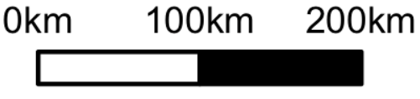
https://be-rural.eu
These educational resources were developed as part of the BE-Rural project
Bio-based strategies and roadmaps for enhanced rural and regional development in the EU (April 2019 – March 2022)
BE-Rural supports
… regional stakeholders in five countries:
Latvia: Vidzeme and Kurzeme
Poland: Szczecin and Vistula Lagoons
Romania: Covasna
Bulgaria: Stara Zagora
North Macedonia: Strumica
The goal of BE-Rural is to realise the potential of regional bio-based economies by supporting relevant actors in the participatory development of bioeconomy strategies and roadmaps
https://be-rural.eu/innovation-regions/
Notes:
BE-Rural has five innovation regions
BE-Rural will create five regional Open Innovation Platforms (OIPs) for the participatory development of bioeconomy strategies and roadmaps. The BE-Rural OIPs will be established in five regions across the EU with different biomass potentials and will be based on the regional Stakeholder Working Groups (SWGs). Within the OIPs, the main task of the SWGs will be to formulate concrete strategy or roadmap documents by engaging with different actors and opening the platform for a wide range of stakeholders in the region, including civil society organisations and citizens.
Stara Zagora, Bulgaria: This innovation region will focus on seeking new technologies for the application of essential oils and herbal plants in the cosmetics and pharmaceutical industry. The small-scale production in this area will be combined with tourism-related activities to expand the existing business status quo and potential. Ultimately, the region will establish closer relations and network between companies. Regional partner: Bulgarian Industrial Association (BIA)
Vidzeme and Kurzeme, Latvia: This region will focus on the potential of by-products of forest management (i.e. from young forest stand thinning, short rotation coppice and forestry (SRC/SRF) plantations, removing of overgrowth in abandoned agricultural lands and perennial grasses) as a source of bioenergy or biorefinery. The region will investigate the value of agroforestry systems of perennial grasses and SRC or SRF trees as grazing areas, and the production of hay or grass seeds. The potential smart use of small timber wood from young forest stand thing will be explored. Regional partner: The Latvian State Forest Research Institute (SILAVA)
Strumica, North Macedonia: The region will focus on the utilization of agricultural residues, specifically the by-production of organic materials from agricultural activities, as a source of energy for domestic and industrial purposes. The region will investigate technology options for energy conversion of biomass materials generated on agricultural fields or farms (field-based residues), as well as those generated during the processing of agricultural products (process-based residues). Regional partner: International Centre for Sustainable Development of Energy, Water and Environment Systems (SDEWES-Skopje)
Szczecin Lagoon and Vistula Lagoon, Poland: This region will focus on small-scale fisheries, specifically on the sustainable use of currently underused and low-value fish species located in two lagoons. The region will investigate small-scale technology options that can be applied to utilize low-value fish species as products for human consumption. Regional partner: The National Marine Fisheries Research Institute (NMFRI)
Covasna, Romania: The region will focus on addressing fragmented value chains and implementing the circular economy concept within the county’s industrial sectors (i.e. wood and furniture, textiles, agro-food, mechanical engineering, green energy). The region will investigate the development potential of underused biomass (plant matter and wood waste) and it implication on societal challenges (e.g., rural unemployment or marginalised communities). This will be done within a local development business model based on a small-scale technology option ensuring the autonomous energy supply for civil and industrial needs. Regional partner: Institute for Economic Forecasting (IPE)
Source: BE-Rural (2020), Innovation regions, available at: https://be-rural.eu/innovation-regions/

