Slide 1
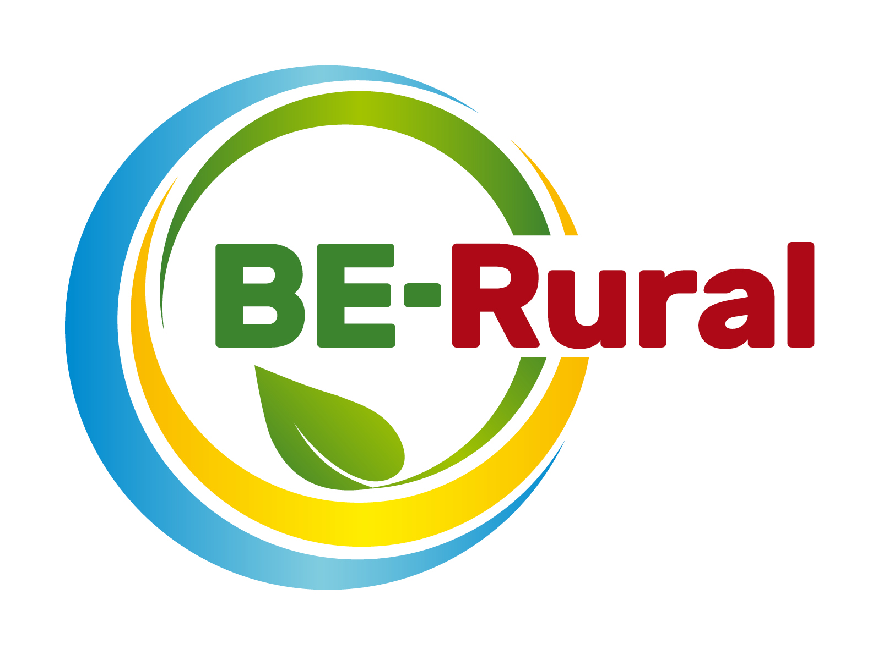
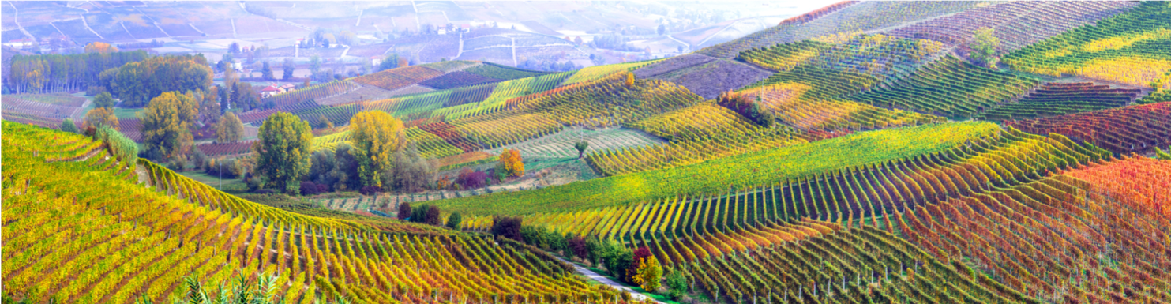
Bioeconomy in the Fisheries Sector
Name of presenter
Notes:
Notes to the teacher: Teacher’s name to go in the space at the bottom left of the slide. Explain that this presentation will explore the potential of the bioeconomy in the fishery sector, by learning about its potentials and challenges. Two small case studies will be presented: Poland and the Faroe Islands. Finally, we will learn about some interesting bioproducts resulting from the implementation of a bio-based economic framework.
Excluding this first slide, outline slide and the video, there are 12 slides – so these slides should take between 12 and 24 minutes to present, depending of amount of explanation.
The video is 2 minutes and 9 seconds long.

Slide 2
Outline
Bioeconomy overview – what it is, ecological limits and challenges
Fisheries feedstock
Examples of bioproducts based on “waste” from the fisheries sector
Notes:
Notes to the teacher: Briefly run through the topics that will be spoken about in this presentation as shown on the slide.

Slide 3
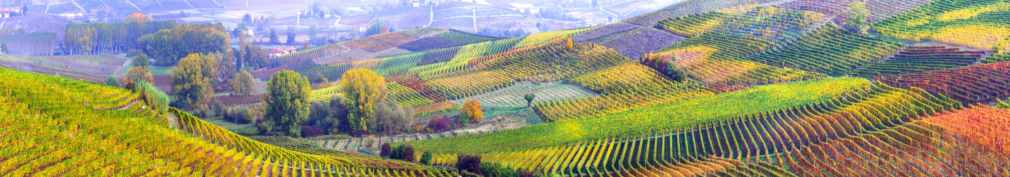
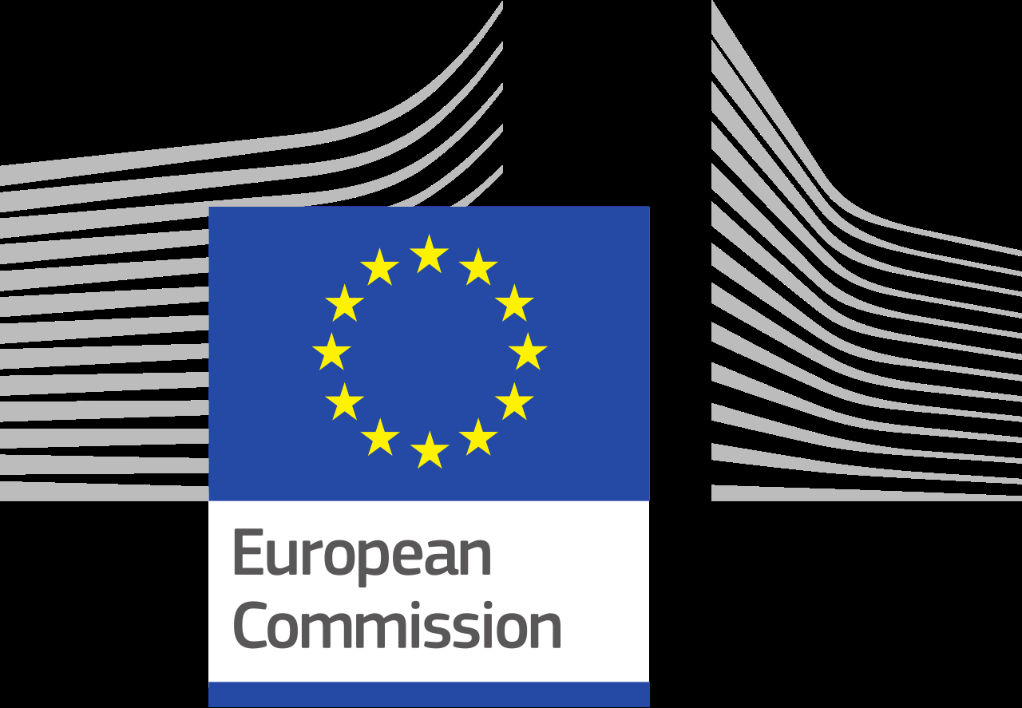
Bioeconomy overview
European Bioeconomy Strategy
The European Commission is taking steps towards a sustainable bioeconomy and has a bioeconomy strategy to promote the bioeconomy and to avoid reaching ecological limits.
The Bioeconomy…
Is the production of goods, services, or energy from biological material as the main resource.
Is strongly linked to sustainability as biodegradable resources are often used and waste is often completely designed out of the system.
Can avoid the depletion of resources for future generations and protect the stability of the planet.
Notes:
Notes to teacher: Explain to class that in order to take steps towards sustainability and the avoidance of reaching ecological limits the bioeconomy is very important. The bioeconomy is the production of goods, services, or energy from biological material as the main resource. This is strongly linked to sustainability as biodegradable resources are often used and waste is often completely designed out of the system. This can avoid the depletion of resources for future generations and protect the stability of the planet. The European Commission is taking steps towards a sustainable bioeconomy. Turning waste into valuable resources and creating incentives to help retailers and consumers cut food waste. The European Commission has a bioeconomy strategy to promote the bioeconomy and avoid reaching ecological limits.
European Commission (2018), A sustainable Bioeconomy for Europe: strengthening the connection between economy, society and the environment. Updated Bioeconomy Strategy. Directorate-General for Research and Innovation, available at: https://ec.europa.eu/research/bioeconomy/pdf/ec_bioeconomy_strategy_2018.pdf accessed: 22 May 2020].

Slide 4
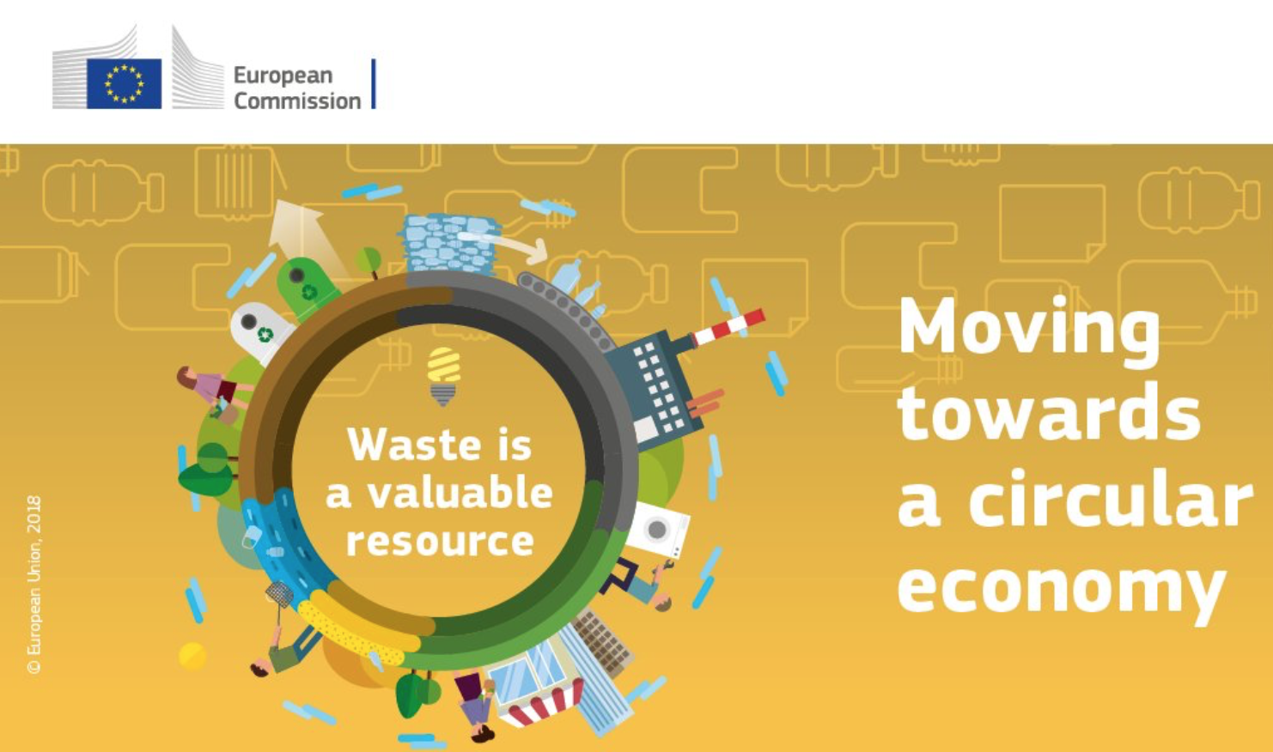
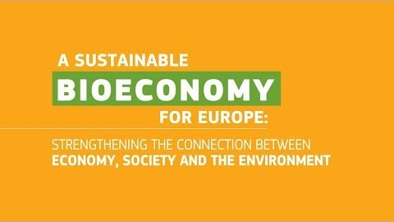
Bioeconomy overview
Bioeconomy and Circular Economy – waste is a valuable resource
Video (2 minutes and 9 seconds): https://www.youtube.com/watch?v=RfRN_hHeIKk
Languages for sub-titles for video include: Bulgarian, Latvian, Macedonian, Polish and Romanian
Notes:
1. Explain bioeconomy to introduce topic and contextualise bioproducts portfolio.
Bioeconomy is defined as the production, utilization and conservation of biological resources to provide information, products, processes and services across all economic sectors aiming towards a sustainable economy (Bell et al., 2018).
“The bioeconomy covers all sectors and systems that their functions and principles. It includes and interlinks: land and marine ecosystems and the services they provide; all primary production sectors rely on biological resources (animals, plants, micro-organisms and derived biomass, including organic waste), that use and produce biological resources (agriculture, forestry, fisheries and aquaculture); and all economic and industrial sectors that use biological resources and processes to produce food, feed, bio-based products, energy and services. To be successful, the European bioeconomy needs to have sustainability and circularity at its heart. This will drive the renewal of our industries, the modernisation of our primary production systems, the protection of the environment and will enhance biodiversity.” (European Commission (2018) ‘A sustainable Bioeconomy for Europe: strengthening the connection between economy, society and the environment’ available at: (https://ec.europa.eu/research/bioeconomy/pdf/ec_bioeconomy_strategy_2018.pdf#view=fit&pagemode=none])
Now we will watch a short video explaining what the bioeconomy is, its potential and challenges.
Play video explaining bioeconomy here: https://www.youtube.com/watch?v=RfRN_hHeIKk&feature=youtu.be
(Languages for sub-titles for video include: Bulgarian, Latvian, Macedonian, Polish and Romanian)
2. Explain circular economy to give context to bioproducts.
Circular Economy is a framework for the development and management of sustainable, waste-as-resource economic system. It aims to keep products, components and materials at the highest utility and value at all times (European Commission, 2018). Moreover, it is designed to process the reduced waste out of the system. The current global economic framework is a linear, this means that we take, produce, use and dispose without fully exploiting all the essential properties of materials. Circular economy seeks to create a more sustainable economic model where no waste is generated, instead it is reutilised as many times as possible. With this, circular economy aims to eliminate all waste and create a closed-loop system purely based on natural resources.
Bell, J., Paula, L., Dodd, T., Németh, S., Nanou, C., Mega, V. and Campos, P. (2018). EU ambition to build the world’s leading bioeconomy—Uncertain times demand innovative and sustainable solutions. New Biotechnology, 40: 25–30.
European Commission (2018), A sustainable Bioeconomy for Europe: strengthening the connection between economy, society and the environment. Updated Bioeconomy Strategy. Directorate-General for Research and Innovation, available at: https://ec.europa.eu/research/bioeconomy/pdf/ec_bioeconomy_strategy_2018.pdf

Slide 5
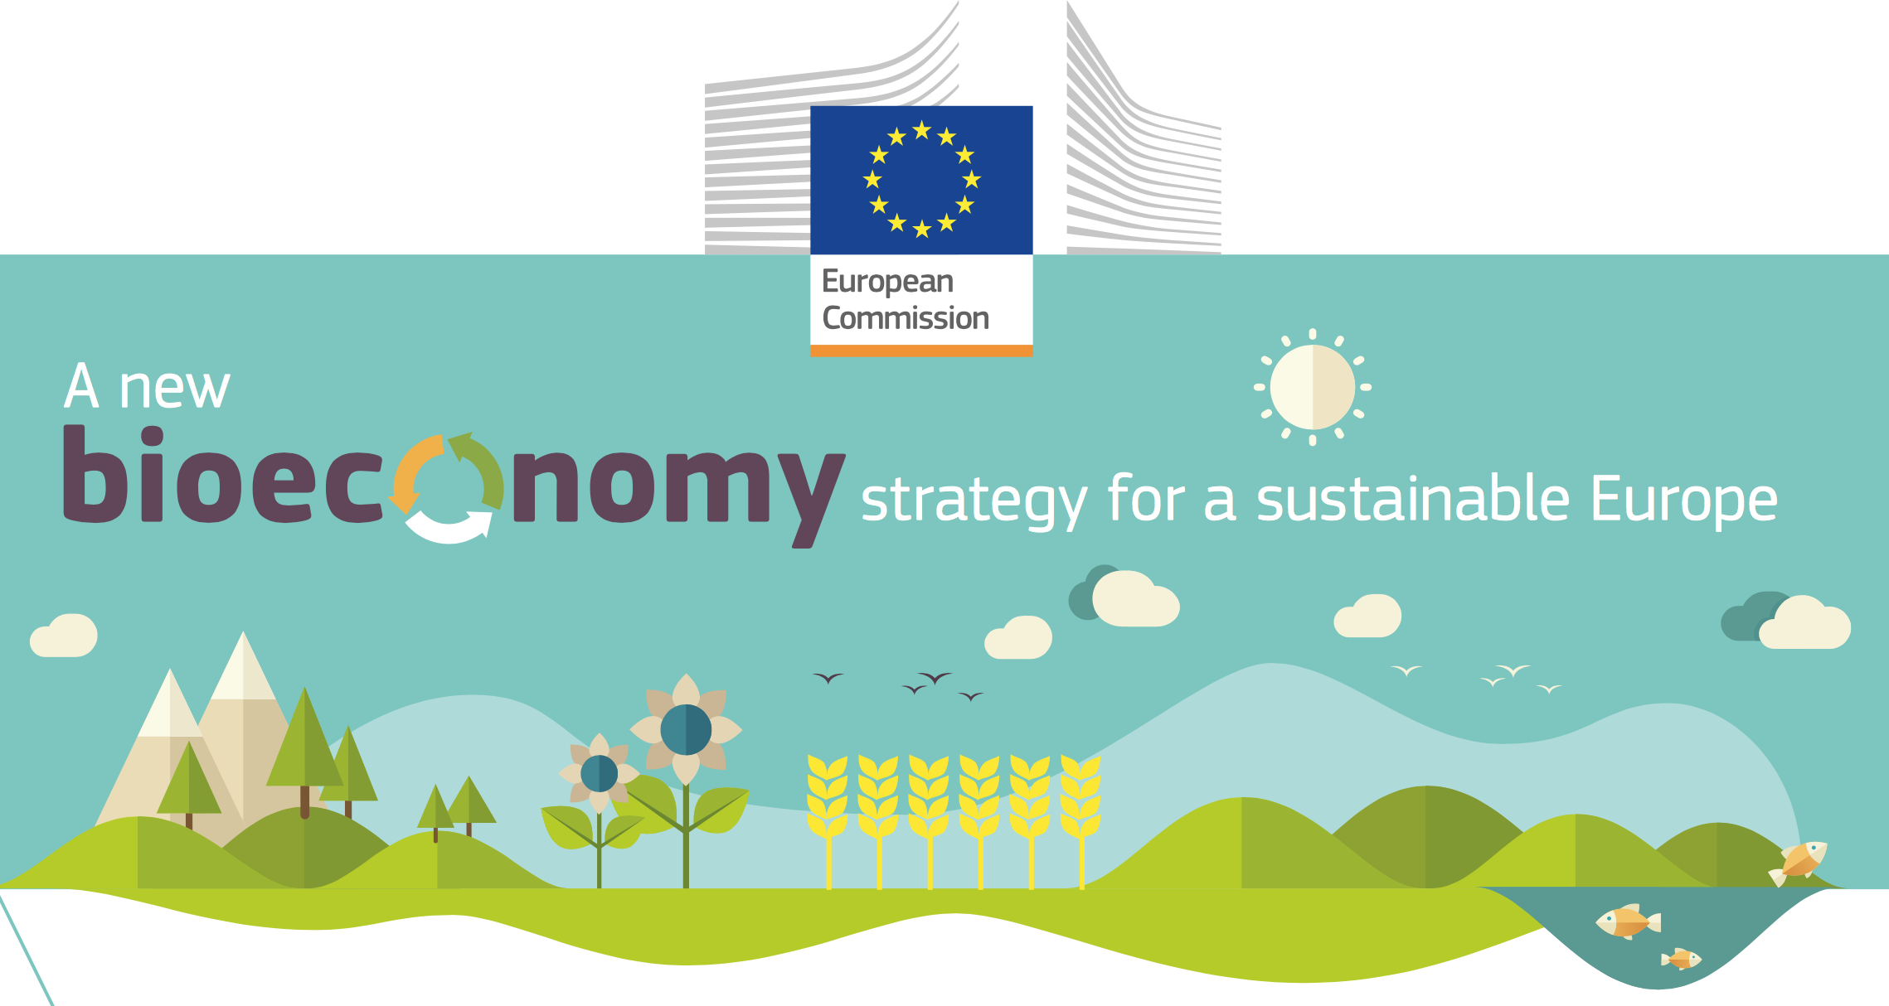
Ecological limits
In addition to links to sustainability and climate change mitigation, it is critical that the bioeconomy operates within safe ecological limits.
With the new bioeconomy strategy, the European Commission supports initiatives at national and regional level to develop an efficient and sustainable bioeconomy and this includes:
  implementing an EU-wide monitoring system to track progress towards a sustainable and circular bioeconomy.
  providing guidance on how best to operate the bioeconomy within safe ecological limits.
Notes:
Notes to teacher: Explain that to try and tackle the issues surrounding ecological limits: National and international bodies have specific guidelines. An example of this is the European Commission’s 2018 publication; ‘A new bioeconomy strategy for a sustainable Europe.’ Further information available at: https://ec.europa.eu/commission/news/new-bioeconomy-strategy-sustainable-europe-2018-oct-11-0_en
Key reading:
EC (2018), Bioeconomy: A new strategy for a sustainable Europe Restoring healthy ecosystems and enhancing biodiversity. European Commission https://ec.europa.eu/research/bioeconomy/pdf/ec_bioeconomy_actions_2018.pdf
Could also check for more advanced reading:
Giampietro, M. (2019). On the circular bioeconomy and decoupling: implications for sustainable growth. Ecological economics, 162, 143-156. https://www.sciencedirect.com/science/article/pii/S0921800918317178
Vivien, F. D., Nieddu, M., Befort, N., Debref, R., & Giampietro, M. (2019). The hijacking of the bioeconomy. Ecological economics, 159, 189-197. https://www.sciencedirect.com/science/article/abs/pii/S0921800918308115

Slide 6
Bioeconomy challenges: Resource Provision and Biodiversity loss
Bioproducts are derived from renewable biological resources. The bioeconomy makes use of many different biomass resources, from crops to forests to microorganisms. Without these feedstocks, there would be no bioeconomy.
It is critical that the bioeconomy does not compete with food production and does not affect biodiversity. For example, marginal lands may not be used for food production but may be important for biodiversity
It is therefore fundamental to carry a biodiversity assessment.
Notes:
Key reading:
The Bioecomomy Consultants (2018), BIG BIOECONOMY CHALLENGES - PART 2. https://www.nnfcc.co.uk/news-big-bioeconomy-challenges-2
Brownlie, S. (2013), IAIA fast tips No. 5 - Biodiversity Assessment. International Association for Impact Assessment (IAIA). https://www.iaia.org/fasttips.php
See slides “What is the Bioeconomy? Opportunities, challenges and solutions” for information on:
Bioeconomy – links to SDGs and climate change, and bioeconomy resources
The transition to a bioeconomy is complex
Biodiversity assessment
Direct, indirect and cumulative impacts
What are ‘impacts and need for Environmental Impact Assessment (EIA) and/or Strategic Environmental Assessment (SEA).
Net positive outcomes, enhancement and the mitigation hierarchy
Example: the impacts of biofuels

Slide 7
Fisheries feedstock
What are examples of bioeconomy feedstocks (or raw materials) in the fisheries & aquaculture sector?
In groups of two discuss and write a list of all the bioeconomy feedstocks (or raw materials) from the fishery and aquaculture sector sector that you can think of.
You have 2 minutes
Notes:
Ask students to write a list of all the bioeconomy feedstocks (or raw materials) from the fisheries and aquaculture sector. The next slide has a list of these materials.
Fisheries could by inland or marine; aquaculture could be inland or marine (mariculture).

Slide 8
Fisheries feedstock
Examples of bioeconomy feedstocks in the fisheries & aquaculture sector
micro and macro algae (also potentially beach-cast algae)
water plants (also from aquaponics)
fish (including low-grade fish and fish by-products: bones, skin, oils, heads, viscera, tails, fins, scales, mince, blood, fish excrements*)
crustaceans (including by-products: shrimp tails, crab shells),
shellfish (including by-products: scallops shells, mussel shells),
other invertebrates (including jellyfish), provided they are sustainably produced.
* fish excrements (recovered on filters and settling tanks) from aquaculture is valuable biomass for the production of agricultural fertilizers.
Notes:
Examples of bioeconomy feedstocks in the aquaculture & marine sector. Source: Bio-based Industries Consortium (2019), Examples of bioeconomy feedstocks. https://ec.europa.eu/knowledge4policy/glossary/feedstock_en
_______________
The European bioeconomy in the fishery sector is estimated to have a turnover of £10bn (EC, 2018a). It also involves 200,000 jobs across all Member States of the EU. Although the processing and trading of fish products is of high importance for the European economy, it generates high amounts of waste during the cycle (EC, 2018b). Processing of fish gives rise to by-products in the form of heads, viscera, shells, frames, skins and others such as tails, fins, scales, mince, blood, etc. These leftovers generated while processing fish are extremely valuable as raw material. The most traded feedstock, and therefore the highest generators of fish waste, are: salmon, tuna, shrimps, and other crustaceans (FAO, 2013). One of the major issues in the fish sector is finding a place for the amounts of fish mort. Its main disposal system is burning the waste in order to produce energy. However, techniques to generate energy from fish waste are still limited. Roughly 66% of fishmeal made from by-products originates from wild capture fish and 34% from aquaculture (EC, 2018c). There are currently many technologies under development to enhance and optimise our use of all fishery resources, from raw material to what we consider as “waste-as-resource” (Europarl, 2020). Most common feedstock after processing fish is: fish processing residues, fish waste, and low value fish. From these it is common to obtain products such as animal feed, Omega-3 fish oil, and protein hydrolysates (*).
(*) Protein hydrolysates: any product of hydrolysis. Protein hydrolysate has special application in sports medicine because its consumption allows amino acids to be absorbed by the body more rapidly than intact proteins, thus maximizing nutrient delivery to muscle tissues.
References
Europarl.europa.eu. 2020. The Fish Meal And Fish Oil Industry - Its Role In The Common Fisheries Policy - Think Tank. https://www.europarl.europa.eu/thinktank/en/document.html?reference=IPOL-PECH_ET(2003)341942
EC, 2018a. A Sustainable Bioeconomy For Europe: Strengthening The Connection Between Economy, Society And The Environment. Bioeconomy Strategy. https://ec.europa.eu/research/bioeconomy/pdf/ec_bioeconomy_strategy_2018.pdf
EC, 2018b. Facts And Figures On The Common Fisheries Policy.https://ec.europa.eu/fisheries/sites/fisheries/files/docs/body/pcp_en.pdf
EC, 2018c. Targeting fish parasites for a healthier aquaculture industry. https://ec.europa.eu/research/infocentre/article_en.cfm?&artid=49518&caller=other
FAO, 2013. Fish to 2030. Prospects For Fisheries and Aquaculture. Agriculture and Environmental Services. http://www.fao.org/3/i3640e/i3640e.pdf

Slide 9
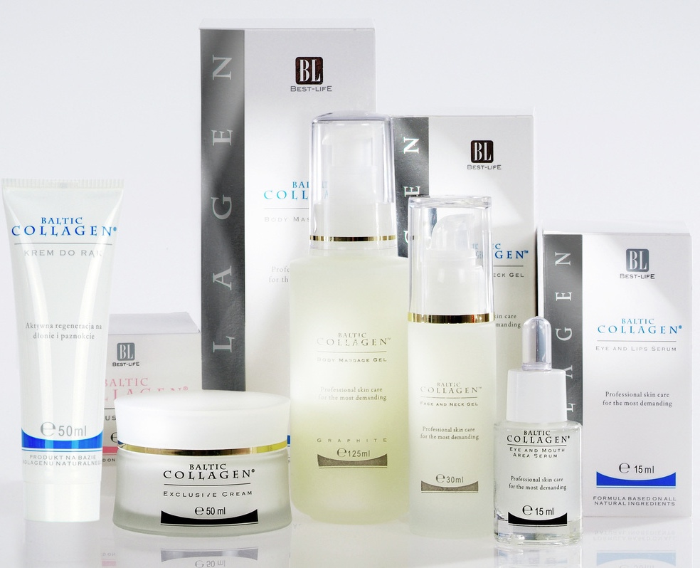
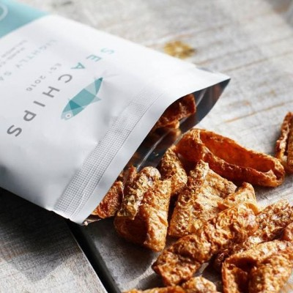
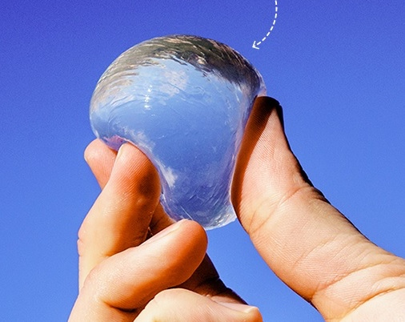
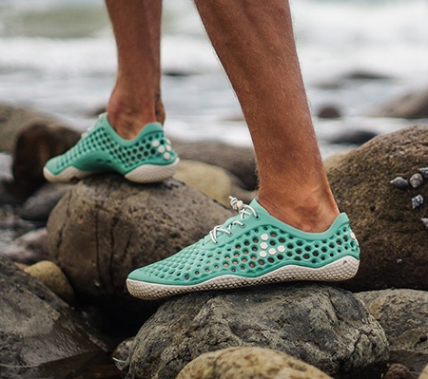
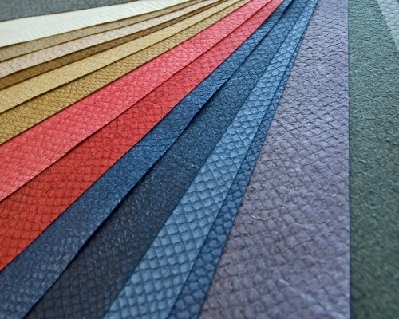
Examples of bioproducts
Bioproducts are materials, chemicals or energy derived from renewable biological resources
In the next slides you will see some bioproducts based on “waste” from the fisheries sector.
Notes:
Bioproducts are materials, chemicals or energy derived from renewable biological resources. It links to Circular Economy as big percentage of these products focus on reusing most of what we consider waste as their base material (European Commission, 2019). This way, discarded products are used in various ways, helping reduce the amount of waste that goes to landfill which takes decades to degrade and contaminates the environment while doing this. A big benefit of bioproducts is that generally the raw material can be grown, harvested and processed close to the point of consumption.
The skin of fish is highly rich in nutrients and proteins. However, it is not a product we are willing to eat. Therefore, fish processing plants remove this part of the fish before it reaches the market (FAO, 2020). These businesses are left, not only with the skin, but with guts, bones and other waste generated through the process. What to do with these “waste”, is a very common question.
Well, many European countries have decided these are not waste but by-products which means skin, guts and bones from fish can still be processed and used to either create new products or implement them in old ones (European Commission, 2018). In the next slides you will see some Bioproducts based on “waste” from the fishery sector.
References
European Commission, 2018. Facts And Figures On The Common Fisheries Policy. Basic Statistical Data. [online] Luxembourg: Imprimerie Centrale. Available at: https://ec.europa.eu/fisheries/sites/fisheries/files/docs/body/pcp_en.pdf
European Commission, 2019. European Bioeconomy Strategy Graphic. [online] Available at: https://ec.europa.eu/knowledge4policy/publication/updated-bioeconomy-strategy-2018_en
Fao.org. 2020. Fish Silage. [online] Available at: http://www.fao.org/3/x5937e/x5937e01.htm

Slide 10
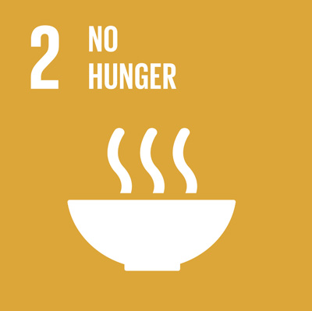
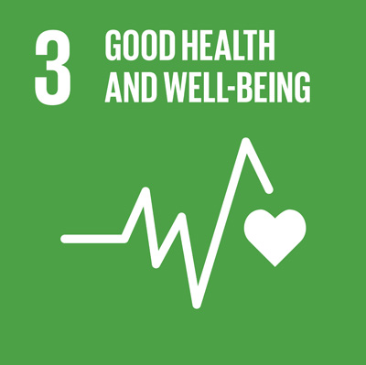
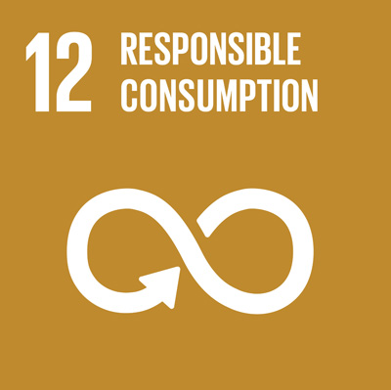
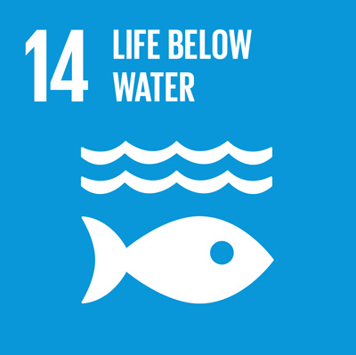
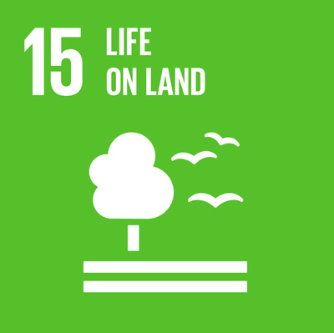
Examples of bioproducts
Cosmetics
Natural collagen - made of top-quality ecological materials, essentially skin of freshwater and saltwater fish
Nail Polisher - natural and water-based nail-polisher made from algae
Baltic collagen, 2020
Notes:
First slide introducing bioproducts related to the waste in the fishery sector. These bioproducts are related to the cosmetics field.
One of the most famous applications for fish-waste products is recovering the nutrients and proteins within the skin to produce high-quality natural collagen. This collagen is then used to create cosmetics and some pharmaceutical products. Baltic cosmetics are one of the first companies in the Nordic countries to manufacture and launch bioproducts obtained from fish-waste (Baltic cosmetics, 2020).
An interesting product that was released last year by a german company is a water-based nail polisher made from recovered sea algae (Biooekonomie, 2020).
*Explain how these products are linked to the SDGs – check out page sdgcompass.org for more information on the goals.*
SDG2 | SDG3 | SDG12 | SDG14 | SDG15
Image references:
Baltic collagen, 2020
SDGcompass, 2020
References:
Baltic Collagen. 2020 [online] Balticcollagen.pl. Available at: http://balticcollagen.pl/baltic-collagen-en/
Biooekonomie.de. 2020. Nail Polish | Bioökonomie.De. [online] Available at: https://biooekonomie.de/en/produkt/nail-polish
Sdgcompass.org. 2020. Learn More About The Sdgs – SDG Compass. [online] Available at: https://sdgcompass.org/sdgs/

Slide 11
Examples of bioproducts
Food
Recovery of Omega-3
Production of fish-based flours and powders
Extraction of fish oil
Example - Sea Chips - handcrafted salmon skin crisps, using the often wasted nutrient-packed skin.
Notes:
This slide includes food bioproducts made from fish waste and other products generated in the fishery sector.
The main nutrient recovered from fish waste is Omega-3 as it is used for many applications in medicine and nutrition. In addition, there is a current increase in the production of fish-based flour, powders, and oils for cooking and as food supplements (European Commission, 2018b).
This product that you see in the photo are salmon skin crisps developed by the company UK Seachips. These crisps are handcrafted and made from recovered skin of salmons in aquaculture farms (Seachips, 2020)
A German company has created an algae chocolate called Algen shokolade (Algenheld, 2020).
A scientist in the University of Puebla Mexico is developing a toothpaste highly rich in nutrients recovered from the bones of fish (Buap, 2020).
*Explain how these products are linked to the SDGs – check out page sdgcompass.org for more information on the goals.*
SDG2 | SDG3 | SDG12 | SDG14 | SDG15
Image references:
SDGcompass, 2020
Seachips, 2020
References:
Algenheld.de. 2020. Algenheld. [online] Available at: https://algenheld.de/
Buap.mx. 2020. Investigador De La BUAP Desarrolla Pasta Dental Reciclando Hueso De Pescado, Benemérita Universidad Autónoma De Puebla. [online] Available at: https://www.buap.mx/content/investigador-de-la-buap-desarrolla-pasta-dental-reciclando-hueso-de-pescado
European Commission, 2018b. Facts And Figures On The Common Fisheries Policy. Basic Statistical Data. [online] Luxembourg: Imprimerie Centrale. Available at: https://ec.europa.eu/fisheries/sites/fisheries/files/docs/body/pcp_en.pdf
Sdgcompass.org. 2020. Learn More About The Sdgs – SDG Compass. [online] Available at: https://sdgcompass.org/sdgs/
seachips. 2020. Seachips. [online] Available at: https://www.sea-chips.com/

Slide 12
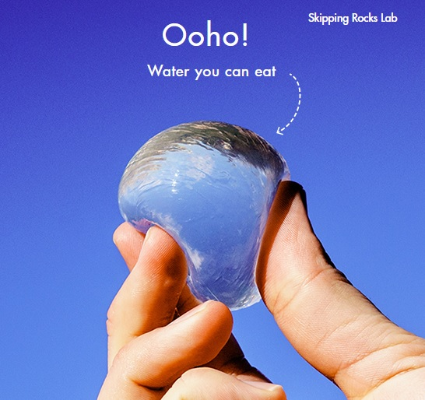
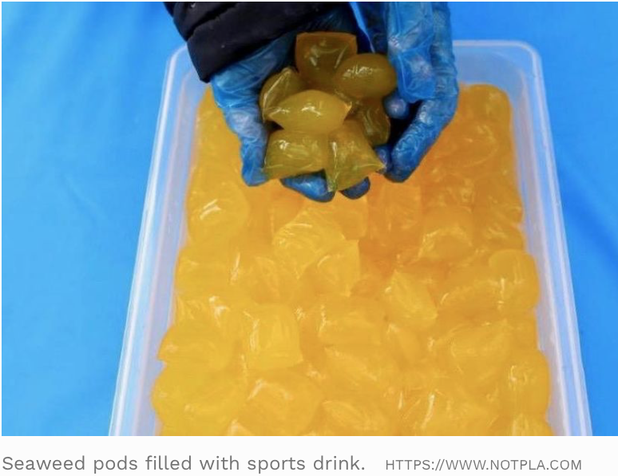
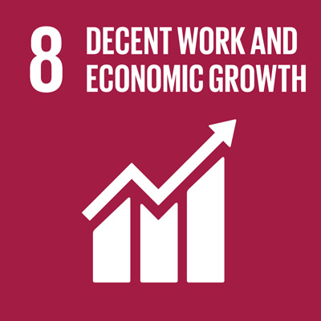
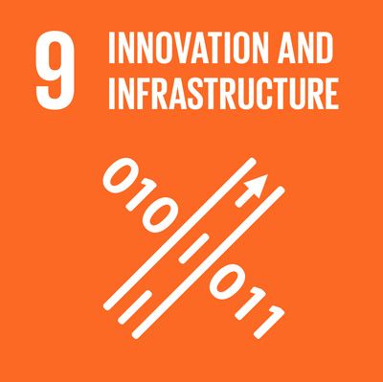
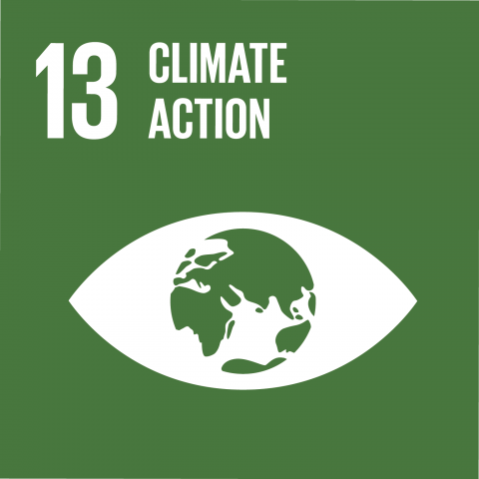
Examples of bioproducts
Packaging
Ooho! - Sustainable packaging made from a combination of brown seaweed and plants
Edible and tasteless packaging
MarinaTex - A home compostable alternative to plastic.
Made from fish waste and compostable materials
Degrades in the soil environment within 6 weeks
In 2019, London marathon runners were given edible seaweed pouches filled with a sports drink instead of plastic bottles.
Notes:
This slide relates to produces made from fish waste for packaging food and objects, such as bio-plastic.
A great bioproduct made from fish waste is bio-plastic from processed fish-waste. On this slide we have two different companies involve in the research and development of bioplastics.
Ooho! is an sustainable version of conventinal packaging (Notpla, 2020). Made of brown seaweed and additional plants, it resembles plastic in almost all its properties. It was mainly created to replace most, if not all, single-use plastics in packaging. The final product is edible and tasteless and can be stored for long periods without affecting its characteristics.
Then we have MarinaTex. This began as a final year project at the University of Sussex and later won the James Dyson Award, an international award for design engineers (MarinaTEX, 2020). It is also a sustainable alternative to plastic made from fish waste and compostable materials. However, in most aspects, this bioproduct exceeds the characteristics from conventional plastics. For instance, it degrades in the environment within 6 weeks and does not release any toxins or harm the surroundings during the degradation process. Additionally, several tests have proven that at the same thickness, this material is stronger than LDPE (low-density polyethylene).
*Explain how these products are linked to the SDGs – check out page sdgcompass.org for more information on the goals.*
SDG2 | SDG8 | SDG9 | SDG12 | SDG13 | SDG14 | SDG15
Image references:
SDGcompass, 2020
Notpla, 2020
References:
MARINATEX. 2020. MARINATEX. [online] Available at: https://www.marinatex.co.uk/
Nace, T. (2019), London Marathon Runners Were Handed Seaweed Pouches Instead Of Plastic Bottles. Forbes, 29 April 2019. https://www.forbes.com/sites/trevornace/2019/04/29/london-marathon-runners-were-handed-seaweed-pouches-instead-of-plastic-bottles/#2311b052ba20
Notpla. 2020. We Make Packaging Disappear - Notpla. [online] Available at: https://www.notpla.com/
Sdgcompass.org. 2020. Learn More About The Sdgs – SDG Compass. [online] Available at: https://sdgcompass.org/sdgs/
Video: London Marathon swaps plastic bottles for edible Ooho drinks capsules. https://www.youtube.com/watch?v=Z2Qz_2UtsPM

Slide 13
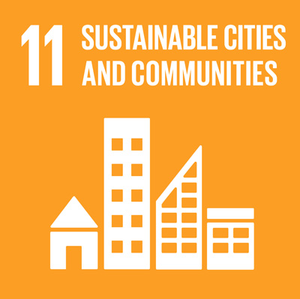
Examples of bioproducts
Clothing
Bloom - Foam with different applications made from algae waste in polluted water. Material is biodegradable and helps mitigate negative effect from excessive algae growth.
Notes:
In this slide, algae as a waste from the fishery sector is explained.
Another less commonly known waste produced during fishing is algae. The amount of algae extracted from the sea during commercial and industrial fishing is so high it is very difficult to give an accurate amount. These algae are then put back to the sea or disposed of with the rest of the waste. Intially this should not be a problem. However, an excess of algae in the sea can lead to the depletion of oxygen in these waters, a release of harmful toxins and to a variation in taste and odour in marine ecosystems.
Algae are rich in potassium, calcium, iron and magnesium and provide many vitamins essential to human health. Moreover, scientist have proven that through the adequate processes, algae can be transformed into a super-material, as strong as steel but only half its weight.
Bloom, a shoe manufacturer, is advocating to reduce the amount of toxic chemicals from human activity which are present in fresh-water. After years of researching in algae technology, they discovered that algae suffer a plasticization process after being subject to heat and pressure. They created the very first sustainable flexi-foam from algae (Bloom, 2020).
*Explain how these products are linked to the SDGs – check out page sdgcompass.org for more information on the goals.*
SDG2 | SDG3 | SDG8 | SDG11 | SDG12 | SDG13 | SDG14 | SDG15
Image references:
BLOOM, 2020. BLOOM | TREAD WELL. [online] Available at: <https://www.bloomtreadwell.com/> EcoWatch. 2020. Researchers Turn Algae Into A Material As Hard As Steel. [online] Available at: https://www.ecowatch.com/algae-science-material-hard-as-steel-2640980632.html
Sdgcompass.org. 2020. Learn More About The Sdgs – SDG Compass. [online] Available at: https://sdgcompass.org/sdgs/

Slide 14
Examples of Bioproducts
Accessories
Leather-type material from salmon skin
NANAI, 2020
Notes:
NANAI is a compnay which has developed a leather-type material made entirely from salmon skin.
*Explain how these products are linked to the SDGs – check out page sdgcompass.org for more information on the goals.*
SDG2 | SDG8 | SDG12 | SDG14 | SDG15
Images references:
NANAI, 2020. Nanai Leather – Salmo Leather – Lachsleder || Product. [online] Available at: https://www.salmo-leather.de/en/produkt/
Sdgcompass.org. 2020. Learn More About The Sdgs – SDG Compass. [online] Available at: https://sdgcompass.org/sdgs/

Slide 15
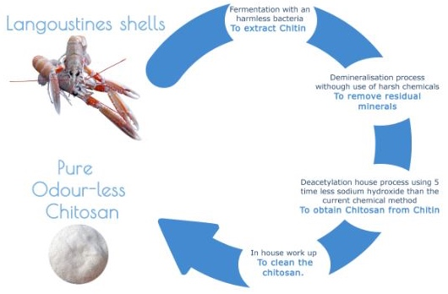
Example of bioproducts
The company Cuantec produces anti-microbial, compostable food packaging that can make food last longer
Process to extract chitin from the shells of langoustines and other sea creatures and process the chitin (*) to obtain chitosan (**).
(*) Chitin a fibrous substance consisting of polysaccharides, which is the major constituent in the exoskeleton of arthropods and the cell walls of fungi.
(**) Chitosan is a sugar that is obtained from the hard outer skeleton of shellfish.
Video from Cuantec (2 minutes and 52 seconds)
https://www.youtube.com/watch?v=d9qw5pLiTjQ
Notes:
Cuantec is a Scottish blue biotech company with a circular economy model which tackles two of the world‘s worst problems – food waste and plastic pollution. They produce an anti-microbial, compostable food packaging which can extend the shelf-life of freash seafood. They extract chitin from the shells of langoustines and other sea creatures and process the chitin to obtain chitosan.
*Play video here (2 minutes and 52 seconds)
https://www.youtube.com/watch?v=d9qw5pLiTjQ
The bioplastic produced by Cuantec has been proven to not affect the quality of the food. In fact, using this alternative to plastic packing can make food last longer.
Cuantec technology and processes are very innovative as they succesfully moved away from the conventional and widely used chemical processes to produce chitosan. This process generally implements harmful chemicals and consumes a lot of energy. Instead of this conventional process, they have developed a biological process to extract the elements they need for their final products. Their biological fermentation process uses 5 times less sodium hydroxide and eliminates the need for hydrochloric acid, making it more sustainable.
Image references:
Cuantec. 2020. Cuantec - Opening Up The Potential Of The Sea. [online] Available at: https://www.cuantec.com/

Slide 16
Questions and Discussion
Name of presenter
Notes:
Notes to the teacher: Speaker’s name to go in the space at the bottom left of the slide. This is the final slide of the presentation. Allow time for students/participants to ask any questions.

Slide 17

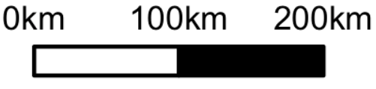
https://be-rural.eu
These educational resources were developed as part of the BE-Rural project
Bio-based strategies and roadmaps for enhanced rural and regional development in the EU (April 2019 – March 2022)
BE-Rural supports
… regional stakeholders in five countries:
Latvia: Vidzeme and Kurzeme
Poland: Szczecin and Vistula Lagoons
Romania: Covasna
Bulgaria: Stara Zagora
North Macedonia: Strumica
The goal of BE-Rural is to realise the potential of regional bio-based economies by supporting relevant actors in the participatory development of bioeconomy strategies and roadmaps
https://be-rural.eu/innovation-regions/
Notes:
BE-Rural has five innovation regions
BE-Rural will create five regional Open Innovation Platforms (OIPs) for the participatory development of bioeconomy strategies and roadmaps. The BE-Rural OIPs will be established in five regions across the EU with different biomass potentials and will be based on the regional Stakeholder Working Groups (SWGs). Within the OIPs, the main task of the SWGs will be to formulate concrete strategy or roadmap documents by engaging with different actors and opening the platform for a wide range of stakeholders in the region, including civil society organisations and citizens.
Stara Zagora, Bulgaria: This innovation region will focus on seeking new technologies for the application of essential oils and herbal plants in the cosmetics and pharmaceutical industry. The small-scale production in this area will be combined with tourism-related activities to expand the existing business status quo and potential. Ultimately, the region will establish closer relations and network between companies. Regional partner: Bulgarian Industrial Association (BIA)
Vidzeme and Kurzeme, Latvia: This region will focus on the potential of by-products of forest management (i.e. from young forest stand thinning, short rotation coppice and forestry (SRC/SRF) plantations, removing of overgrowth in abandoned agricultural lands and perennial grasses) as a source of bioenergy or biorefinery. The region will investigate the value of agroforestry systems of perennial grasses and SRC or SRF trees as grazing areas, and the production of hay or grass seeds. The potential smart use of small timber wood from young forest stand thing will be explored. Regional partner: The Latvian State Forest Research Institute (SILAVA)
Strumica, North Macedonia: The region will focus on the utilization of agricultural residues, specifically the by-production of organic materials from agricultural activities, as a source of energy for domestic and industrial purposes. The region will investigate technology options for energy conversion of biomass materials generated on agricultural fields or farms (field-based residues), as well as those generated during the processing of agricultural products (process-based residues). Regional partner: International Centre for Sustainable Development of Energy, Water and Environment Systems (SDEWES-Skopje)
Szczecin Lagoon and Vistula Lagoon, Poland: This region will focus on small-scale fisheries, specifically on the sustainable use of currently underused and low-value fish species located in two lagoons. The region will investigate small-scale technology options that can be applied to utilize low-value fish species as products for human consumption. Regional partner: The National Marine Fisheries Research Institute (NMFRI)
Covasna, Romania: The region will focus on addressing fragmented value chains and implementing the circular economy concept within the county’s industrial sectors (i.e. wood and furniture, textiles, agro-food, mechanical engineering, green energy). The region will investigate the development potential of underused biomass (plant matter and wood waste) and it implication on societal challenges (e.g., rural unemployment or marginalised communities). This will be done within a local development business model based on a small-scale technology option ensuring the autonomous energy supply for civil and industrial needs. Regional partner: Institute for Economic Forecasting (IPE)
Source: BE-Rural (2020), Innovation regions, available at: https://be-rural.eu/innovation-regions/

