Slide 1
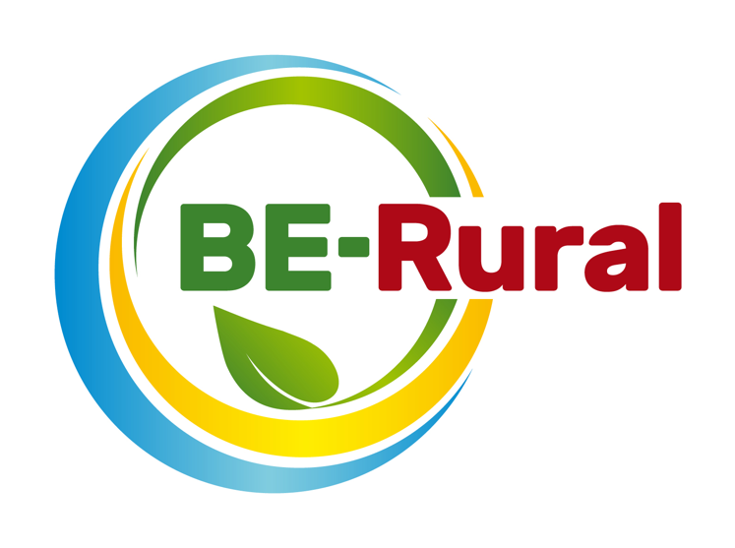
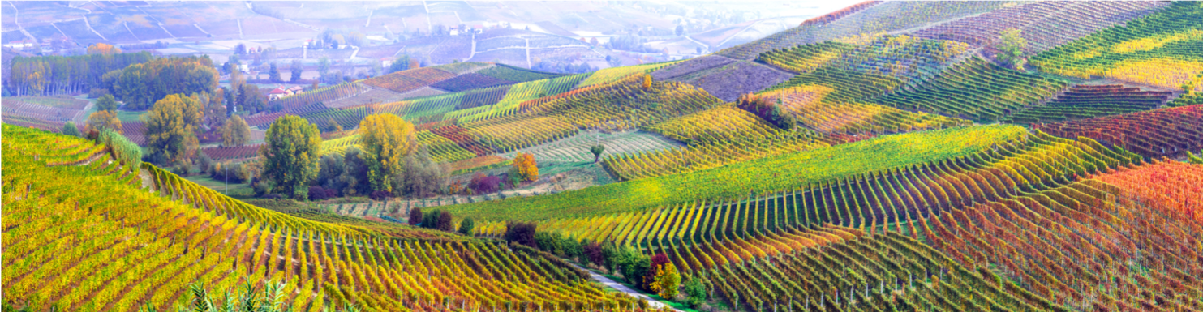
Forest Bioeconomy
Name of presenter
Notes:
Notes to the teacher:
Teacher’s name to go in the space at the bottom left of the slide. Explain that this presentation introduces forest bioeconomy.
Excluding the two videos, the outline slide and this first slide, there are 19 slides – so these slides should take between 19 and 38 minutes to present, depending of amount of explanation.
The two videos are around 2 minutes long each.

Slide 2
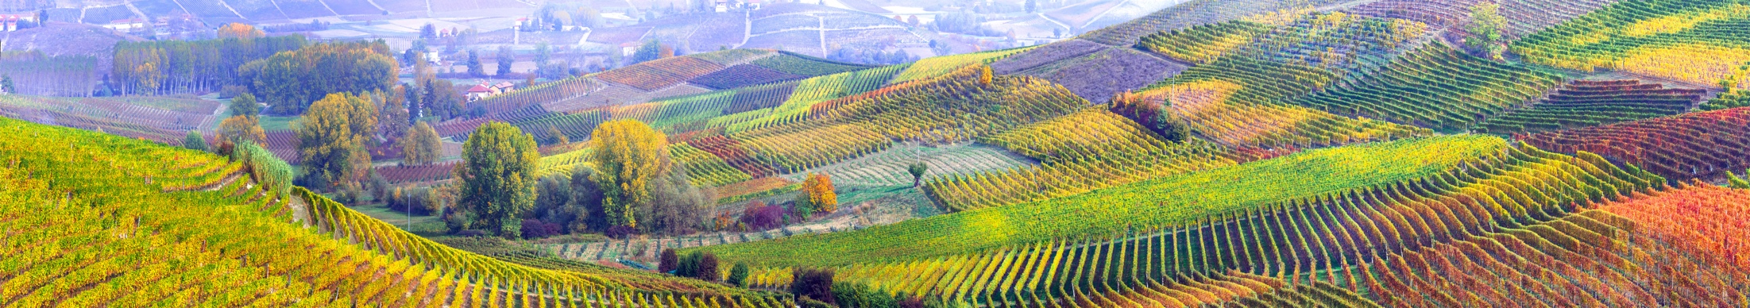
Topics
Bioeconomy overview – what it is, ecological limits and challenges
Biodiversity assessment
Forestry feedstock
Video: Forest Bioeconomy
SDGs linked to forest bioeconomy
Forestry technology: Sustainable fibres from wood
Forestry technology: Small-scale pelletising units
Forestry technology: The containerised pyrolysis unit
Forestry technology: Biomaterials from agro-forestry residues & mycelium
Forestry technology: Mobile wood chipping units
Examples of bioproducts
Conclusion

Slide 3

Bioeconomy overview
European Bioeconomy Strategy
The European Commission is taking steps towards a sustainable bioeconomy and has a bioeconomy strategy to promote the bioeconomy and to avoid reaching ecological limits.
The Bioeconomy…
Is the production of goods, services, or energy from biological material as the main resource.
Is strongly linked to sustainability as biodegradable resources are often used and waste is often completely designed out of the system.
Can avoid the depletion of resources for future generations and protect the stability of the planet.
Notes:
Notes to teacher: Explain to class that in order to take steps towards sustainability and the avoidance of reaching ecological limits the bioeconomy is very important. The bioeconomy is the production of goods, services, or energy from biological material as the main resource. This is strongly linked to sustainability as biodegradable resources are often used and waste is often completely designed out of the system. This can avoid the depletion of resources for future generations and protect the stability of the planet. The European Commission is taking steps towards a sustainable bioeconomy. Turning waste into valuable resources and creating incentives to help retailers and consumers cut food waste. The European Commission has a bioeconomy strategy to promote the bioeconomy and avoid reaching ecological limits.
European Commission (2018), A sustainable Bioeconomy for Europe: strengthening the connection between economy, society and the environment. Updated Bioeconomy Strategy. Directorate-General for Research and Innovation, available at: https://ec.europa.eu/research/bioeconomy/pdf/ec_bioeconomy_strategy_2018.pdf accessed: 22 May 2020].

Slide 4
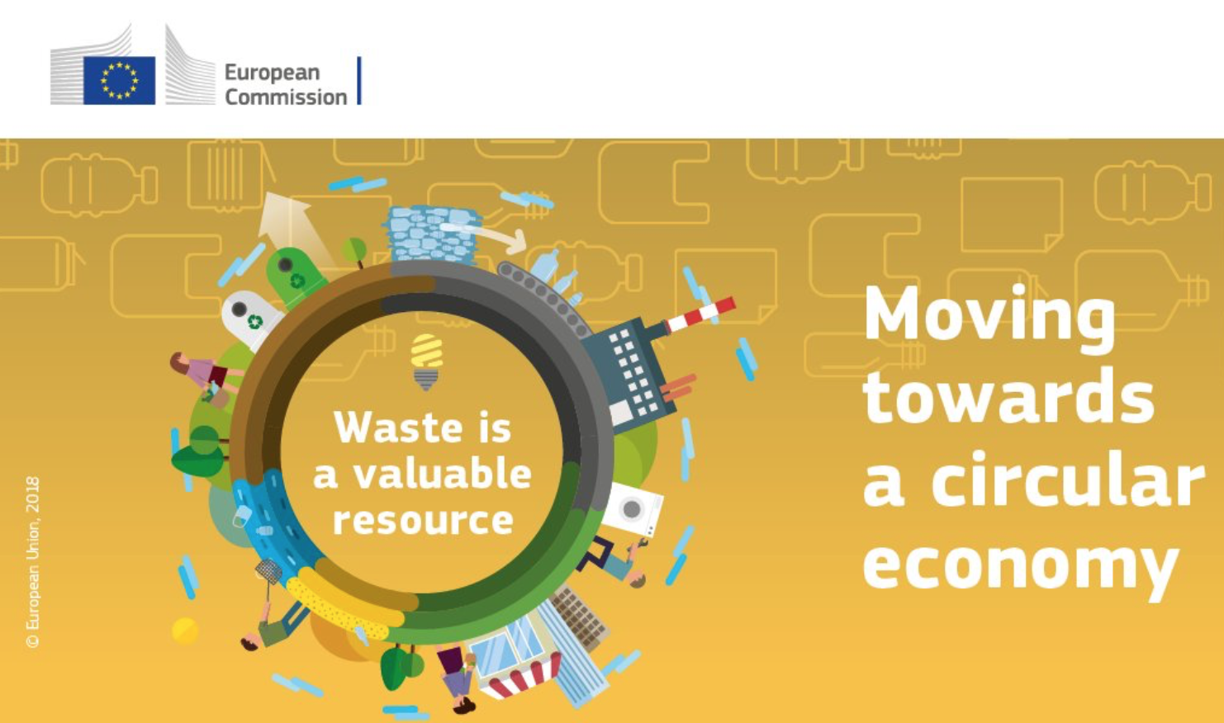
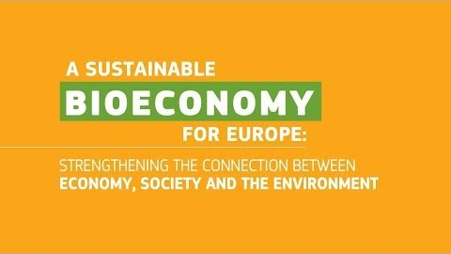
Bioeconomy overview
Bioeconomy and Circular Economy – waste is a valuable resource
Video (2 minutes and 9 seconds): https://www.youtube.com/watch?v=RfRN_hHeIKk
Languages for sub-titles for video include: Bulgarian, Latvian, Macedonian, Polish and Romanian
Notes:
1. Explain bioeconomy to introduce topic and contextualise bioproducts portfolio.
Bioeconomy is defined as the production, utilization and conservation of biological resources to provide information, products, processes and services across all economic sectors aiming towards a sustainable economy (Bell et al., 2018).
“The bioeconomy covers all sectors and systems that their functions and principles. It includes and interlinks: land and marine ecosystems and the services they provide; all primary production sectors rely on biological resources (animals, plants, micro-organisms and derived biomass, including organic waste), that use and produce biological resources (agriculture, forestry, fisheries and aquaculture); and all economic and industrial sectors that use biological resources and processes to produce food, feed, bio-based products, energy and services. To be successful, the European bioeconomy needs to have sustainability and circularity at its heart. This will drive the renewal of our industries, the modernisation of our primary production systems, the protection of the environment and will enhance biodiversity.” (European Commission (2018) ‘A sustainable Bioeconomy for Europe: strengthening the connection between economy, society and the environment’ available at: (https://ec.europa.eu/research/bioeconomy/pdf/ec_bioeconomy_strategy_2018.pdf#view=fit&pagemode=none])
Now we will watch a short video explaining what the bioeconomy is, its potential and challenges.
Play video explaining bioeconomy here: https://www.youtube.com/watch?v=RfRN_hHeIKk&feature=youtu.be
(Languages for sub-titles for video include: Bulgarian, Latvian, Macedonian, Polish and Romanian)
2. Explain circular economy to give context to bioproducts.
Circular Economy is a framework for the development and management of sustainable, waste-as-resource economic system. It aims to keep products, components and materials at the highest utility and value at all times (European Commission, 2018). Moreover, it is designed to process the reduced waste out of the system. The current global economic framework is a linear, this means that we take, produce, use and dispose without fully exploiting all the essential properties of materials. Circular economy seeks to create a more sustainable economic model where no waste is generated, instead it is reutilised as many times as possible. With this, circular economy aims to eliminate all waste and create a closed-loop system purely based on natural resources.
Bell, J., Paula, L., Dodd, T., Németh, S., Nanou, C., Mega, V. and Campos, P. (2018). EU ambition to build the world’s leading bioeconomy—Uncertain times demand innovative and sustainable solutions. New Biotechnology, 40: 25–30.
European Commission (2018), A sustainable Bioeconomy for Europe: strengthening the connection between economy, society and the environment. Updated Bioeconomy Strategy. Directorate-General for Research and Innovation, available at: https://ec.europa.eu/research/bioeconomy/pdf/ec_bioeconomy_strategy_2018.pdf

Slide 5
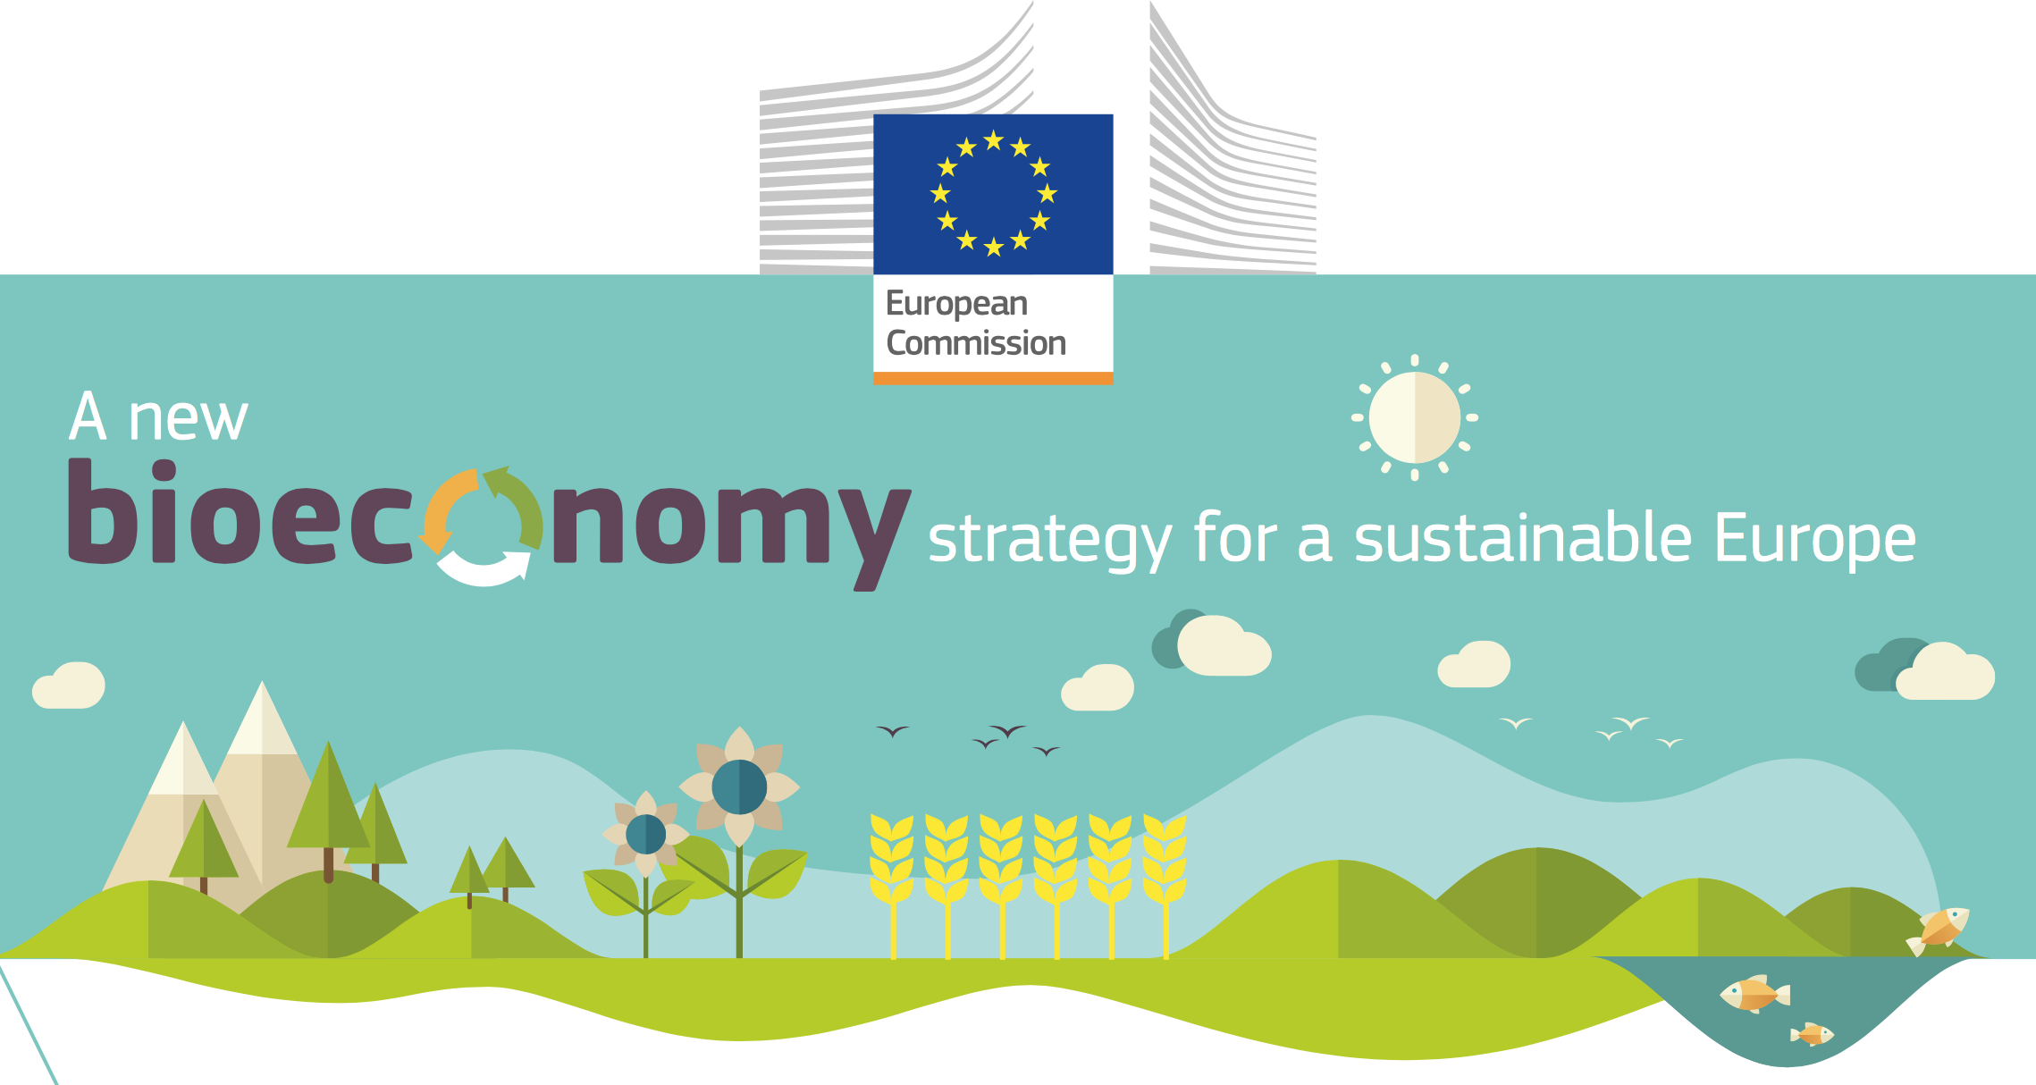
Ecological limits
In addition to links to sustainability and climate change mitigation, it is critical that the bioeconomy operates within safe ecological limits.
With the new bioeconomy strategy, the European Commission supports initiatives at national and regional level to develop an efficient and sustainable bioeconomy and this includes:
  implementing an EU-wide monitoring system to track progress towards a sustainable and circular bioeconomy.
  providing guidance on how best to operate the bioeconomy within safe ecological limits.
Notes:
Notes to teacher: Explain that to try and tackle the issues surrounding ecological limits: National and international bodies have specific guidelines. An example of this is the European Commission’s 2018 publication; ‘A new bioeconomy strategy for a sustainable Europe.’ Further information available at: https://ec.europa.eu/commission/news/new-bioeconomy-strategy-sustainable-europe-2018-oct-11-0_en
Key reading:
EC (2018), Bioeconomy: A new strategy for a sustainable Europe Restoring healthy ecosystems and enhancing biodiversity. European Commission https://ec.europa.eu/research/bioeconomy/pdf/ec_bioeconomy_actions_2018.pdf
Could also check for more advanced reading:
Giampietro, M. (2019). On the circular bioeconomy and decoupling: implications for sustainable growth. Ecological economics, 162, 143-156. https://www.sciencedirect.com/science/article/pii/S0921800918317178
Vivien, F. D., Nieddu, M., Befort, N., Debref, R., & Giampietro, M. (2019). The hijacking of the bioeconomy. Ecological economics, 159, 189-197. https://www.sciencedirect.com/science/article/abs/pii/S0921800918308115

Slide 6
Bioeconomy challenges: Resource Provision and Biodiversity loss
Bioproducts are derived from renewable biological resources. The bioeconomy makes use of many different biomass resources, from crops to forests to microorganisms. Without these feedstocks, there would be no bioeconomy.
It is critical that the bioeconomy does not compete with food production and does not affect biodiversity. For example, marginal lands may not be used for food production but may be important for biodiversity
It is therefore fundamental to carry a biodiversity assessment.
Notes:
Key reading:
The Bioecomomy Consultants (2018), BIG BIOECONOMY CHALLENGES - PART 2. https://www.nnfcc.co.uk/news-big-bioeconomy-challenges-2
Brownlie, S. (2013), IAIA fast tips No. 5 - Biodiversity Assessment. International Association for Impact Assessment (IAIA). https://www.iaia.org/fasttips.php
See slides “What is the Bioeconomy? Opportunities, challenges and solutions” for information on:
Bioeconomy – links to SDGs and climate change, and bioeconomy resources
The transition to a bioeconomy is complex
Biodiversity assessment
Direct, indirect and cumulative impacts
What are ‘impacts and need for Environmental Impact Assessment (EIA) and/or Strategic Environmental Assessment (SEA).
Net positive outcomes, enhancement and the mitigation hierarchy
Example: the impacts of biofuels

Slide 7
Forestry Feedstock
What are examples of bioeconomy feedstocks (or raw materials) in the forestry sector?
In groups of two write a list of all the bioeconomy feedstocks (or raw materials) from the forestry sector that you can think of.
You have 2 minutes
Notes:
Ask students to write a list of all the bioeconomy feedstocks (or raw materials) from the forestry sector. The next slide has a list of these materials.
What is feestock? Feedstock is the raw/bio material from the forests that is input into process to make biobased products. This can be classified into waste products from forest management as well as wood, leaves etc produced by forest.

Slide 8
Forestry Feedstock
Examples of bioeconomy feedstocks (or raw materials) in the forestry sector
Bamboo
Bark
Branches
Black liquor
Cellulose
Hardwood
Lignin
Leaves
Post-consumer wood
Softwood
Sawdust
Stumps
Wood pellets
Source: Bio-based Industries Consortium (2019), Examples of bioeconomy feedstocks. https://ec.europa.eu/knowledge4policy/glossary/feedstock_en
Notes:
Examples of bioeconomy feedstocks in the forestry sector. Source: Bio-based Industries Consortium (2019), Examples of bioeconomy feedstocks. https://ec.europa.eu/knowledge4policy/glossary/feedstock_en
Feedstock List (Bark to Wood Pellets): Bio-based Industries Consortium (2020) Examples of Bioeconomy feedstocks, available at: [https://biconsortium.eu/bioeconomy-feedstocks]
The forestry sector has been found to have potential for the bioeconomy. This would been bio-based products from wood and by products of forest management.
“The forest-based sector includes all stakeholders with a major interest in forestry, forest-based materials and products. Wood is the key component of the pulp and paper industry, it can be used for energy production, it is an important construction material and for the furniture industry. Forest-based biomass is also used for many different bio-based products, such as insulation material, barrier materials for damp protection, biopolymers, bio-based plastics and composites, carbon fibre, chemicals and cellulose-based textiles, smart packaging materials (Swedish Forest Industries Federation 2013 in European Commission, 2017 [https://ec.europa.eu/research/bioeconomy/pdf/publications/bioeconomy_development_in_eu_regions.pdf])
“Many companies are making efforts to replacing fossil feedstock with renewable biological resources in other products and processes, using innovative technologies” (BLOOM Factsheet What is the bioeconomy (2019) available at: [https://bloom-bioeconomy.eu/wp-content/uploads/2019/01/BLOOM-Factsheet-What-is-the-Bioeconomy.pdf])
“Renewable feedstocks are already playing a central role within the bioeconomy: 150 million tonnes of forestry products are used to generate 770 TWh of primary energy each year in Europe, with a further 210 TWh from waste and 12 TWh from agricultural residues.” (National Non-Food Crops Centre (NNFCC) available at: [https://www.nnfcc.co.uk/feedstocks]

Slide 9
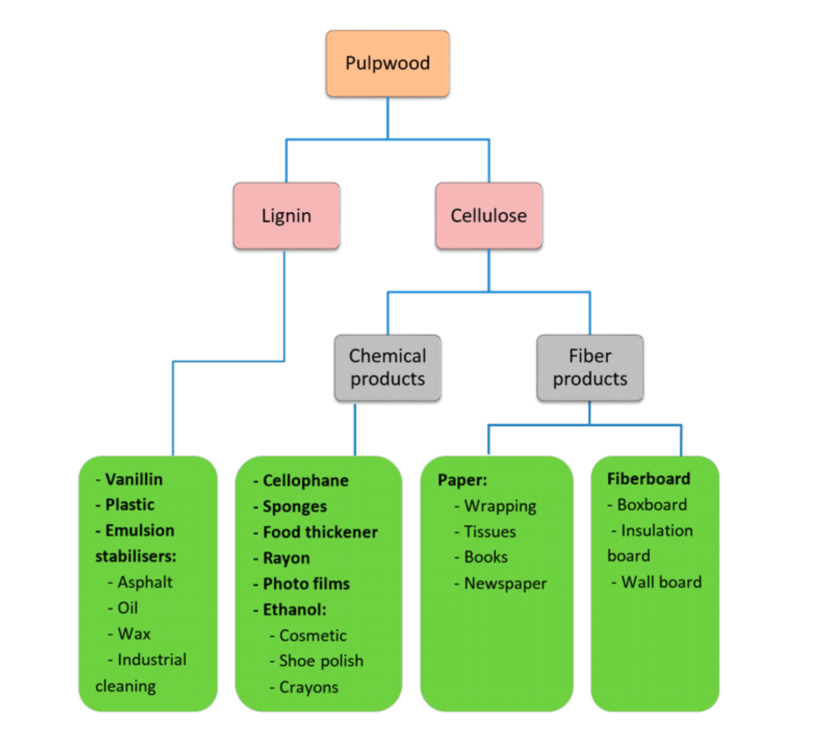
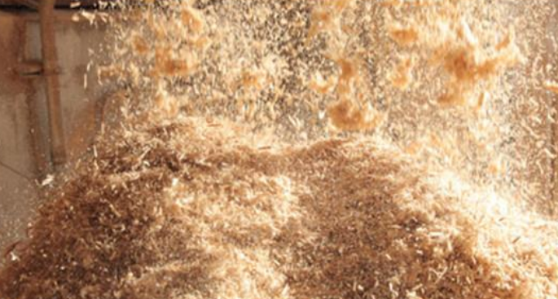
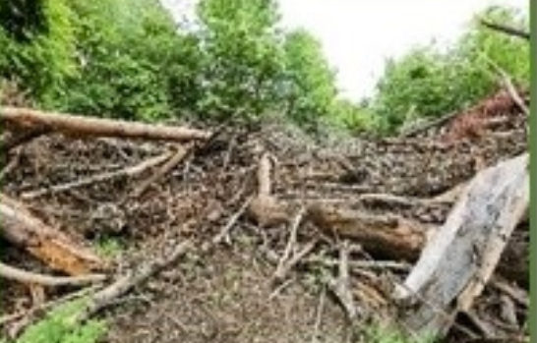
Forestry Feedstock
What are forest bioeconomy feedstocks?
Sawdust (Colmorgen and Khajawa, 2019)
Forestry residue (EERE, 2020)
Source: Forest Pedagogics (2016)
Notes:
Point out how Lignin and cellulose have the potential to provide for a wide range of products – see flowchart
Feedstock List (Lingin and Cellulose) and flowchart: Forest Pedagogics (2016) 11th European Forest Pedagogics Congress 2016 Bioeconomy Teaching material [http://forestpedagogics.eu/mediadateien/biri-2016/Bioeconomy_Teaching-material.pdf]
Image Forest residue: Energy Efficiency and Renewable Energy (EERE) (2020), Biomass Feedstock, available at: [https://www.energy.gov/eere/bioenergy/biomass-feedstocks]
Image Sawdust: Colmorgen, F., Khawaja, C. (2019): Small-scale technology options for regional bioeconomies. Small-scale technology options for regional bioeconomies available at: [https://be-rural.eu/wp-content/uploads/2019/10/BE-Rural_D2.1_Small-scale_technology_options.pdf]
Other examples of feedstock - InnProBio ‚‘Factsheet No. 1 What are bio-based products?’ available at: [https://innprobio.innovation-procurement.org/fileadmin/user_upload/Factsheets/Factsheet_n_1.pdf]
“Approximately 490 million tonnes of forestry biomass (dry mass) are currently exploited annually in Europe (including for pulp, paper and other traditional uses). An estimated 245 million tonnes of wood are used in the woodworking and pulp and paper industry annually and 240 million tonnes of wood are used for heat and power production. Forest based raw materials have high shares in the production of biobased products and bioenergy, mainly via the lignin platform. At industrial scale, forest residues and waste wood can be converted to advanced biofuels or intermediates. However, sustainability considerations are very important as increasing the extraction of forest residues and biomass beyond a certain point will inevitably lead to trade-offs between productivity and environmental and economic sustainability. Beyond sustainability considerations, there are technical and economic limitations of forestry biomass used as feedstock” –Tsagaraki, E., Karachaliou E., Delioglanis, I. and Kouzi E. (2017) D2.1 Bio-based products and applications potential, available at: [http://www.bioways.eu/download.php?f=150&l=en&key=441a4e6a27f83a8e828b802c37adc6e1] p.5

Slide 10
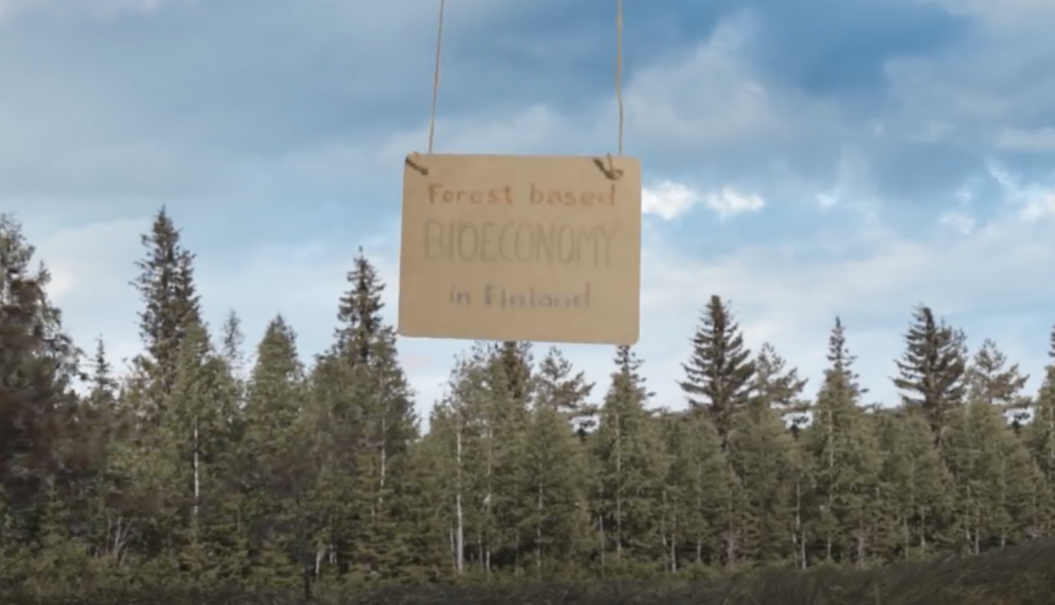
Video: Forest Bioeconomy
What is the forest bioeconomy?
Video (1 minutes and 43 seconds): https://www.youtube.com/watch?v=w8JaCLECuM4&t=8s
Notes:
Finland is an example of a forest-based bioeconomy.
*play video* ‘Forest based bioeconomy in Finland’ https://www.youtube.com/watch?v=w8JaCLECuM4&t=8s
“Even though many people are not aware of it, the bioeconomy is already part of our everyday lives. Biological resources and innovative technologies are already being used to replace unsustainable products and processes that are currently produced from fossil resources. Some biobased goods may even have novel properties which make them superior to the products we currently depend on. “ (BioSTEP (2016) Exhibition brochure Glasgow: Bioeconomy in everyday life [http://www.bio-step.eu/fileadmin/BioSTEP/Bio_documents/BioSTEP_Bioeconomy-in-everyday-life_Glasgow_Exhibition-Guide.pdf])
Factsheet from BLOOM on the bioeconomy can also be used to introduce bioeconomy (BLOOM Factsheet What is the bioeconomy (2019) available at: [https://bloom-bioeconomy.eu/wp-content/uploads/2019/01/BLOOM-Factsheet-What-is-the-Bioeconomy.pdf])
Alternatives to video in slide:
Video: ‘The bioeconomy starts here!’ https://www.youtube.com/watch?v=2xvXkOMRTs4
Video: ‘Bioeconomy – University of Hohenheim’ https://www.youtube.com/watch?v=OvpD52n1olM
Video: ‘ERIFORE – European Research Infrastructure for Circular Forest Bioeconomy’ https://www.youtube.com/watch?v=eMnTl0XV_F4
Video: ‘Bioeconomy in Norway’ https://www.youtube.com/watch?v=fJJCkwyHaKA
Video: ‘Bioeconomy Knowledge centre’ https://www.youtube.com/watch?v=oPadmhfDAjk
https://www.youtube.com/watch?v=D5KNcdsT2lY&t=68s

Slide 11
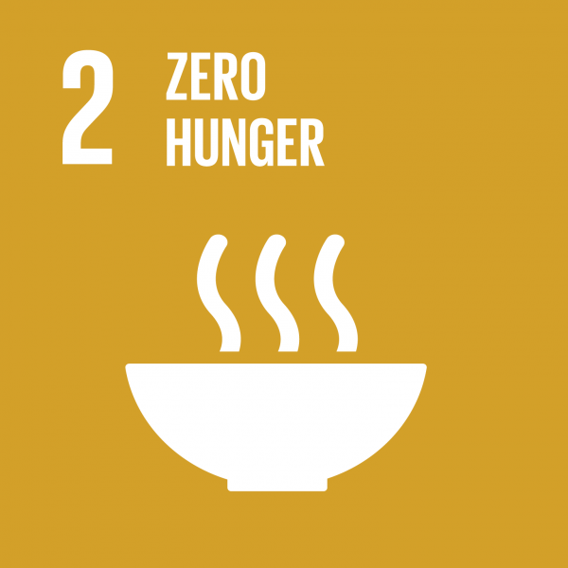
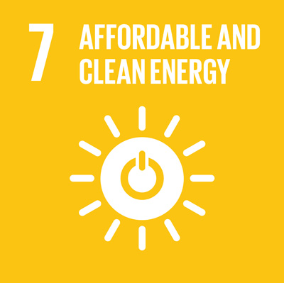
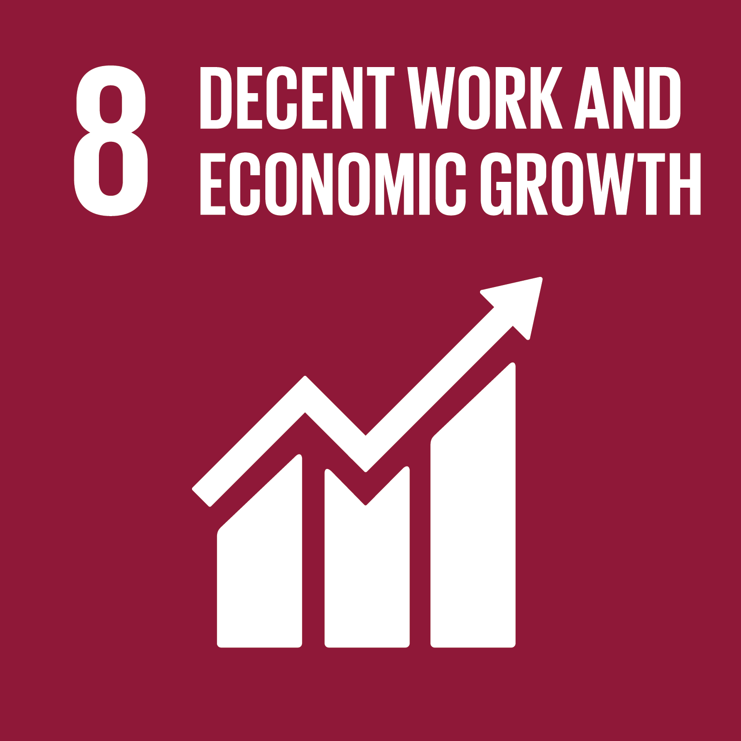
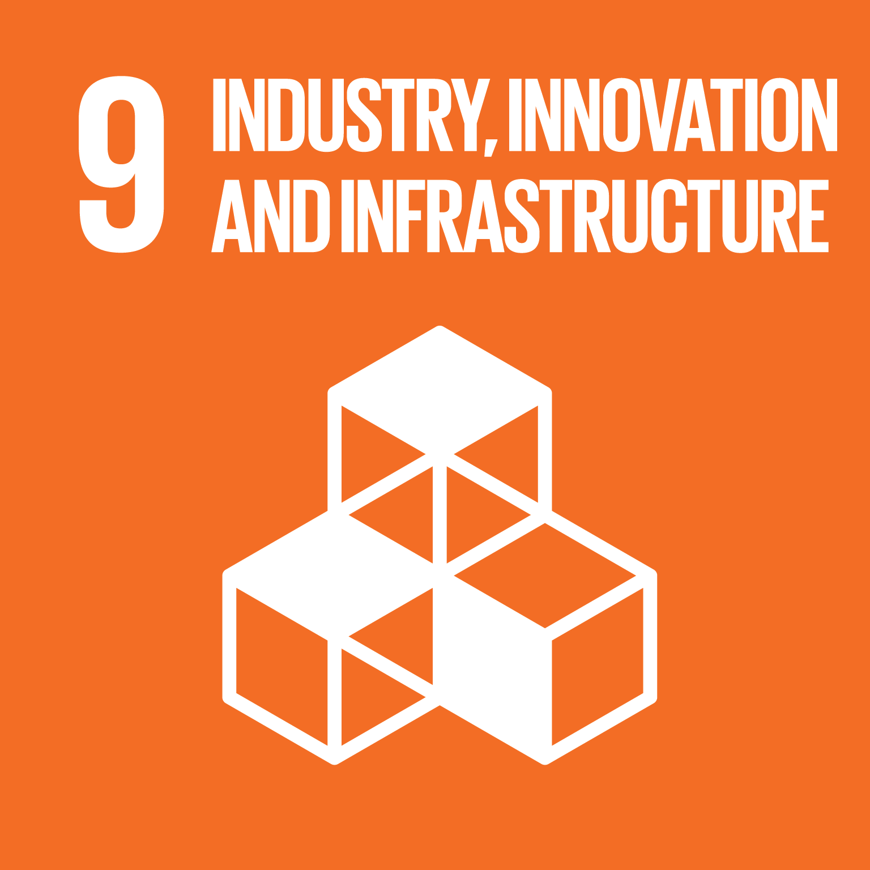
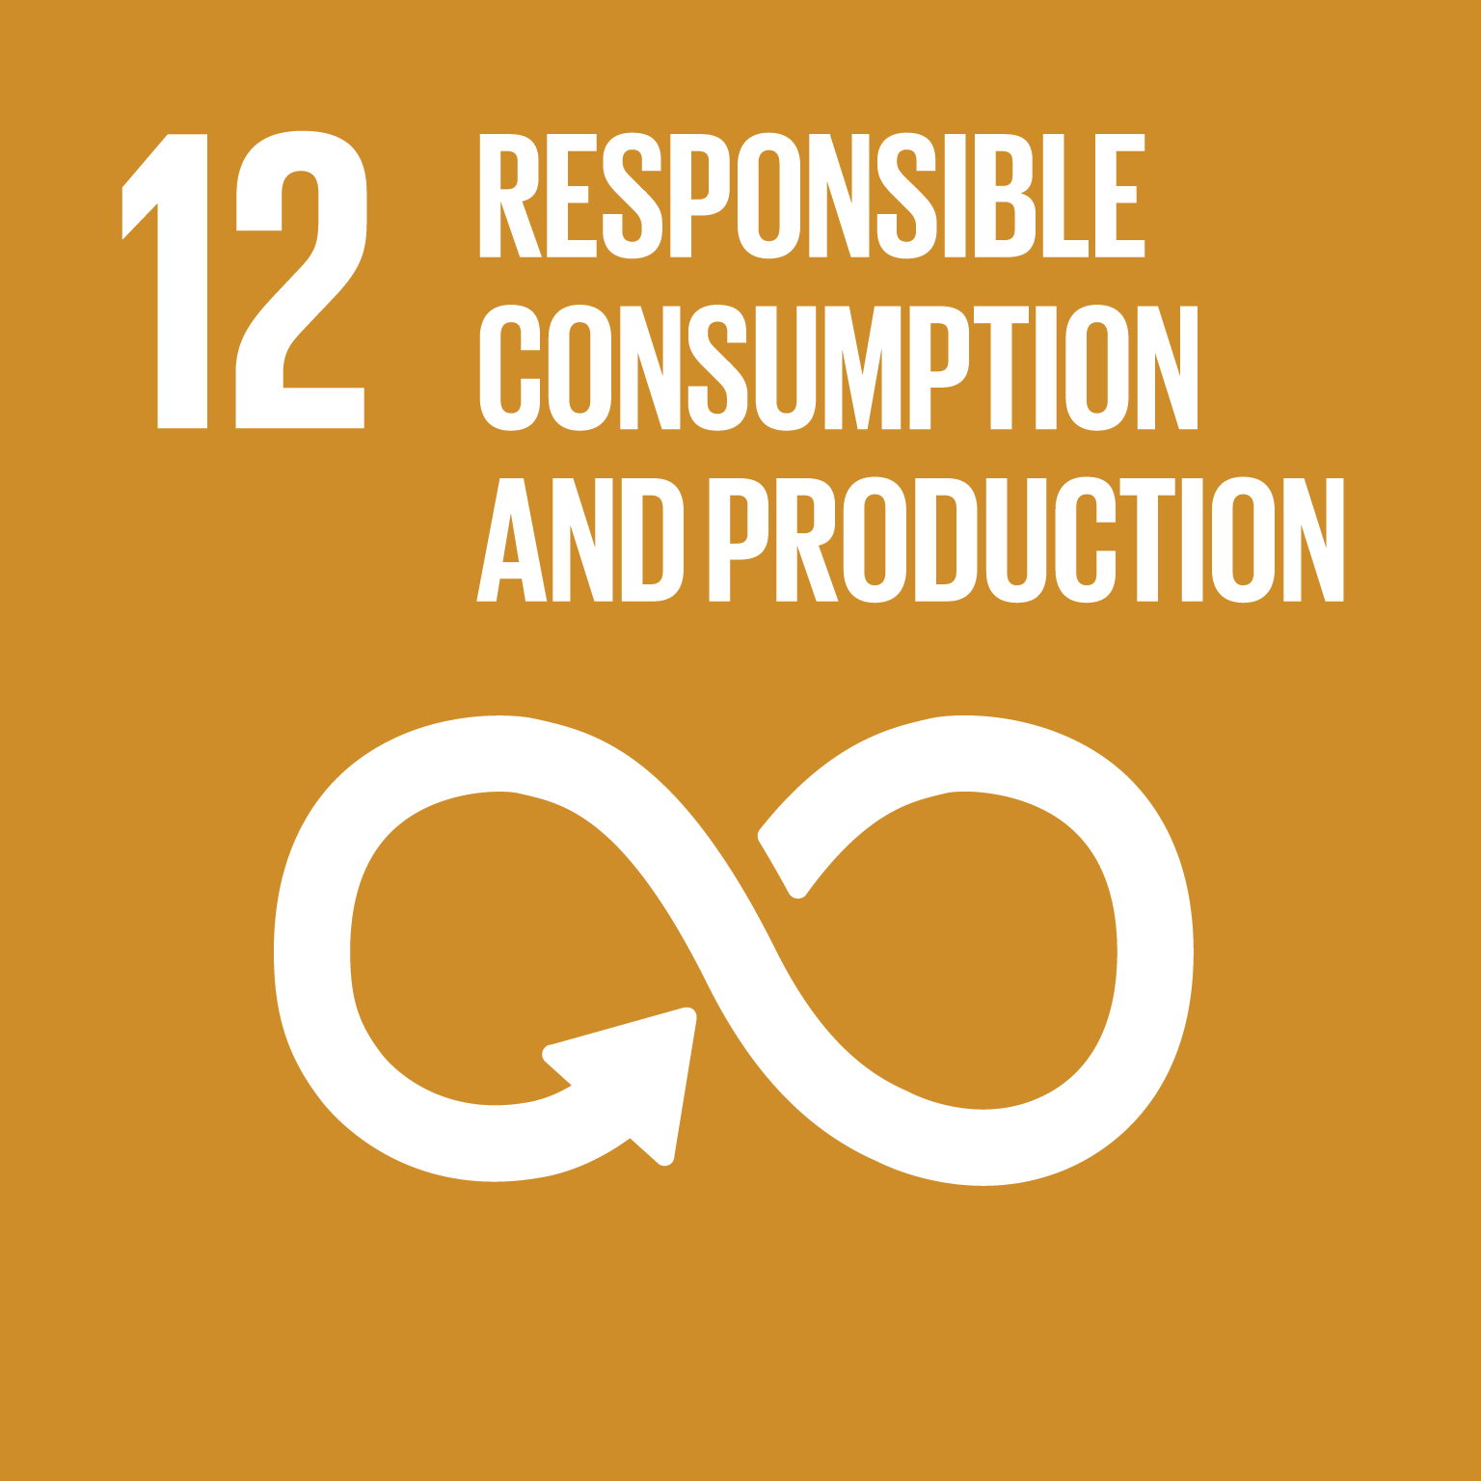
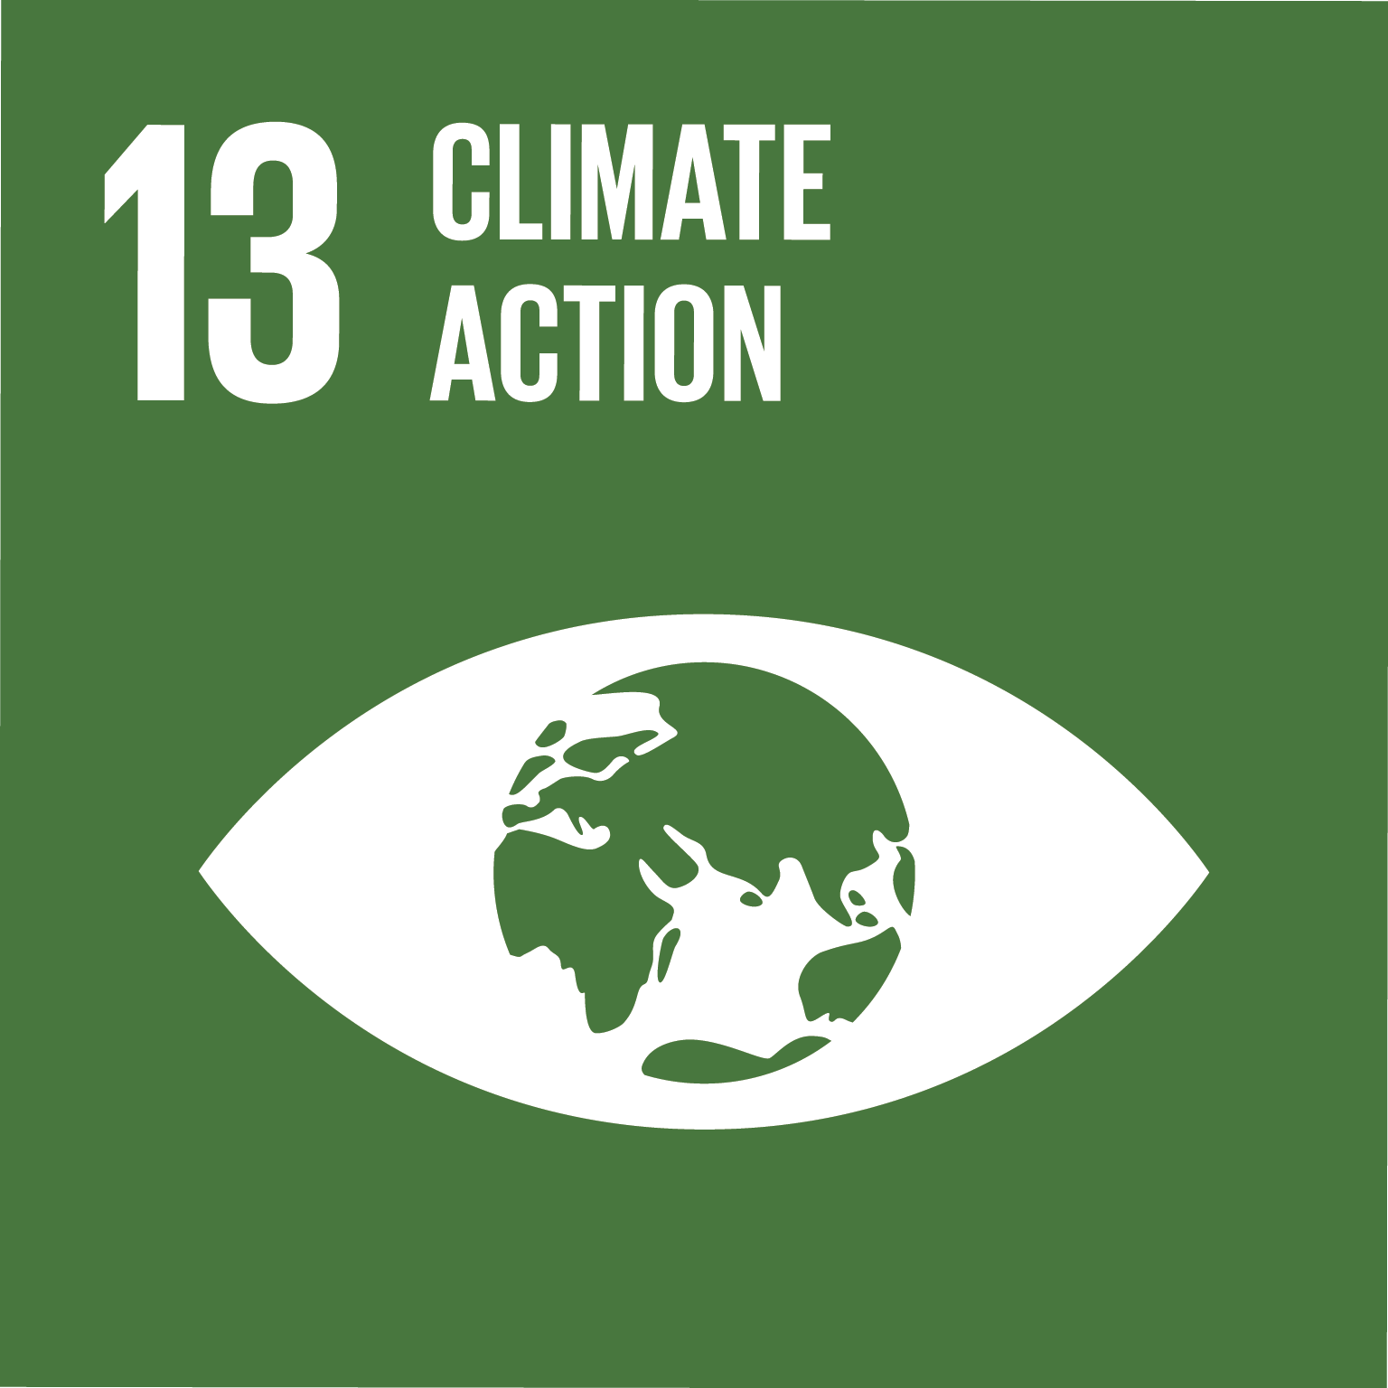
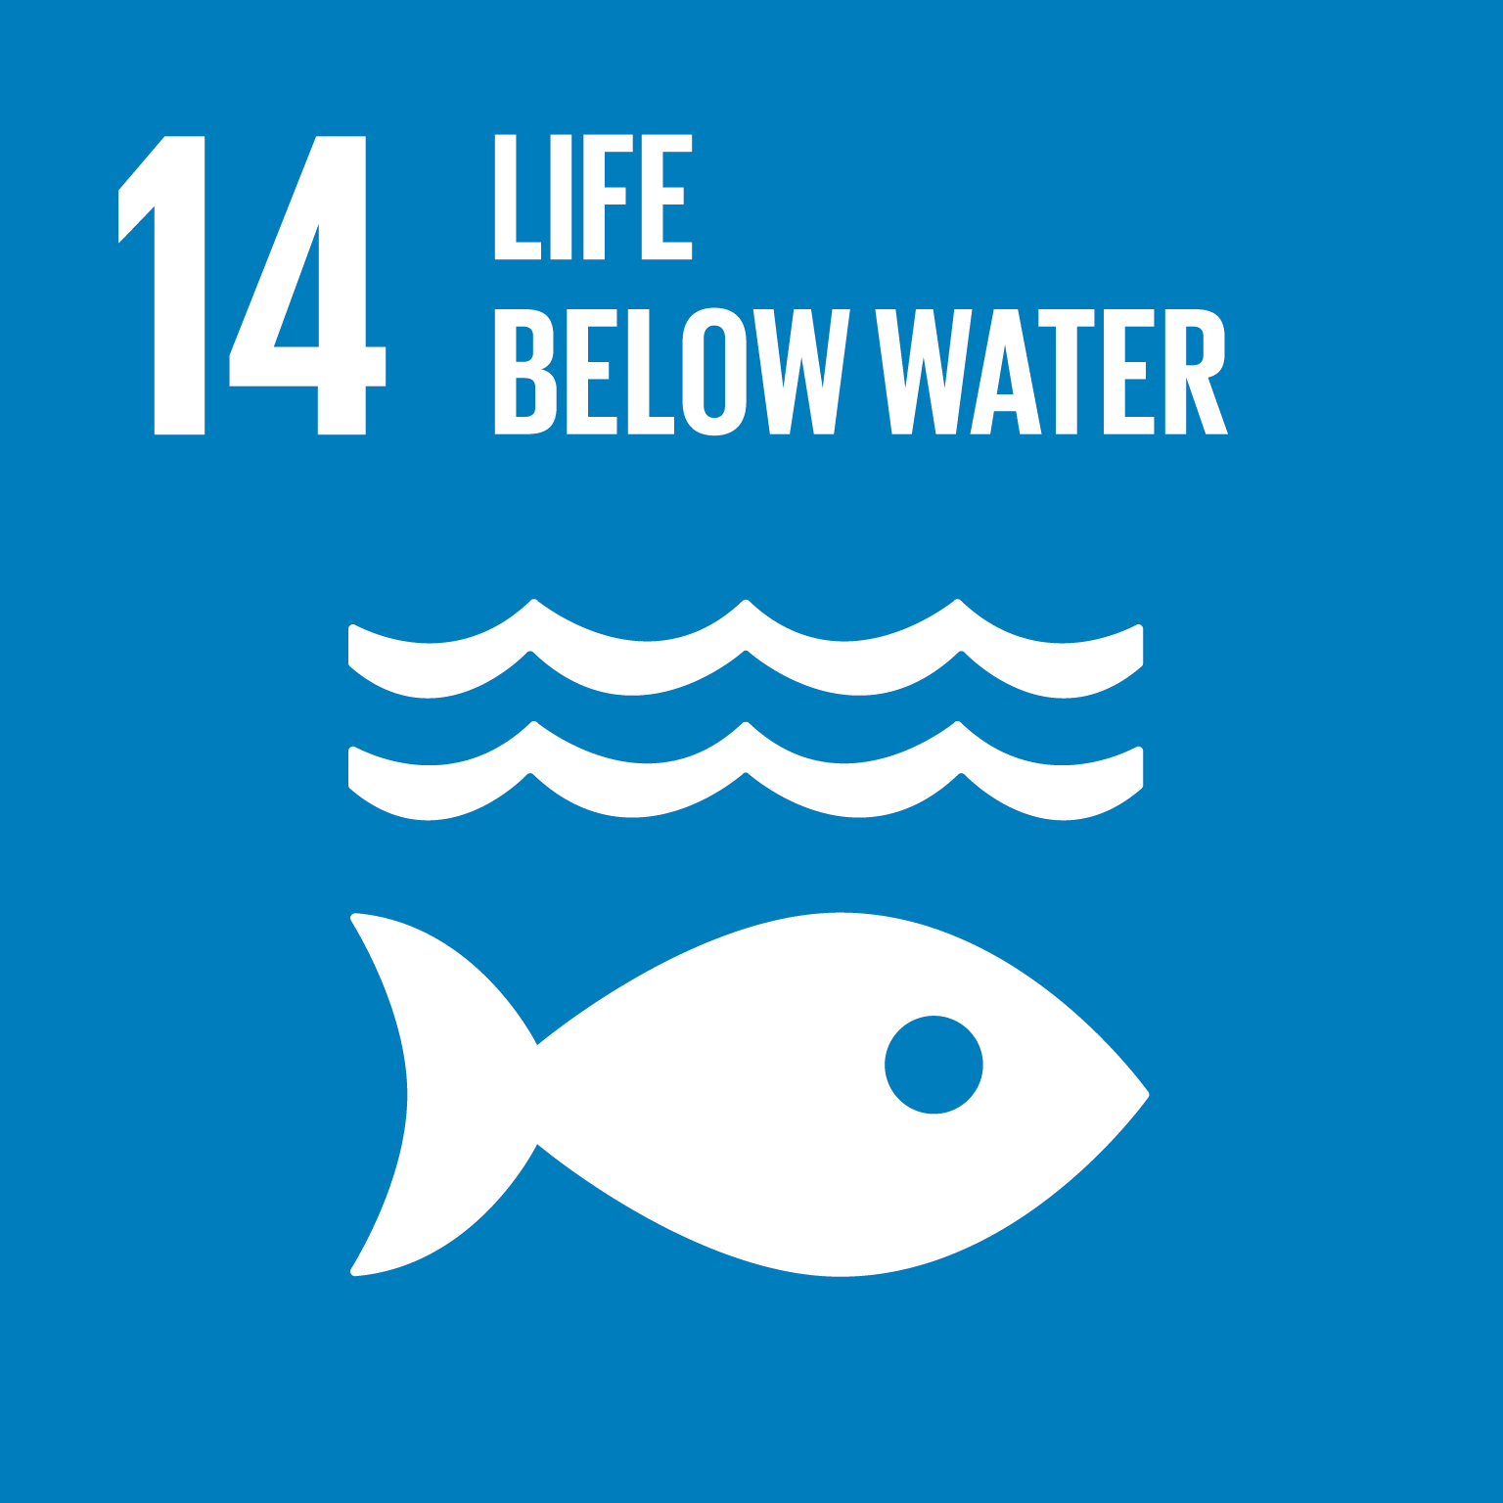
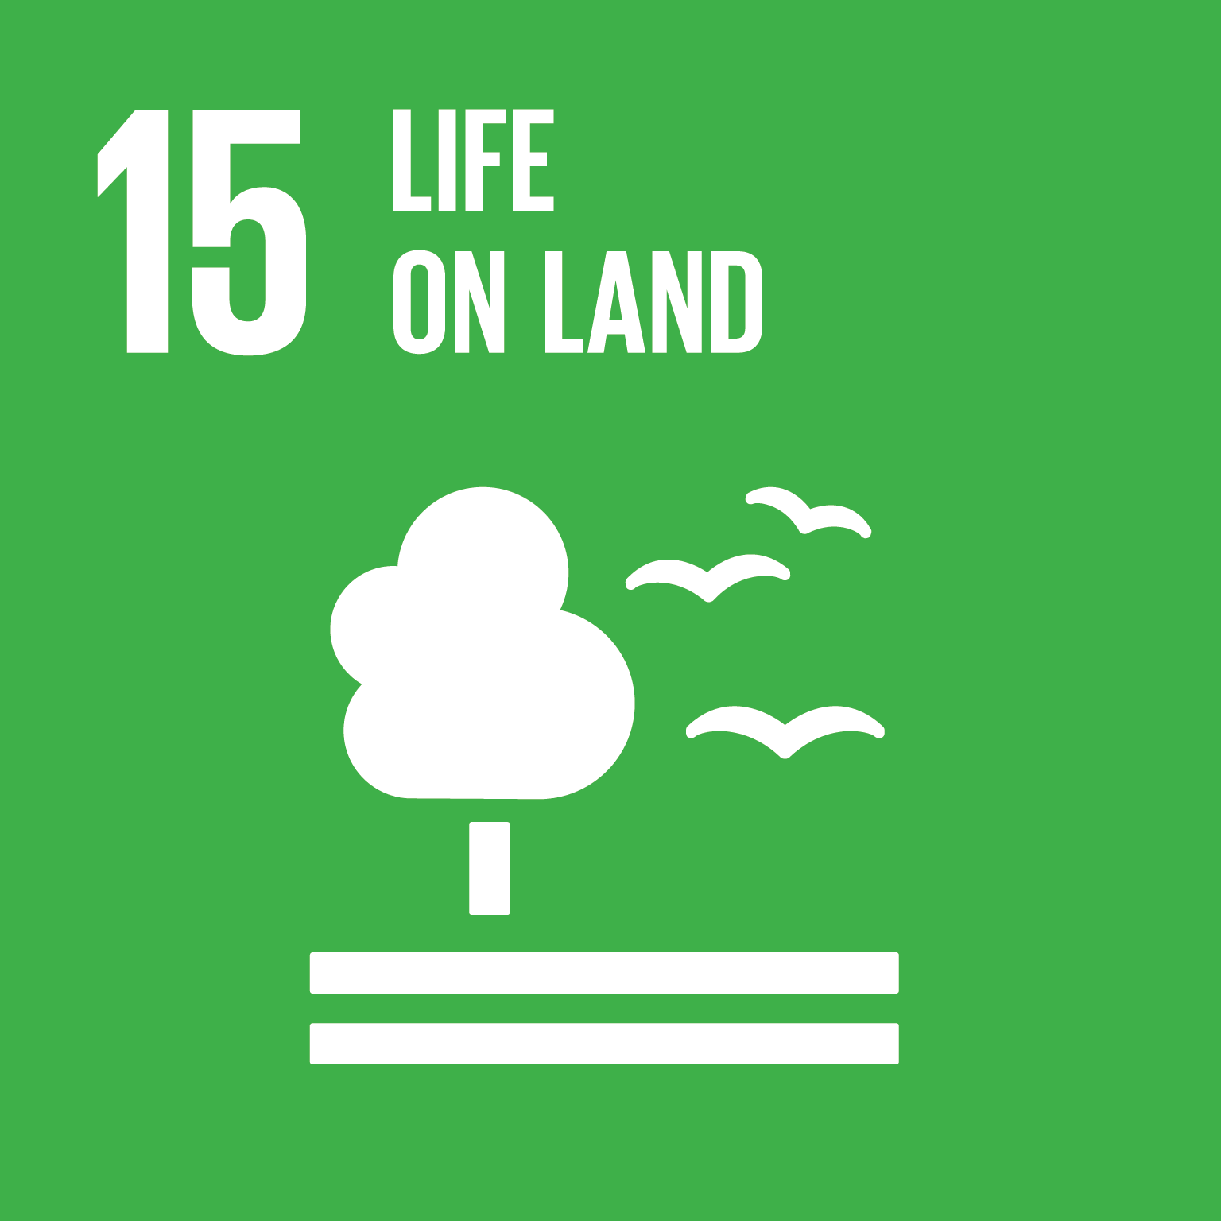
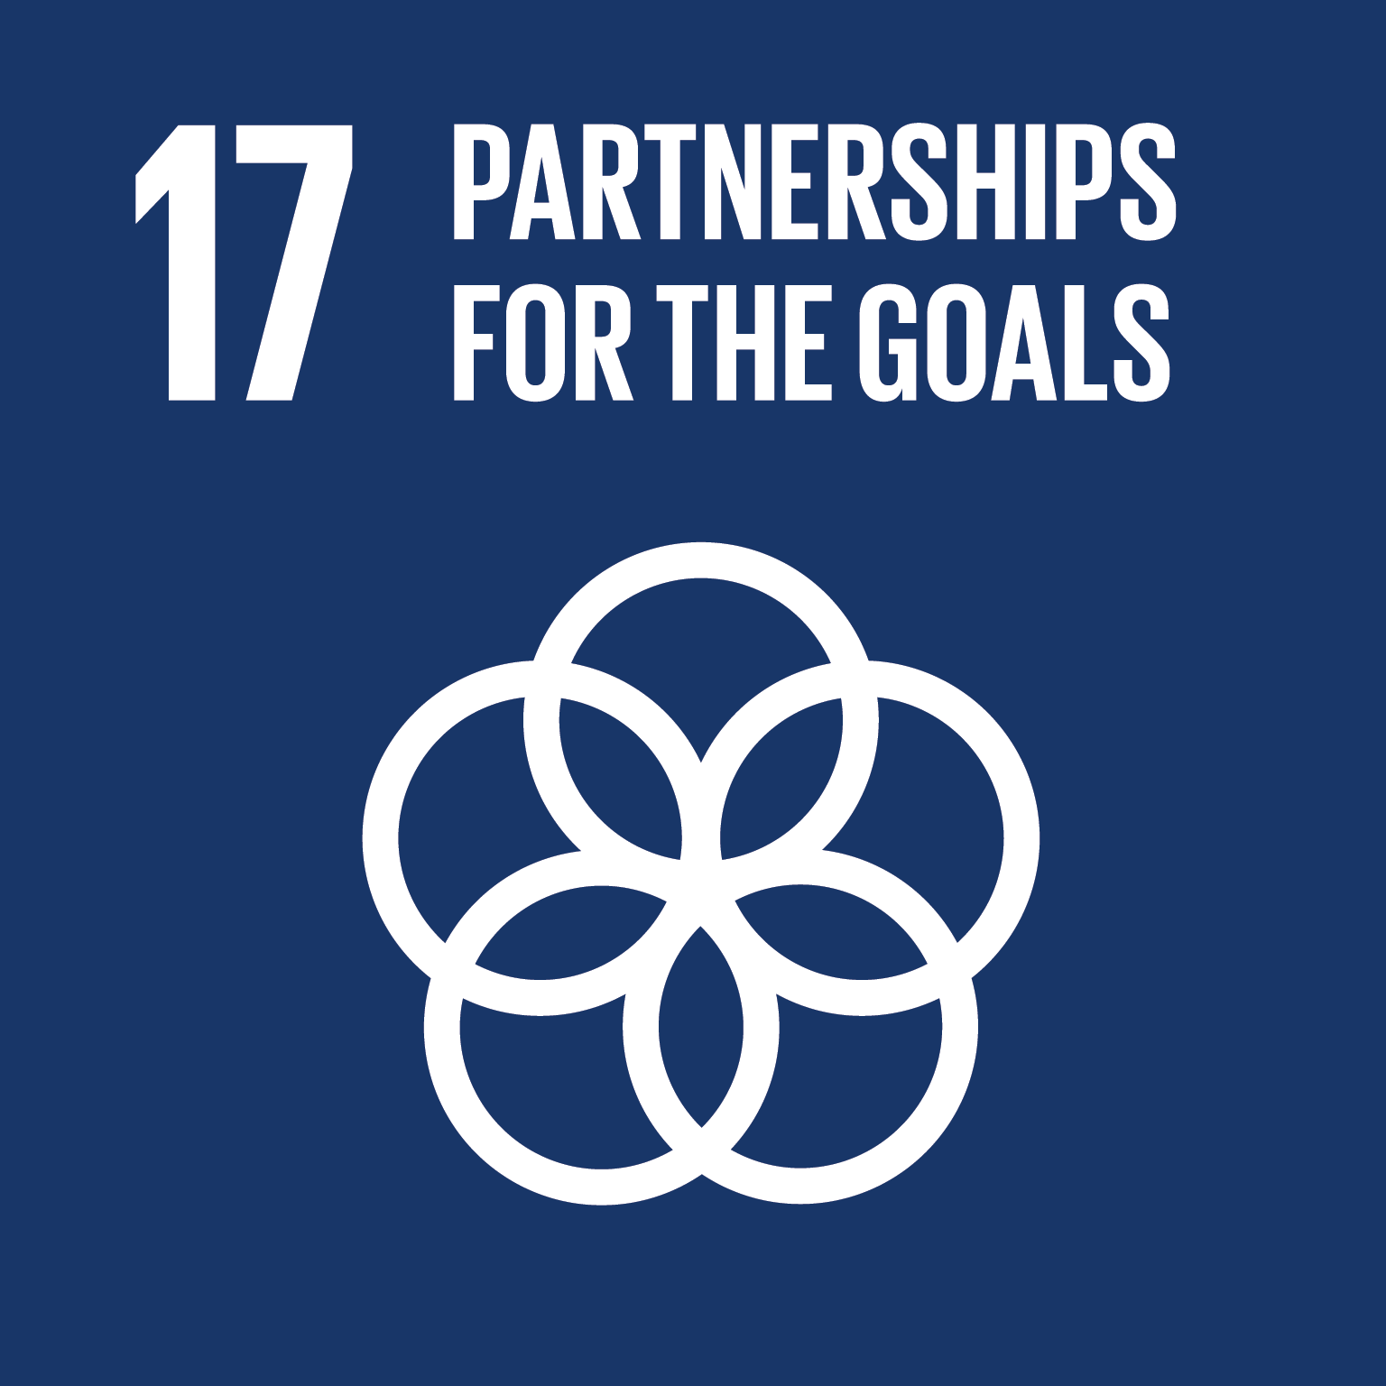
How does the forest bioeconomy lead to sustainable development?
SDGs link to forest bioeconomy
Notes:
The Sustainable Development Goals was introduced by the UN in 2015 and is part of the 2030 Agenda for Sustainable Development (UN Sustainable Development Goals Website [https://sustainabledevelopment.un.org/?menu=1300]
Question: Which goals do you think are relevant to a forest-based bioeconomy?
Once answers given – allow images to show up on slides
SDG Explanations (UN Sustainable Development Goals Website [https://sustainabledevelopment.un.org/?menu=1300]): (Can explain all or focus on a few such as SDG 15, 13, 12) (Text in italics can be used to link SDGs presented with rest of the presentation)
SDG 2. End hunger, achieve food security and improved nutrition and promote sustainable agriculture *as will be seen later on one of the products from the forest bioeconomy is a health drink, showing potential for the forest bioeconomy to provide nutrition*
SDG 7. Ensure access to affordable, reliable, sustainable and modern energy for all *forests are a source of renewable energy especially in the form of wood chips and pellets which are burnt to produce renewable energy, switching to energy from the forest bioeconomy can help meet this target*
SDG 8. Promote sustained, inclusive and sustainable economic growth, full and productive employment and decent work for all *growing the bioeconomy will create new jobs for example in regions such as Vidzeme and Kurzeme*
SDG 9. Build resilient infrastructure, promote inclusive and sustainable industrialisation and foster innovation *The bioeconomy encourages innovation as new technologies are needed to convert feedstock into biobased products*
SDG 12. Ensure sustainable consumption and production patterns *resource efficiency, reducing waste and mainstreaming sustainability practices across all sectors of the economy is part of this goal and the bioeconomy has sustainability and circularity as an important aspect of it helping to reduce waste and avoid the depletion of resources*
SDG 13. Take urgent action to combat climate change and its impacts *The bioeconomy looks to alternatives to fossil fuels to produce products which tend to have lower carbon footprints and also result in less emissions when produced*
SDG 14. Conserve and sustainable use the oceans, seas and marine resources for sustainable development *using biobased products means less plastics entering and polluting the oceans and affecting marine life. Moreover, technology used to make fibres from forest-based feedstocks does not pollute waters*
SDG 15. Protect, restore and promote sustainable use of terrestrial ecosystems, sustainably manage forests, combat desertification, and halt and reverse land degradation and halt biodiversity loss *This is probably the most significant SDG to a forest bioeconomy as a forest-based bioeconomy will encourage the sustainable use and management of forest and can help halt and reverse land degradation and halt biodiversity loss*
SDG 17. Strengthen the means of implementation and revitalize the global partnership for sustainable development *
Some SDGs will be more relevant to a forest-based bioeconomy than others. For example, SDG 15.

Slide 12
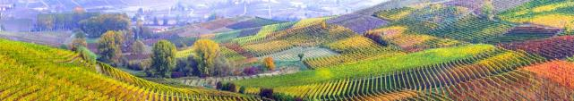
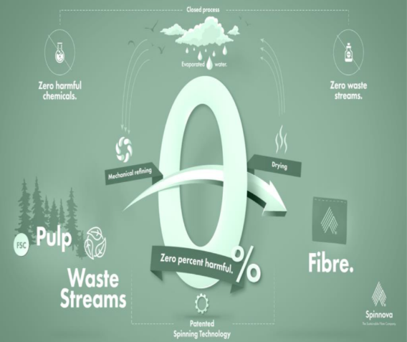
Forestry technology: Sustainable fibres from wood
Spinnova Ltd
Technology that can turn wood fibres into yarn without using harmful chemicals
The produced yarns are fire retardant, antimicrobial, as warm as wool, & naturally biodegradable
The only by-product is evaporated water, which is re-used in the processing
Scalable technology that can use FSC-certified wood instead of less ecological fibres e.g. cotton, viscose or polyester
Creation of new & extended value chains
Source: Spinnova, 2020
Notes:
This process is built upon a mechanical treatment of the pulp, fiber suspension flows and rheology. Spinnova produces fiber out of micro fibrillated cellulose which can be described as a pasty mass of tiny wood fibers. This finely ground pulp mass then flows through a nozzle, where the fibers rotate and align with the flow, creating a strong, elastic fiber network. Using the patented spinning technology, the fiber is spun and dried. The outcome of this process is a fluffy but solid wool-like material, suitable for spinning into yarn and to use for textile production. The only by-product of the process is evaporated water, which is lead back into the process. (Colmorgen and Khawaja, 2019).
Colmorgen, F., Khawaja, C. (2019): Small-scale technology options for regional bioeconomies. BE-Rural Project, https://be-rural.eu/. WIP Renewable Energies, Munich, Germany.
Video on Spinnova: https://spinnova.com/wp-content/uploads/2018/06/Spinnova-vimeo-20180507.mp4?_=1 [3 minutes] – This video explains more about the company and what they do.

Slide 13
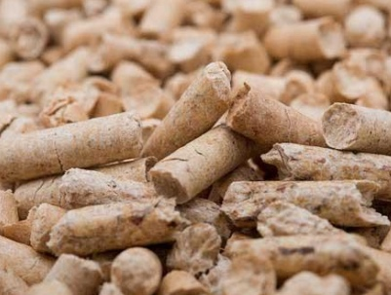
Forestry technology: Small-scale pelletising units
Pelletizing - the process of compressing or molding a material into the shape of a pellet.
GEMCO, abc Machinery, AMISY
Technology for pelletising solid biofuels – which improves their mechanical & physical properties (eg increased density & homogenisation) & so facilitates transport & handling
Various feedstocks can be used (eg wood waste, sawdust, crop residues) to produce eg animal feed, organic fertiliser, biofuel
Processing of raw materials in small local plants can create new local income streams
Source: Colmorgen and Khajawa (2019)
Small pellet plant with a capacity of 50- 1100kg/h from GEMCO Energy. Source: Colmorgen and Khajawa (2019)
Notes:
Pelletizing is a pressure agglomeration process that can be used to improve the mechanical and physical properties of solid biofuels. The compacting process leads to the formation of lager fuel particles with reduced surface area. The technology is often used to homogenize the mechanical properties, increase the density and improve the transportation and handling properties. Depending on the feedstock, a water content of 10-15 % is needed to achieve the required physical fuel properties (Colmorgen and Khawaja, 2019)
Colmorgen, F., Khawaja, C. (2019): Small-scale technology options for regional bioeconomies. BE-Rural Project, https://be-rural.eu/. WIP Renewable Energies, Munich.
Company: GEMCO http://www.biofuelmachines.com/
The process of pelletising includes the following steps: (Colmorgen, Khawaja and Rutz (2020)
Initial size reduction (chipping) if it is not already in a small size (e.g. sawdust)
Drying until a moisture content of 8-12%
Fine grinding using a hammer mill which will grind the raw materials into smaller pieces with a diameter under 5 mm
Pelletising where pellets are extruded using special dies. High pressure and temperatures are needed in this process, which softens lignin in the wood and binds the material in the pellet together
Cooling which allows the pellets to become rigid
Bagging and truck loading
Colmorgen, F., Khawaja, C. and Rutz, D., (2020): Handbook on regional and local bio-based economies, available at: [https://be-rural.eu/wp-content/uploads/2020/03/BE-Rural_D2.5_Handbook.pdf]

Slide 14
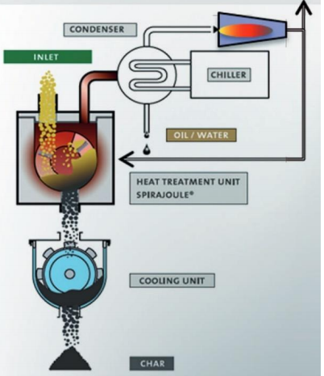
Forestry technology: The containerised pyrolysis unit
ETIA Biogreen
Fossil-free pyrolysis process (thermal decomposition of materials at high temperatures in an inert environment)
Highly versatile system for converting biomass (wood, crops & forest residues) & waste into high-value products & energy (pyrolysis oil, syngas, biochar, heat, wood vinegar)
Ready-to-use technology that is suitable for fast, temporary applications, & can easily be shipped or stored
Suitable for decentralised use on a small-scale, thus creating new income streams
Biogreen containerized pyrolysis unit. Source: Colmorgen and Khajawa (2019)
Biogreen’s patented technology. Source: Colmorgen and Khajawa (2019)
Notes:
“Pyrolysis is the thermal decomposition of materials at high temperatures in an inert environment. The treatment leads to the formation of new molecules and is irreversible. The exclusion of oxygen during the treatment provokes high energy contents in the products received, that often have a more superior character than the original residue. Biogreen® offers a fossil-free pyrolysis process that allows to convert various feedstocks into bio-based products and renewable energy. By not emitting carbon, replacing petroleum-based products and thus sequestrating carbon, Biogreen® contributes to the decarbonization of industries. Biogreen® offers a continuous process based on the Spirajoule® technology, an exclusive process for thermal treatment. The centerpiece of the process is a hollow shaft screw conveyor that is heated by a low voltage current.“ (Colmorgen and Khawaja, 2019)
Colmorgen, F., Khawaja, C. (2019): Small-scale technology options for regional bioeconomies. BE-Rural Project, https://be-rural.eu/. WIP Renewable Energies, Munich.
Biogreen© is a simple and flexible pyrolysis solution to produce biochar, oil, solid fuels and syngas from your biomass residues. Company website → (http://www.biogreen-energy.com/)

Slide 15
Forestry technology: Biomaterials from agro-forestry residues & mycelium
Spawnfoam
A 100% biodegradable, biocomposite material made of fungi, organic additives & biomass from local agroindustry & forestry
Mycelium acts as a bonding agent to cohere the biomass particles
The biocomposite material can be pressed & moulded into different shapes (eg pots, packaging material, construction material)
The biocomposites are as effective & efficient as their fossil-based counterparts but are harmless or beneficial to the natural environment
Source: Colmorgen and Khajawa (2019)
Notes:
“Spawnfoam developed a process, which enables them to produce an innovative biocomposite material made of fungi, organic additives and biomass from the surrounding agroindustry and forestry. The chopped and blended biomass used is the raw material base for the process. The key of Spawnfoam is the application of mycelium, which works as a bonding agent to cohere the biomass particles. Finally, the composite material can be pressed and molded in different shapes, depending on the desired product”. (Colmorgen and Khawaja, 2019)
Colmorgen, F., Khawaja, C. (2019): Small-scale technology options for regional bioeconomies. BE-Rural Project, https://be-rural.eu/. WIP Renewable Energies, Munich.

Slide 16
Forestry technology: Mobile wood chipping units
Erpék Ind SRL
The mobile wood chipping unit is highly flexible as it is mounted on a trailer chassis & can operate without an external power source
The wood chipper requires only a small investment (c. €17,000) & payback can be reached after running for 900 hours
Simple technology & high replication potential means good scope for new income streams
Wood chips have various potential uses (e.g. solid fuel, wood pulp production, mulch)
Mobile wood chipping unit (Erpék Ind 2019) Source: Colmorgen and Khajawa (2019)
Notes:
“Erpék Ind offers a mobile wood chipping unit which can be fed with wood based raw material from forest industry, agriculture and municipalities. The woodchipper is mounted on a trailer chassis why it is highly flexible and suitable for different surfaces. Since the woodchipper is driven by an integrated 60 HP diesel engine, it can work autonomously without any external power. The feeding of the chipper is done manually. In one hour, up to 15 m3 of chipped biomass can be produced. The volume of the raw materials can be reduced to 25% whereby the transport and logistic process of wood materials becomes simpler and cheaper”. (Colmorgen and Khawaja, 2019)
Colmorgen, F., Khawaja, C. (2019): Small-scale technology options for regional bioeconomies. BE-Rural Project, https://be-rural.eu/. WIP Renewable Energies, Munich.
Wood chips can be divided into the following groups:
Forest chips (produced from logs, whole trees, logging residues, or stumps)
Wood residue chips (produced from untreated wood residues, recycled wood, offcuts)
Sawing residue chips (produced from sawmill residues)
Short rotation coppice chips (produced from energy crops)” (European Technology and Innovation Platform (2020) Wood chips, available at: http://www.etipbioenergy.eu/value-chains/feedstocks/forestry/wood-chips

Slide 17
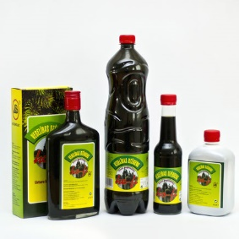


Example of bioproduct
Health Drink Ho-Fi
Company Name: Biolat
Country: Latvia
Feedstock: conifer needle foliage
Description: Coniferous sodium chlorophyllin is a concentrate of chlorophyll derivatives obtained from coniferous (mainly SPRUCE) extracts. It contains water-soluble chlorophyll derivatives (chlorines, feophitins, feoforbides), coniferous paraffinic acids and fatty acids sodium salts and other compounds. Sodium chlorophyll stimulates the body's overall immunity.
Source: Biolat, 2019
Notes:
The Latvia Bioeocnomy Strategy includes producing more sustainable and environmentally-friendly products, and also completely new products (Country Profile: Latvia [https://biooekonomierat.de/fileadmin/profiles_for_map/Country_profile_Latvia_1.pdf])
Image and product information: Biolat ‘Healthy drink Ho-Fi 0.05 %’ (2020a) available at: [https://www.biolat.lv/en/products/hofi-en/]

Slide 18
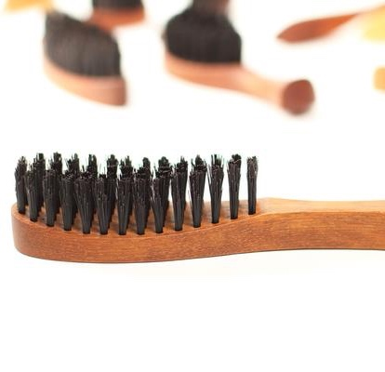
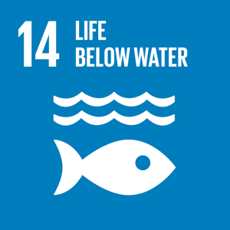

Example of bioproduct
Company Name: Wild Good
Country: Latvia
Feedstock: boar hair and sustainably sourced wood
Description: Hairbrush with wild boar skin, these bristle brushes are made of wild boar bristle and 100 percent chemical free wood. Boar bristles have been used for centuries and according to the producers they give hair strength, suppleness and get rid of static electricity. Boars are numerous in Latvian forests and hunted for their meat, to control the population and to allow agriculture. The fur is a by-product and would otherwise be thrown away.
Conventional Product: Plastic Hairbrush
Eco Hairbrush
Source: Wild Good, 2020
Notes:
Questions: How do they link with the SDGs? – less plastic use
What other plastic products can be made of wood instead? – link to products in their everyday life
https://www.wild-good.com/

Slide 19

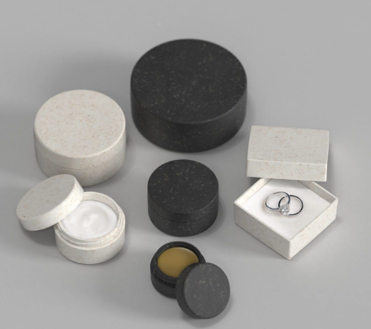

Example of bioproduct
Cosmetics Containers
Company Name: Sulapac
Country: Finland
Feedstock: wood and biodegradable, plant-based binders
Description: biodegradable and microplastic-free material made entirely from renewable sources and certified wood. It can be used as packaging for everything from cosmetics to foodstuff to gift boxes and more. It has all the benefits of plastic, yet it biodegrades completely and leaves no trace once it’s gone
CO₂ and Water: Carbon neutral
Conventional Product: Plastic packaging
Source: Sulapac, 2020
Notes:
These products are also made from forest biomass and with further investment and development in the Latvian regions these too could be produced there.
Guess what the products are made from before explaining.
Discuss benefits and who would be willing to buy this instead
https://www.sulapac.com/.

Slide 20


Example of bioproduct
Bathroom Sink
Company Name: Woodio Ltd
Country: Finland
Feedstock: small woodchips bound together with resin
Description: Approximately 80% of the material is solid wood. All Woodio products are disposable as energy waste at the end of their lifecycle.
CO₂ and Water: Woodio products have a significantly lower carbon footprint, throughout the whole product lifecycle, than similar traditional ceramic bathroom fixtures. In fact, 55kg lower per unit.
Conventional Product: Ceramic sinks and bathtubs
Source: Woodio, 2020
Notes:
Guess percentage of material that is wood before showing information.
Discuss benefits and drawbacks of using woodbased sink.
https://woodio.fi/

Slide 21

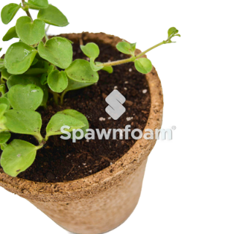
Example of bioproduct
Company Name: Spawnfoam
Country: Portugal
Feedstock: By-products and residues from agriculture and forestry, mycelium
Description:
100% biodegradable, contributing to:
+ Environmental sustainability;
+ Decarbonization;
+ Ecological footprint reduction.
CO₂ and Water: the biocomposites have the potential to replace petroleum-based products, they reduce the dependence on fossil fuels and GHG emissions. Thus, Spawnfoam helps reducing the ecological footprint and contributes actively to decarbonization
Conventional Product: Plastic or ceramic pots
Plant Pots
Source: Spawnfoam, 2020
Notes:
Presenter can ask which SDGs linked to the product before they appear.
Spawnfoam (2020) ‘Products’ available at: [http://www.spawnfoam.pt/en/#products]

Slide 22
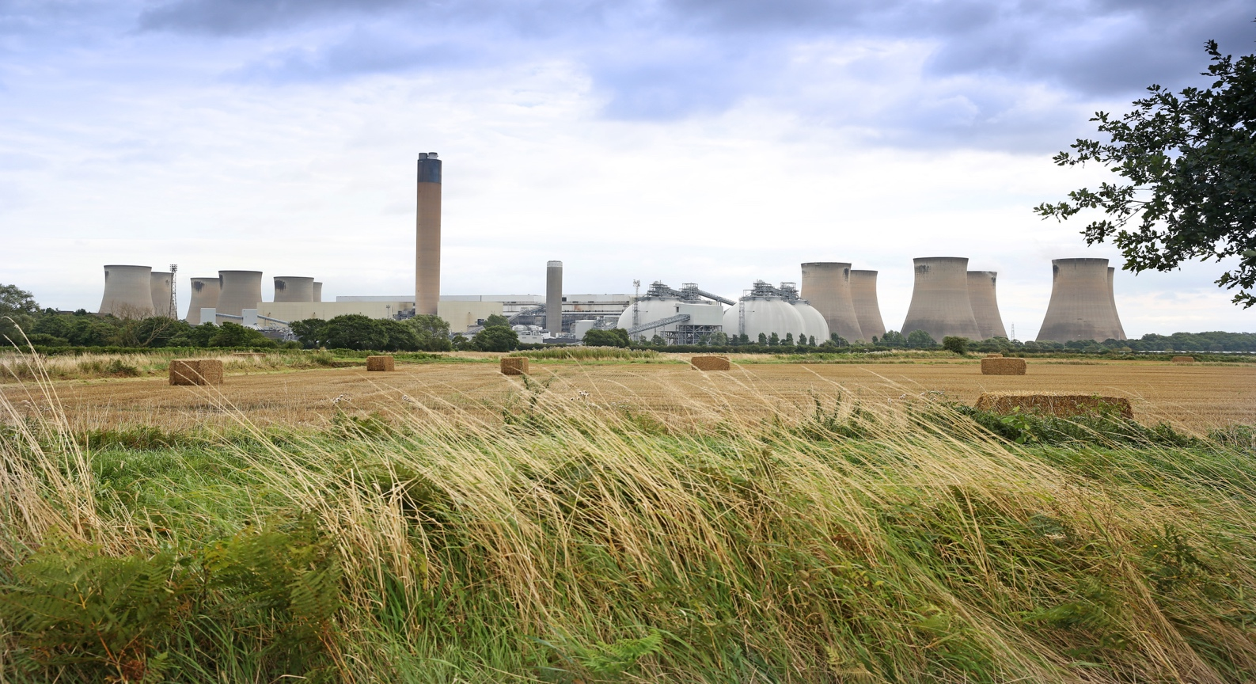

Example of bioproduct
Company Name: Drax (Drax Power Station together with Drax Biomass)
Country: United Kingdom
Feedstock: wood chips and pellets, largely made up of low-grade wood and low value residues produced as a bi-product of the production and processing of higher value solid wood products (e.g. saw-timber for construction and furniture).
Description: produced from burning wood chips. Europe's largest biomass-fuelled power station. Wood pellets to produce 17% of the UK's renewable energy. Drax Biomass manufactures compressed wood pellets produced from sustainably managed working forests
CO₂ and Water: Wood pellets at Drax: Lead to 80% less CO₂ than coal, including supply chain emissions
Conventional Product: fossil fuel
Biofuel
Drax Power Station, Source: Drax, 2020
Notes:
Discuss renewable energy – why do we still use fossil fuels?
https://www.drax.com/

Slide 23
Conclusion
Forestry is one key sector of the bioeconomy
Several feedstocks have the potential to create a wide range of products
The Bioeconomy can help meet SDG targets – for forest-based bioeconomies: SDG 15 is the most relevant
Biobased products may also result in less use of water and less C0₂ emissions
Notes:
Final summary points.

Slide 24
Questions and Discussion
Name of presenter
Notes:
Notes to the teacher: Speaker’s name to go in the space at the bottom left of the slide. This is the final slide of the presentation. Allow time for students/participants to ask any questions.

Slide 25



https://be-rural.eu
These educational resources were developed as part of the BE-Rural project
Bio-based strategies and roadmaps for enhanced rural and regional development in the EU (April 2019 – March 2022)
BE-Rural supports
… regional stakeholders in five countries:
Latvia: Vidzeme and Kurzeme
Poland: Szczecin and Vistula Lagoons
Romania: Covasna
Bulgaria: Stara Zagora
North Macedonia: Strumica
The goal of BE-Rural is to realise the potential of regional bio-based economies by supporting relevant actors in the participatory development of bioeconomy strategies and roadmaps
https://be-rural.eu/innovation-regions/
Notes:
BE-Rural has five innovation regions
BE-Rural will create five regional Open Innovation Platforms (OIPs) for the participatory development of bioeconomy strategies and roadmaps. The BE-Rural OIPs will be established in five regions across the EU with different biomass potentials and will be based on the regional Stakeholder Working Groups (SWGs). Within the OIPs, the main task of the SWGs will be to formulate concrete strategy or roadmap documents by engaging with different actors and opening the platform for a wide range of stakeholders in the region, including civil society organisations and citizens.
Stara Zagora, Bulgaria: This innovation region will focus on seeking new technologies for the application of essential oils and herbal plants in the cosmetics and pharmaceutical industry. The small-scale production in this area will be combined with tourism-related activities to expand the existing business status quo and potential. Ultimately, the region will establish closer relations and network between companies. Regional partner: Bulgarian Industrial Association (BIA)
Vidzeme and Kurzeme, Latvia: This region will focus on the potential of by-products of forest management (i.e. from young forest stand thinning, short rotation coppice and forestry (SRC/SRF) plantations, removing of overgrowth in abandoned agricultural lands and perennial grasses) as a source of bioenergy or biorefinery. The region will investigate the value of agroforestry systems of perennial grasses and SRC or SRF trees as grazing areas, and the production of hay or grass seeds. The potential smart use of small timber wood from young forest stand thing will be explored. Regional partner: The Latvian State Forest Research Institute (SILAVA)
Strumica, North Macedonia: The region will focus on the utilization of agricultural residues, specifically the by-production of organic materials from agricultural activities, as a source of energy for domestic and industrial purposes. The region will investigate technology options for energy conversion of biomass materials generated on agricultural fields or farms (field-based residues), as well as those generated during the processing of agricultural products (process-based residues). Regional partner: International Centre for Sustainable Development of Energy, Water and Environment Systems (SDEWES-Skopje)
Szczecin Lagoon and Vistula Lagoon, Poland: This region will focus on small-scale fisheries, specifically on the sustainable use of currently underused and low-value fish species located in two lagoons. The region will investigate small-scale technology options that can be applied to utilize low-value fish species as products for human consumption. Regional partner: The National Marine Fisheries Research Institute (NMFRI)
Covasna, Romania: The region will focus on addressing fragmented value chains and implementing the circular economy concept within the county’s industrial sectors (i.e. wood and furniture, textiles, agro-food, mechanical engineering, green energy). The region will investigate the development potential of underused biomass (plant matter and wood waste) and it implication on societal challenges (e.g., rural unemployment or marginalised communities). This will be done within a local development business model based on a small-scale technology option ensuring the autonomous energy supply for civil and industrial needs. Regional partner: Institute for Economic Forecasting (IPE)
Source: BE-Rural (2020), Innovation regions, available at: https://be-rural.eu/innovation-regions/

