Slide 1
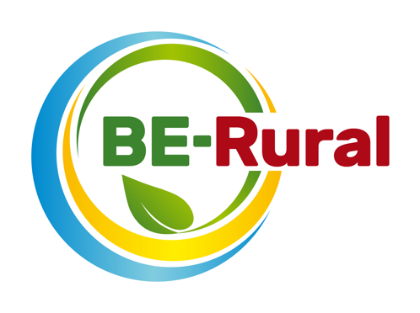
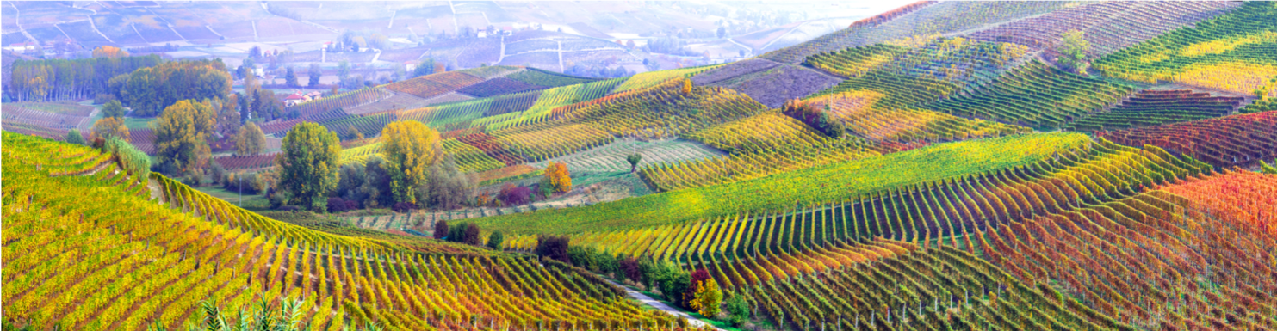
Agriculture and the Bioeconomy
Name of presenter
Notes:
Notes to the teacher: Teacher’s name to go in the space at the bottom left of the slide. Explain that this presentation will look at the relationship between the bioeconomy and agriculture, and specifically how agricultural residues can be utilised to aid both environmental and societal goals.
Excluding the this first slide, outline slide and the video, there are 15 slides – so these slides should take between 15 and 30 minutes to present, depending of amount of explanation.
The video is 2 minutes and 52 seconds long.

Slide 2
Outline
Bioeconomy overview – what it is, ecological limits and challenges
Agriculture feedstock
Agriculture = A plethora of biological resources
Why is the bioeconomy important for agriculture?
Agriculture and SDGs
Agri-derived Bio based products
Biofuels from waste straw
T-Shirts made with waste milk
Paper from cocoa beans shells
Grass Fed Mobile Biorefinery
Impacts of biofuels
Video: bioeconomy in a rural setting
Notes:
Notes to the teacher: Briefly run through the topics that will be spoken about in this presentation as shown on the slide.

Slide 3
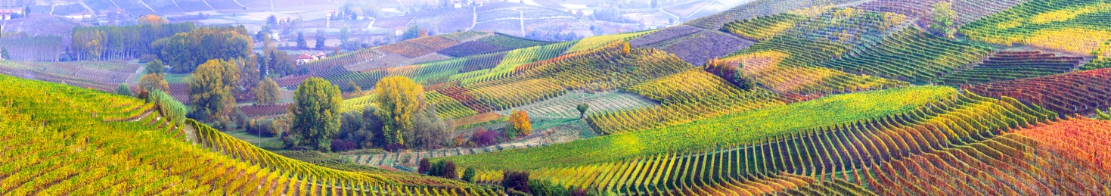

Bioeconomy overview
European Bioeconomy Strategy
The European Commission is taking steps towards a sustainable bioeconomy and has a bioeconomy strategy to promote the bioeconomy and to avoid reaching ecological limits.
The Bioeconomy…
Is the production of goods, services, or energy from biological material as the main resource.
Is strongly linked to sustainability as biodegradable resources are often used and waste is often completely designed out of the system.
Can avoid the depletion of resources for future generations and protect the stability of the planet.
Notes:
Notes to teacher: Explain to class that in order to take steps towards sustainability and the avoidance of reaching ecological limits the bioeconomy is very important. The bioeconomy is the production of goods, services, or energy from biological material as the main resource. This is strongly linked to sustainability as biodegradable resources are often used and waste is often completely designed out of the system. This can avoid the depletion of resources for future generations and protect the stability of the planet. The European Commission is taking steps towards a sustainable bioeconomy. Turning waste into valuable resources and creating incentives to help retailers and consumers cut food waste. The European Commission has a bioeconomy strategy to promote the bioeconomy and avoid reaching ecological limits.
European Commission (2018), A sustainable Bioeconomy for Europe: strengthening the connection between economy, society and the environment. Updated Bioeconomy Strategy. Directorate-General for Research and Innovation, available at: https://ec.europa.eu/research/bioeconomy/pdf/ec_bioeconomy_strategy_2018.pdf accessed: 22 May 2020].

Slide 4
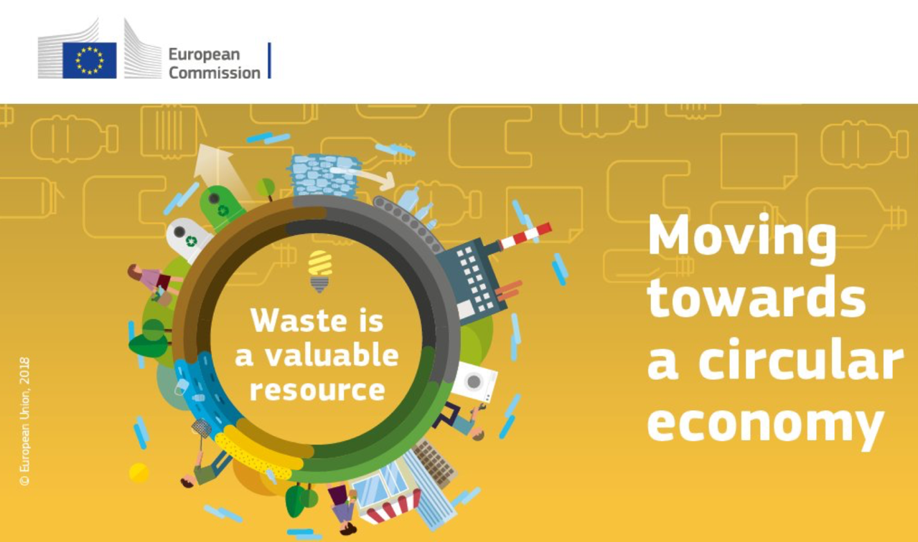
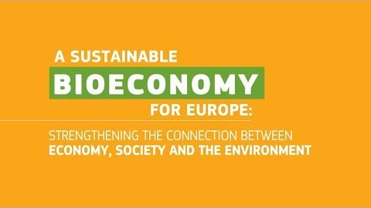
Bioeconomy overview
Bioeconomy and Circular Economy – waste is a valuable resource
Video (2 minutes and 9 seconds): https://www.youtube.com/watch?v=RfRN_hHeIKk
Languages for sub-titles for video include: Bulgarian, Latvian, Macedonian, Polish and Romanian
Notes:
1. Explain bioeconomy to introduce topic and contextualise bioproducts portfolio.
Bioeconomy is defined as the production, utilization and conservation of biological resources to provide information, products, processes and services across all economic sectors aiming towards a sustainable economy (Bell et al., 2018).
“The bioeconomy covers all sectors and systems that their functions and principles. It includes and interlinks: land and marine ecosystems and the services they provide; all primary production sectors rely on biological resources (animals, plants, micro-organisms and derived biomass, including organic waste), that use and produce biological resources (agriculture, forestry, fisheries and aquaculture); and all economic and industrial sectors that use biological resources and processes to produce food, feed, bio-based products, energy and services. To be successful, the European bioeconomy needs to have sustainability and circularity at its heart. This will drive the renewal of our industries, the modernisation of our primary production systems, the protection of the environment and will enhance biodiversity.” (European Commission (2018) ‘A sustainable Bioeconomy for Europe: strengthening the connection between economy, society and the environment’ available at: (https://ec.europa.eu/research/bioeconomy/pdf/ec_bioeconomy_strategy_2018.pdf#view=fit&pagemode=none])
Now we will watch a short video explaining what the bioeconomy is, its potential and challenges.
Play video explaining bioeconomy here: https://www.youtube.com/watch?v=RfRN_hHeIKk&feature=youtu.be
(Languages for sub-titles for video include: Bulgarian, Latvian, Macedonian, Polish and Romanian)
2. Explain circular economy to give context to bioproducts.
Circular Economy is a framework for the development and management of sustainable, waste-as-resource economic system. It aims to keep products, components and materials at the highest utility and value at all times (European Commission, 2018). Moreover, it is designed to process the reduced waste out of the system. The current global economic framework is a linear, this means that we take, produce, use and dispose without fully exploiting all the essential properties of materials. Circular economy seeks to create a more sustainable economic model where no waste is generated, instead it is reutilised as many times as possible. With this, circular economy aims to eliminate all waste and create a closed-loop system purely based on natural resources.
Bell, J., Paula, L., Dodd, T., Németh, S., Nanou, C., Mega, V. and Campos, P. (2018). EU ambition to build the world’s leading bioeconomy—Uncertain times demand innovative and sustainable solutions. New Biotechnology, 40: 25–30.
European Commission (2018), A sustainable Bioeconomy for Europe: strengthening the connection between economy, society and the environment. Updated Bioeconomy Strategy. Directorate-General for Research and Innovation, available at: https://ec.europa.eu/research/bioeconomy/pdf/ec_bioeconomy_strategy_2018.pdf

Slide 5
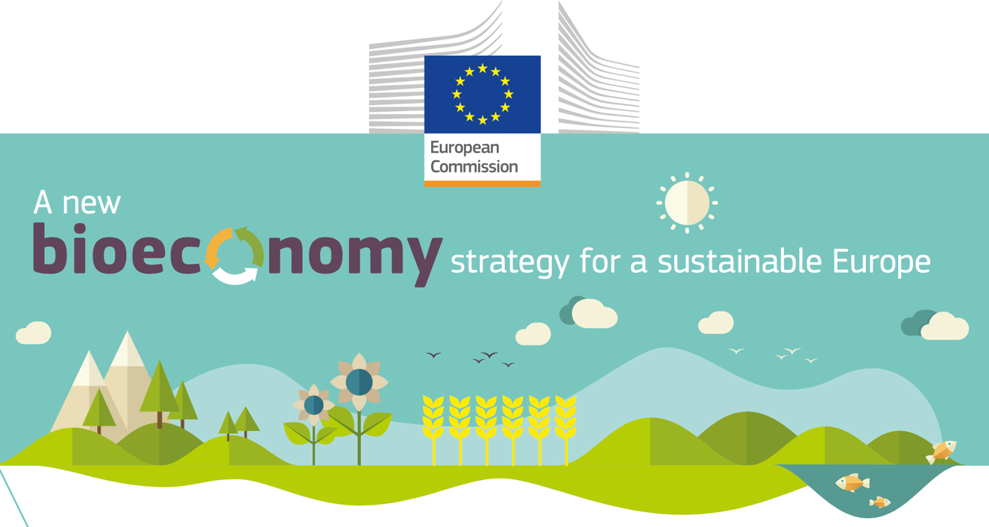
Ecological limits
In addition to links to sustainability and climate change mitigation, it is critical that the bioeconomy operates within safe ecological limits.
With the new bioeconomy strategy, the European Commission supports initiatives at national and regional level to develop an efficient and sustainable bioeconomy and this includes:
  implementing an EU-wide monitoring system to track progress towards a sustainable and circular bioeconomy.
  providing guidance on how best to operate the bioeconomy within safe ecological limits.
Notes:
Notes to teacher: Explain that to try and tackle the issues surrounding ecological limits: National and international bodies have specific guidelines. An example of this is the European Commission’s 2018 publication; ‘A new bioeconomy strategy for a sustainable Europe.’ Further information available at: https://ec.europa.eu/commission/news/new-bioeconomy-strategy-sustainable-europe-2018-oct-11-0_en
Key reading:
EC (2018), Bioeconomy: A new strategy for a sustainable Europe Restoring healthy ecosystems and enhancing biodiversity. European Commission https://ec.europa.eu/research/bioeconomy/pdf/ec_bioeconomy_actions_2018.pdf
Could also check for more advanced reading:
Giampietro, M. (2019). On the circular bioeconomy and decoupling: implications for sustainable growth. Ecological economics, 162, 143-156. https://www.sciencedirect.com/science/article/pii/S0921800918317178
Vivien, F. D., Nieddu, M., Befort, N., Debref, R., & Giampietro, M. (2019). The hijacking of the bioeconomy. Ecological economics, 159, 189-197. https://www.sciencedirect.com/science/article/abs/pii/S0921800918308115

Slide 6
Bioeconomy challenges: Resource Provision and Biodiversity loss
Bioproducts are derived from renewable biological resources. The bioeconomy makes use of many different biomass resources, from crops to forests to microorganisms. Without these feedstocks, there would be no bioeconomy.
It is critical that the bioeconomy does not compete with food production and does not affect biodiversity. For example, marginal lands may not be used for food production but may be important for biodiversity
It is therefore fundamental to carry a biodiversity assessment.
Notes:
Key reading:
The Bioecomomy Consultants (2018), BIG BIOECONOMY CHALLENGES - PART 2. https://www.nnfcc.co.uk/news-big-bioeconomy-challenges-2
Brownlie, S. (2013), IAIA fast tips No. 5 - Biodiversity Assessment. International Association for Impact Assessment (IAIA). https://www.iaia.org/fasttips.php
See slides “What is the Bioeconomy? Opportunities, challenges and solutions” for information on:
Bioeconomy – links to SDGs and climate change, and bioeconomy resources
The transition to a bioeconomy is complex
Biodiversity assessment
Direct, indirect and cumulative impacts
What are ‘impacts and need for Environmental Impact Assessment (EIA) and/or Strategic Environmental Assessment (SEA).
Net positive outcomes, enhancement and the mitigation hierarchy

Slide 7
Agriculture feedstock
What are examples of bioeconomy feedstocks (or raw materials) in the agri-food sector?
In groups of two write a list of all the bioeconomy feedstocks (or raw materials) from the agri-food sector that you can think of.
You have 2 minutes
Notes:
Ask students to write a list of all the bioeconomy feedstocks (or raw materials) from the agri-food sector. The next slide has a list of these materials.

Slide 8
Agriculture feedstock
Examples of bioeconomy feedstocks (or raw materials) in the agri-food sector
Animal produce
Animal manure
Apples
Bean varities
Berries
Barley
Beeswax
Beet
Canola
Cotton
Coffee beans
Corn/maize
Citrus fruits
Dairy produce
Flax
Grapes (wine, etc.)
Grass
Nuts
Miscanthus
Mushrooms
Olives
Onions
Potatoes
Rapeseed
Rice
Rye
Sunflower
Tomatoes
Tobacco
Wheat
Whey
Source: Bio-based Industries Consortium (2019), Examples of bioeconomy feedstocks. https://ec.europa.eu/knowledge4policy/glossary/feedstock_en
Notes:
Examples of bioeconomy feedstocks in the agri-food sector.
Source:
Bio-based Industries Consortium (2019), Examples of bioeconomy feedstocks. https://ec.europa.eu/knowledge4policy/glossary/feedstock_en

Slide 9
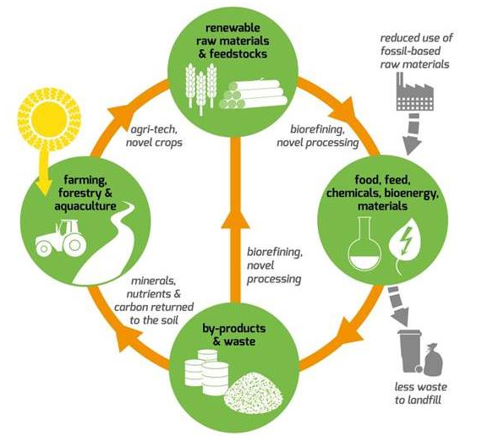
Agriculture = A plethora of biological resources
The farming industry is inextricably linked with the organic process and the circular flow of life on earth
Agricultural practices involve harnessing natural processes to produce food.
These processes create both intentional produce (fruit/vegetable) and indirect waste (orange peels/ wheat straw)
Bioeconomy = waste as an opportunity/resource.
Diagram showing circular flow of bio materials (Biovale, 2020)
Notes:
Biological resources are the base of the agriculture industry. This makes it especially important to the development of the bioeconomy.
The farming industry is inextricably linked with the organic process and the circular flow of life on earth. This means that farming has a crucial role to play in harnessing the biological resources at their disposal.
In order to create food, farming practices create both intentional produce (e.g. fruit and vegetables) and indirect waste (e.g. orange peels and wheat straw).
The central theme of the Bioeconomy requires us to look at the way we process certain products and how we can maximise the potential of the resources contained therein. Agricultural residues is one way for adding value to resources already extracted.
References:
Biovale. 2020. The Bioeconomy. https://www.biovale.org/the-bioeconomy/

Slide 10

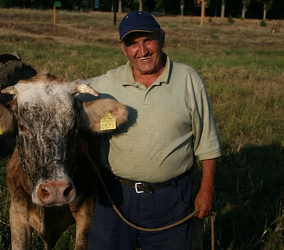
Why is the bioeconomy important for agriculture?
Increasing challenges to farmers:
Need for diversification
Growing competition
Climate change
Changing dietary habits
The bioeconomy as an opportunity to meet these challenges
Macedonian farmer (Vittuari, 2011)
Notes:
Farmers are a group of people who will feel the more immediate consequences of the rapidly changing world around us.
Agriculture depends on the weather and seasonal cycles, so the effects of climate change can have extremely negative impacts for farmers through not being able to harvest their crops as a result of too much rain or too little rain, or not being able to let their cattle outside as a result of bad weather.
Growing competition from an increasingly global world means farmers must adapt and diversify their output if they are to compete. Taking advantage of opportunities that come along with embracing the bioeconomy could be key the farmers thriving in the future.
The rise of veganism and resulting dietary changes in the coming generations will mean that farmers who have traditionally bred animals for human consumption may have to alter methods.
References:
Vittuari, M., 2011. Macedonia discovering a green economy. Osservatorio Balcani Caucaso Transeuropa [online]. https://www.balcanicaucaso.org/eng/Areas/North-Macedonia/Macedonia-discovering-a-green-economy-104620

Slide 11
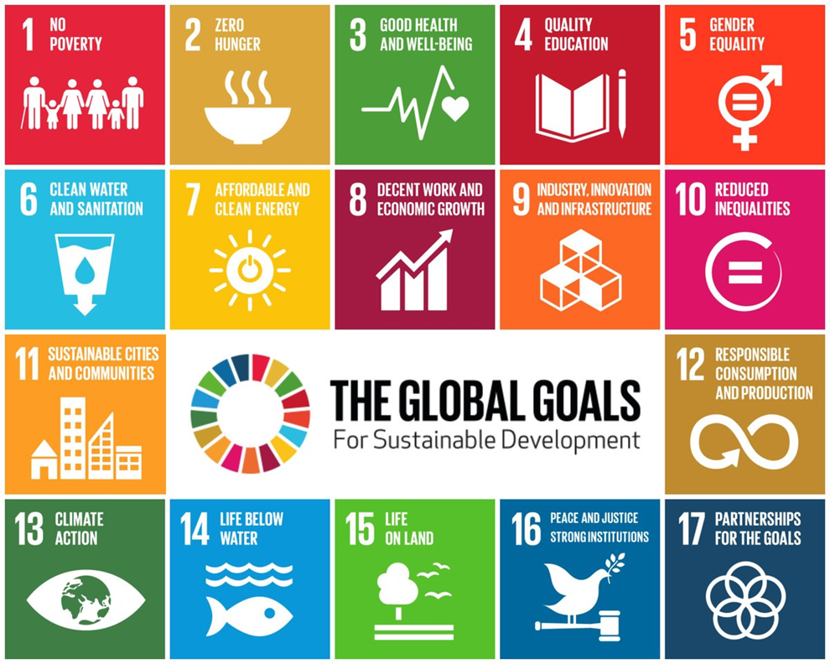
Agriculture and SDGs
SDG 1: No poverty
SDG 2: Zero hunger
SDG 6: Clean water and Sanitation
SDG 7: Affordable and clean energy
SDG 12: Responsible consumption and production
SDH 13: Climate action
SDG 15: Life on land
Source: The Founder Institute (2019)
Notes:
Given that agriculture aims to create food for humans and it has a large impact on the environment, creating more sustainable farming practices is crucial if we are to forge a more sustainable future.
Goals 1, 2, 6, 7, 12, 13, and 15 are particularly related to agriculture for the following reasons:
SDG1: End poverty
- Growth in the agriculture sector, particularly in low-income and agrarian
economies is at least twice effective in reducing hunger and poverty than from any
other sector. (Nhemachena et al, 2018)
SDG2 : Zero hunger
- Transforming food systems and agriculture are important for ensuring enough food is produced to feed the growing population through sustainable utilization of planet resources. (Nhemachena et al, 2018)
SDG6: Water
- Agriculture uses at least 70% of all water withdrawals.
- The challenge for sustainable agricultural systems is to ensure that food production is increased to feed growing population using less water in future. (Nhemachena et al, 2018)
SDG7: Energy
- Energy plays an important role in achieving food security and better nutrition. (Nhemachena et al, 2018)
SDG12: Sustainable consumption and production
- A third of the food produced each year in the world is lost or wasted
- Food production systems should be transformed to ensure sustainable production of food while reducing environmental impacts (e.g., loss of soil, water and nutrients, greenhouse gas emissions, degradation of ecosystems). (Nhemachena et al, 2018)
SDG13: Combat climate change
- Despite the threats posed by climate change on agricultural production systems, investments in the sector can support both climate change adaptation and mitigation at the same time improving the livelihoods of billions of rural people that rely on the sector. (Nhemachena et al, 2018)
SDG15: Life on land
- Degradation of resources threaten sustainability of agricultural systems, for example: a third of farmland is degraded, at least 75% of crop genetic diversity has been lost and 22% of animal breeds are at risk. (Nhemachena et al, 2018)
By supporting a more sustainable approach to agriculture and encouraging innovative solutions to problems by employing methods like those promoted through the bioeconomy, we can go a long way to helping achieve the targets set out in the SDG’s.
References:
Nhemachena, C., Matchaya, G., Nhemachena, C.R., Karuaihe, S., Muchara, B. and Nhlengethwa, S., 2018. Measuring baseline agriculture-related sustainable development goals index for southern Africa. Sustainability, 10 (3), p.849
Source of image: The Founder Institute. 2019. UN Sustainable Development Goals. [online] Available at: <https://fi.co/insight/17-companies-helping-meet-the-17-un-sustainable-development-goals> [Accessed 16 April 2020].

Slide 12
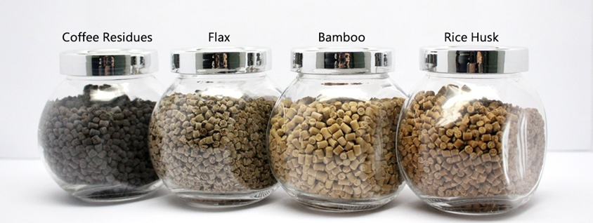
Agri-derived Bio based products
FPC™ (Fiber Particulate Composite) – a bio-composite from agricultural waste that can reduce the use of plastic
Every year, about 8 million tons of plastic waste escapes into the oceans from coastal nations (Parker, 2019).
FPC™ is made of 100% natural ingredients from agricultural by-products and can be used like a “plastic” with current plastic molding methods (eTic, 2020).
FPC™ is biodegradable and its production does not compete with food production (eTic, 2020).
FPC™ Pellets from coffee residues, flax, bamboo and rice husk (eTic, 2020)
Notes:
A slide with an example of a product that illustrate the potential for new bioproducts derived from agricultural residues.
Plastic pollution is a huge problem for our oceans, Every year, about 8 million tons of plastic waste escapes into the oceans for coastal nations. What makes this an especially troublesome issue is the fact that these oil based plastics can persist for hundreds of years before breaking down (Parker, 2019).
Bio-based plastics such the one from the Taiwanese company eTouchic Innovation Company Limited (eTic) aims to embrace agricultural by-products in order to move away from conventional oil based plastics (European Commission, 2015).
eTic combines the rice husks with a sort of biobased resin. This mixture can then be processed into a fibre composite building material (FPC™ - Fiber Particulate Composite) that has similar properties as conventional oil based plastics but is biodegradable (eTic , 2020).
FPC™ comes in pellets it can be used with current plastic moulding methods (eTic, 2020).
Such biohybrid materials are lightweight, sturdy, fire resistant and have excellent insulation characteristics, making them an attractive green building material (eTic, 2020).
FPC™ can be decomposed naturally and does not emit any greenhouse gases.
Bio-plastics such as PLA (Polylactic Acid is a polymer made from renewable resources), compete for land and water with biofuels and food crops (as the primary feedstock is currently corn). To produce 200,000 tones of bio-plastics such as PLA, requires 250,000-350,000 tonnes of crops. On the other hand, FPC™ utilizes agricultural waste and therefore its production does not compete with food production (eTic, 2020).
In the picture we can see the different materials from which the company have created FPC™. What makes this innovation particularly exciting is the array of biological materials from which it can be created.
References:
European Commission (2015). Bioeconomy in everyday life. [online] Brussells: European Commission, pp.1–44. https://www.biovale.org/wp-content/uploads/2015/11/Bioeconomy-in-everyday-life-2015.pdf
eTic (2020) What is FPC™? eTouchic Innovation Company Limited (eTic). http://www.etouchic.com/en/waste-management
Parker, L. (2019) The World's Plastic Pollution Crisis Explained. National Geographic, 7 June 2019. https://www.nationalgeographic.com/environment/habitats/plastic-pollution/

Slide 13
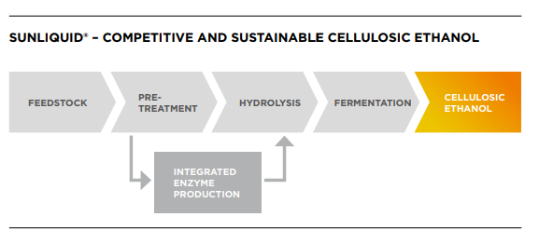
Biofuels from waste straw
Biofuels are derived from renewable resources.
Until now, mostly sugar from arable crops has been used.
To avoid competition with food production, residual materials such as straw have come to the attention of several biofuel manufacturers.
240 million tons of cereal straw are produced each year as an agricultural by-product in the EU alone (Clariant, 2020).
Diagram showing the process followed in order to create Sunliquid Biofuel (Clariant, 2020)
Notes:
The continued use of carbon based fossil fuels are one of the main drivers of human-made climate change. Alternative, less environmental harmful fuels must be invested in if we are to reach climate targets like those set out in the SDG’s. Biofuels derived from arable crops are not a new innovation but Sunliquid Biofuel differs in that it is derived exclusively from the residues of wheat straw.
The Swiss chemical company Clariant has established a biorefinery demonstration plant, in which wheat straw bioethanol is produced. With the help of enzymes, the lignocellulose is decomposed and recovered from the plant fibre into its individual components. The resulting sugar molecules serve as food for yeast and the
fungi ferment them into alcohol. This can then be added to premium petrol for petrol engines (Clariant, 2020).
For some time now, many companies have shown a growing interest in the production of ethanol from renewable lignocellulosic resources, such as agricultural residues. These resources do not compete with food and feed crops, but are created in sufficient quantities worldwide as a by-product of current agricultural practices, as in the case of straw left over from cereal production (Clariant, 2020).
About 240 million tons of cereal straw are produced each year as an agricultural by-product in the EU alone. Only a small part of this is currently utilized. Long term studies have shown that up to 60% could be taken of the field and are thus available for further uses. By processing this amount of straw, about 25% of the predicted EU demand for petrol could be replaced by cellulosic ethanol in 2020, solely out of surplus material. This means that cellulosic ethanol can play a key role along Europe´s path towards sustainable and climate-friendly road transport (Clariant, 2020).
References:
Clariant. 2020. Sunliquid. https://www.clariant.com/en/Business-Units/New-Businesses/Biotech-and-Biobased-Chemicals/Sunliquid

Slide 14


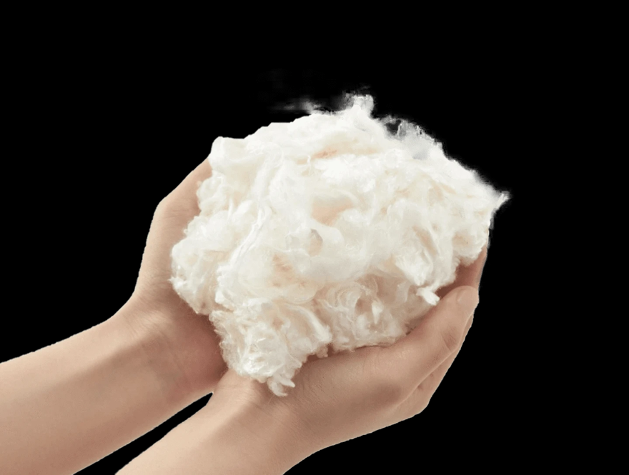
T-Shirts made with waste milk
16% of dairy products are thrown away every year (Gross, 2018).
The fashion industry is responsible for 10% of the world’s carbon emissions (McFall-Johnsen, 2019)
It takes about 700 gallons of water to produce one cotton shirt (McFall-Johnsen, 2019).
Using excess milk to make clothes reduces water, reduces carbon emissions and reduces water consumption.
Milk fiber and Mi Terro t-shirt (Mi Terro, 2020)
Notes:
1.3 billion tons of food end up in landfills, where it releases 3.3 billion tons of greenhouse gases. Amongst that, 128 million tons of milk are dumped every year globally (Mi Terro, 2020).
Los Angeles based clothing manufacturer have a team of scientists working on technology that allows them to create fibres from waste milk that are soft, comfortable and environmentally friendly (Mi Terro, 2020).
The process starts by obtaining waste milk that gets fermented and then skimmed, removing its fat content. It is subsequently dewatered, resulting in a powdered milk that gets purified to remove all substances other than a naturally-occurring protein known as casein. The powdered casein is next immersed in alkali, producing a solution that is passed through a spinneret to create fibers. Sulfuric acid is then used to remove the alkali from those fibers, which are finally stretched and spun into yarn (Mi Terro, 2020).
Given the enormous amount of milk wasted every year globally, along with the huge impact of the fashion industry on our environment, utilising waste products in such a manner is an exciting and innovative way to create value for farmers whilst at the same time helping to curb our detrimental impact on the environment.
References:
Gross, A. S., 2018. One in six pints of milk thrown away each year, study shows. The Guardian, 28 Nov 2018. https://www.theguardian.com/environment/2018/nov/28/one-in-six-pints-of-milk-thrown-away-each-year-study-shows
McFall-Johnsen, M., 2019. The fashion industry emits more carbon than international flights and maritime shipping combined. Here are the biggest ways it impacts the planet. Business Insider, 21 October 2019. https://www.businessinsider.com/fast-fashion-environmental-impact-pollution-emissions-waste-water-2019-10
Mi Terro. 2020. Mission. https://www.miterro.com/pages/mission

Slide 15

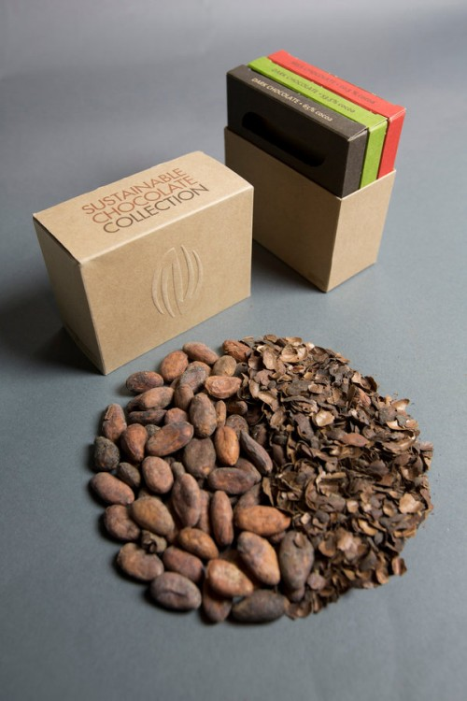
Paper from cocoa beans shells
Global warming potential (GWP) of chocolate ranges from 2.9–4.2 kg CO2 eq./kg (Konstantas et al., 2018).
According to the International Cocoa Organisation, 4.25 million tonnes of cocoa beans were produced in 2016 (The Economic Times, 2018).
For every pound of cocoa beans, farmers produce 12 times as much biomass (Wright, 2019).
Turning cocoa bean shells into paper can make use of this waste product.
James Cropper paper (Nirvana Creative Production House, 2015)
Notes:
Chocolate is a delicacy consumed with world over. According to the International Cocoa Organisation, 4.25 million tonnes of cocoa beans were produced in 2016 (The Economic Times, 2018).
For every pound of cocoa beans, farmers produce 12 times as much biomass. (Wright 2019).
British manufacturer James Cropper has been pioneering a technology that turns the shells of cocoa beans into paper. “A bio-recycling solution that, unlike other cocoa recycling processes, doesn’t necessitate burning or gradual degrading of the fibres of the cocoa shell, the finished light brown paper utilises the cocoa as a natural colourant, avoiding the need for artificial dyes.” (James Cropper plc, 2014).
“The cocoa shell represents around 12% of the fruit itself, making the production of a versatile paper from the remnants of the chocolate production process a potentially significant breakthrough for the food and packaging industries” (James Cropper pls, 2014)
Given the enormous amount of chocolate sold every year across the globe and the throwaway nature of our relationship with small wrappers, by changing using residues and creating packaging that can decompose, huge progress can be made in battling the problem of disposable plastic in nature.
It has been cited that cocoa farmers earn as little as 74p a day, well below the world’s extreme poverty line (Von Dacre, 2019). This is a problem beyond making more use of cocoa bean residues. By enabling farmers to maximise the amount of money they can earn from their plants, it is also possible to try and lift these cocoa farmers out of poverty.
References:
The Economic Times 2018. Chocolate production may be harming environment: Study. The Economic Times, 2 April 2018. https://economictimes.indiatimes.com/news/science/chocolate-production-may-be-harming-environment-study/articleshow/63577769.cms?from=mdr
James Cropper plc. 2014. Sweet innovation as cocoa waste is transformed. https://www.jamescropper.com/news/2014-01-17-sweet-innovation-as-cocoa-waste-is-transformed.
Von Dacre, J. S., 2019. How your chocolate addiction traps cocoa farmers in poverty. Inside Over, 7 November 2019. https://www.insideover.com/society/how-your-chocolate-addiction-traps-cocoa-farmers-in-poverty.html.
Nirvana Creative Production House (2015) Material of the month, June 2015: Cacao Paper. Nirvana Creative Production House, 29 May 2015. https://nirvanacph.com/2015/05/cacao-paper/
Wright, A., 2019. Scientists around the world are turning agricultural waste into food, packaging and skincare products. GreenBiz. https://www.greenbiz.com/article/scientists-around-world-are-turning-agricultural-waste-food-packaging-and-skincare-products
Konstantas, A., Jeswani, H., Stamford, L., & Azapagic, A. (2018). Environmental impacts of chocolate production and consumption in the UK. Food Research International, 106: 1012-1025.

Slide 16

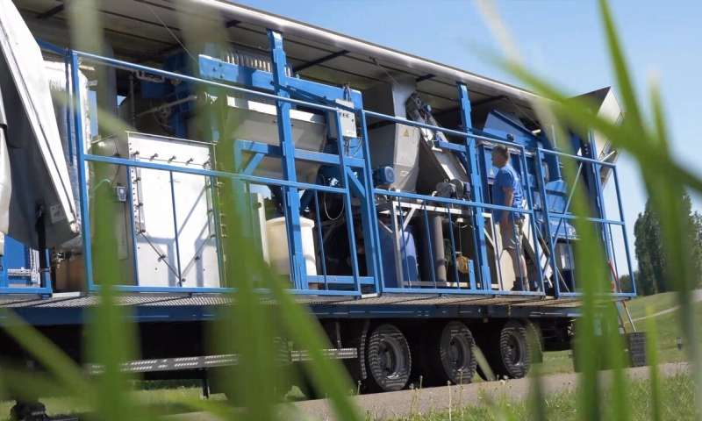
Grass Fed Mobile Biorefinery
The grass fed mobile biorefinery separates the grass into juice and fibre.
The juice can be turned into a dry protein-rich cake that can be absorbed more easily by cows.
The leftover fibre can be processed into a sustainable alternative to synthetic fertiliser or used as a more efficient supply of fuel for anaerobic digesters.
(Phys.org, 2019).
A grass fed mobile biorefinery (Phys.org, 2019).
Notes:
Known for its distinctive aerial green patchwork landscape, Ireland is more than 67% covered in grassland. This gives the country an enormous proliferation of a useful agricultural residue, grass, which is used mostly for grazing and rearing livestock.
Researchers at the University of Tralee have developed the Ireland’s first grass fed biorefinery, which aims to look at grass-based bioeconomy options in Ireland.
This mobile biorefinery separates the grass into a juice and a fibre. “The juice is turned into a dry protein-rich cake that can be absorbed easier by cows so it generates less emissions from their digestion process or from feeding them other feed, like soy beans” (Phys.org, 2019).
“The leftover fibre can be processed into a sustainable alternative to synthetic fertiliser or used as a more efficient supply of fuel for anaerobic digesters, which breaks down the biological material and turns it into natural gas” (Phys.org, 2019).
This technology hopes are to decrease emissions and make Ireland less dependent on imported protein.
References:
Finn, C. (2013) Ireland really is the garden of Europe, survey finds. TheJournal.ie, 26 October 2013. https://www.thejournal.ie/eurostat-ireland-covered-by-the-most-grasslands-in-europe-1148673-Oct2013/
Phys.org (2019) Ireland’s first grass-fed biorefinery. Phys.org, 15 May 2019. https://phys.org/news/2019-05-ireland-grass-fed-biorefinery-road-farmers.html

Slide 17
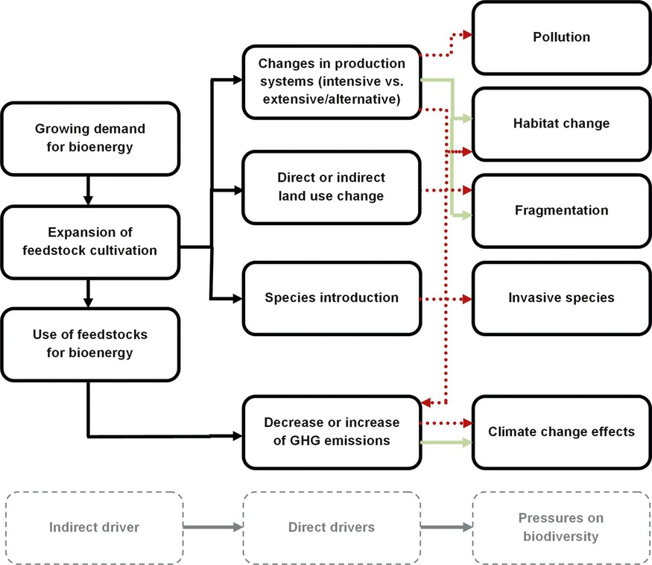
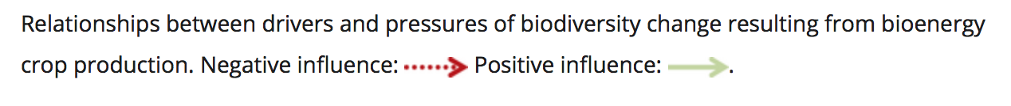
Example: The impacts of biofuels
Immerzeel et al. (2014), provide a detailed review on biodiversity impacts of bioenergy crop production. The authors point out:
importance of the initial land use - majority of negative impacts refer to the conversion of natural vegetation to first generation biofuel crops.
crops have different impacts – depends if 1st, 2nd and 3rd generation biofuels
biodiversity impacts include habitat change, fragmentation, pollution, invasive species and climate change effects (see Figure)
(Immerzeel et al., 2014)
Notes:
Very important to consider the impacts of biofuels that vary according to 1st, 2nd and 3rd generation biofuels.
Key reading:
Immerzeel, D.J., Verweij, P., Hilst, F. and Faaij, A.P. (2014), Biodiversity impacts of bioenergy crop production: a state‐of‐the‐art review. GCB Bioenergy, 6:183-209

Slide 18
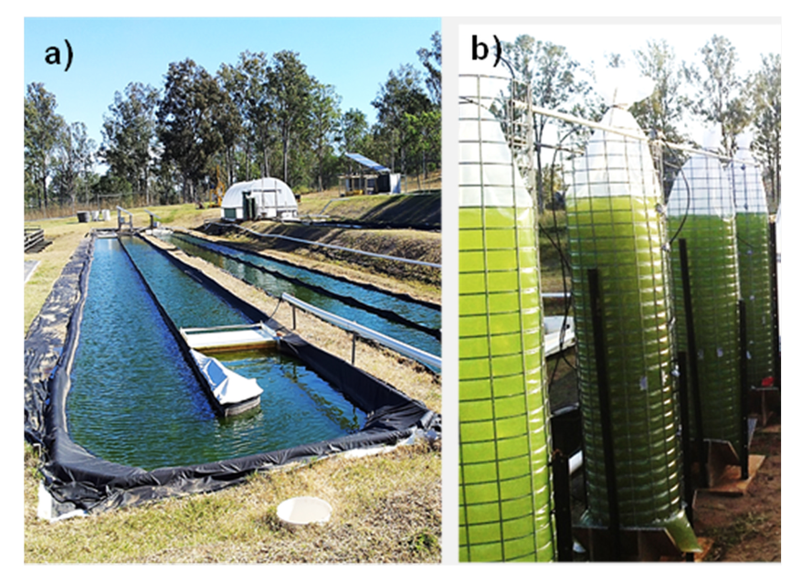
1st, 2nd and 3rd generation biofuels
Three types of biofuels (Oregan State University, n.d.):
1st generation biofuels (e.g. rape oil, sunflower oil, beet sugarcane, corn, potatoes) - main drawback: come from biomass that is also a food source.
2nd generation biofuels (e.g. agricultural and forest residues) come from non-food biomass, but still compete with food production for land use.
3rd generation biofuels (e.g. engineered crops such as algae) present the best possibility for alternative fuel because they don’t compete with food. Algae can grow in areas unsuitable for 1st and 2nd generation crops, which would relieve stress on water and arable land used. Plus it can be grown using sewage, wastewater, and saltwater.
Algae Energy Farm in Australia
(Algae Biotechnolog Laboratory, University of Queensland, Australia).
Cultivation on open ponds (a) following initial growth in sealed bags (b).
Source: Correa, et al. (2019)
Notes:
Key reading:
Correa, D., Hawthorne, B., Fargione, J., Hill, J., Possingham, H., Thomas-Hall, S. and Schenk, P. (2019). Towards the implementation of sustainable biofuel production systems. Renewable and Sustainable Energy Reviews, 107: 250-263.
Oregan State University (n.d.), Bioenergy Education Initiative. https://agsci.oregonstate.edu/sites/agsci.oregonstate.edu/files/bioenergy/generations-of-biofuels-v1.3.pdf

Slide 19
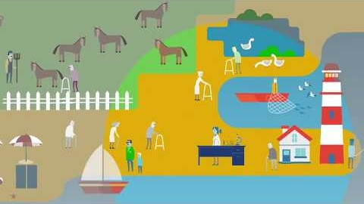
Video: bioeconomy in a rural setting
Video (2 minutes and 52 seconds): https://youtu.be/JfLNRr2lFcg?list=UUY-frt3uTqgVZW-DLjoo5bA
Languages for sub-titles for video include: Bulgarian, Latvian, Macedonian, Polish and Romanian
Notes:
This video is a great explanation of the bioeconomy in a rural setting. Explaining how focusing on bio-resources, like those found in agricultural settings, can enhance communities and lives of people who live in the areas the resources are found, but at the same time addresses environmental issues. The video could be a good way to summarise the presentation and also start a discussion.
Matís Iceland (2017), The Bioeconomy – A rural area approach. https://youtu.be/JfLNRr2lFcg?list=UUY-frt3uTqgVZW-DLjoo5bA
Languages for sub-titles for video include: Bulgarian, Latvian, Macedonian, Polish and Romanian

Slide 20
Questions and Discussion
Name of presenter
Notes:
Notes to the teacher: Speaker’s name to go in the space at the bottom left of the slide. This is the final slide of the presentation. Allow time for students/participants to ask any questions.

Slide 21



https://be-rural.eu
These educational resources were developed as part of the BE-Rural project
Bio-based strategies and roadmaps for enhanced rural and regional development in the EU (April 2019 – March 2022)
BE-Rural supports
… regional stakeholders in five countries:
Latvia: Vidzeme and Kurzeme
Poland: Szczecin and Vistula Lagoons
Romania: Covasna
Bulgaria: Stara Zagora
North Macedonia: Strumica
The goal of BE-Rural is to realise the potential of regional bio-based economies by supporting relevant actors in the participatory development of bioeconomy strategies and roadmaps
https://be-rural.eu/innovation-regions/
Notes:
BE-Rural has five innovation regions
BE-Rural will create five regional Open Innovation Platforms (OIPs) for the participatory development of bioeconomy strategies and roadmaps. The BE-Rural OIPs will be established in five regions across the EU with different biomass potentials and will be based on the regional Stakeholder Working Groups (SWGs). Within the OIPs, the main task of the SWGs will be to formulate concrete strategy or roadmap documents by engaging with different actors and opening the platform for a wide range of stakeholders in the region, including civil society organisations and citizens.
Stara Zagora, Bulgaria: This innovation region will focus on seeking new technologies for the application of essential oils and herbal plants in the cosmetics and pharmaceutical industry. The small-scale production in this area will be combined with tourism-related activities to expand the existing business status quo and potential. Ultimately, the region will establish closer relations and network between companies. Regional partner: Bulgarian Industrial Association (BIA)
Vidzeme and Kurzeme, Latvia: This region will focus on the potential of by-products of forest management (i.e. from young forest stand thinning, short rotation coppice and forestry (SRC/SRF) plantations, removing of overgrowth in abandoned agricultural lands and perennial grasses) as a source of bioenergy or biorefinery. The region will investigate the value of agroforestry systems of perennial grasses and SRC or SRF trees as grazing areas, and the production of hay or grass seeds. The potential smart use of small timber wood from young forest stand thing will be explored. Regional partner: The Latvian State Forest Research Institute (SILAVA)
Strumica, North Macedonia: The region will focus on the utilization of agricultural residues, specifically the by-production of organic materials from agricultural activities, as a source of energy for domestic and industrial purposes. The region will investigate technology options for energy conversion of biomass materials generated on agricultural fields or farms (field-based residues), as well as those generated during the processing of agricultural products (process-based residues). Regional partner: International Centre for Sustainable Development of Energy, Water and Environment Systems (SDEWES-Skopje)
Szczecin Lagoon and Vistula Lagoon, Poland: This region will focus on small-scale fisheries, specifically on the sustainable use of currently underused and low-value fish species located in two lagoons. The region will investigate small-scale technology options that can be applied to utilize low-value fish species as products for human consumption. Regional partner: The National Marine Fisheries Research Institute (NMFRI)
Covasna, Romania: The region will focus on addressing fragmented value chains and implementing the circular economy concept within the county’s industrial sectors (i.e. wood and furniture, textiles, agro-food, mechanical engineering, green energy). The region will investigate the development potential of underused biomass (plant matter and wood waste) and it implication on societal challenges (e.g., rural unemployment or marginalised communities). This will be done within a local development business model based on a small-scale technology option ensuring the autonomous energy supply for civil and industrial needs. Regional partner: Institute for Economic Forecasting (IPE)
Source: BE-Rural (2020), Innovation regions, available at: https://be-rural.eu/innovation-regions/

