Slide 1
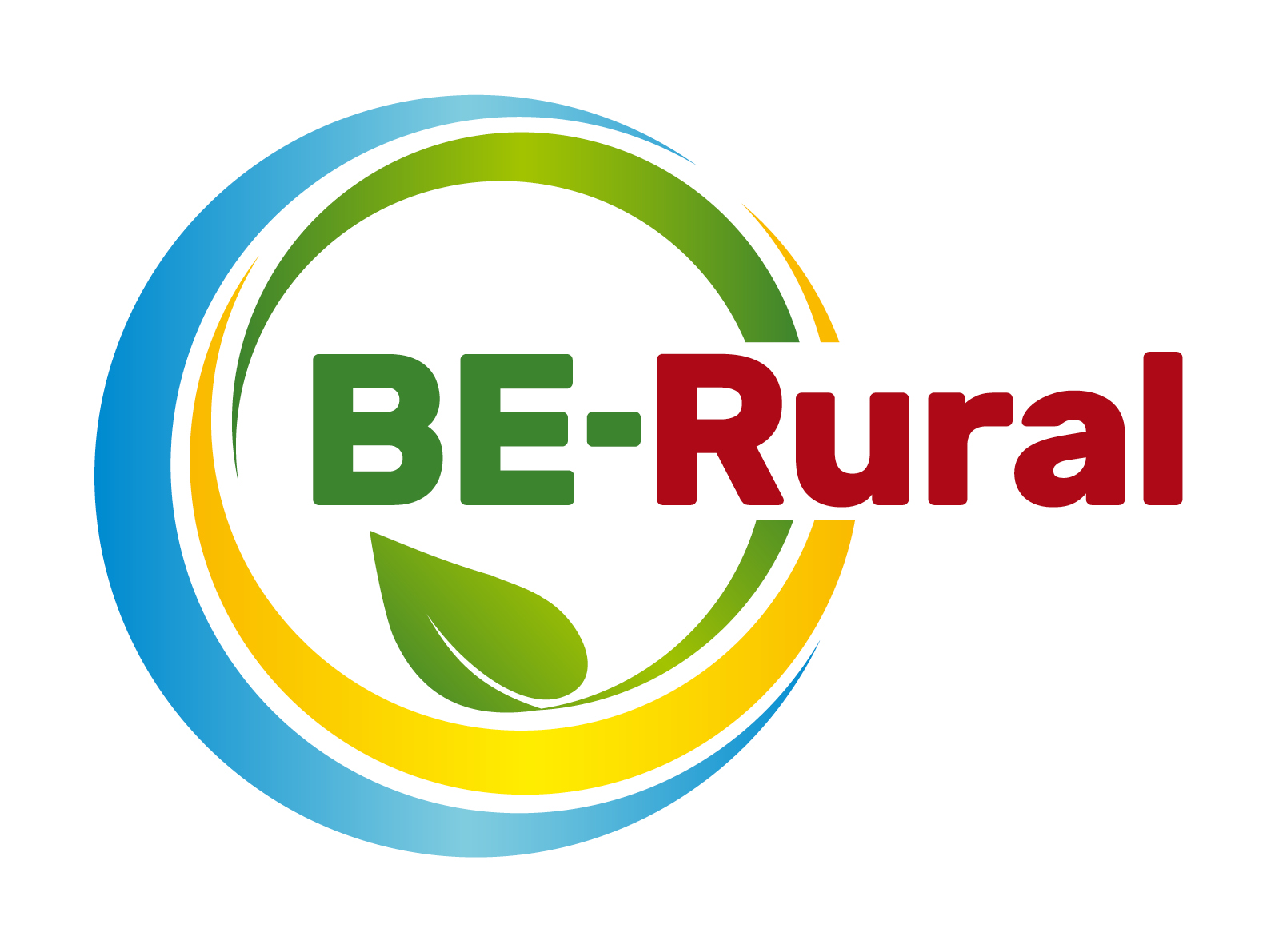
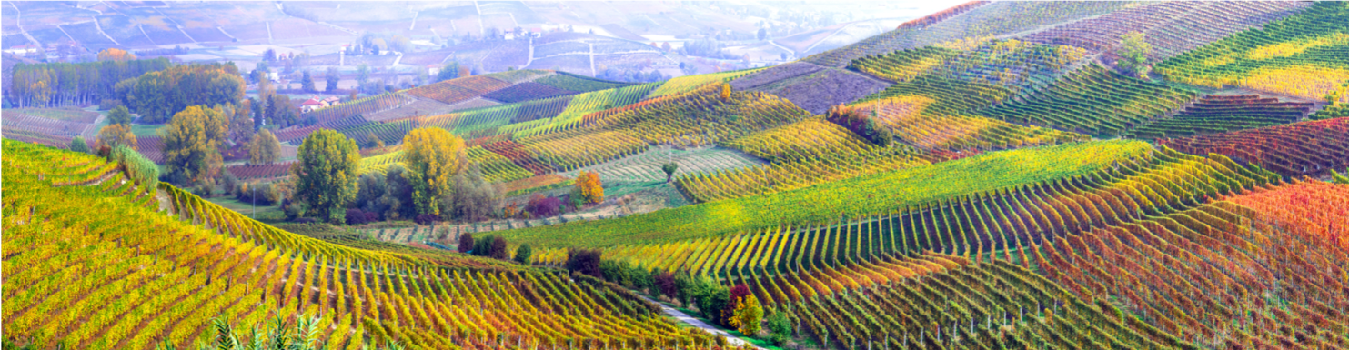
Introduction to the Sustainable Development Goals (SDGs) and their links to the bioeconomy
Name of presenter
Notes:
Notes to the teacher: Teacher’s name to go in the space at the bottom left of the slide. Explain that this presentation introduces the 17 Sustainable Development Goals (SDGs) and shows links between the bioeconomy and some of the SDGs.
Excluding the first slide, the video and the outline slide, there are 21 slides – so these slides should take between 21 and 42 minutes to present, depending of amount of explanation.
The video is 2 minutes and 8 seconds long.
Time to do the exercise on SDGs achievement around the world can vary. Information on one goal and one country can be quickly accessed in minutes. So could be used just for 5 or 10 minutes in class, but there is opportunity for in-depth research over hours or even days (which could be used as part of homework).

Slide 2
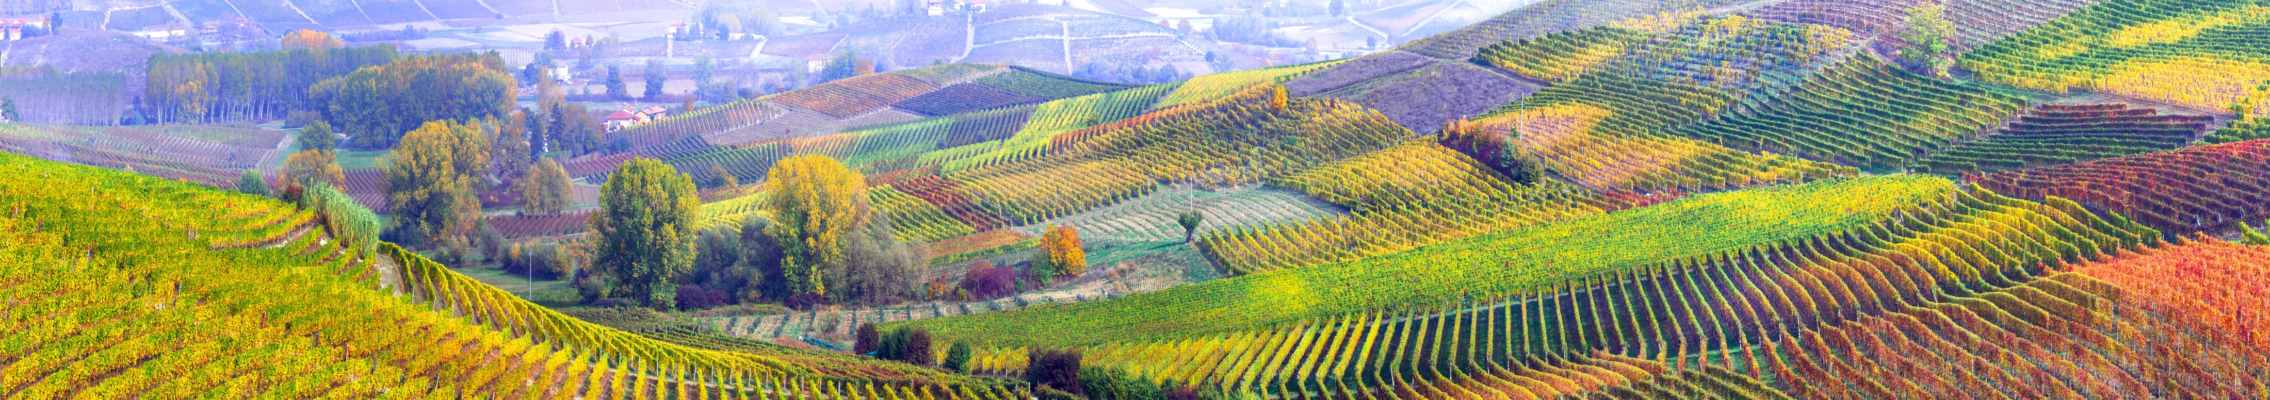
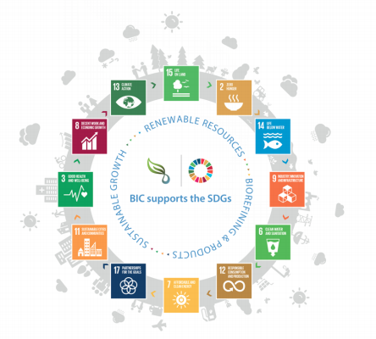
Overview
Overview
What are the Sustainable Development Goals (SDGs)?
What are the targets in each SDG?
Exercise on SDGs achievement around the world.
The links between the bioeconomy and some of the SDGs.
Notes:
Source image: Biobased Industries Consortium, 2018. Bioeconomy and the UN Sustainable Development Goals. Biobased Industries Consortium: Brussels, Belgium.

Slide 3
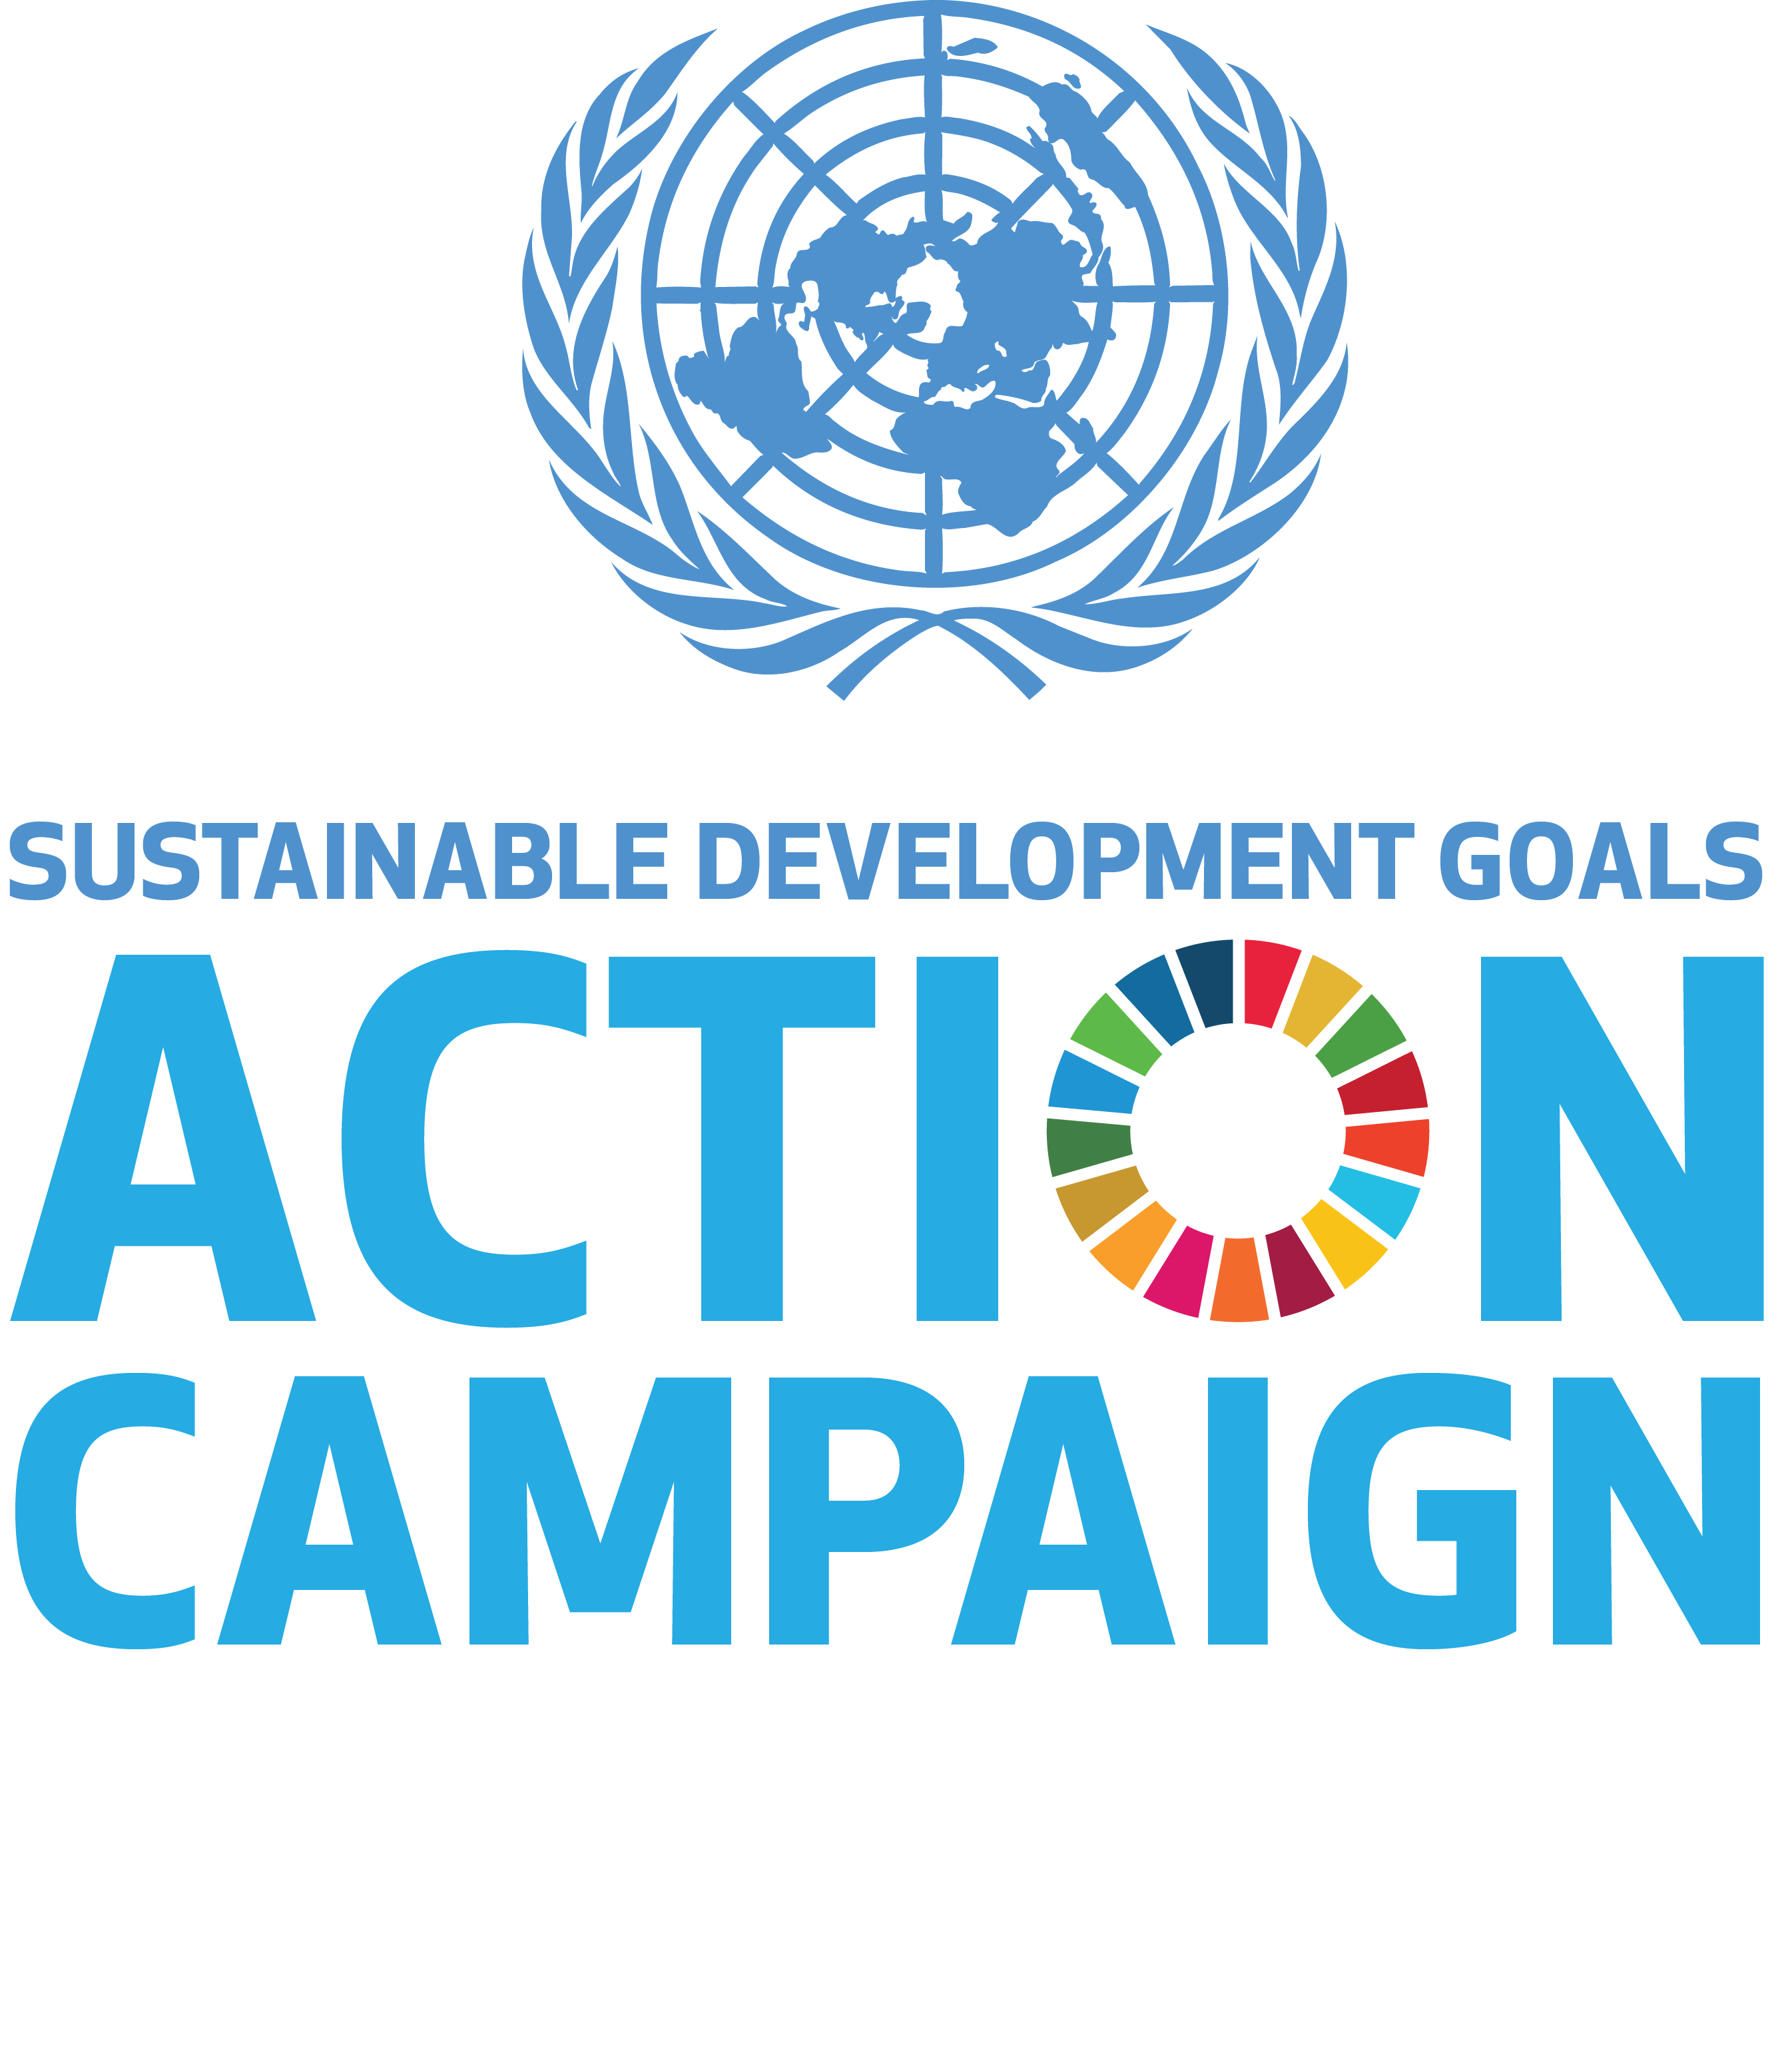
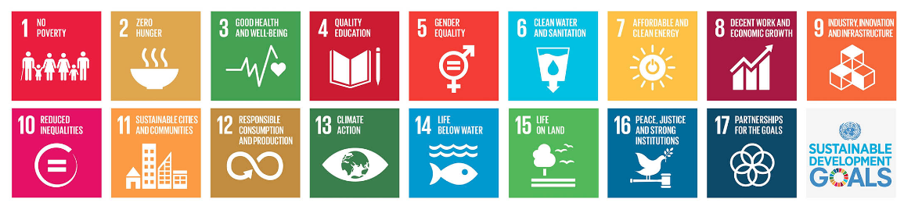
The Sustainable Development Goals (SDGs)
• In September 2015 the United Nations adopted the 17 Sustainable Development Goals (SDGs).
• The 17 SDGs contain 169 specific targets.
• Governments from 193 countries agreed to implement these goals to achieve the 2030 Agenda for Sustainable Development.
Source: https://sustainabledevelopment.un.org/?menu=1300
Notes:
This slide presents an overview of the SDGs – when they started, number of SDGs, number of targets and number of countries that agreed to implement these goals.
Source image: United Nations. (2015): Sustainable Development Goals. https://sustainabledevelopment.un.org/?menu=1300
‌

Slide 4
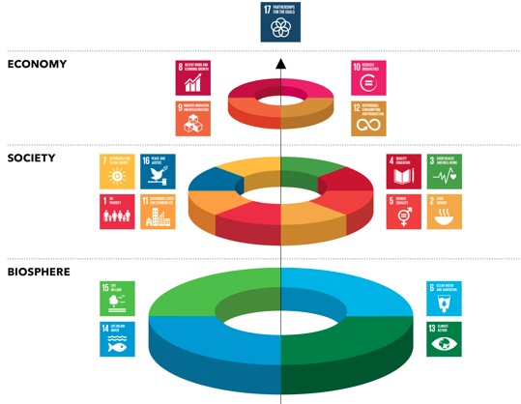
SDG ‘Wedding Cake’
A new way of viewing the economic, social and ecological aspects of the SDGs.
(proposed by Johan Rockström and Pavan Sukhdev, Stockholm Resilience Centre)
• This model implies that the economy and society are seen as embedded parts of the biosphere.
• All SDGs are directly or indirectly connected to each other.
• Goal 17 is the global partnership required for sustainable development.
Source: Azote Images for Stockholm Resilience Centre, Stockholm University
Notes:
This is a very important slide and could be discussed in class. It suggests that all SDGs are directly or indirectly connected to each other and that the SDG17 is fundamental as it is the global partnership required for sustainable development.
Very importantly, this way at looking at the SDGs implies that the economy and society are seen as integral part of the biosphere (which relates to the concept of “strong sustainability”).
This model is sometimes called the SDG ‘Wedding Cake’.
Stockholm Resilience Centre. (2016) Stockholm University: Azote Images. https://www.stockholmresilience.org/research/research-news/2017-02-28-contributions-to-agenda-2030.html
This excellent guide shows the connections between all SDGs and is a very useful education resource: Manitoba Council for International Cooperation (2018) Sustainable Foundations: A Guide for Teaching the Sustainable Development Goals, http://mcic.ca/pdf/SDG_Primer_FINAL.pdf

Slide 5
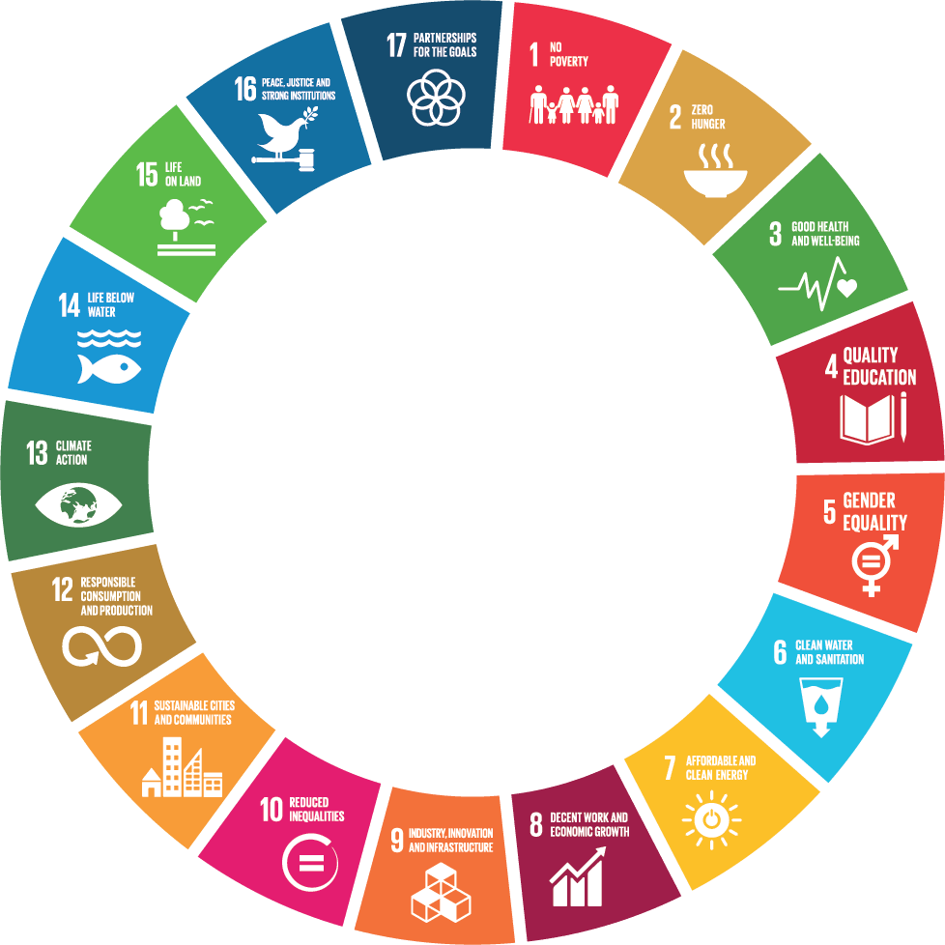
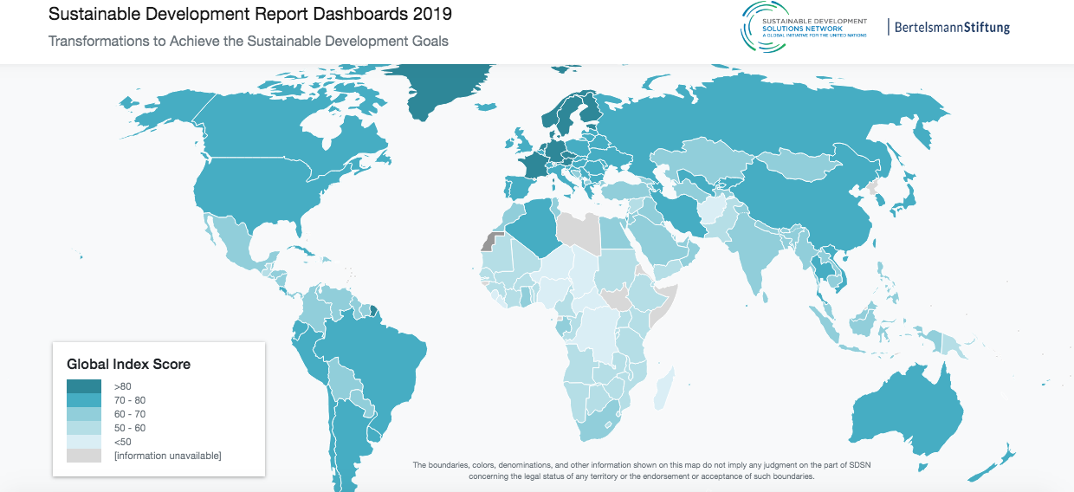
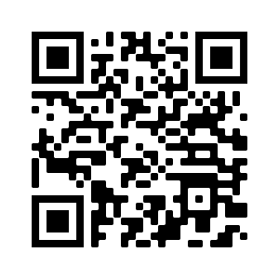
SDGs around the world
Exercise on SDGs achievement around the world
Access this web https://dashboards.sdgindex.org/#/and pick the country
that you have visited last to check their SDGs achievement (including the 169 targets).
Notes:
This amazing interactive map provides a visual representation of countries’ performance by SDGs to identify priorities for action. Students can access this resource on their phones or computers, or results for different countries can be shown on the screen.
This is the best resource to explain how each SDG is associated with different targets and to see how the different countries are performing in relation to each of the 17 SDGs and each of the 169 targets.
A Global Initiative for United Nations. (2019): Sustainable Development Report Dashboards. https://dashboards.sdgindex.org/#/
SDGs logo image source: C-CHANGE (2017) Sustainable Development Goals (SDGs). https://www.c-change.io/blogs/2017/8/3/time-for-a-new-normal-in-global-capital-markets-advancing-investment-in-the-sustainable-development-goals-sdgs

Slide 6
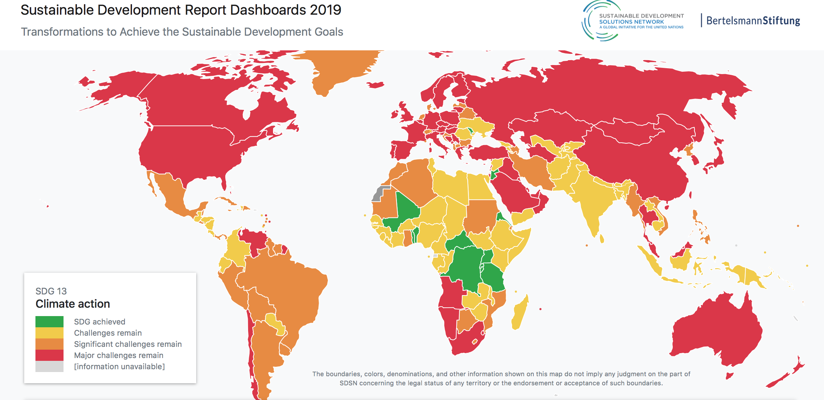
SDG 13 around the world
https://dashboards.sdgindex.org/#/
Notes:
This is an example for SDG 13 (Climate Action). The same can be done for all 17 SDGs.

Slide 7

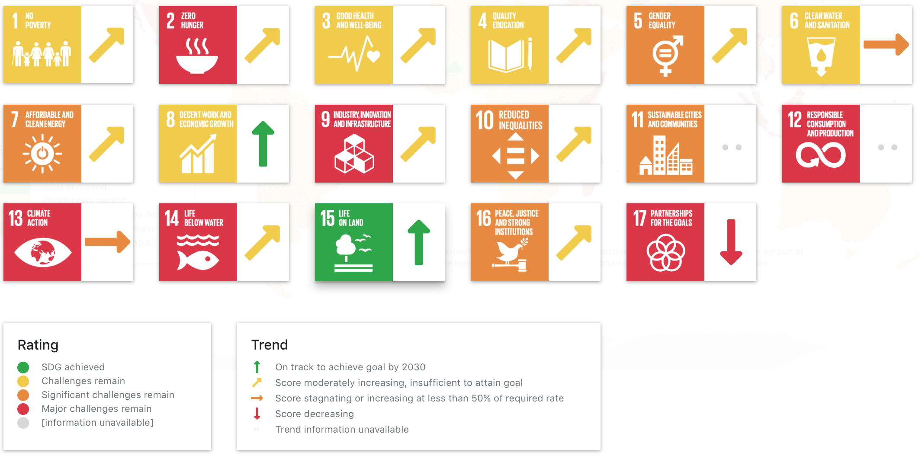

SDGs in Poland
Achievement of SDGs in Poland in 2019
https://dashboards.sdgindex.org/#/
Notes:
Then the performance for each country for each SDG can be assessed. This is an example for Poland but can be done for any country.

Slide 8
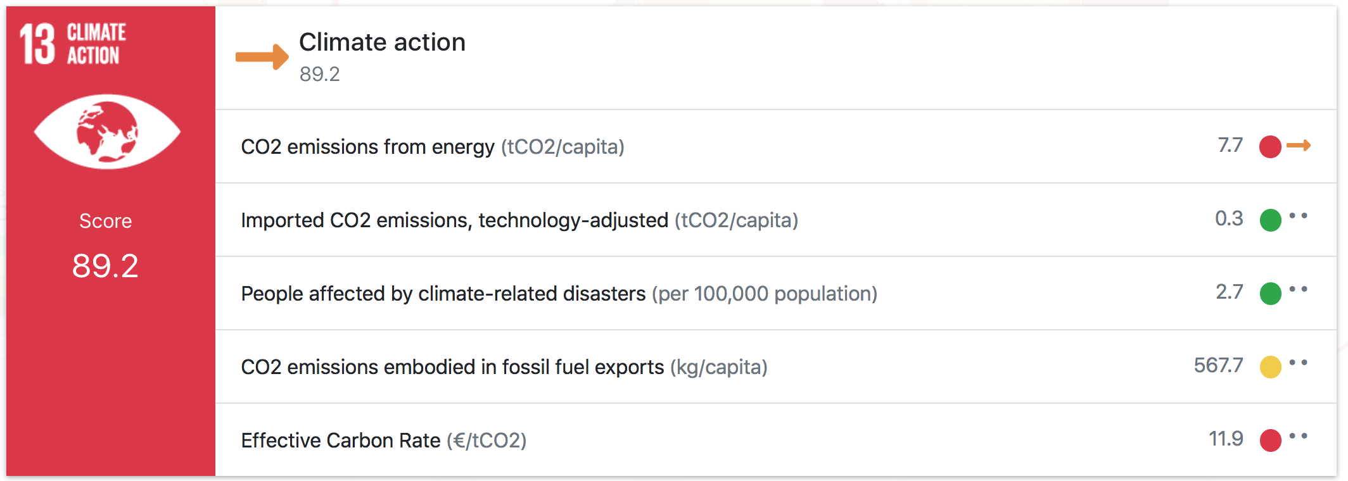
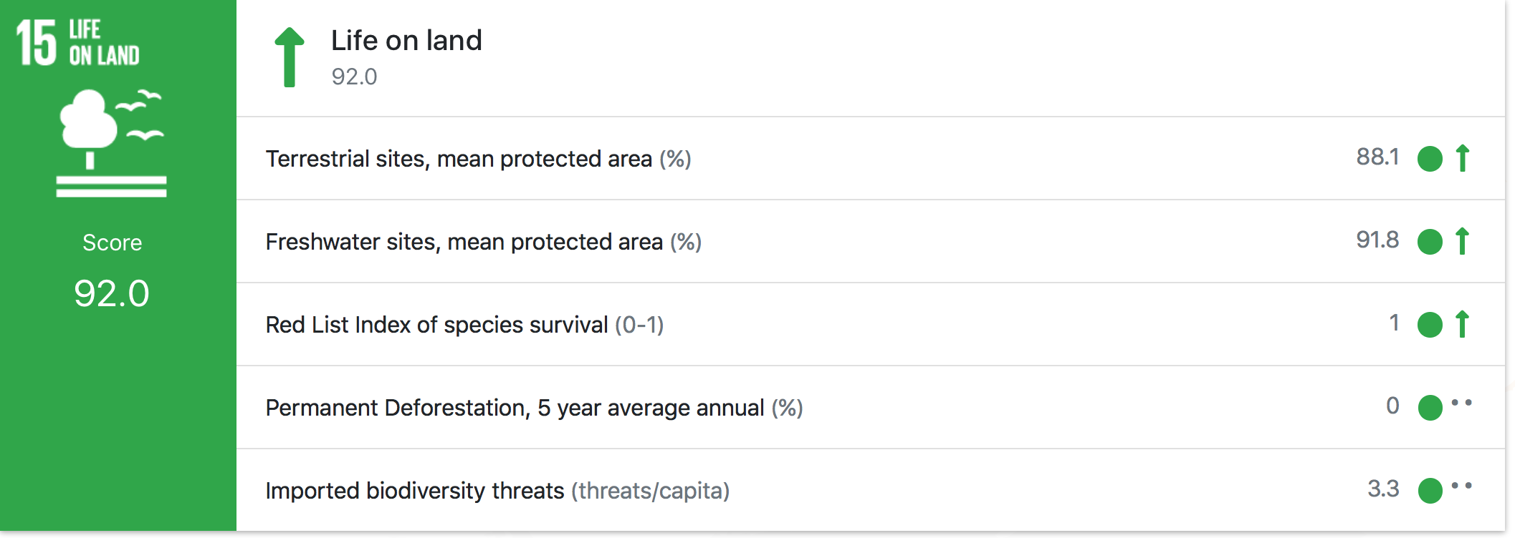
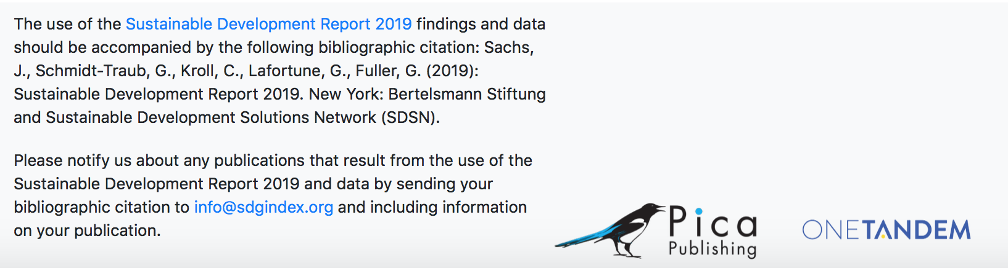
SDG 13 and SDG 15 in Poland
https://dashboards.sdgindex.org/#/
Notes:
Then the detailed performance for each SDG for each country can be assessed with regards to the achievement for all the targets for that SDG.
This is an example for Poland for SDG 13 and SDG 15 but this can be done for the combination of any country and any SDG.

Slide 9

What is the bioeconomy?
European Bioeconomy Strategy
The European Commission is taking steps towards a sustainable bioeconomy and has a bioeconomy strategy to promote the bioeconomy and to avoid reaching ecological limits.
The Bioeconomy…
Is the production of goods, services, or energy from biological material as the main resource.
Is strongly linked to sustainability as biodegradable resources are often used and waste is often completely designed out of the system.
Can avoid the depletion of resources for future generations and protect the stability of the planet.
Notes:
Notes to teacher: Explain to class that in order to take steps towards sustainability and the avoidance of reaching ecological limits the bioeconomy is very important. The bioeconomy is the production of goods, services, or energy from biological material as the main resource. This is strongly linked to sustainability as biodegradable resources are often used and waste is often completely designed out of the system. This can avoid the depletion of resources for future generations and protect the stability of the planet. The European Commission is taking steps towards a sustainable bioeconomy. Turning waste into valuable resources and creating incentives to help retailers and consumers cut food waste. The European Commission has a bioeconomy strategy to promote the bioeconomy and avoid reaching ecological limits.
European Commission (2018), A sustainable Bioeconomy for Europe: strengthening the connection between economy, society and the environment. Updated Bioeconomy Strategy. Directorate-General for Research and Innovation, available at: https://ec.europa.eu/research/bioeconomy/pdf/ec_bioeconomy_strategy_2018.pdf accessed: 22 May 2020].

Slide 10
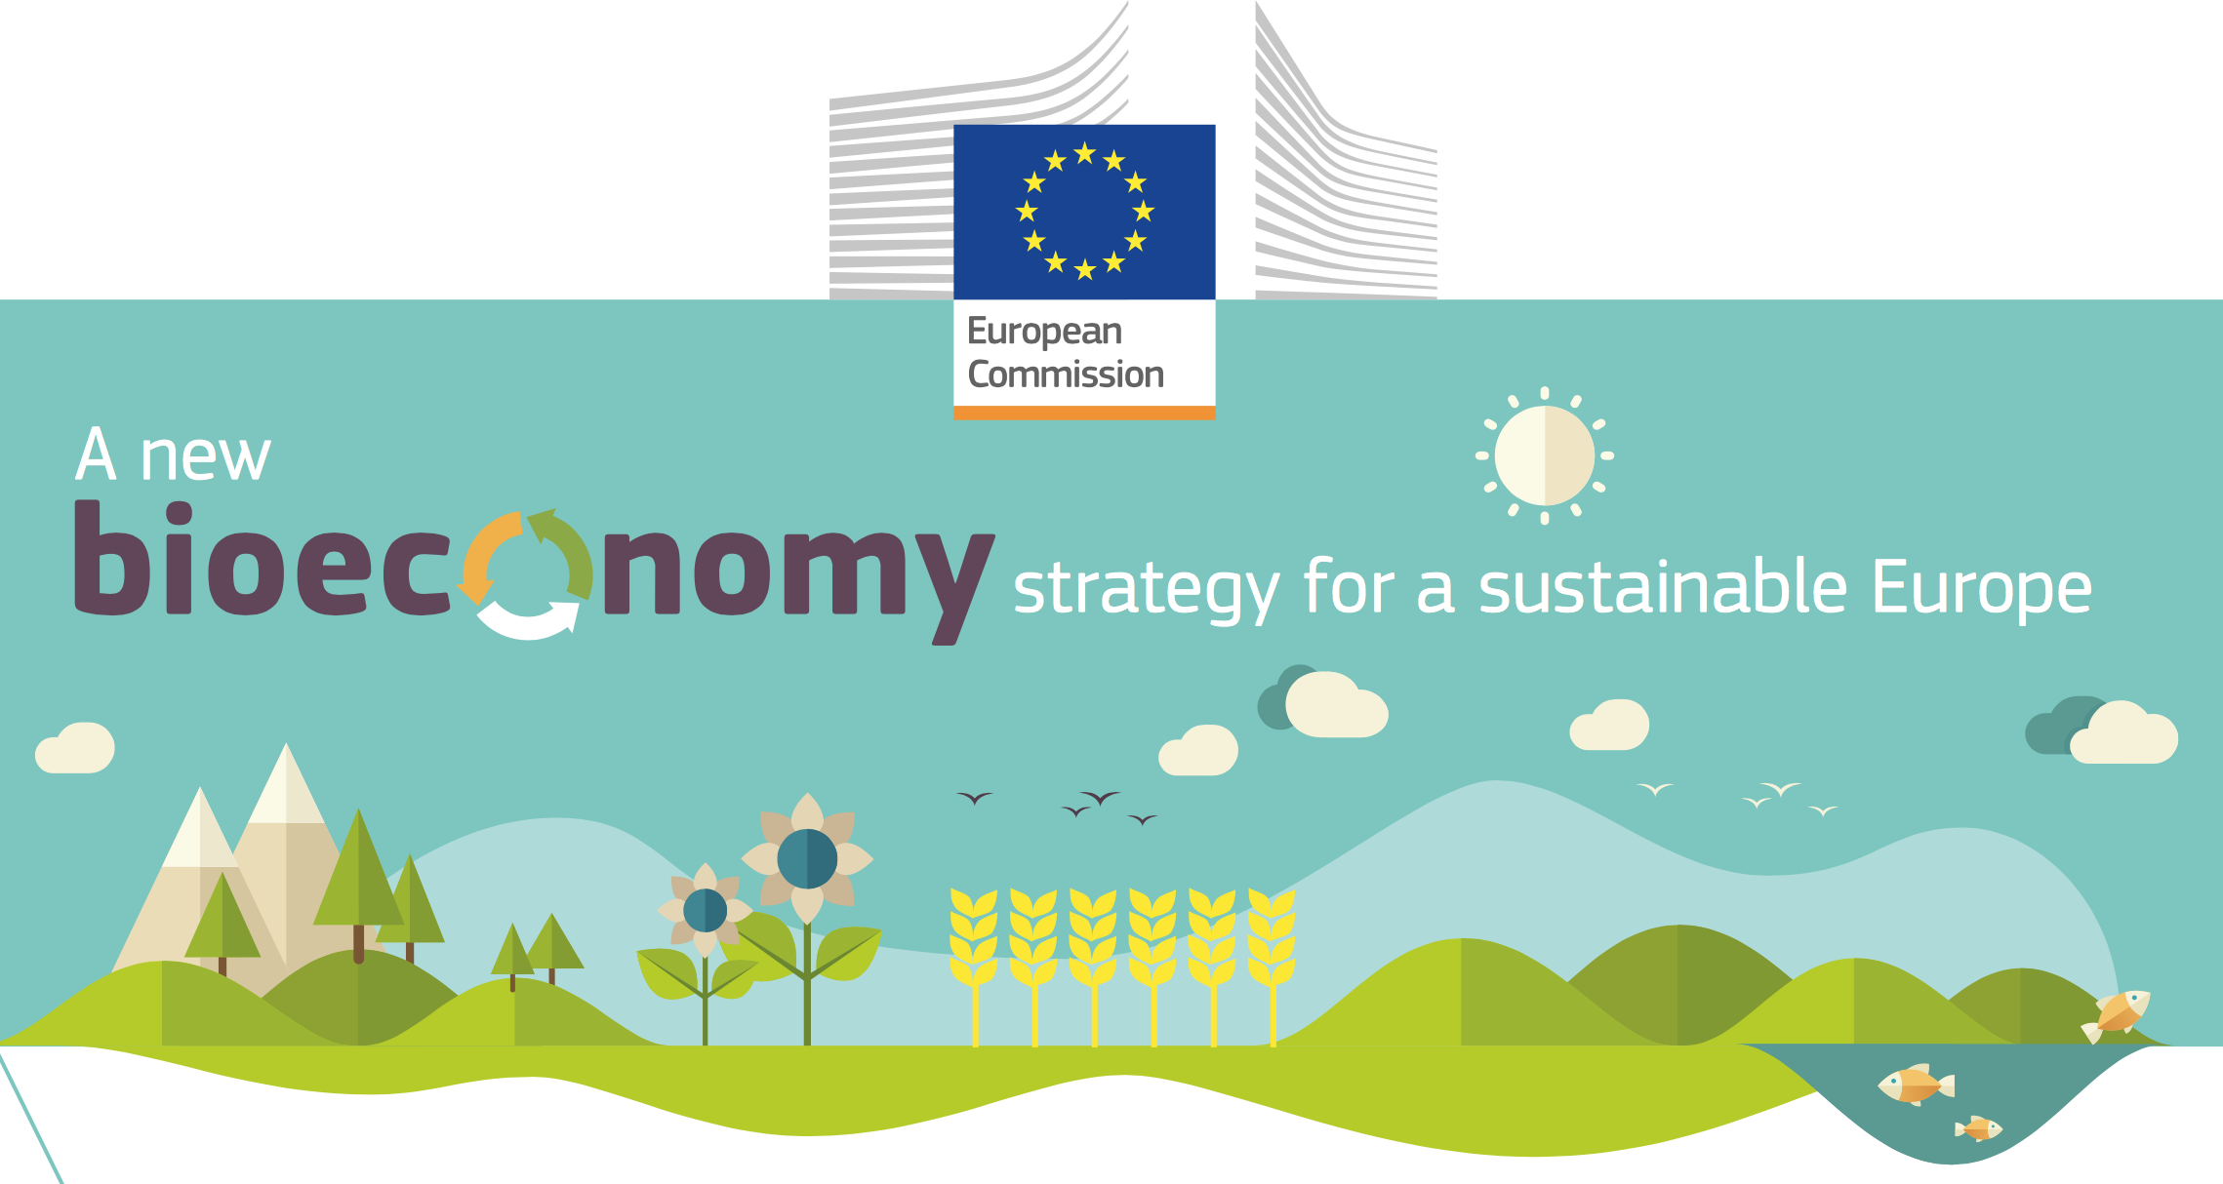
Ecological limits
In addition to links to sustainability and climate change mitigation, it is critical that the bioeconomy operates within safe ecological limits.
With the new bioeconomy strategy, the European Commission supports initiatives at national and regional level to develop an efficient and sustainable bioeconomy and this includes:
implementing an EU-wide monitoring system to track progress towards a sustainable and circular bioeconomy.
providing guidance on how best to operate the bioeconomy within safe ecological limits.
Notes:
Notes to teacher: Explain that to try and tackle the issues surrounding ecological limits: National and international bodies have specific guidelines. An example of this is the European Commission’s 2018 publication; ‘A new bioeconomy strategy for a sustainable Europe.’ Further information available at: https://ec.europa.eu/commission/news/new-bioeconomy-strategy-sustainable-europe-2018-oct-11-0_en
Key reading:
EC (2018), Bioeconomy: A new strategy for a sustainable Europe Restoring healthy ecosystems and enhancing biodiversity. European Commission https://ec.europa.eu/research/bioeconomy/pdf/ec_bioeconomy_actions_2018.pdf
Could also check for more advanced reading:
Giampietro, M. (2019). On the circular bioeconomy and decoupling: implications for sustainable growth. Ecological economics, 162, 143-156. https://www.sciencedirect.com/science/article/pii/S0921800918317178
Vivien, F. D., Nieddu, M., Befort, N., Debref, R., & Giampietro, M. (2019). The hijacking of the bioeconomy. Ecological economics, 159, 189-197. https://www.sciencedirect.com/science/article/abs/pii/S0921800918308115
See slides “What is the Bioeconomy? Opportunities, challenges and solutions” for information on:
Bioeconomy – links to SDGs and climate change, and bioeconomy resources
The transition to a bioeconomy is complex
Biodiversity assessment
Direct, indirect and cumulative impacts
What are ‘impacts and need for Environmental Impact Assessment (EIA) and/or Strategic Environmental Assessment (SEA).
Net positive outcomes, enhancement and the mitigation hierarchy
Example: the impacts of biofuels

Slide 11
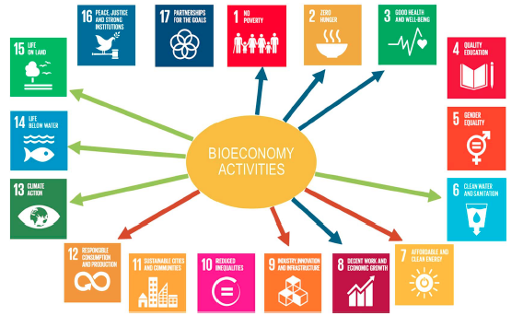
Links SDGs - Bioeconomy
Sustainable Development Goals are affected by bioeconomy activities
Some of the aims of the bioeconomy are complementary or even identical to SDG targets. A sustainable bioeconomy has the potential to advance several SDGs.
However, there can also be potential negative effects that should be eliminated or reduced. For example, “increased demand for land can lead to land grabbing, displacements, unequal distribution of land considering soil quality, and loss of communal land” (Heimann, 2019, p. 52)
Blue arrow: Socioeconomic targets.
Green arrow: Ecological targets.
Red arrow: Clean industry & economic targets.
Source: Heimann, T., 2019. Bioeconomy and SDGs: does the bioeconomy support the achievement of the SDGs?. Earth's Future, 7(1), pp.43-57.
Notes:
This slide shows links between the bioeconomy and the SDGs.
Heimann, T., 2019. Bioeconomy and SDGs: does the bioeconomy support the achievement of the SDGs?. Earth's Future, 7(1), pp.43-57.

Slide 12
Interactions among Sustainable Development Goals (SDGs)
The importance of the interactions between SDGs was emphasised in the UN’s Global Sustainable Report for 2019.
This figure is based on 65 global assessments comprising UN reports and international scientific assessments, as well as 112 scientific articles published since 2015 with explicit reference to the SDGs.
This assessment reveals relative importance of the potential trade-offs by mapping the summed scores of influencing (horizontal) and influenced (vertical) interactions among SDGs. Figure also shows important gaps in knowledge where certain cells in the matrix are left blank.
Source: Independent Group of Scientists appointed by the Secretary-General (2019), Global Sustainable Development Report 2019: The Future is Now – Science for Achieving Sustainable Development, (United Nations, New York).
https://sustainabledevelopment.un.org/content/documents/24797GSDR_report_2019.pdf
Notes:
Source: Independent Group of Scientists appointed by the Secretary-General (2019), Global Sustainable Development Report 2019: The Future is Now – Science for Achieving Sustainable Development, (United Nations, New York).
https://sustainabledevelopment.un.org/content/documents/24797GSDR_report_2019.pdf

Slide 13
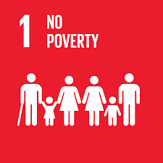
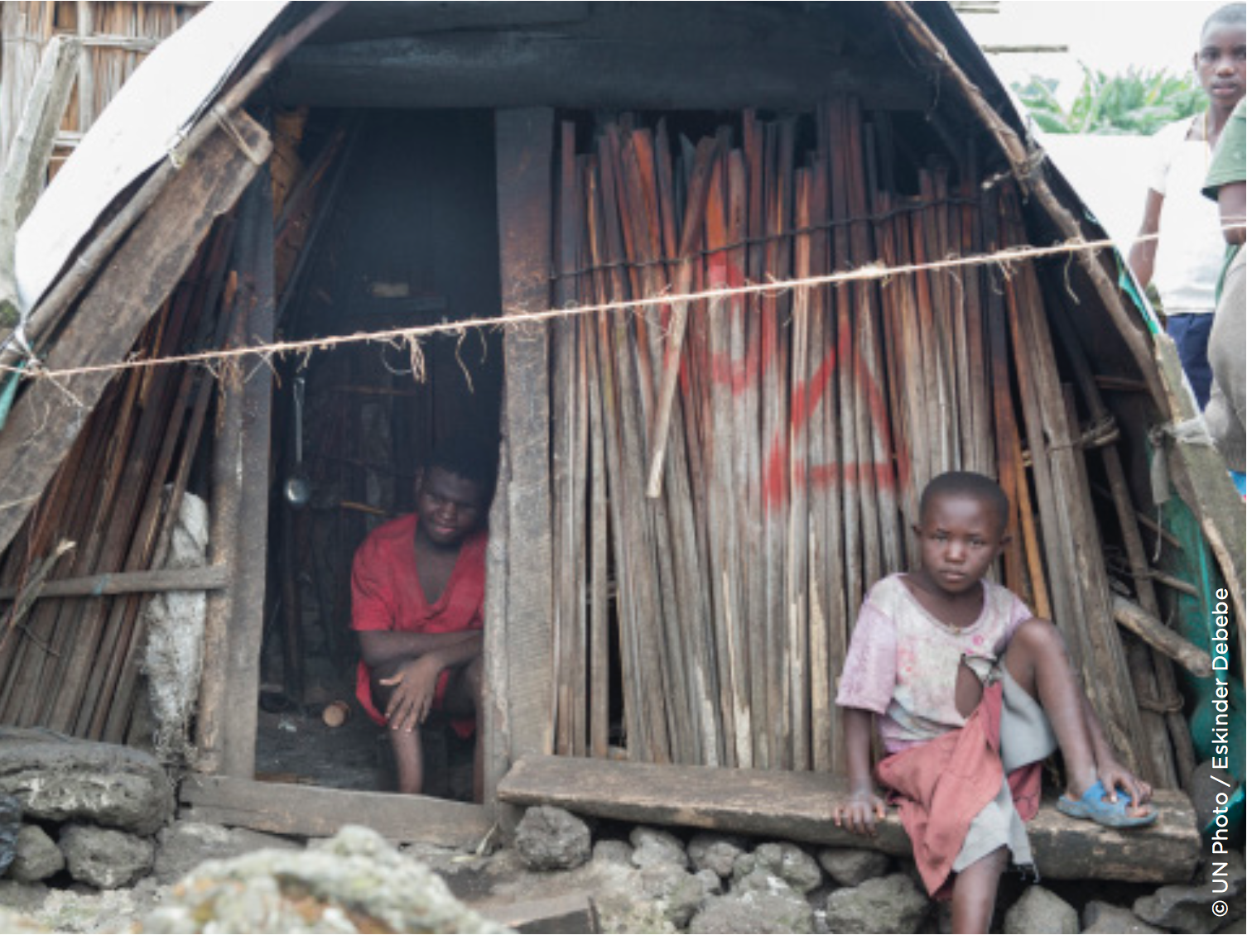
SDG 1
Goal 1: No Poverty
Aim: End poverty in all forms everywhere.
Bioeconomy can contribute to the eradication of poverty while respecting local natural resources. Bioeconomy can beimportant to the poorest people by, for example, contributing to local economic development and livelihoods by creating new local jobs in cities and rural areas.
Source of image: https://www.un.org/sustainabledevelopment/sustainable-development-goals/
Notes:
Manitoba Council for International Cooperation. (2018) Sustainable Foundations: A Guide for Teaching the Sustainable Development Goals. [http://mcic.ca/pdf/SDG_Primer_FINAL.pdf
Heimann, T., 2019. Bioeconomy and SDGs: does the bioeconomy support the achievement of the SDGs?. Earth's Future, 7(1), pp.43-57.
Source of image: https://www.un.org/sustainabledevelopment/sustainable-development-goals/

Slide 14
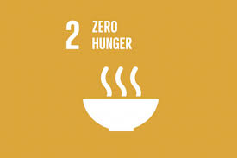
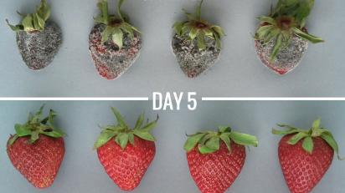
SDG 2
Goal 2: Zero Hunger
Aim: End hunger, achieve food security and improved nutrition and promote sustainable agriculture.
Bioeconomy can contribute to sustainable investments in agriculture, crops increase, utilization of undervalued resources for nutrition and improvement of food quality, indirectly contributing also to reducing food waste. For example, a spray produced using organic waste residues can make food stay fresh for longer.
https://apeelsciences.com/
Notes:
Manitoba Council for International Cooperation. (2018) Sustainable Foundations: A Guide for Teaching the Sustainable Development Goals. [http://mcic.ca/pdf/SDG_Primer_FINAL.pdf
Heimann, T., 2019. Bioeconomy and SDGs: does the bioeconomy support the achievement of the SDGs?. Earth's Future, 7(1), pp.43-57.
Source of image: https://apeelsciences.com/

Slide 15
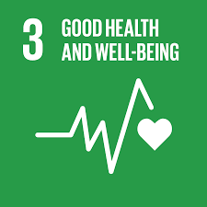

SDG 3
Goal 3: Good health and well being
Aim: Ensure healthy lives and promote well-being for all at all ages.
Bioeconomy can contribute to good health and well being by providing modern sources of probiotics and essential nutrients, and reducing air, water and soil pollution associated with hazardous fossil-based products. Plus it can integrate bioactive compounds, in food and health & cosmetic products, that may promote good health.
Source: Quimidroga S.A.
Notes:
Manitoba Council for International Cooperation. (2018) Sustainable Foundations: A Guide for Teaching the Sustainable Development Goals. [http://mcic.ca/pdf/SDG_Primer_FINAL.pdf
Heimann, T., 2019. Bioeconomy and SDGs: does the bioeconomy support the achievement of the SDGs?. Earth's Future, 7(1), pp.43-57.
Quimidroga (2019) Qd: Natural Cosmetics. https://www.quimidroga.com/en/2019/09/26/natural-cosmetics/
Manitoba Council for International Cooperation. (2018) Sustainable Foundations: A Guide for Teaching the Sustainable Development Goals. http://mcic.ca/pdf/SDG_Primer_FINAL.pdf

Slide 16
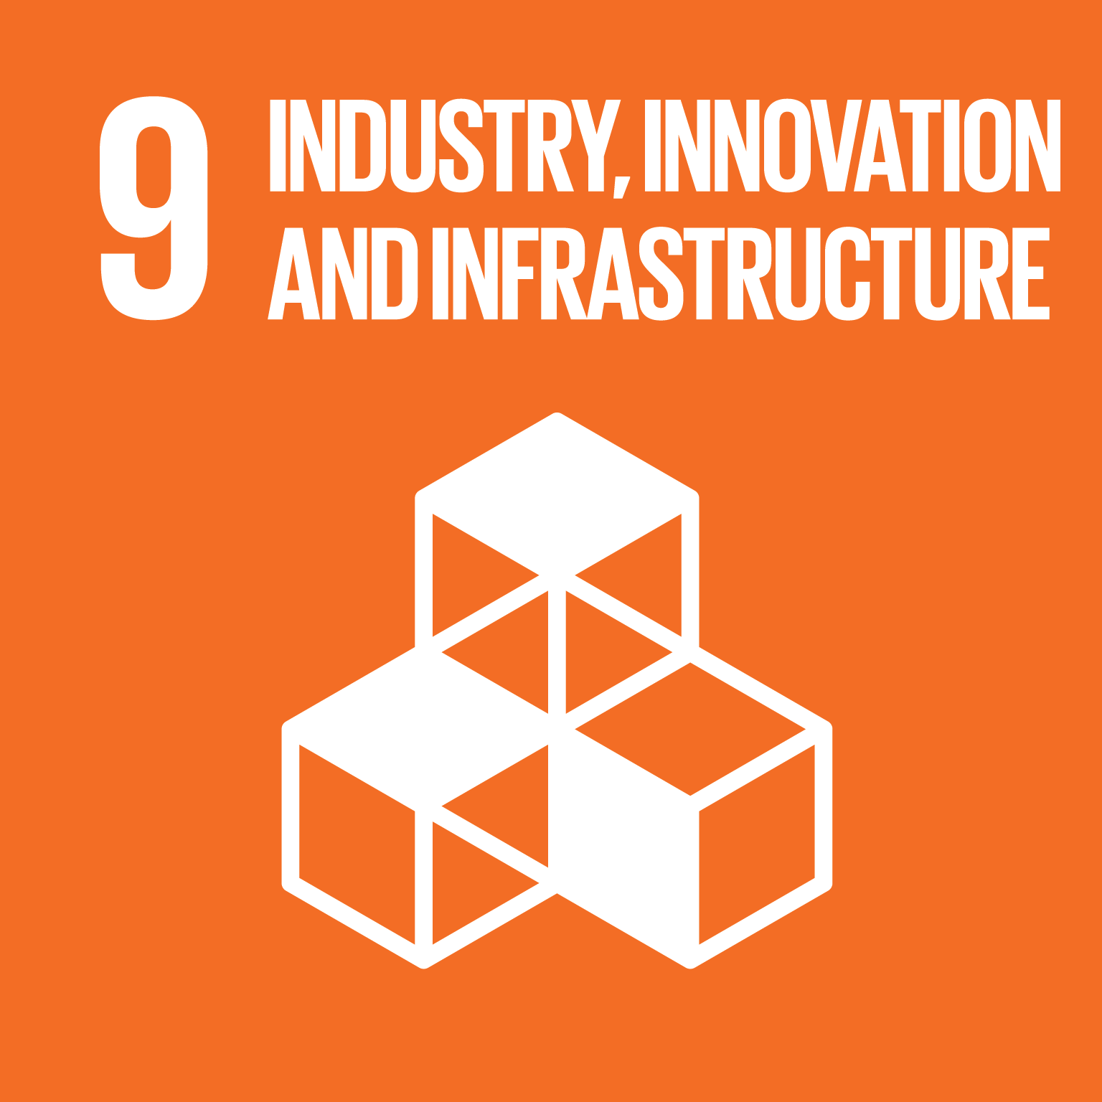
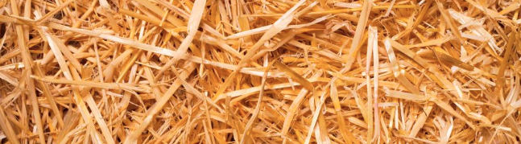
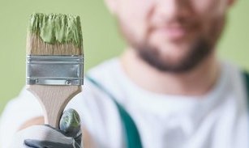
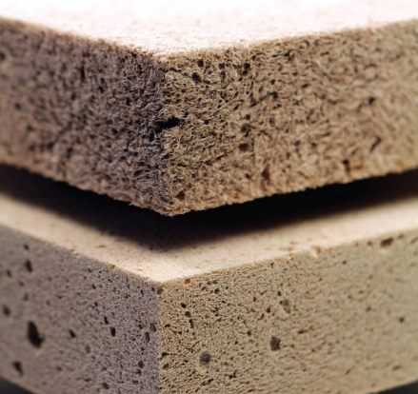
SDG 9
Goal 9: Industries, Innovation and Infrastructure
Source: Novasep: cellulosic sugars
Aim: Build resilient infrastructure, promote inclusive and sustainable
industrialization and foster innovation.
Bioeconomy is important for this SDG as stimulates the growth of bio-based industry and innovation. For example, low-value solid wood waste can be converted into high purity intermediate building blocks of cellulosic sugars. These wood-based materials can be used to replace fossil-based materials in everyday applications, e.g., biofuels, coatings and bio-based foams.
Source: photografee.eu - stock.adobe.com
Source: wood foam interior
Notes:
Manitoba Council for International Cooperation. (2018) Sustainable Foundations: A Guide for Teaching the Sustainable Development Goals. [http://mcic.ca/pdf/SDG_Primer_FINAL.pdf
Heimann, T., 2019. Bioeconomy and SDGs: does the bioeconomy support the achievement of the SDGs?. Earth's Future, 7(1), pp.43-57.
European Coatings. (2020): EC Survey: Bio-based coatings.[Online] Available from: https://www.european-coatings.com/Raw-materials-technologies/Raw-materials/EC-Survey-Bio-based-coatings
Novasep: services and technologies for life science and chemical industries. (2018): Purification processes for cellulosic sugars.[Online] Available from: https://www.novasep.com/home/products-services/fermentation-products-and-chemicals-intermediates/industrial-processes/purification-processes-for-cellulosic-sugars.html
Wood-based panels international. (2018) wbpi: Wood foam – a product on the rise?.[Online] Available from: http://www.wbpionline.com/features/wood-foam-a-product-on-the-rise-6097690/
Bio-based Industries Consortium (2018), Bioeconomy and the UN Sustainable Development Goals. A view from the Bio-based Industries Consortium – July 2018.

Slide 17
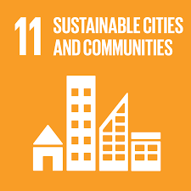

SDG 11
Goal 11: Sustainable cities and communities
Aim: Making cities and human settlements inclusive, safe,
resilient and sustainable.
Bioeconomy can link rural and urban areas through bio-based products and bioenergy. It can contribute to sustainable cities and communities by using bio-based materials in new sustainable buildings. For example, the use of new filtration systems such as moss plantation. The surfaces of moss can remove dust, carbon dioxide and ozone from the air.
Source: Chris Giles, CNN
https://edition.cnn.com/style/article/citytree-urban-pollution/index.html
Notes:
Manitoba Council for International Cooperation. (2018) Sustainable Foundations: A Guide for Teaching the Sustainable Development Goals. [http://mcic.ca/pdf/SDG_Primer_FINAL.pdf
Heimann, T., 2019. Bioeconomy and SDGs: does the bioeconomy support the achievement of the SDGs?. Earth's Future, 7(1), pp.43-57.
Chris Giles (2017) Edition.CNN: This 'tree' has the environmental benefits of a forest. [Online] Available from: https://edition.cnn.com/style/article/citytree-urban-pollution/index.html

Slide 18
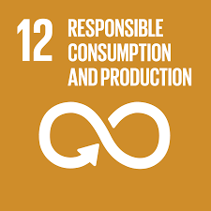
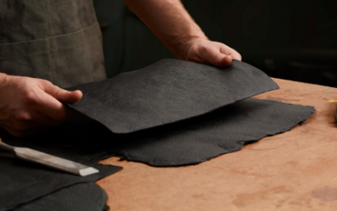
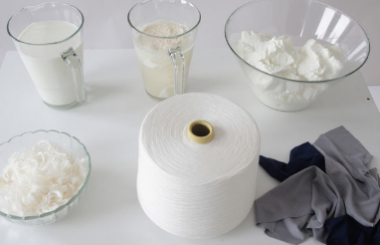
SDG 12
Goal 12: Responsible consumption and production
Source: Gearpatrol.com by Bolt Threads
Aim: Ensure sustainable consumption and production patterns.
Bioeconomy can contribute to responsible consumption and production by decoupling production and consumption from use of fossil-based products. And instead using renewable resources and residues from everyday products to produce new products for a variety of sectors such as clothing, fashion and furniture. For example, leather made of mushrooms or a fabric made from waste milk.
Source: Anke Domaske, Milk fabric
Notes:
Manitoba Council for International Cooperation. (2018) Sustainable Foundations: A Guide for Teaching the Sustainable Development Goals. [http://mcic.ca/pdf/SDG_Primer_FINAL.pdf
Heimann, T., 2019. Bioeconomy and SDGs: does the bioeconomy support the achievement of the SDGs?. Earth's Future, 7(1), pp.43-57.
Anke Domaske. (2011)LS: N global: MILK MADE: DAIRY DRESS IS A NATURAL WINNER.[Online] Available from: https://www.lsnglobal.com/news/article/4921/milk-made-dairy-dress-is-a-natural-winner
Tucker Bowe. (2018)Gear patrol: In the Future, Leather Will Be Made From Mushrooms Not Cows.[Online] Available from: https://gearpatrol.com/2018/04/16/bolt-threads-mylo-leather/

Slide 19
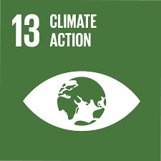
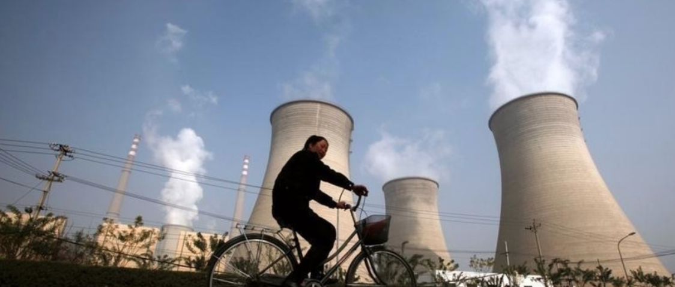
SDG 13
Goal 13: Climate action
Aim: Take urgent action to combat climate change and its impact.
Bioeconomy can replace fossil resources with renewable resources and using CO₂ as a feedstock and low-carbon production. For examples, the use of CO₂ as a feedstock to make key products such as building materials, chemicals and fuels. Billions of tons of CO₂ can be removed from the atmosphere every year and turned into commercially successful products.
Source: The World Economic Forum by REUTERS/David Gray
Notes:
Manitoba Council for International Cooperation. (2018) Sustainable Foundations: A Guide for Teaching the Sustainable Development Goals. [http://mcic.ca/pdf/SDG_Primer_FINAL.pdf
Heimann, T., 2019. Bioeconomy and SDGs: does the bioeconomy support the achievement of the SDGs?. Earth's Future, 7(1), pp.43-57.
A Global Initiative for United Nations. (2019): Sustainable Development Report Dashboards 2019.[Online] Available from: https://dashboards.sdgindex.org/#/
The World Economic Forum. (2019): CO2 can be a valuable raw material, not just a climate killer. Here’s how.: https://www.weforum.org/agenda/2019/01/turning-co2-from-climate-destroyer-into-useful-raw-material

Slide 20
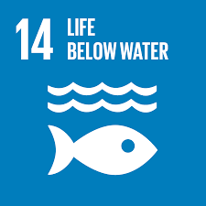
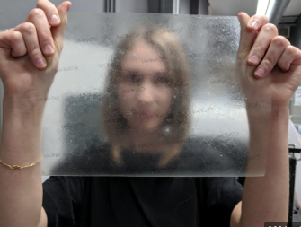
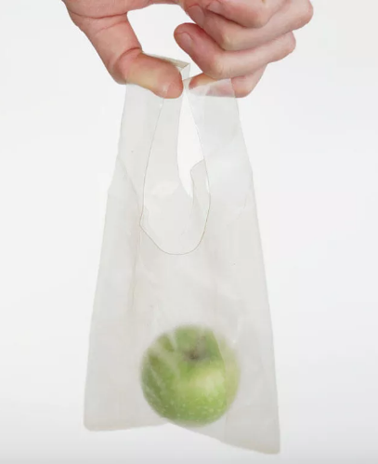
SDG 14
Goal 14: Life below water
Aim: Conserve and sustainably use the oceans, seas and marine resources for sustainable development.
Bioeconomy (or Blue bioeconomy) can make better use of the marine fauna (fish) and flora (algae) for high value bio- products such as food/feed, cosmetics and bio-pharma. For example, can use fish, shellfish and seaweed residues to develop alternatives to fossil-based plastics. This way it can convert a waste stream into new plastic-like products, that are strong, organic, biodegradable and do not harm the environment.
Source: REUTERS/Stuart McDill
Source: James Dyson Award
Notes:
Manitoba Council for International Cooperation. (2018) Sustainable Foundations: A Guide for Teaching the Sustainable Development Goals. [http://mcic.ca/pdf/SDG_Primer_FINAL.pdf
Heimann, T., 2019. Bioeconomy and SDGs: does the bioeconomy support the achievement of the SDGs?. Earth's Future, 7(1), pp.43-57.
Stuart McDill. (2019) Reuters: Tipping the scales? Briton develops fish waste 'plastic'. https://www.reuters.com/article/us-britain-dyson-award/tipping-the-scales-briton-develops-fish-waste-plastic-idUSKBN1XO007
The James Dyson Award. (2019) MarinaTex: INTERNATIONAL WINNER. [Online] Available from: https://www.jamesdysonaward.org/2019/project/marinatex/
Bio-based Industries Consortium (2018), Bioeconomy and the UN Sustainable Development Goals. A view from the Bio-based Industries Consortium – July 2018.

Slide 21
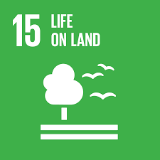
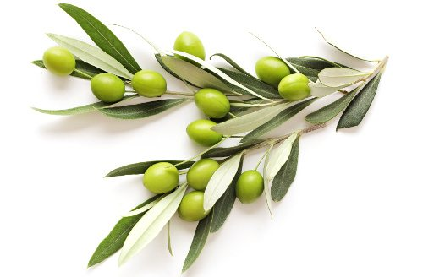
SDG 15
Goal 15: Life on land
Aim: Sustainably management forests, combat desertification, halt and reverse land degradation, halt biodiversity loss.
Bioeconomy promotes the value of biodiversity as a bioeconomy asset. It sees plants as a highly valuable resource for biomass, including biofuels. Sustainability, biodiversity and soil conservation are enabled by using natural resources sustainably according to the specific local conditions, preventing overexploitation and land degradation, and avoiding scarce resources. For example, olive leaves can be natural and environmentally friendly alternative tanning agents.
Notes:
Manitoba Council for International Cooperation. (2018) Sustainable Foundations: A Guide for Teaching the Sustainable Development Goals. [http://mcic.ca/pdf/SDG_Primer_FINAL.pdf
Heimann, T., 2019. Bioeconomy and SDGs: does the bioeconomy support the achievement of the SDGs?. Earth's Future, 7(1), pp.43-57.
Biobased Industries Consortium, 2018. Bioeconomy and the UN Sustainable Development Goals. Biobased Industries Consortium: Brussels, Belgium.
United Nations. (2015): Sustainable Development Goals. [Online] Available from: https://sustainabledevelopment.un.org/?menu=1300
Source of image: https://www.herbal-supplement-resource.com/wp-content/uploads/2019/07/OliveLeaves2.jpeg

Slide 22
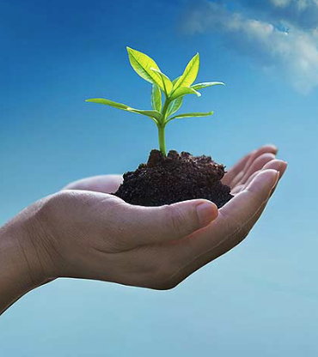
Monitoring the Bioeconomy
The importance of monitoring and counteracting any negative effects of the bioeconomy.
The bioeconomy is only advantageous if potential negative effects are monitored and counteracted. Novel bio-based products can have a positive impact, but they are no miracle solution to all sustainability challenges. They can only contribute to a sustainability transformation along with consumption decreases and extension of product life.
Source of image: http://www.eutimes.eu/tag/environmental-protection/
Notes:
It is important to emphasise that bioeconomy can only contribute to a sustainability transformation along with consumption decreases and extension of product life. This could be a good discussion topic with the students.

Slide 23
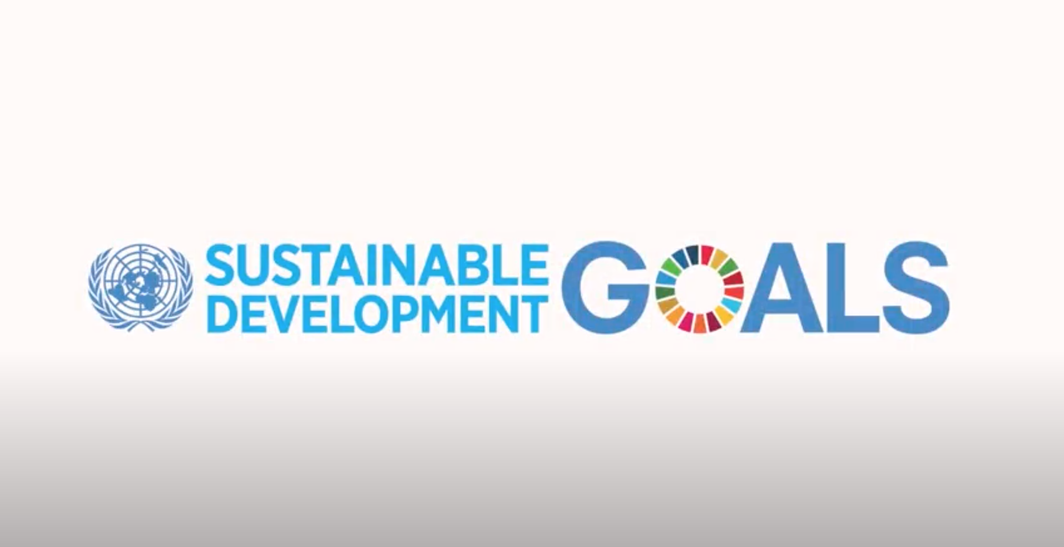
Video on the SDGs
Video (2 minutes and 8 seconds): https://www.youtube.com/watch?v=3WODX8fyRHA
Languages for sub-titles for video include: Bulgarian, Latvian, Macedonian, Polish and Romanian
Notes:
Interesting United Nations video is about sustainable development, SDGs, and strategies, methods and advances related to the same. Video is really well made and fulfils its purpose to educate people and inform them about sustainable development, why sustainable development is necessary, and reasons and advantages of setting SDGs. It can work well as a summary of the material covered.

Slide 24
Questions and Discussion
Name of presenter
Notes:
Notes to the teacher: Speaker’s name to go in the space at the bottom left of the slide. This is the final slide of the presentation. Allow time for students/participants to ask any questions.

Slide 25

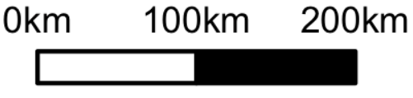
https://be-rural.eu
These educational resources were developed as part of the BE-Rural project
Bio-based strategies and roadmaps for enhanced rural and regional development in the EU (April 2019 – March 2022)
BE-Rural supports
… regional stakeholders in five countries:
Latvia: Vidzeme and Kurzeme
Poland: Szczecin and Vistula Lagoons
Romania: Covasna
Bulgaria: Stara Zagora
North Macedonia: Strumica
The goal of BE-Rural is to realise the potential of regional bio-based economies by supporting relevant actors in the participatory development of bioeconomy strategies and roadmaps
https://be-rural.eu/innovation-regions/
Notes:
BE-Rural has five innovation regions
BE-Rural will create five regional Open Innovation Platforms (OIPs) for the participatory development of bioeconomy strategies and roadmaps. The BE-Rural OIPs will be established in five regions across the EU with different biomass potentials and will be based on the regional Stakeholder Working Groups (SWGs). Within the OIPs, the main task of the SWGs will be to formulate concrete strategy or roadmap documents by engaging with different actors and opening the platform for a wide range of stakeholders in the region, including civil society organisations and citizens.
Stara Zagora, Bulgaria: This innovation region will focus on seeking new technologies for the application of essential oils and herbal plants in the cosmetics and pharmaceutical industry. The small-scale production in this area will be combined with tourism-related activities to expand the existing business status quo and potential. Ultimately, the region will establish closer relations and network between companies. Regional partner: Bulgarian Industrial Association (BIA)
Vidzeme and Kurzeme, Latvia: This region will focus on the potential of by-products of forest management (i.e. from young forest stand thinning, short rotation coppice and forestry (SRC/SRF) plantations, removing of overgrowth in abandoned agricultural lands and perennial grasses) as a source of bioenergy or biorefinery. The region will investigate the value of agroforestry systems of perennial grasses and SRC or SRF trees as grazing areas, and the production of hay or grass seeds. The potential smart use of small timber wood from young forest stand thing will be explored. Regional partner: The Latvian State Forest Research Institute (SILAVA)
Strumica, North Macedonia: The region will focus on the utilization of agricultural residues, specifically the by-production of organic materials from agricultural activities, as a source of energy for domestic and industrial purposes. The region will investigate technology options for energy conversion of biomass materials generated on agricultural fields or farms (field-based residues), as well as those generated during the processing of agricultural products (process-based residues). Regional partner: International Centre for Sustainable Development of Energy, Water and Environment Systems (SDEWES-Skopje)
Szczecin Lagoon and Vistula Lagoon, Poland: This region will focus on small-scale fisheries, specifically on the sustainable use of currently underused and low-value fish species located in two lagoons. The region will investigate small-scale technology options that can be applied to utilize low-value fish species as products for human consumption. Regional partner: The National Marine Fisheries Research Institute (NMFRI)
Covasna, Romania: The region will focus on addressing fragmented value chains and implementing the circular economy concept within the county’s industrial sectors (i.e. wood and furniture, textiles, agro-food, mechanical engineering, green energy). The region will investigate the development potential of underused biomass (plant matter and wood waste) and it implication on societal challenges (e.g., rural unemployment or marginalised communities). This will be done within a local development business model based on a small-scale technology option ensuring the autonomous energy supply for civil and industrial needs. Regional partner: Institute for Economic Forecasting (IPE)
Source: BE-Rural (2020), Innovation regions, available at: https://be-rural.eu/innovation-regions/

