Slide 1
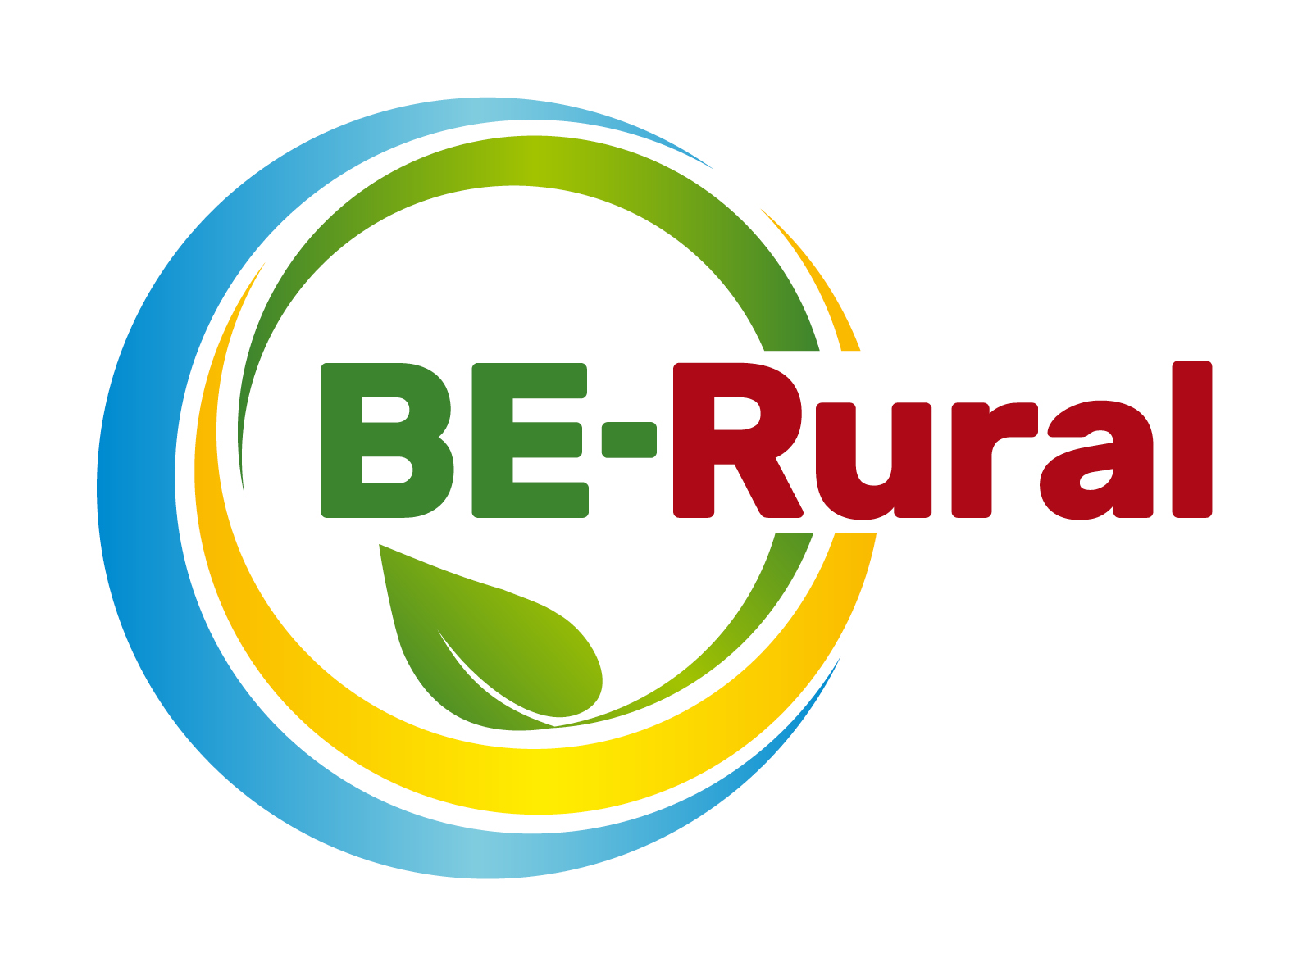
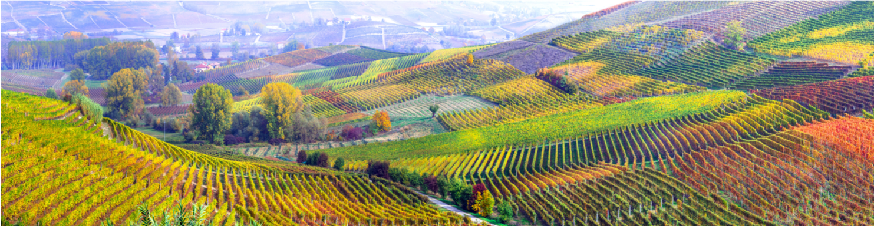
Key principles of sustainability and links to bioeconomy
Name of presenter
Notes:
Notes to the teacher: Teacher’s name to go in the space at the bottom left of the slide. Explain that this presentation aims to educate on the key principles of sustainability (and how the bioeconomy can be a strategy for sustainability), using definitions, examples and interactive questions.
Excluding the two Mentimeter exercises, this first slide and the outline slides, there are 20 slides – so these slides should take between 20 and 40 minutes to present, depending of amount of explanation.
The two Mentimeter exercises will take around 2 minutes each.

Slide 2
Outline
What is Sustainability?
The Sustainability problem
Weak vs Strong Sustainability
Tragedy of the commons
Quick Quiz
How The Bioeconomy contributes to sustainability
Ecological limits and the Bioeconomy
The importance of innovation
Notes:
Notes to the teacher: Briefly run through the topics that will be spoken about in this presentation as shown on the slide.

Slide 3
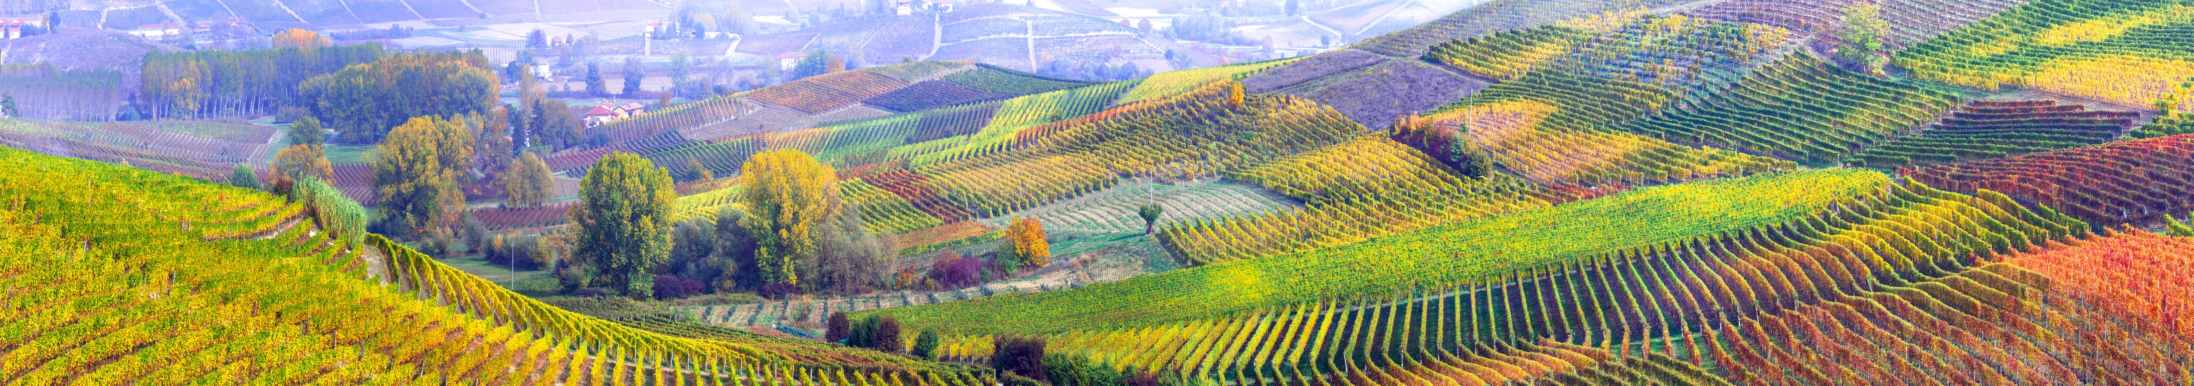
Mentimeter code – -- -- --
What is Sustainability?
Go to - https://www.menti.com/
Type any words that you associate with Sustainability into the Mentimeter
Notes:
** This slide only works after obtaining a Mentimeter code before the presentation.**
Notes to the teacher:
Explain that sustainability can be hard to define, and it can mean different things to different people. Use the mentimeter app word-cloud function and get participants to type in the words that they associate with “Sustainability”. Put Mentimeter code in top right of slide.
When participants/students have finished this; read out some of the most popular words and make any comments that you feel are relevant. This task will get the students/participants thinking about how they already view the concept of sustainability. Use link - https://www.menti.com/

Slide 4
What is sustainability?
“Development that meets the needs of the present without compromising the ability of future generations to meet their own needs”
(World Commission on Environment and Development, 1987)
Notes:
Notes to the teacher: This is the most famous definition. Our Common Future is also called the “Brundtland Report” (because the former Norwegian Prime Minister Gro Harlem Brundtland's role was the Chair of the World Commission on Environment and Development).
Read out this definition and try to link back to the words that the participants/students came up with on the Mentimeter activity on the previous slide.
World Commission on Environment and Development. (1987). Our common future. Oxford: Oxford University Press. (Available at: http://www.princeton.edu/~ota/disk1/1993/9340/934004.PDF)
The publication of Our Common Future and the work of the World Commission on Environment and Development laid the groundwork for the convening of the 1992 Earth Summit and the adoption of Agenda 21, the Rio Declaration and to the establishment of the Commission on Sustainable Development.

Slide 5
What is sustainability?
“The property of being environmentally sustainable; the degree to which a process or enterprise is able to be maintained or continued while avoiding the long-term depletion of natural resources” (Oxford English Dictionary, 2020)
Notes:
Notes to the teacher: This is a newer definition. Read out this definition and try to link back to the words that the participants/students came up with on the Mentimeter activity on the previous slide.
Oxford College of Procurement and Supply, (2020), How sustainable is sustainability?, available at: https://www.oxfordcollegeofprocurementandsupply.com/how-sustainable-is-sustainability/

Slide 6
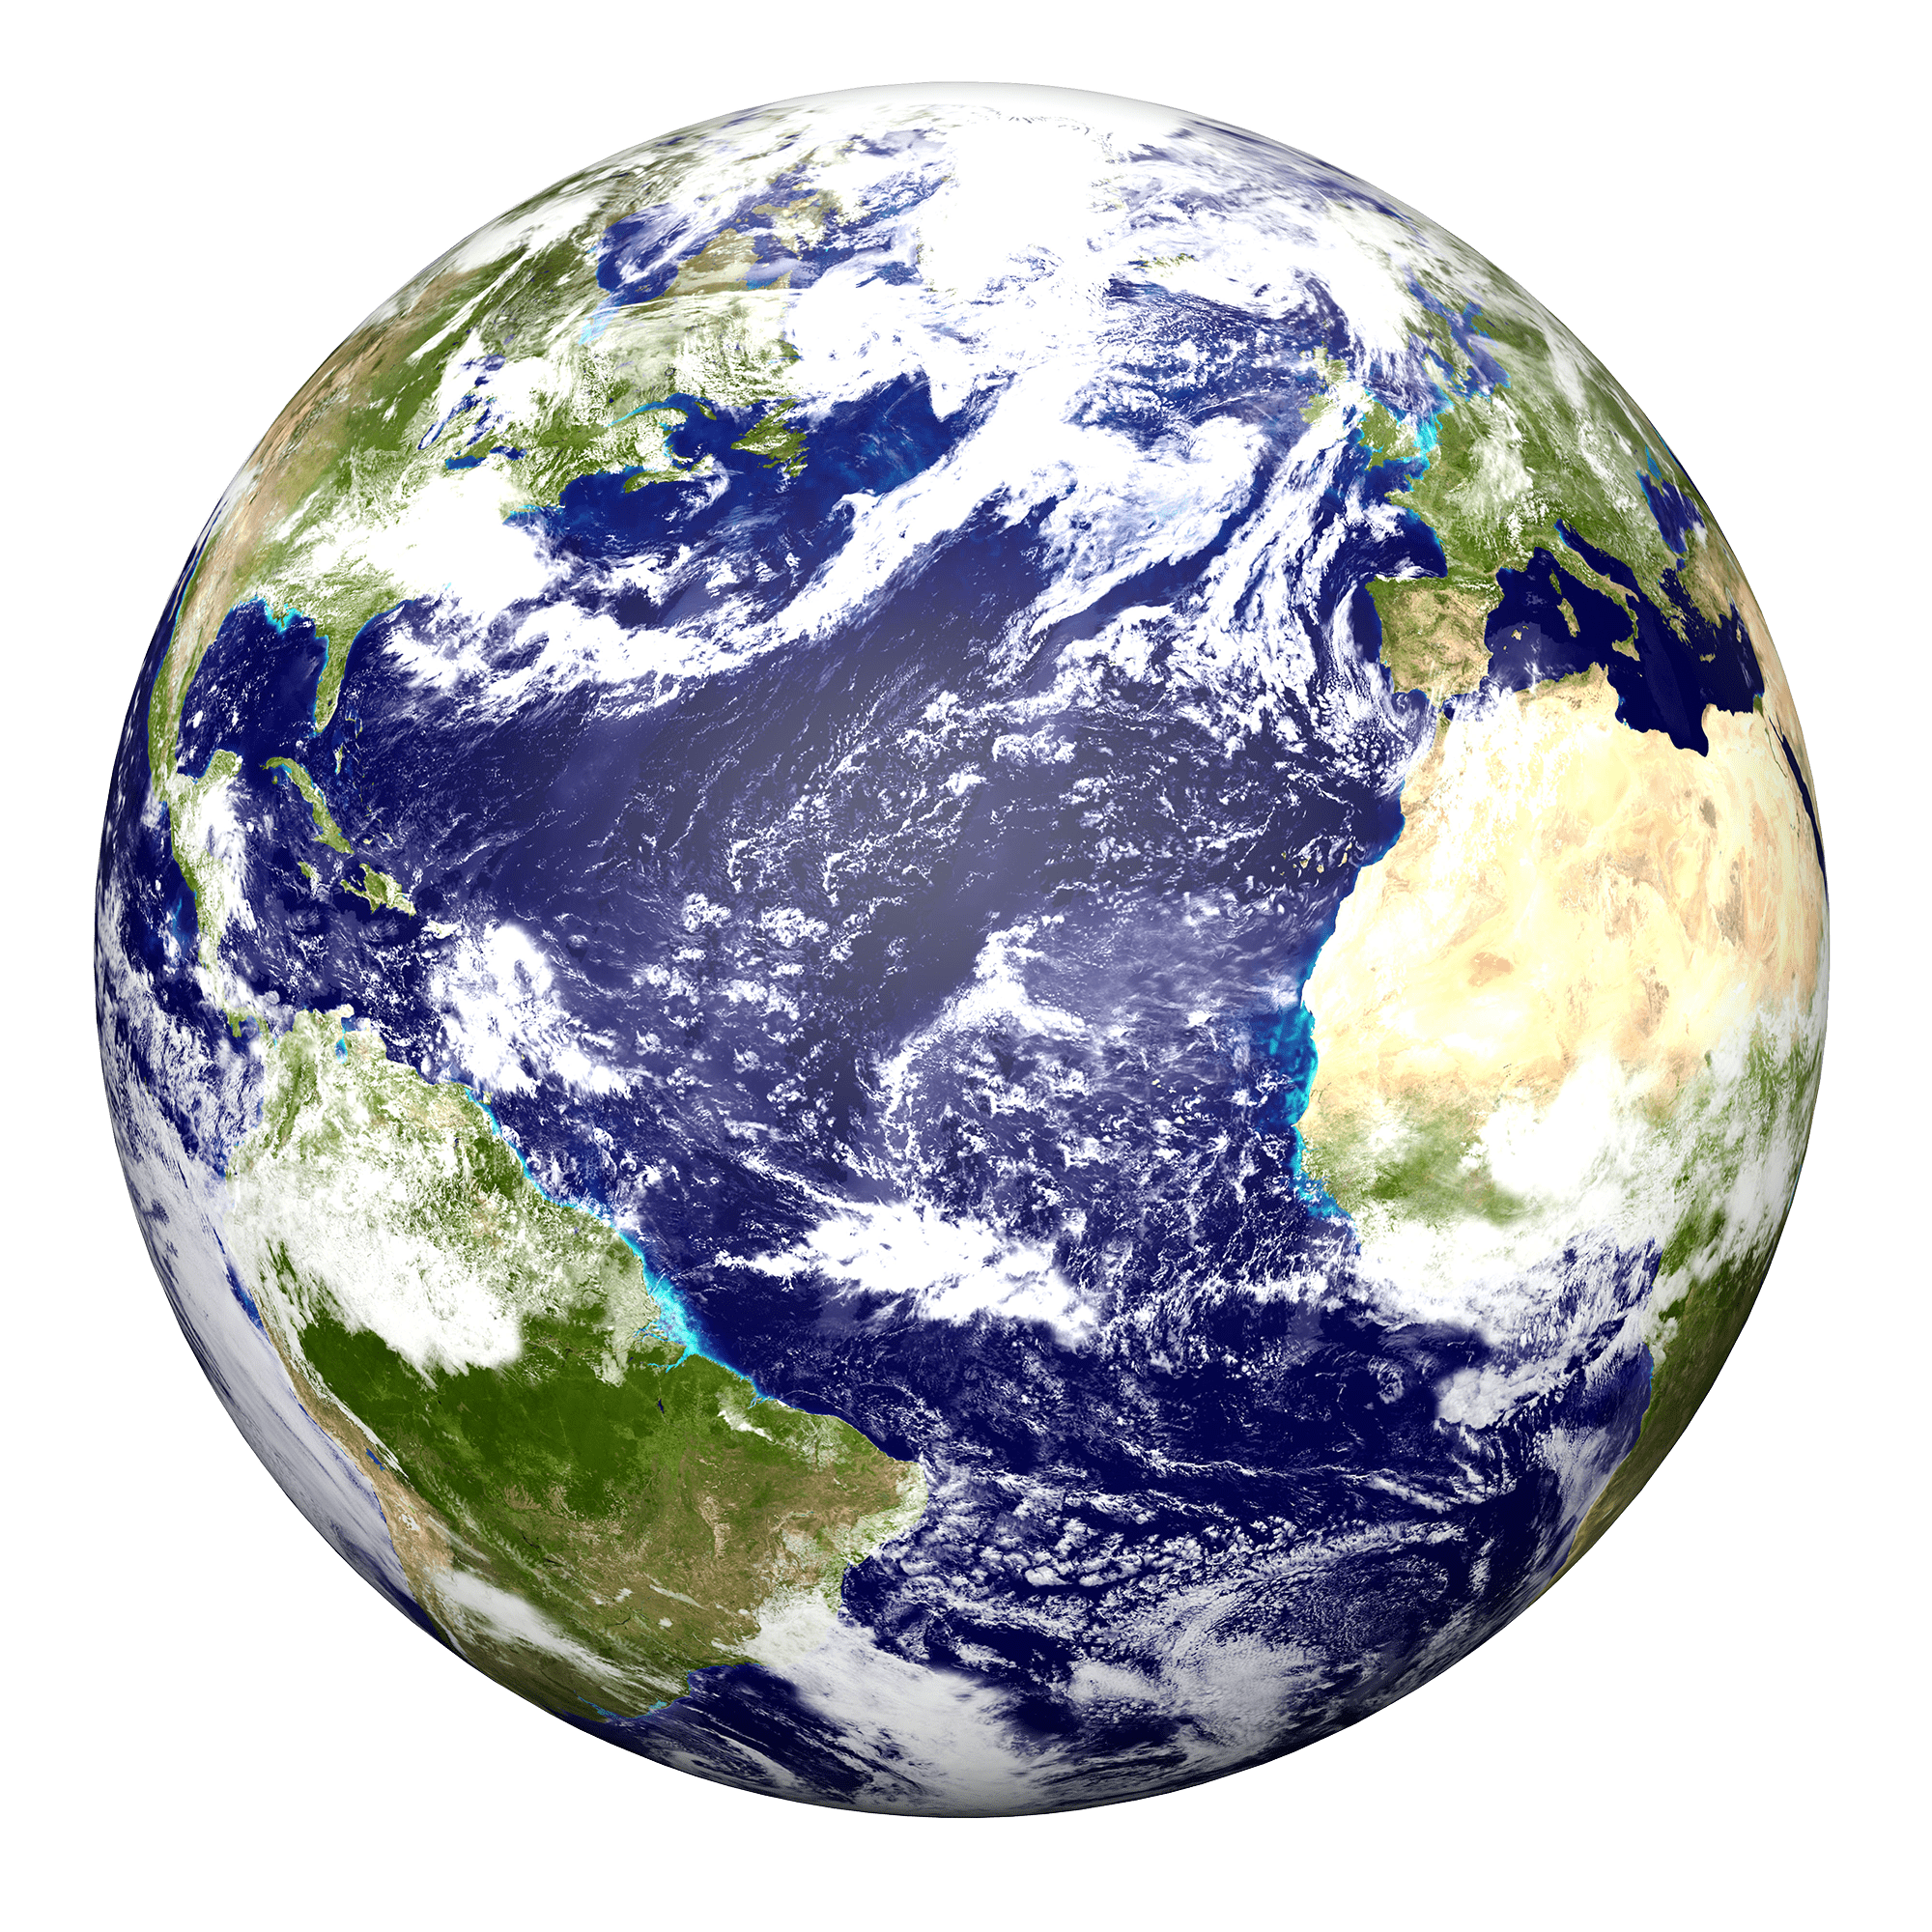
What is sustainability?
The key point within both definitions can be identified as avoiding the depletion of resources so that future generations can have their needs met.
The key point within both definitions can be identified as avoiding the depletion of resources so that future generations can have their needs met.
What do we mean by resources?
By resources we mean both infinite and finite materials that can be found on the earth.
This Photo by Unknown Author is licensed under CC BY-SA-NC
Notes:
Notes to the teacher: The key point within both of the previous definitions can be identified as avoiding the depletion of resources so that future generations can have their needs met. – Try to link words back to the Mentimeter word cloud if possible.
The first animation on the slide will highlight the words “avoiding the depletion of resources”. The second animation on the slide will make the “What do we mean by resources?” text appear. Say that by resources we mean both infinite and finite materials that can be found on the earth.

Slide 7
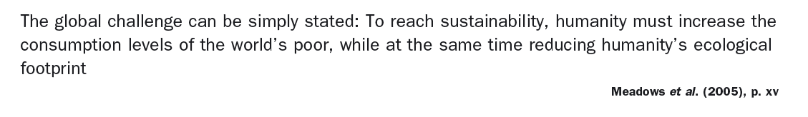
What is sustainability?
Social equity…
This Photo by Unknown Author is licensed under CC BY-SA-NC
Notes:
Notes to the teacher: Explain that: It should be noted that sustainability is not just to do with resources though. It should also be about social equity. It should be about increasing consumption levels of the world’s poor, while also reducing humanity’s overall ecological footprint. Social, economic and ecological issues must therefore be considered when thinking about sustainability. This is often represented in diagrams. – Show diagram on next slide.
Meadows. Dennis; Meadows. Donella; Randers. J; (2005). Limits To Growth: The 30-Year Update (Hardcover ed.). Chelsea Green Publishing. ISBN 1931498512.,

Slide 8
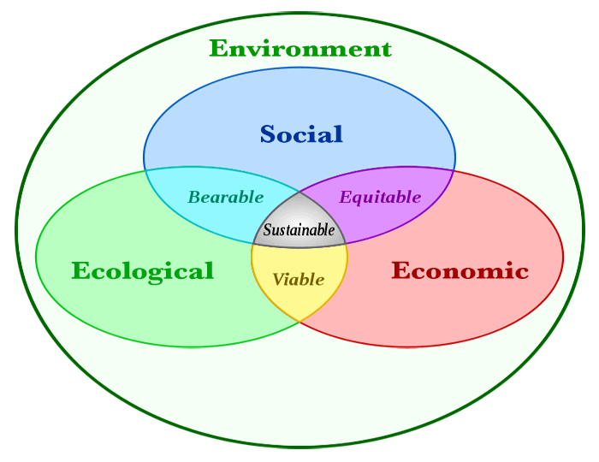
Sustainability diagram
https://commons.wikimedia.org/wiki/File:Sustainability-diagram-v4.gif
The links between these factors is critical. “Many approaches to sustainability…have begun by addressing the social, economic and ecological considerations separately. The combined effect is not merely an absence of integrative expertise, data and authority but an entrenched tendency to neglect the interdependence of these factors.’ (Gibson 2006, p. 259)
Notes:
Notes to teacher: Some students/participants may benefit from seeing diagrams of the concepts being talked about. Explain that to truly achieve sustainability; Ecological, Economic and Social issues need to be considered. An integral approach to tackling social, economic and ecological issues together is important. Tackling the issues separately or neglecting one can lead to poor or mixed results. Use laser pointer to point at “bearable” “equitable” and “viable” when talking about the mixed results.
Gibson, R.B., 2006. Beyond the pillars: Sustainability assessment as a framework for effective integration of social, economic and ecological considerations in significant decision making. Journal of Environmental Assessment Policy and Management, 8(3), pp.259–280.

Slide 9
The Sustainability problem
Complexity and Wickedness
The examination of the process of sustainability transition and the hurdles that make it difficult.
These have been called wicked problems (Rittel and Webber 1973), the ‘problematique’ (Reid et al. 2006) or the sustainability problem (Common 1995).
Notes:
Explain that - The complexity of approaching sustainability and trying to give equal attention to the three main issues is known as The Sustainability Problem. The main concern is around the problem’s constantly changing nature and the uncertainty of our knowledge on it.
Common, M. (1995), Sustainability and Policy: Limits to Economics. Cambridge UK: Cambridge University Press.
Pryshlakivsky J., Searcy C. (2013) Sustainable Development as a Wicked Problem. In: Kovacic S., Sousa-Poza A. (eds) Managing and Engineering in Complex Situations. Topics in Safety, Risk, Reliability and Quality, vol 21. Springer, Dordrecht
Reid, W.V., Berkes,F., Wilbanks, T. and Capistrano, D. (eds.) 2006. Bridging Scales and Knowledge Systems: Concepts and Applications in Ecosystem Assessment. Washington DC: Millennium Ecosystem Assessment and Island Press.
Rittel, H.W.J. and Webber, M.M. 1973. Dilemmas in a general theory of planning. Policy Sciences, Vol. 4, No. 2, pp. 155-169.

Slide 10
The Sustainability problem
“Knowledge of the system we deal with is always incomplete. Surprise is inevitable. Not only is the science incomplete, the system itself is a moving target”.
(Hollings 1973, p. 2)
Notes:
More about the complexity of approaching sustainability and any other complex systems.
Hollings, C.S. 1973. Resilience and Stability of Ecological Systems. Annual Review of Ecology and Systematics , Vol. 4 , pp. 1-23.

Slide 11
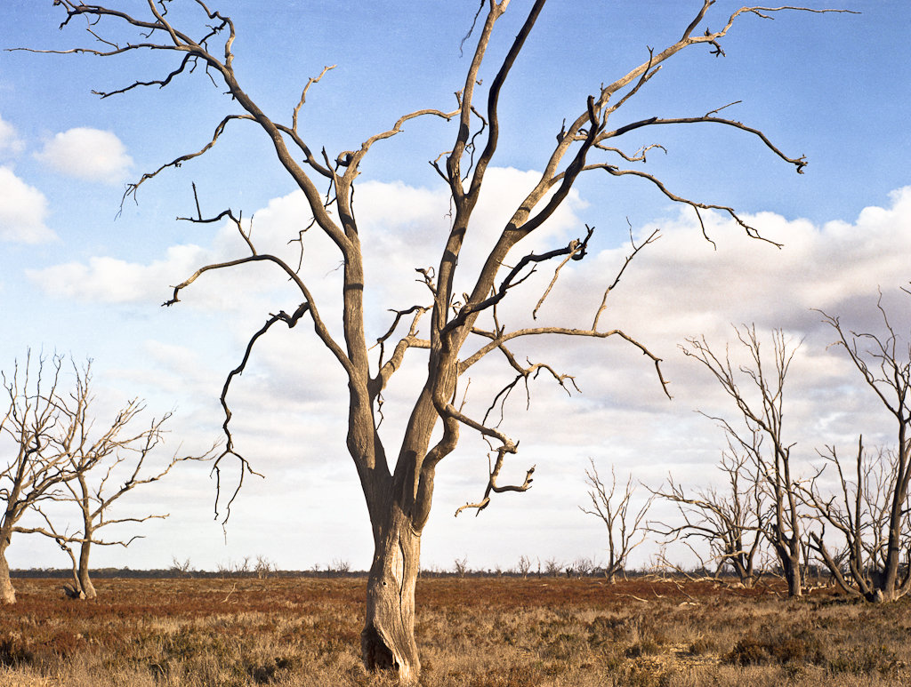
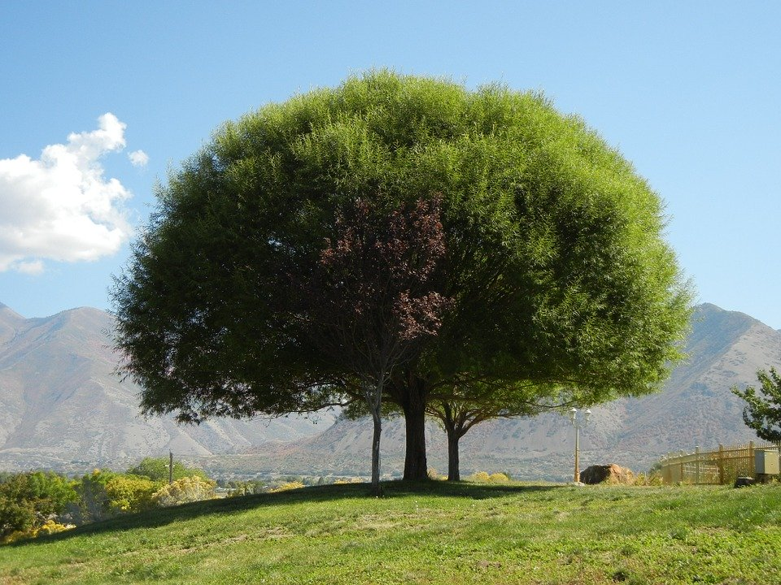
Weak vs Strong sustainability
Weak sustainability Vs
Strong sustainability
This Photo by Unknown Author is licensed under CC BY-NC This Photo by Unknown Author is licensed under CC BY-NC
Notes:
Notes to teacher: Explain thta another issue surrounding sustainability is the important distinction that needs to be made between weak sustainability and strong sustainability. Animate the first picture when the word WEAK is said, and the second picture when the word STRONG is said.
Neumayer, E. 2010. Weak versus Strong Sustainability. 3rd Ed. UK: Elgar.

Slide 12
Weak vs Strong sustainability
Weak sustainability Vs
Strong sustainability
Weak Sustainability
Weak sustainability allows for the depletion or degradation of natural resources, so long as such depletion is offset by increases in the stocks of other forms of capital (for example, by investing royalties from depleting mineral reserves in factories).
This Photo by Unknown Author is licensed under CC BY-NC This Photo by Unknown Author is licensed under CC BY-NC
Notes:
Notes to teacher: Explain that weak Sustainability allows for the depletion or degradation of natural resources, so long as such depletion is offset by increases in the stocks of other forms of capital. For example, by investing royalties from depleting mineral reserves in factories.

Slide 13
Weak vs Strong sustainability
Weak sustainability Vs
Strong sustainability
Weak Sustainability
Assumes that manufacture capital is of equal value, can take the place, of natural capital. Weak sustainability allows for the depletion or degradation of natural resources, so long as such depletion is replaced by increases in human-made capital (for example, by investing royalties from depleting mineral reserves in factories). It allows trade-offs.
Strong sustainability
Strong sustainability requires that all forms of capital must be maintained independently of one another. Existing natural stocks must be retained, for example timber stocks, as the functions they perform cannot be replaced. It limits the substitution of environmental capital by human-made capital and allocates some resources as critical natural capital (stock) to survival. It imposes thresholds.
This Photo by Unknown Author is licensed under CC BY-NC This Photo by Unknown Author is licensed under CC BY-NC
Notes:
Notes to teacher: Explain that strong sustainability requires that all forms of capital must be maintained independently of one another. Existing stock must be retained, for example timber stocks, as the functions the timber can perform cannot be replaced or offset by anything else, such as investing in royalties.

Slide 14
Weak vs Strong sustainability
A weak sustainability approach considers that human-made and natural capital are substitutable in the long term, whilst supporters of strong sustainability believe they are not.
Notes:
Notes to teacher: This is a summary of weak and strong sustainability - supporters of weak sustainability suggest that human-made and natural capital are substitutable in the long term, whilst supporters of strong sustainability believe they are not.

Slide 15

Tragedy of the Commons
The commons
Sustainable use
Unsustainable use – Depleted resource
20 acres of shared grazing land
10 Cows (Carrying capacity)
20 + Cows
(Over the tipping point)
Notes:
Notes to teacher: Explain that; the tragedy of the commons is a concept that is linked to sustainability. It comes about when there is a shared resource that individuals have incentive to use. If individuals neglect the well-being of society and favour personal gain then it can result in overconsumption, under investment, and depletion of the resource. Ultimately the resource is lost for everyone.
Show the 3 pictures and explain. Picture 1 – The commons: A shared pasture that multiple farmers have access to and freedom to graze their cattle on. Picture 2 – Sustainable use of this shared resource would be all the farmers sticking to the carrying capacity amount of cattle. Picture 3 – However, if individuals decide to keep adding a few more cows thinking that their additional input will not make a difference then the tipping point will be reached and the resource will be depleted and no farmer will be able to use the resource.
Carrying capacity in ecology refers to the number of people, animals, or crops which a region can support without environmental degradation.

Slide 16
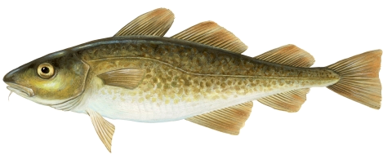
Tragedy of the Commons
By the 1990s, cod populations were so low that the Grand Banks fishing industry collapsed.
Historic examples:
Grand Banks fisheries
The Grand Banks are fishing grounds off the coast of Newfoundland.
In the 1960s and 1970s, advances in fishing technology meant that more and more cod could be caught.
Slide 16
Notes:
Notes to teacher: This is a real-life example to help students/participants understand the concept. Explain that the Grand Banks are fishing grounds off the coast of Newfoundland. In the 1960s and 1970s, advances in fishing technology meant that more and more cod could be caught. Because of this, By the 1990s, cod populations were so low that the Grand Banks fishing industry collapsed. It was too late for regulation and management; the cod stocks had been irreparably damaged. Since then, the cod populations have remained low, and some scientists doubt the Grand Banks ecosystem will ever recover.

Slide 17
Mentimeter code – -- -- --
Quick Quiz! Go to - https://www.menti.com/
On Mentimeter match the situations to what they are examples of:
- The Sustainability problem
Weak Sustainability
Strong Sustainability
Tragedy of the commons
Notes:
** This slide only works after obtaining a Mentimeter code before the presentation.**
Notes to teacher: Use the Mentimeter quiz function and input the questions below. Put Mentimeter code in top right corner of slide. There are 3 situations being described, and each one is an example of either weak sustainability, strong sustainability or tragedy of the commons. Allow students some time to select their answers and then read the correct answer/title combinations.
Question 1: “Planting two trees for every one tree cut down is an example of… Options: Weak sustainability, Tragedy of the commons, Strong sustainability, or the Sustainability problem?”.
The correct answer is Strong sustainability.
Question 2: “Depleting timber stocks, then buying royalties to compensate is an example of… Options: Weak sustainability, Tragedy of the commons, Strong sustainability, or the Sustainability problem?”.
The correct answer was Weak sustainability.
Question 3: “All of us driving to the shops thinking: “One more car won’t make a difference,” Then the excessive cars causing us all to suffer from air pollution is an example of…
Options: Weak sustainability, Tragedy of the commons, Strong sustainability, or the Sustainability problem?”.
The correct answer is Tragedy of the commons.

Slide 18

Outline
What is Sustainability?
The Sustainability problem
Weak vs Strong Sustainability
Tragedy of the commons
Quick Quiz
How The Bioeconomy contributes to sustainability
Ecological limits and the Bioeconomy
The importance of innovation
Notes:
Notes to teacher: Go over what has already been covered, and what is still to be covered. What has been covered in black, what is still to cover in white.

Slide 19

How the bioeconomy contributes to sustainability?
European Bioeconomy Strategy
The European Commission is taking steps towards a sustainable bioeconomy and has a bioeconomy strategy to promote the bioeconomy and to avoid reaching ecological limits.
The Bioeconomy…
Is the production of goods, services, or energy from biological material as the main resource.
Is strongly linked to sustainability as biodegradable resources are often used and waste is often completely designed out of the system.
Can avoid the depletion of resources for future generations and protect the stability of the planet.
Notes:
Notes to teacher: Explain to class that in order to take steps towards sustainability and the avoidance of reaching ecological limits the bioeconomy is very important. The bioeconomy is the production of goods, services, or energy from biological material as the main resource. This is strongly linked to sustainability as biodegradable resources are often used and waste is often completely designed out of the system. This can avoid the depletion of resources for future generations and protect the stability of the planet. The European Commission is taking steps towards a sustainable bioeconomy. Turning waste into valuable resources and creating incentives to help retailers and consumers cut food waste. The European Commission has a bioeconomy strategy to promote the bioeconomy and avoid reaching ecological limits.
European Commission (2018), A sustainable Bioeconomy for Europe: strengthening the connection between economy, society and the environment. Updated Bioeconomy Strategy. Directorate-General for Research and Innovation, available at: https://ec.europa.eu/research/bioeconomy/pdf/ec_bioeconomy_strategy_2018.pdf accessed: 22 May 2020].

Slide 20
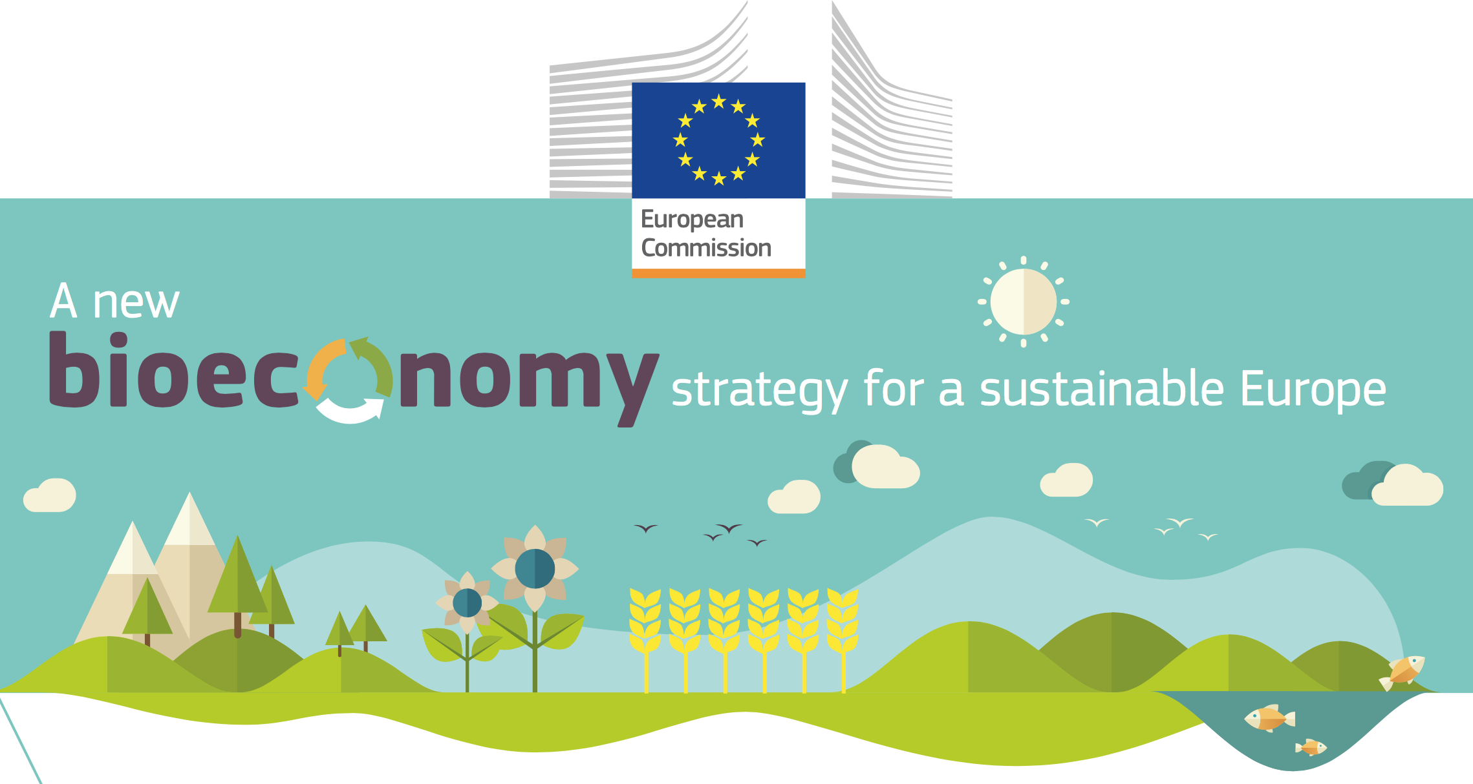
Ecological limits
In addition to links to sustainability and climate change mitigation, it is critical that the bioeconomy operates within safe ecological limits.
With the new bioeconomy strategy, the European Commission supports initiatives at national and regional level to develop an efficient and sustainable bioeconomy and this includes:
implementing an EU-wide monitoring system to track progress towards a sustainable and circular bioeconomy.
providing guidance on how best to operate the bioeconomy within safe ecological limits.
Notes:
Notes to teacher: Explain that to try and tackle the issues surrounding ecological limits: National and international bodies have specific guidelines. An example of this is the European Commission’s 2018 publication; ‘A new bioeconomy strategy for a sustainable Europe.’ Further information available at: https://ec.europa.eu/commission/news/new-bioeconomy-strategy-sustainable-europe-2018-oct-11-0_en
Key reading:
EC (2018), Bioeconomy: A new strategy for a sustainable Europe Restoring healthy ecosystems and enhancing biodiversity. European Commission https://ec.europa.eu/research/bioeconomy/pdf/ec_bioeconomy_actions_2018.pdf
Could also check for more advanced reading:
Giampietro, M. (2019). On the circular bioeconomy and decoupling: implications for sustainable growth. Ecological economics, 162, 143-156. https://www.sciencedirect.com/science/article/pii/S0921800918317178
Vivien, F. D., Nieddu, M., Befort, N., Debref, R., & Giampietro, M. (2019). The hijacking of the bioeconomy. Ecological economics, 159, 189-197. https://www.sciencedirect.com/science/article/abs/pii/S0921800918308115
See slides “What is the Bioeconomy? Opportunities, challenges and solutions” for information on:
Bioeconomy – links to SDGs and climate change, and bioeconomy resources
The transition to a bioeconomy is complex
Biodiversity assessment
Direct, indirect and cumulative impacts
What are ‘impacts and need for Environmental Impact Assessment (EIA) and/or Strategic Environmental Assessment (SEA).
Net positive outcomes, enhancement and the mitigation hierarchy
Example: the impacts of biofuels

Slide 21
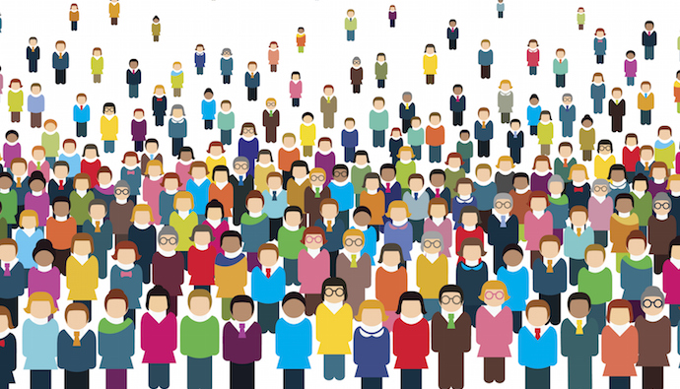
Ecological limits and the bioeconomy
Ecological limits
Ecological limits centre around three main areas:
Food resources
The capacity of ecosystems
The populations within ecosystems
It is projected that the world’s human population will reach about 10 billion by 2050
With a linear economy, and such a large population, we will exceed the ecological limits!
Notes:
Notes to teacher: Explain that another key issue surrounding sustainability relates to ecological limits. Ecological limits are the planet’s limits on being able to support life as it currently is. Ecological limits centre around three main areas: (1) Food resources (2) The maximum capacity of ecosystems (3) The territoriality of populations within ecosystems.
Explain that with the human population predicated to hit 10 billion by 2050 it does not seem farfetched to imagine a world where the ecological limit will be reached.
Background information: “Carrying capacity” is the number of people who can live, in the way they happen to be living, without damaging the environment or diminishing its ability to support people in the future. Steps need to be taken to protect food resources and ecosystems.

Slide 22
Ecological limits and the bioeconomy
Measures being taken by the European Commission
Implement an EU-wide monitoring system to track progress towards a sustainable and circular bioeconomy;
Enhance our knowledge base and understanding of specific bioeconomy areas by gathering data and ensuring better access to it through the Knowledge Centre for the Bioeconomy;
Provide guidance and promote good practices on how to operate in the bioeconomy within safe ecological limits.
European Commission (2018)
Notes:
Notes to teacher: Some measures that the European Commisson outline are as follows: (1) Implement an EU-wide monitoring system to track progress towards a sustainable and circular bioeconomy; (2) Enhance our knowledge base and understanding of specific bioeconomy areas by gathering data and ensuring better access to it through the Knowledge Centre for the Bioeconomy; (3) Provide guidance and promote good practices on how to operate in the bioeconomy within safe ecological limits.
Explain that these measures would help prevent ecological limits being reached as they help to educate people and promoted effective practices. Further information available at: https://ec.europa.eu/commission/news/new-bioeconomy-strategy-sustainable-europe-2018-oct-11-0_en

Slide 23
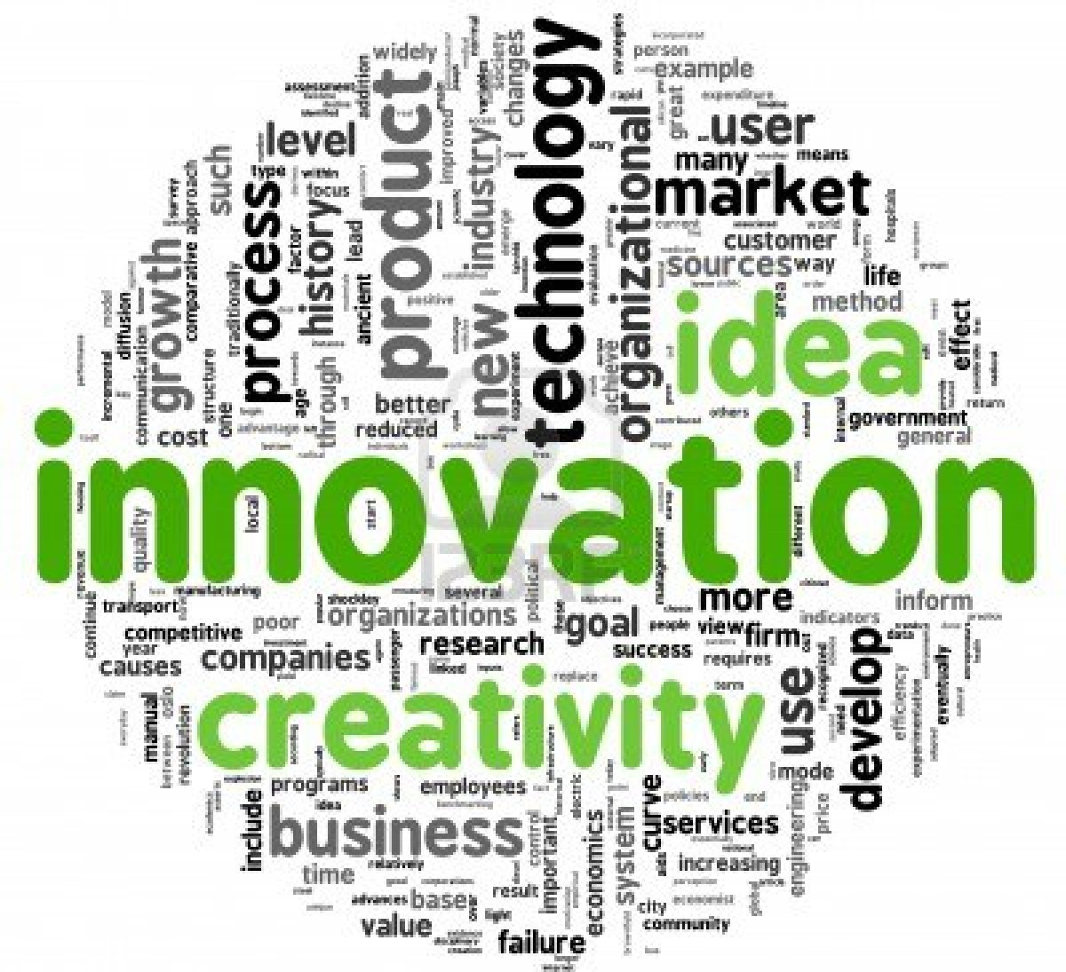
The importance of innovation
This Photo by Unknown Author is licensed under CC BY
Notes:
Notes to teacher: Explain that Innovation is incredibly important when considering how the human population can remain within ecological limits. Products that can be used again and again, often from waste are highly sustainable and avoid a depletion of resources. These can be known as bio-products.

Slide 24
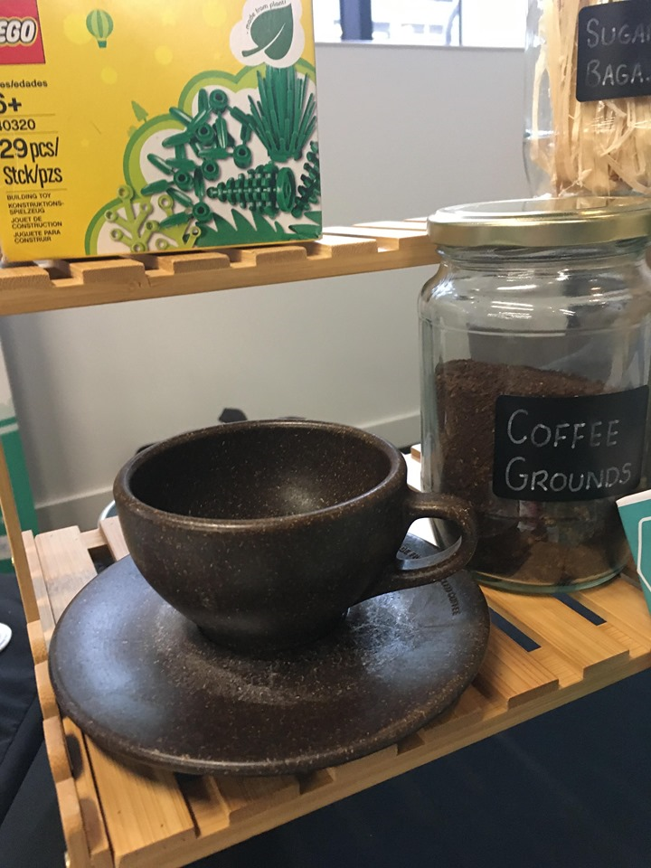
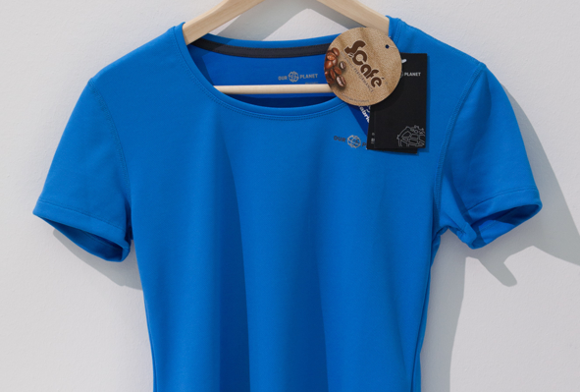
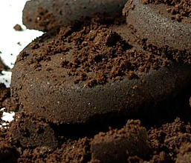
The importance of innovation
coffee ground waste
What are these two items are made from?
Notes:
Notes to teacher: Ask the participants if they have any idea what these two items are made from. The answer is coffee ground waste for both. An animation will remove the blue rectangle in the middle and reveal the anwer.

Slide 25
Outline
What is Sustainability?
The Sustainability problem
Weak vs Strong Sustainability
Tragedy of the commons
Quick Quiz
How The Bioeconomy contributes to sustainability
Ecological limits and the Bioeconomy
The importance of innovation
Notes:
Notes to the teacher: Mention that that is everything to be spoken about today.

Slide 26
Key Points Covered – Sustainability
Preserving resources for future generations and social equity!
Many problems surrounding the issue!
The risk of reaching ecological limits!
Innovation into the future!
This Photo by Unknown Author is licensed under CC BY-SA-NC
Notes:
Notes to the teacher: This is a slide to summarise the Power point’s main points. Explain that (1) Sustainability should be about preserving resources for future generations and social equity. (2) There are many issues and concepts surrounding sustainability such as weak sustainability/strong sustainability/the tragedy of the commons/the sustainability problem. (3) As the human population continues to rise, there is a risk that we will hit our ecological limits (4) Innovation, such as bio-products is one way in which we could try and combat this problem.

Slide 27
Questions and Discussion
Name of presenter
Notes:
Notes to the teacher: Speaker’s name to go in the space at the bottom left of the slide. This is the final slide of the presentation. Allow time for students/participants to ask any questions.

Slide 28

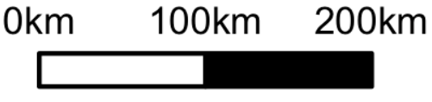
https://be-rural.eu
These educational resources were developed as part of the BE-Rural project
Bio-based strategies and roadmaps for enhanced rural and regional development in the EU (April 2019 – March 2022)
BE-Rural supports
… regional stakeholders in five countries:
Latvia: Vidzeme and Kurzeme
Poland: Szczecin and Vistula Lagoons
Romania: Covasna
Bulgaria: Stara Zagora
North Macedonia: Strumica
The goal of BE-Rural is to realise the potential of regional bio-based economies by supporting relevant actors in the participatory development of bioeconomy strategies and roadmaps
https://be-rural.eu/innovation-regions/
Notes:
BE-Rural has five innovation regions
BE-Rural will create five regional Open Innovation Platforms (OIPs) for the participatory development of bioeconomy strategies and roadmaps. The BE-Rural OIPs will be established in five regions across the EU with different biomass potentials and will be based on the regional Stakeholder Working Groups (SWGs). Within the OIPs, the main task of the SWGs will be to formulate concrete strategy or roadmap documents by engaging with different actors and opening the platform for a wide range of stakeholders in the region, including civil society organisations and citizens.
Stara Zagora, Bulgaria: This innovation region will focus on seeking new technologies for the application of essential oils and herbal plants in the cosmetics and pharmaceutical industry. The small-scale production in this area will be combined with tourism-related activities to expand the existing business status quo and potential. Ultimately, the region will establish closer relations and network between companies. Regional partner: Bulgarian Industrial Association (BIA)
Vidzeme and Kurzeme, Latvia: This region will focus on the potential of by-products of forest management (i.e. from young forest stand thinning, short rotation coppice and forestry (SRC/SRF) plantations, removing of overgrowth in abandoned agricultural lands and perennial grasses) as a source of bioenergy or biorefinery. The region will investigate the value of agroforestry systems of perennial grasses and SRC or SRF trees as grazing areas, and the production of hay or grass seeds. The potential smart use of small timber wood from young forest stand thing will be explored. Regional partner: The Latvian State Forest Research Institute (SILAVA)
Strumica, North Macedonia: The region will focus on the utilization of agricultural residues, specifically the by-production of organic materials from agricultural activities, as a source of energy for domestic and industrial purposes. The region will investigate technology options for energy conversion of biomass materials generated on agricultural fields or farms (field-based residues), as well as those generated during the processing of agricultural products (process-based residues). Regional partner: International Centre for Sustainable Development of Energy, Water and Environment Systems (SDEWES-Skopje)
Szczecin Lagoon and Vistula Lagoon, Poland: This region will focus on small-scale fisheries, specifically on the sustainable use of currently underused and low-value fish species located in two lagoons. The region will investigate small-scale technology options that can be applied to utilize low-value fish species as products for human consumption. Regional partner: The National Marine Fisheries Research Institute (NMFRI)
Covasna, Romania: The region will focus on addressing fragmented value chains and implementing the circular economy concept within the county’s industrial sectors (i.e. wood and furniture, textiles, agro-food, mechanical engineering, green energy). The region will investigate the development potential of underused biomass (plant matter and wood waste) and it implication on societal challenges (e.g., rural unemployment or marginalised communities). This will be done within a local development business model based on a small-scale technology option ensuring the autonomous energy supply for civil and industrial needs. Regional partner: Institute for Economic Forecasting (IPE)
Source: BE-Rural (2020), Innovation regions, available at: https://be-rural.eu/innovation-regions/

