Slide 1
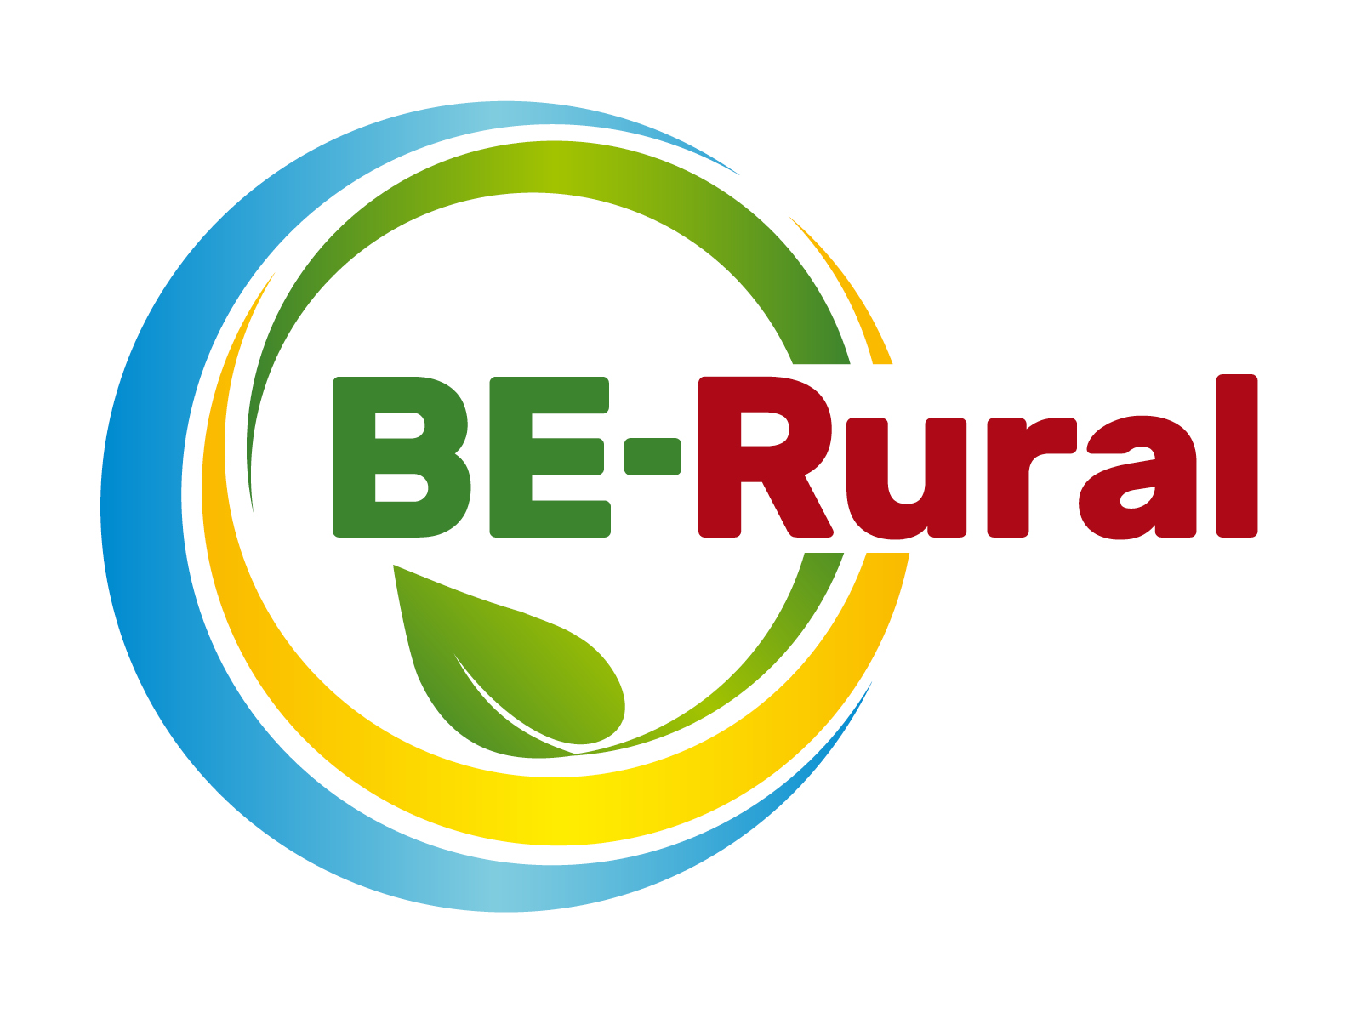
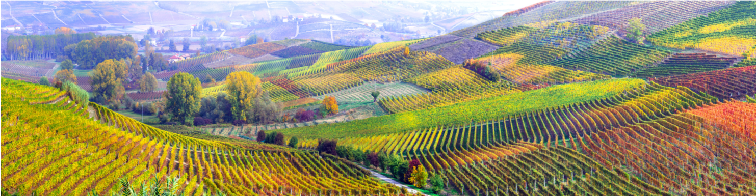
What is the Bioeconomy?
Opportunities, challenges and solutions
Name of presenter
Notes:
Notes to the teacher:
Teacher’s name to go in the space at the bottom left of the slide. Explain that this presentation introduces the key principles and opportunities of bioeconomy and links to sustainability. It also discusses the challenges and solutions of the bioeconomy.
Excluding the two videos and quiz, the outline slide and this first slide, there are 23 slides – so these slides should take between 23 and 46 minutes to present, depending of amount of explanation.
The two videos are around 2 minutes long each.
Quiz with 6 questions - will take 6 minutes or more (depending if reading extra information).

Slide 2
Outline
What is the bioeconomy and what is biomass? (including video)
Bioeconomy around the world
Bioeconomy jobs by sector and socio-economic impacts
Bioeconomy – links to SDGs
Bioeconomy & climate change
Ecological limits
Bioeconomy resources and video “Bioeconomy starts here”
The transition to a bioeconomy is complex
Bioeconomy challenges: Resource Provision and Biodiversity loss
Biodiversity assessment
Direct, indirect and cumulative impacts
What are ‘impacts and need for EIA and/or SEA.
Net positive outcomes, enhancement and the mitigation hierarchy
Example: the impacts of biofuels
Bioeconomy Quiz
Notes:
Notes to the teacher: Briefly run through the topics that will be spoken about in this presentation as shown on the slide.

Slide 3
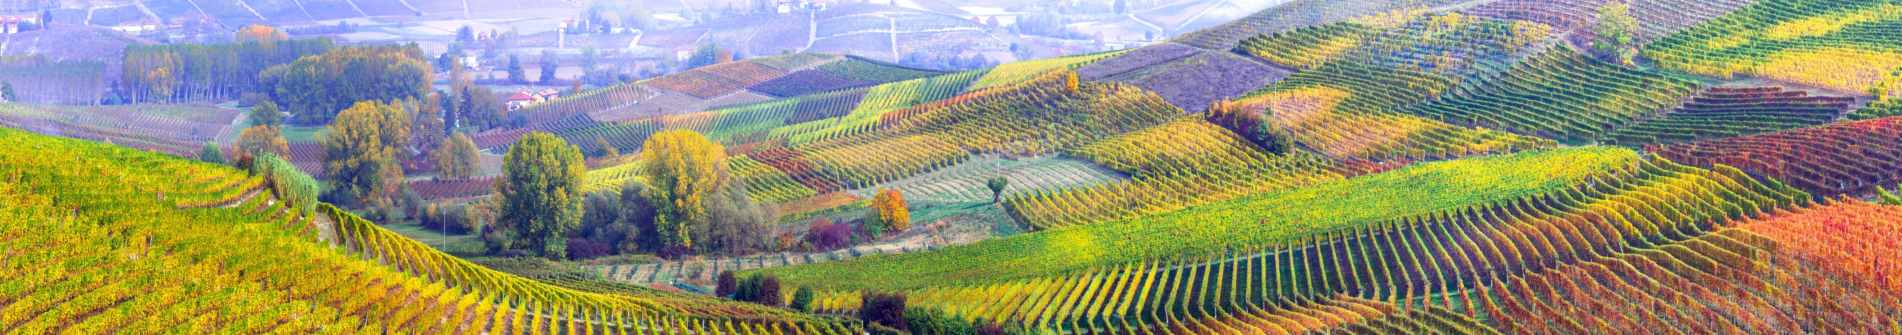
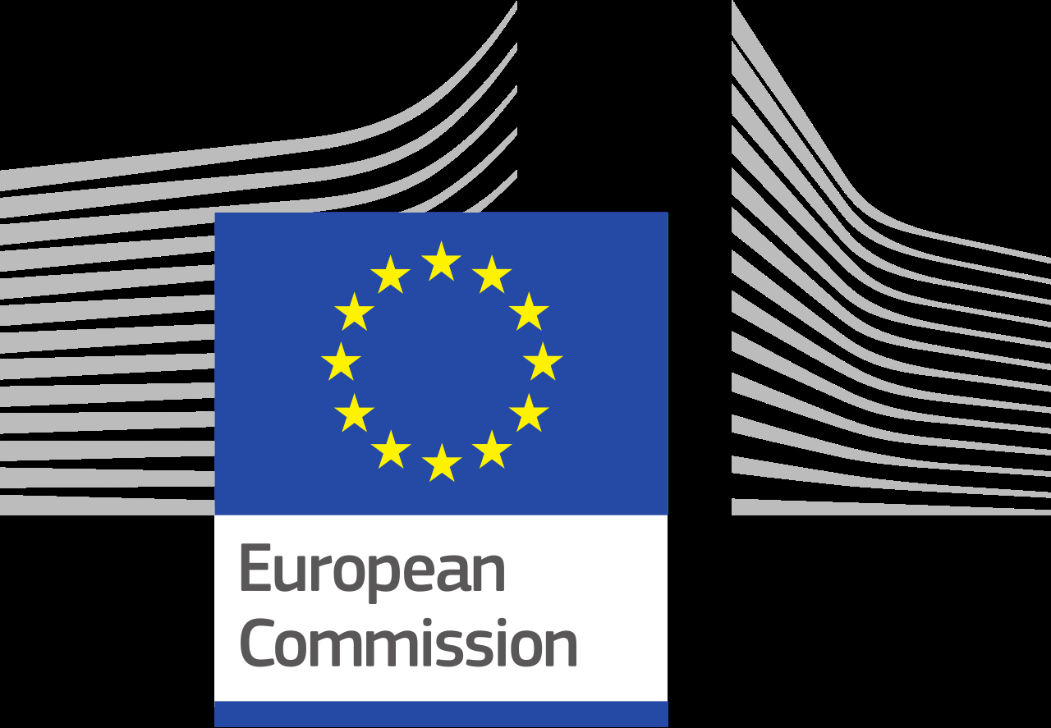
What is the bioeconomy?
European Bioeconomy Strategy
The European Commission is taking steps towards a sustainable bioeconomy and has a bioeconomy strategy to promote the bioeconomy and to avoid reaching ecological limits.
The Bioeconomy…
Is the production of goods, services, or energy from biological material as the main resource.
Is strongly linked to sustainability as biodegradable resources are often used and waste is often completely designed out of the system.
Can avoid the depletion of resources for future generations and protect the stability of the planet.
Notes:
Notes to teacher: Explain to class that in order to take steps towards sustainability and the avoidance of reaching ecological limits the bioeconomy is very important. The bioeconomy is the production of goods, services, or energy from biological material as the main resource. This is strongly linked to sustainability as biodegradable resources are often used and waste is often completely designed out of the system. This can avoid the depletion of resources for future generations and protect the stability of the planet. The European Commission is taking steps towards a sustainable bioeconomy. Turning waste into valuable resources and creating incentives to help retailers and consumers cut food waste. The European Commission has a bioeconomy strategy to promote the bioeconomy and avoid reaching ecological limits.
European Commission (2018), A sustainable Bioeconomy for Europe: strengthening the connection between economy, society and the environment. Updated Bioeconomy Strategy. Directorate-General for Research and Innovation, available at: https://ec.europa.eu/research/bioeconomy/pdf/ec_bioeconomy_strategy_2018.pdf accessed: 22 May 2020].

Slide 4
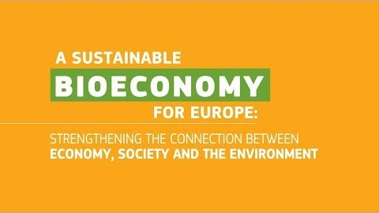
What is the bioeconomy?
What is Bioeconomy?
Video (2 minutes and 9 seconds): https://www.youtube.com/watch?v=RfRN_hHeIKk
Languages for sub-titles for video include: Bulgarian, Latvian, Macedonian, Polish and Romanian
Notes:
The bioeconomy uses renewable biological resources from land and sea – such as crops, forests, fish, animals and micro-organisms – to produce food, materials and energy. This video gives an overview.
Video (2 minutes and 9 seconds): https://www.youtube.com/watch?v=RfRN_hHeIKk
Languages for sub-titles for video include: Bulgarian, Latvian, Macedonian, Polish and Romanian
“The bioeconomy covers all sectors and systems that their functions and principles. It includes and interlinks: land and marine ecosystems and the services they provide; all primary production sectors rely on biological resources (animals, plants, micro-organisms and derived biomass, including organic waste), that use and produce biological resources (agriculture, forestry, fisheries and aquaculture); and all economic and industrial sectors that use biological resources and processes to produce food, feed, bio-based products, energy and services. To be successful, the European bioeconomy needs to have sustainability and circularity at its heart. This will drive the renewal of our industries, the modernisation of our primary production systems, the protection of the environment and will enhance biodiversity.” (European Commission (2018) ‘A sustainable Bioeconomy for Europe: strengthening the connection between economy, society and the environment’ available at: (https://ec.europa.eu/research/bioeconomy/pdf/ec_bioeconomy_strategy_2018.pdf#view=fit&pagemode=none])

Slide 5
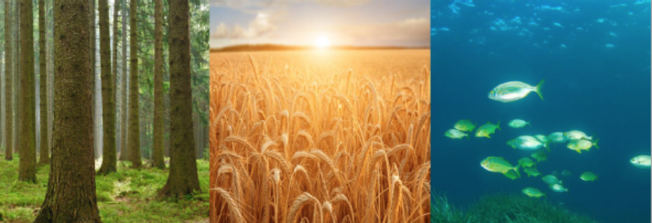
What is biomass?
Biomass is the physical basis of the bioeconomy.
Biomass is "the biodegradable fraction of products, waste and residues from biological origin from agriculture (including vegetal and animal substances), forestry and related industries including fisheries and aquaculture, as well as the biodegradable fraction of industrial and municipal waste” (EC 2019)
Measuring biomass availability is important because it is limited, which can potentially lead to competition for biomass between different biomass-using sectors.
Knowledge on biomass production, availability and use is key.
Notes:
EC (2019), Biomass - Knowledge for policy, https://ec.europa.eu/knowledge4policy/bioeconomy/topic/biomass_en
Image source: Camia A., Robert N., Jonsson R., Pilli R., García-Condado S., López-Lozano R., van der Velde M., Ronzon T., Gurría P., M’Barek R., Tamosiunas S., Fiore G., Araujo R., Hoepffner N., Marelli L., Giuntoli J., Biomass production, supply, uses and flows in the European Union. First results from an integrated assessment, EUR 28993 EN, Publications Office of the European Union, Luxembourg, 2018, ISBN 978-92-79-77237-5, doi:10.2760/539520, JRC109869
‌

Slide 6
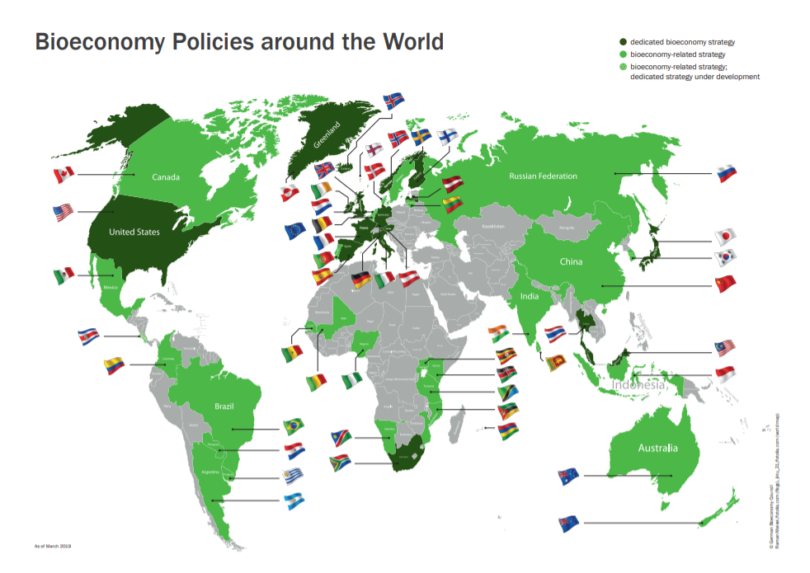
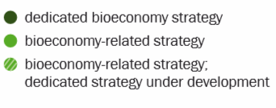

Bioeconomy around the world
Notes:
This map shows bioeconomy policies around the world. The countries colored in green are the countries that either have a dedicated bioeconomy strategy or a bioeconomy-related strategy in place. The grey scaled countries do not currently have a dedicated or related strategy in place for a transition to a bioeconomy. Poland, Romania, Bulgaria, and North Macedonia are all shaded grey, but BE-Rural is looking to change this.
According to the EC (2018), the bioeconomy has the potential to generate 1 million new green jobs by the year 2030. The expected job growth will help countries, like Poland, Romania, Bulgaria, and North Macedonia, build their economy by building industries that will help rural communities who have seen a decline in job opportunities.
An example provided by the EC (2018) states “local deployment of one biorefinery can create up to 4000 jobs in 4 years and better recycling of high value organic waste in cities could create 1200 new jobs in the long run“.
EC (2018), Bioeconomy: A new strategy for a sustainable Europe Restoring healthy ecosystems and enhancing biodiversity. European Commission https://ec.europa.eu/research/bioeconomy/pdf/ec_bioeconomy_actions_2018.pdf
Image: BE-Rural (2019). Background - BE-Rural. https://be-rural.eu/background/

Slide 7
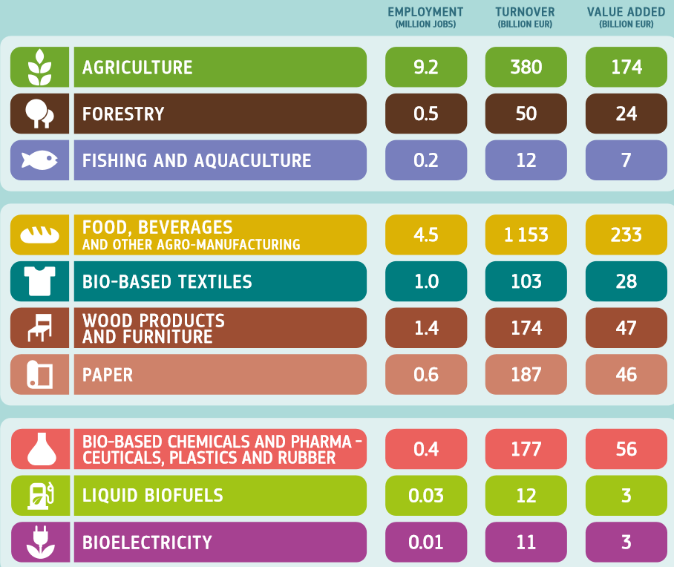
Bioeconomy jobs by sector
EU Bioeconomy Jobs by Sector
Data for 2015
Notes:
There are 10 sectors that are contributing the bioeconomy job growth in the EU. Agriculture, forestry, fishing and aquaculture, food/beverages, bio-based textiles, wood products and furniture, paper, bio-based chemicals and pharmaceuticals, plastics and rubber, liquid biofuels, and bioelectricity are all industries that will see a continue rise in employment numbers if the pursuit towards a bioeconomy continues.
The numbers represented in the chart are the 2015 employment numbers in the European Union for the bioeconomy sectors. These industries reached close to 18 million jobs and added value back to the economy that reached approximately €621 billion.
EC (2018), Bioeconomy: A new strategy for a sustainable Europe Restoring healthy ecosystems and enhancing biodiversity. European Commission https://ec.europa.eu/research/bioeconomy/pdf/ec_bioeconomy_actions_2018.pdf
‌

Slide 8
Socio-economic impacts of bioeconomy
The bioeconomy can have a positive impact in local jobs.
However, negative impacts can also occur. The quality of work and livelihoods of rural communities depend on direct access to land and water for food production, community and cultural life. So if the production of bioproducts effects the livelihoods of rural communities, then that would be an unacceptable negative impact.
It is critical that investments in the bioeconomy (such as biofuels) do not increase inequalities in income, power and access to resources such as land and water.
Notes:
Source:
Work, Water and Food on the Energy Frontiers: Challenges and Futures for 21st Century Technologies in Scotland and Brazil
Stewart, P., Garvey, B., João, E., Tuohy, P., Silva Plata, C., Mendonca, M., Oliveira, A. R., Santos, C., Alves, L. C., Gonçalves, R. J. A. F., Souza, E. A., Mazzu, A., Sheridan, P., Shearer, A., Breen, L. & de Bartolo, C., 2 Feb 2016, 20 p. Glasgow : University of Strathclyde. https://strathprints.strath.ac.uk/57280/

Slide 9
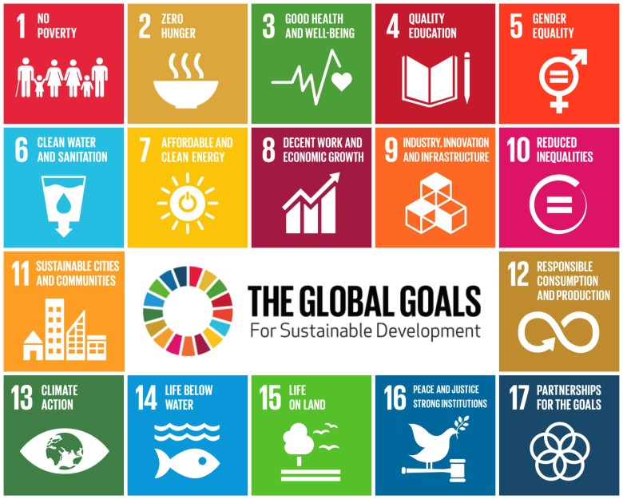
Bioeconomy – links to SDGs
SDGs and the Job Sectors
Agriculture – 1, 2, 3, 6, 8, 11, 12, 13, 15
Forestry – 12,13,15
Fishing and Aquaculture – 12, 13, 14
Food/beverages – 1, 2, 3, 6, 12, 13, 14, 15
Bio-based Textiles – 8, 9, 12
Wood products and Furniture – 8, 9, 12
Paper – 8, 9, 12
Bio-based Chemicals and Pharmaceuticals – 3, 8, 9, 12
Plastics and Rubber – 8, 9, 12
Liquid Biofuels and Bioelectricity – 7, 8, 9, 11, 12
Notes:
There are 17 Sustainable Development Goals set out by the United Nations to create a sustainable global economy and environment. The 10 job sectors for the EU all play multiple roles in helping obtain the goals set forth by the UN.
The common goal under each industry is number 12: responsible consumption and protection. SDG 12 aims to “drastically reduce food waste, begin making more environmentally sound decisions, and help encourage companies to adopt increasingly sustainable practices in all forms of their business” (The Founder Institute, 2019). SDG 12 embodies the purpose surrounding the transition to a bioeconomy as it aims to encompass all aspects surrounding the production of goods, services, and energy to lead to a more sustainable environment for the people and for our planet.
The Founder Institute (2019). Founder Institute. https://fi.co/insight/17-companies-helping-meet-the-17-un-sustainable-development-goals

Slide 10
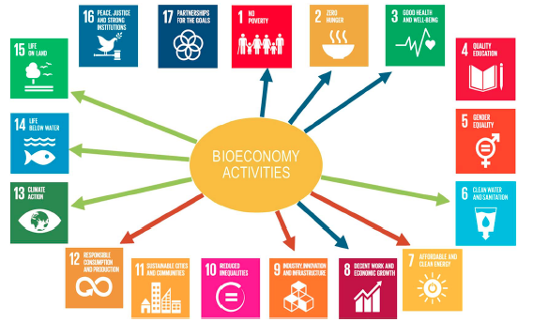
Links between SDGs and Bioeconomy
Sustainable Development Goals are affected by bioeconomy activities
Some of the aims of the bioeconomy are complementary or even identical to SDG targets. A sustainable bioeconomy has the potential to advance several SDGs.
However, there can also potential negative effects that should be eliminated or reduced. For example, “increased demand for land can lead to land grabbing, displacements, unequal distribution of land considering soil quality, and loss of communal land” (Heimann, 2019, p. 52)
Blue arrow: Socioeconomic targets.
Green arrow: Ecological targets.
Red arrow: Clean industry & economic targets.
Source: Heimann, T., 2019. Bioeconomy and SDGs: does the bioeconomy support the achievement of the SDGs?. Earth's Future, 7(1), pp.43-57.
Notes:
This slide shows links between the bioeconomy and the SDGs.
Heimann, T., 2019. Bioeconomy and SDGs: does the bioeconomy support the achievement of the SDGs?. Earth's Future, 7(1), pp.43-57.

Slide 11
Interactions among Sustainable Development Goals (SDGs)
The importance of the interactions between SDGs was emphasised in the UN’s Global Sustainable Report for 2019.
This figure is based on 65 global assessments comprising UN reports and international scientific assessments, as well as 112 scientific articles published since 2015 with explicit reference to the SDGs.
This assessment reveals relative importance of the potential trade-offs by mapping the summed scores of influencing (horizontal) and influenced (vertical) interactions among SDGs. Figure also shows important gaps in knowledge where certain cells in the matrix are left blank.
Source: Independent Group of Scientists appointed by the Secretary-General (2019), Global Sustainable Development Report 2019: The Future is Now – Science for Achieving Sustainable Development, (United Nations, New York).
https://sustainabledevelopment.un.org/content/documents/24797GSDR_report_2019.pdf
Notes:
Source: Independent Group of Scientists appointed by the Secretary-General (2019), Global Sustainable Development Report 2019: The Future is Now – Science for Achieving Sustainable Development, (United Nations, New York).
https://sustainabledevelopment.un.org/content/documents/24797GSDR_report_2019.pdf

Slide 12
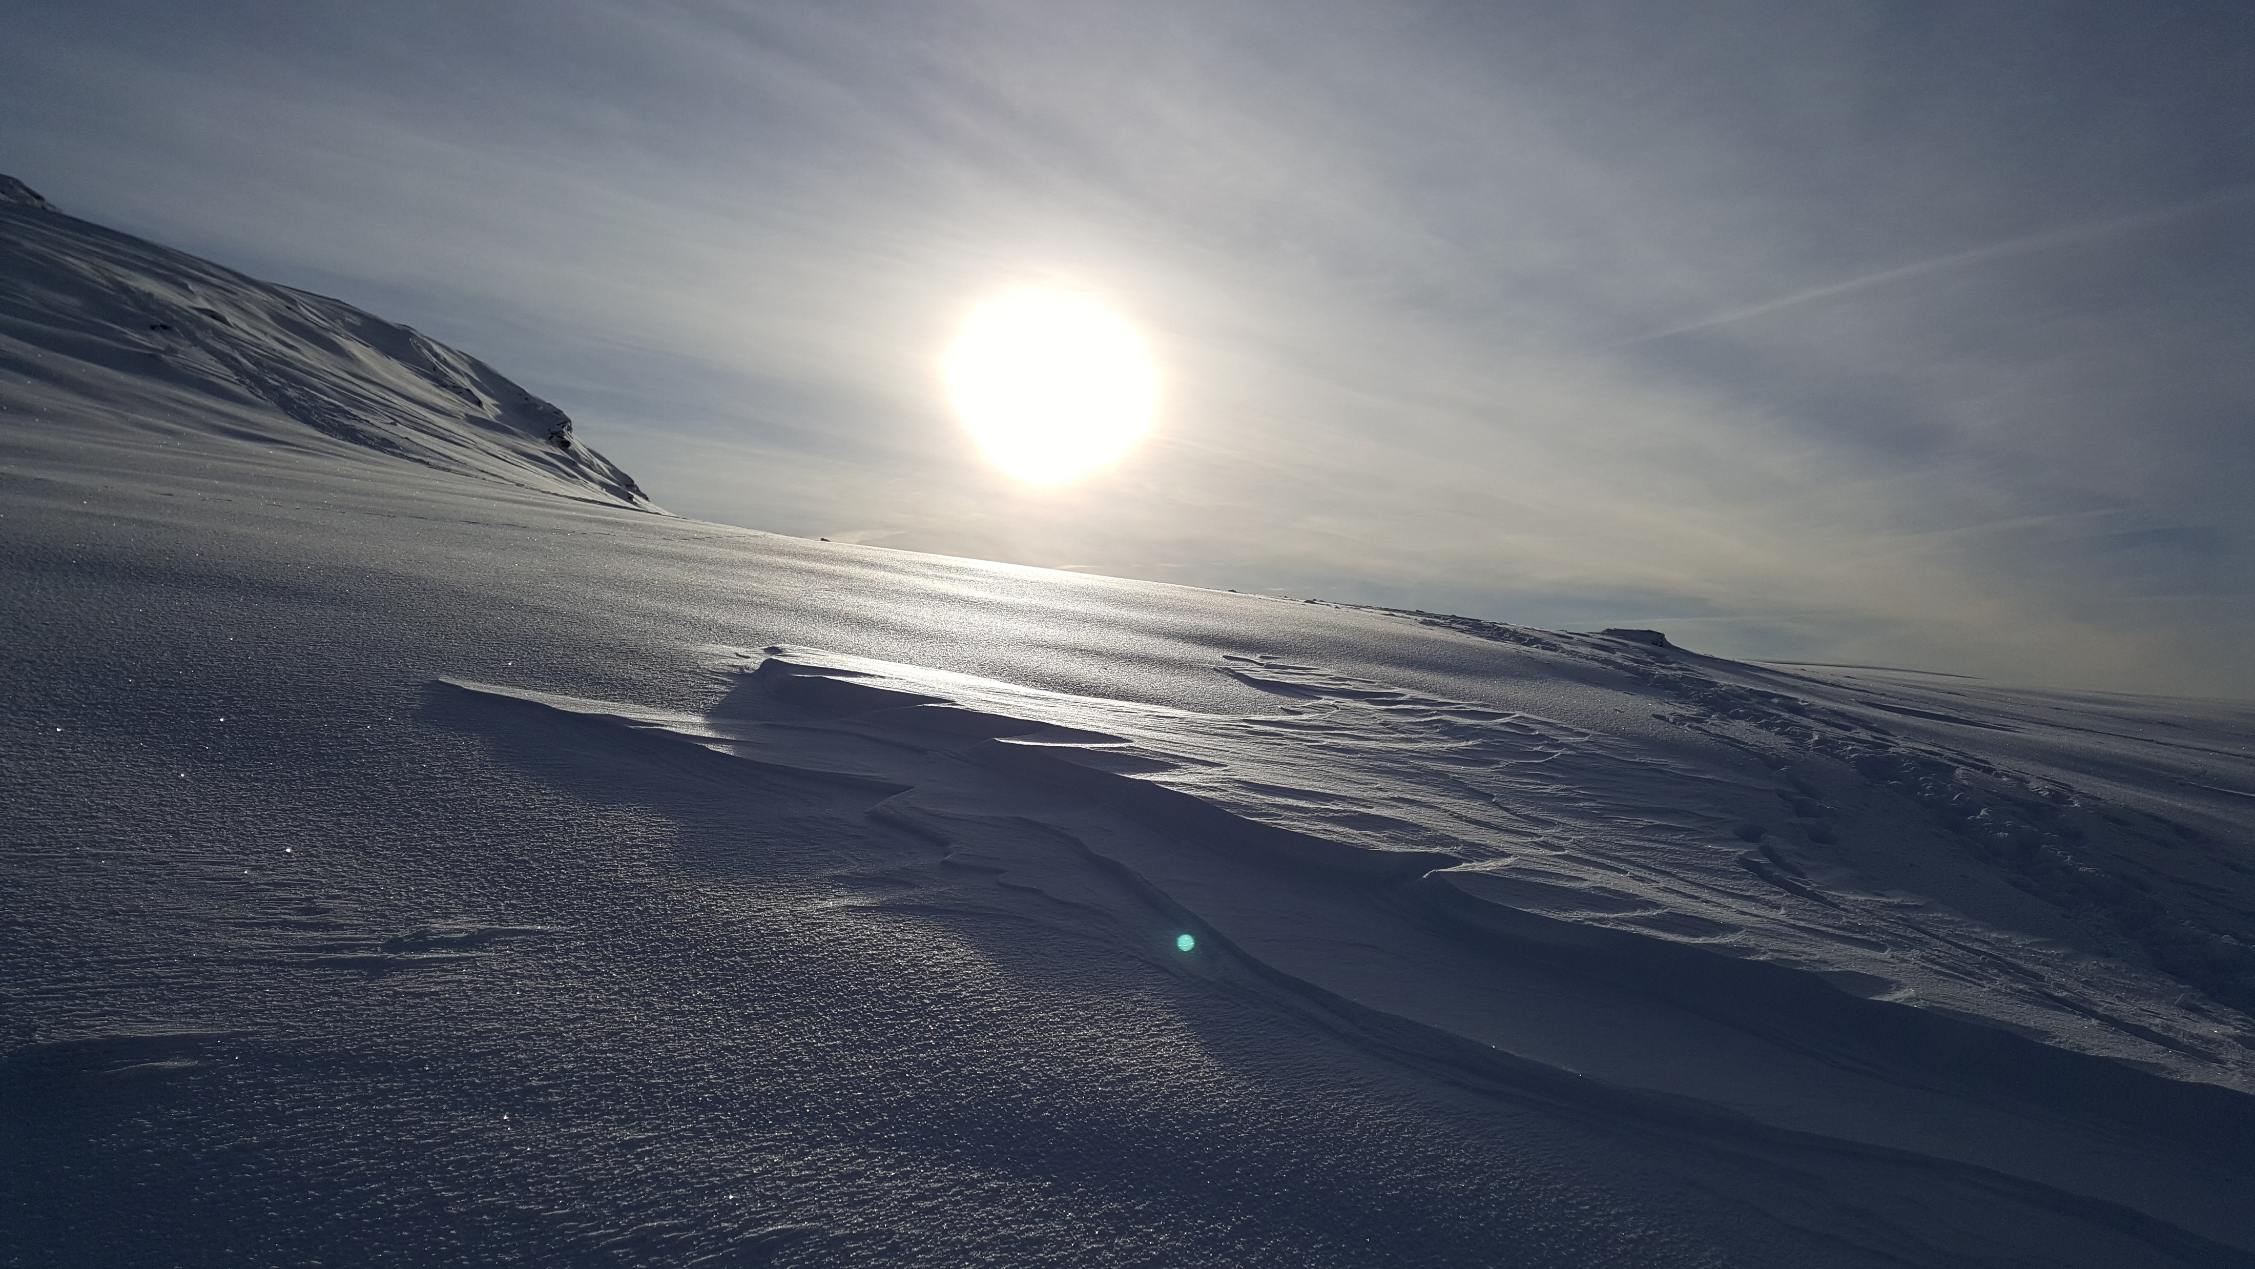
Bioeconomy & climate change
Bioeconomy and climate change mitigation
“Bioeconomy offers great opportunities to realising a competitive, circular and sustainable economy with a sound industrial base that is less dependent on fossil carbon. A sustainable bioeconomy also contributes to climate change mitigation, with oceans, forests and soils being major carbon sinks and fostering negative CO₂ emissions.”
Bell et al. (2018, p. 25)
Scottish Highlands
Bell, J., Paula, L., Dodd, T., Németh, S., Nanou, C, Mega, V. & Campos, P. (2018) EU ambition to build the world’s leading bioeconomy: Uncertain times demand innovative and sustainable solutions. New Biotechnology 40: 25–30.
Notes:
It is important to point out not only links to sustainability but also climate change mitigation.

Slide 13
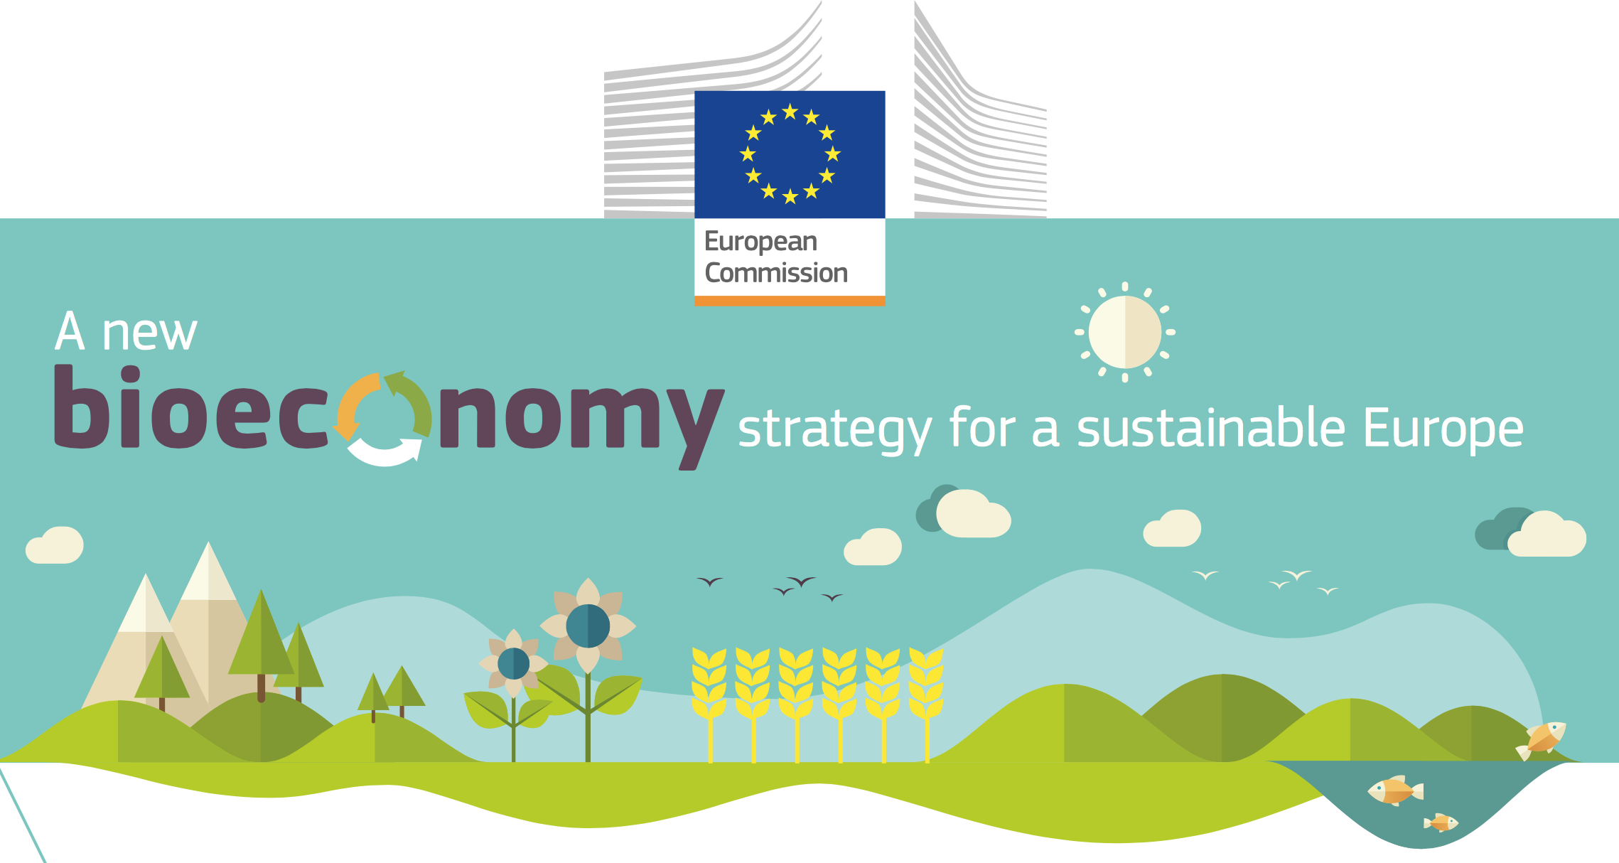
Ecological limits
In addition to links to sustainability and climate change mitigation, it is critical that the bioeconomy operates within safe ecological limits.
With the new bioeconomy strategy, the European Commission supports initiatives at national and regional level to develop an efficient and sustainable bioeconomy and this includes:
  implementing an EU-wide monitoring system to track progress towards a sustainable and circular bioeconomy.
  providing guidance on how best to operate the bioeconomy within safe ecological limits.
Notes:
Notes to teacher: Explain that to try and tackle the issues surrounding ecological limits: National and international bodies have specific guidelines. An example of this is the European Commission’s 2018 publication; ‘A new bioeconomy strategy for a sustainable Europe.’ Further information available at: https://ec.europa.eu/commission/news/new-bioeconomy-strategy-sustainable-europe-2018-oct-11-0_en
Key reading:
EC (2018), Bioeconomy: A new strategy for a sustainable Europe Restoring healthy ecosystems and enhancing biodiversity. European Commission https://ec.europa.eu/research/bioeconomy/pdf/ec_bioeconomy_actions_2018.pdf
Could also check for more advanced reading:
Giampietro, M. (2019). On the circular bioeconomy and decoupling: implications for sustainable growth. Ecological economics, 162, 143-156. https://www.sciencedirect.com/science/article/pii/S0921800918317178
Vivien, F. D., Nieddu, M., Befort, N., Debref, R., & Giampietro, M. (2019). The hijacking of the bioeconomy. Ecological economics, 159, 189-197. https://www.sciencedirect.com/science/article/abs/pii/S0921800918308115

Slide 14
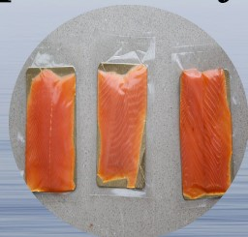
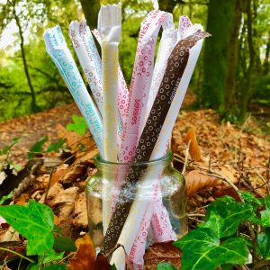

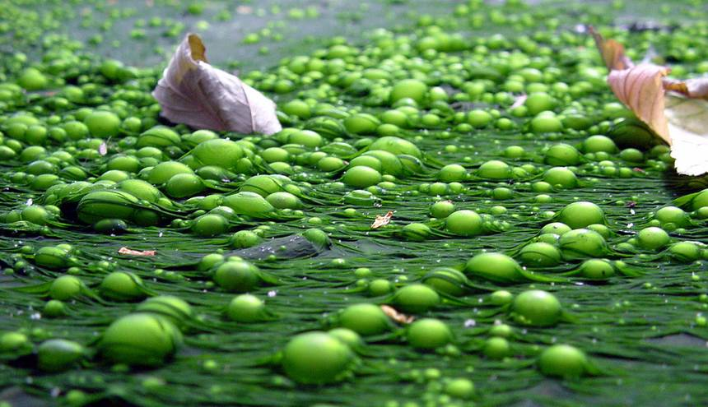

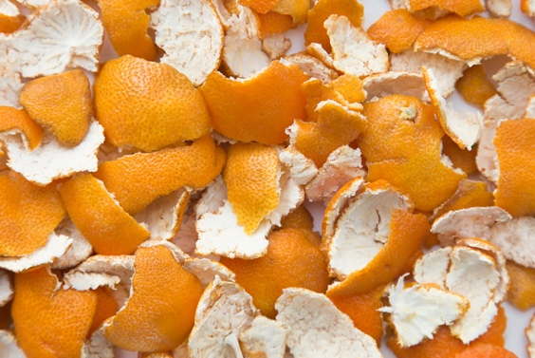
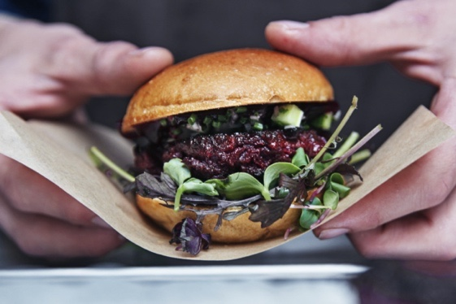
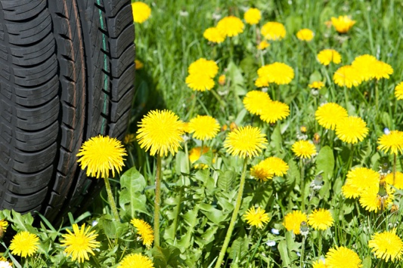

Bioeconomy resources
So what can the bioeconomy use as resources?
Discarded Shells and Fish Skin from Fisheries
Aquafaba (the water leftover from cooking chickpeas)
Algae and Seaweed
Milk Protein
Mushroom Roots
Coffee Grounds
Wheat Bran
Plants
Insects
Wood
Elephant Poo
Notes:
Reminder: the bioeconomy uses renewable biological resources from land and sea – such as crops, forests, fish, animals and micro-organisms – to produce food, materials and energy.
Companies are finding innovative ways to use materials that would otherwise end up in a landfill and transforming them into products that can be made in a more sustainable way.

Slide 15
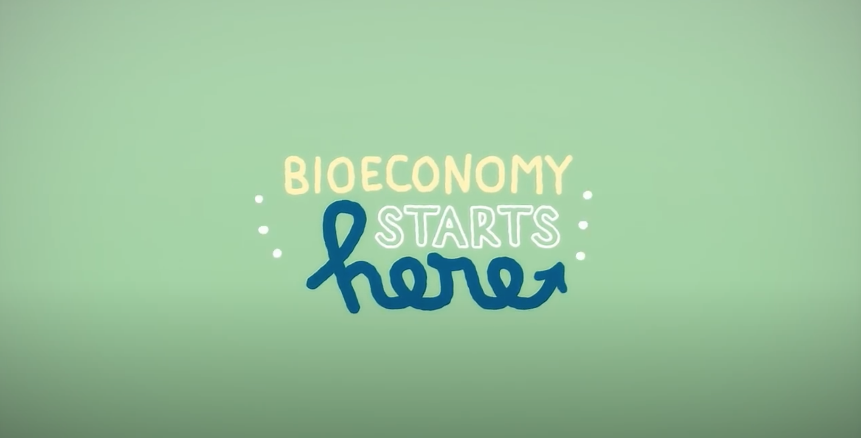
Video: Bioeconomy starts here
Video (1 minute and 57 seconds): https://www.youtube.com/watch?v=2xvXkOMRTs4
Languages for sub-titles for video include: Bulgarian, Latvian, Macedonian, Polish and Romanian
Notes:
Video explains briefly the most important basics of a bioeconomy by means of an animated film. It presents the differences between fossil and biological resources as basis for products. It introduces the bioeconomy as a circular economy and illustrates its positive aspects and advantages in the future.

Slide 16
The transition to a bioeconomy is complex
Factors influencing the bioeconomy: government policy, regulatory conditions, intellectual property rights, human resources, social acceptance, market structure (McCormick and Kautto, 2013), resource availability, sustainability and environmental impacts.
“The transition to an energy and materials production regime based on renewable resources can […] be expected to be fraught with many setbacks and obstacles, technically and politically. [This is further complicated by] the grand challenges faced today: energy security, food security and water security and climate crisis.” (Philp, 2018, p.11)
“What further complicates the bioeconomy is that the drivers and constraints involve complex interactions and feedbacks, making it highly challenging to isolate and analyse factors.” (McCormick and Kautto, 2013, p. 2599).
McCormick, K. and Kautto, N. (2013). The Bioeconomy in Europe: An Overview. Sustainability, 5: 2589-2608.
Philp, J. (2018). The bioeconomy, the challenge of the century for policy makers. New Biotechnology. 40 (Part A): 11-19.
Notes:
These two papers discuss issues associated with the complexity of the transition to bioeconomy.
Key reading:
McCormick, K. and Kautto, N. (2013). The Bioeconomy in Europe: An Overview. Sustainability, 5: 2589-2608.
Philp, J. (2018). The bioeconomy, the challenge of the century for policy makers. New Biotechnology. 40 (Part A): 11-19.

Slide 17
Bioeconomy challenges: Resource Provision and Biodiversity loss
Bioproducts are derived from renewable biological resources. The bioeconomy makes use of many different biomass resources, from crops to forests to microorganisms. Without these feedstocks, there would be no bioeconomy.
It is critical that the bioeconomy does not compete with food production and does not affect biodiversity. For example, marginal lands may not be used for food production but may be important for biodiversity
It is therefore fundamental to carry a biodiversity assessment.
Notes:
Key reading:
The Bioecomomy Consultants (2018), BIG BIOECONOMY CHALLENGES - PART 2. https://www.nnfcc.co.uk/news-big-bioeconomy-challenges-2
Brownlie, S. (2013), IAIA fast tips No. 5 - Biodiversity Assessment. International Association for Impact Assessment (IAIA). https://www.iaia.org/fasttips.php

Slide 18
Biodiversity assessment
Five important things to do when carrying out a biodiversity assessment:
1. Identify major constraints, high risk areas, and significant impacts on biodiversity and ecosystem services at the outset, seeking alternatives to avoid them. Only when impacts are unavoidable should measures to minimize, restore, offset biodiversity loss, and compensate for lost ecosystem goods and services be addressed.
2. Use appropriate local specialists with explicit Terms of Reference and integrate social, economic and biodiversity considerations. Assess indirect, induced and cumulative impacts on biodiversity as well as direct impacts; these impacts are often more harmful than direct or “footprint” impacts.
3. Engage with interested and affected parties—including indigenous peoples—to identify and evaluate impacts and to determine how traditional knowledge and local cultural practices can contribute to any biodiversity initiative.
4. Take a precautionary approach when baseline information is poor, or there is uncertainty about impacts or the effectiveness of mitigation. Good monitoring, research and adaptive responses are crucial for managing impacts on biodiversity.
5. Seek to make a lasting net positive contribution to biodiversity conservation in the affected area through interventions beyond “no net loss.”
Notes:
Key reading:
Brownlie, S. (2013), IAIA fast tips No. 5 - Biodiversity Assessment. International Association for Impact Assessment (IAIA). https://www.iaia.org/fasttips.php

Slide 19
Direct, indirect and cumulative impacts
In addition to direct impacts, it is critical to assess indirect, induced and cumulative impacts on biodiversity as these impacts are often more harmful than direct impacts.
Direct - caused by the project and occur in the same time and place as the project itself.
Example: Damage to wetland due to construction of a bridge.
Indirect impacts - triggered by project but affect the environment as a knock-on effect, which can be later in time or farther removed in distance from project.
Example: A road could include potential changes in land use, which in turn can trigger erosion, which in turn can trigger silting of a river, which in turn can affect water supply.
Cumulative impacts - caused by the sum of the project's impacts on the environmental component and/or the project's impacts when added to those of other past, present, or future projects. Three types of cumulative impacts:
additive or aggregate - the simple sum of all the impacts
antagonistic or neutralising - where impacts counteract each other, reducing the overall impact.
synergistic - where impacts interact to produce an impact greater than the sum of the individual impacts
Notes:
In addition to direct impacts, it is critical to assess indirect, induced and cumulative impacts on biodiversity as these impacts are often more harmful than direct impacts.
Students could think of both direct and indirect impacts of different activities

Slide 20
What are ‘impacts’?
What are ‘impacts’?
Impacts are changes that are judged to have environmental, political, economic or social significance to society. Impacts may be positive or negative and may affect the environment, communities, human health and well-being, desired sustainability objectives, or a combination of these.
Source: Partidário, M. (2012), IAIA fast tips No. 1 - What is Impact Assessment. International Association for Impact Assessment (IAIA). https://www.iaia.org/fasttips.php
Notes:
Key reading:
IAIA (1999), Principles of EIA best practice. International Association for Impact Assessment. [http://www.iaia.org/best-practice.php]
Partidário, M. (2012), IAIA fast tips No. 1 - What is Impact Assessment. International Association for Impact Assessment (IAIA). https://www.iaia.org/fasttips.php

Slide 21
An EIA and/or SEA may also be needed or useful
What is Environmental Impact Assessment (EIA)?
What is SEA (Strategic Environmental Assessment)?
EIA is a process that examines (in a transparent way) the environmental consequences of a proposed project, e.g. a new biofuel factory, in advance, to inform decision-making.
EIA has been in force in the EU since 1985
  SEA is the process of evaluating the impacts of proposed policies, plans and programmes, to inform decision-making.
  For example, an energy policy, a local plan, and a coordinated series of dams.
SEA has been in force in the EU since 2001
Notes:
Key reading:
IAIA (1999), Principles of EIA best practice. International Association for Impact Assessment. [http://www.iaia.org/best-practice.php]
Partidário, M. (2012), IAIA fast tips No. 1 - What is Impact Assessment. International Association for Impact Assessment (IAIA). https://www.iaia.org/fasttips.php
Environmental assessment in Europe:
https://ec.europa.eu/environment/eia/index_en.htm
Member States' summaries of Strategic Environmental Assessment - Each national summary provides basic information on the legal, administrative and policy context regarding the SEA system in a Member State. It describes the legal and administrative framework supporting the implementation of the SEA Directive, including the organisational arrangements as well as procedural obligations in place.
https://ec.europa.eu/environment/eia/member_states_summaries.htm

Slide 22
Projects need to think about net positive outcomes
Impacts on Natural Habitats
+
Contribution
Break-Even Point
Restore & Offset
Impacts
Residual
Impacts
Residual
Impacts
_
Potential
Impact
Net positive outcomes
Minimize Impacts
No net loss
Avoid
Impacts
Notes:
“Net Positive Impact (NPI) on biodiversity is a target for project outcomes in which the impacts on biodiversity (i.e. the variety of ecosystems and living things) caused by the project are outweighed by the actions taken to avoid and reduce such impacts, rehabilitate affected species/landscapes and offset any residual impacts.” (NPI Alliance, 2015).
Key reading:
Brownlie, S. (2013), IAIA fast tips No. 5 - Biodiversity Assessment. International Association for Impact Assessment (IAIA). https://www.iaia.org/fasttips.php
NPI Alliance (2015). Net Positive Impact for biodiversity: The conservation case. Gland, Switzerland: IUCN.
https://www.iucn.org/sites/dev/files/import/downloads/npi__conservation__01_2016_1.pdf

Slide 23
Importance of enhancement
In addition to consider the mitigation of negative environmental impacts (i.e. making changes to the project or potential location to avoid adverse effects) it is important to also consider the enhancement of positive impacts (ensuring the success of a wider range of direct and indirect benefits that could possibly flow from the project or strategic action).
‘Benefits’ means positive outcomes to communities and/or the biophysical environment in the form of (João et al., 2011):
opportunities for social and community development
improved health and wellbeing
improved biodiversity
restored ecosystems
increased green spaces and improved urban design
improved landscape character
protected and respected cultural heritage
Notes:
Key reading:
João, E, Vanclay, F and den Broeder, L. (2011), Emphasising enhancement in all forms of impact assessment: introduction to a special issue. Impact Assessment and Project Appraisal, 29(3): 170-180.

Slide 24
Mitigation hierarchy
When considering negative impacts, the mitigation hierarchy must be always considered
Source: CSBI (2015)
The mitigation hierarchy is a tool to prevent the negative impacts of development projects. And, if prevention is not possible, then to remediate any impacts. It has a sequence of four key actions—avoid, minimize, restore and offset. Avoid is the most preferred action and offset is the least preferred one.
Notes:
Key reading:
CSBI (2015). A cross-sector guide for implementing the mitigation hierarchy. Prepared by the Biodiversity Consultancy on behalf of IPIECA, ICMM and the Equator Principles Association: Cambridge UK.
This publication is aimed at environmental professionals working in, or with, extractive industries and financial institutions, who are responsible for overseeing the application of the mitigation hierarchy to biodiversity conservation, while balancing conservation needs with development priorities. The guide is currently available in English, and may be translated into additional languages in the future subject to demand. It is a companion document to CSBI’s Timeline Tool and the joint CSBI-MFI Biodiversity Working Group’s Good Practices for the Collection of Biodiversity Baseline Data.
There is a summary (which includes the diagram in the slide) available in English, Italian, French, Russian and Spanish.

Slide 25
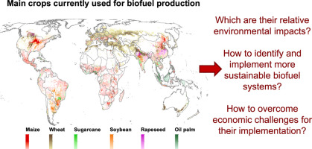
Need to maximize socioeconomic and environmental benefits
Correa et al. (2019, p. 250) argue that:
“A sustainable biofuel production should maximize socioeconomic and environmental benefits.”
“The identification and implementation of sustainable biofuel production alternatives should be based on rigorous assessments that integrate socioeconomic and environmental objectives at local, regional, and global scales.”
Source: Correa et al. (2019)
Notes:
Key reading:
Correa, D., Hawthorne, B., Fargione, J., Hill, J., Possingham, H., Thomas-Hall, S. and Schenk, P. (2019). Towards the implementation of sustainable biofuel production systems. Renewable and Sustainable Energy Reviews, 107: 250-263.

Slide 26
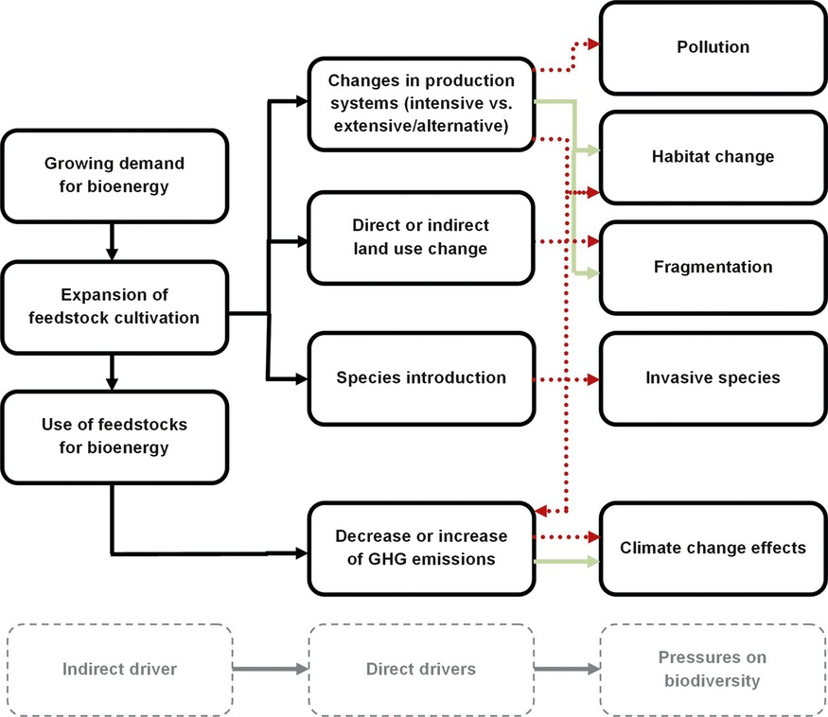
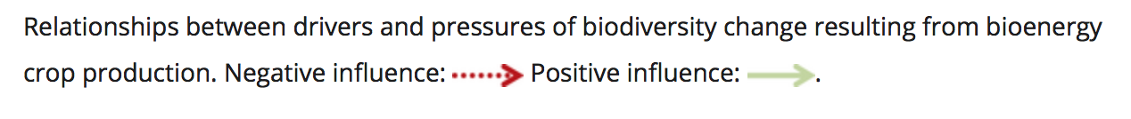
Example: The impacts of biofuels
Immerzeel et al. (2014), provide a detailed review on biodiversity impacts of bioenergy crop production. The authors point out:
importance of the initial land use - majority of negative impacts refer to the conversion of natural vegetation to first generation biofuel crops.
crops have different impacts – depends if 1st, 2nd and 3rd generation biofuels
biodiversity impacts include habitat change, fragmentation, pollution, invasive species and climate change effects (see Figure)
(Immerzeel et al., 2014)
Notes:
Very important to consider the impacts of biofuels that vary according to 1st, 2nd and 3rd generation biofuels.
Key reading:
Immerzeel, D.J., Verweij, P., Hilst, F. and Faaij, A.P. (2014), Biodiversity impacts of bioenergy crop production: a state‐of‐the‐art review. GCB Bioenergy, 6:183-209

Slide 27
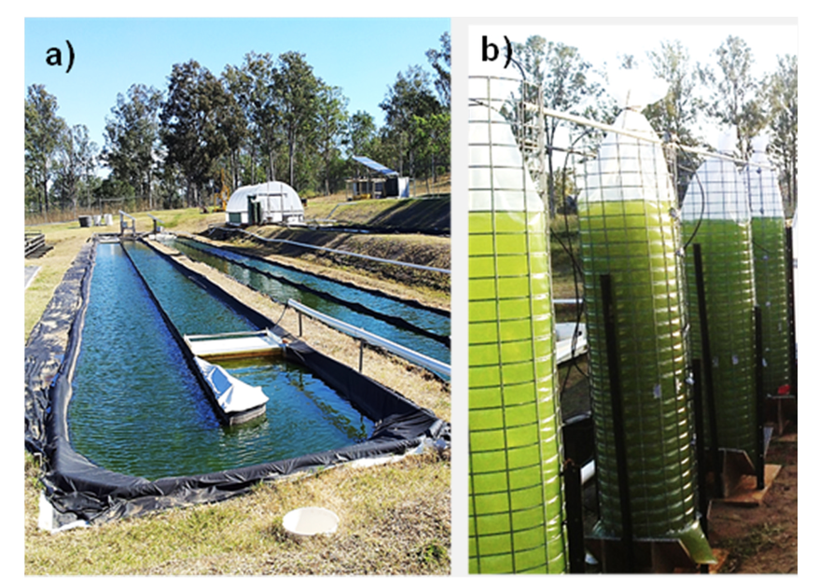
1st, 2nd and 3rd generation biofuels
Three types of biofuels (Oregan State University, n.d.):
1st generation biofuels (e.g. rape oil, sunflower oil, beet sugarcane, corn, potatoes) - main drawback: come from biomass that is also a food source.
2nd generation biofuels (e.g. agricultural and forest residues) come from non-food biomass, but still compete with food production for land use.
3rd generation biofuels (e.g. engineered crops such as algae) present the best possibility for alternative fuel because they don’t compete with food. Algae can grow in areas unsuitable for 1st and 2nd generation crops, which would relieve stress on water and arable land used. Plus it can be grown using sewage, wastewater, and saltwater.
Algae Energy Farm in Australia
(Algae Biotechnolog Laboratory, University of Queensland, Australia).
Cultivation on open ponds (a) following initial growth in sealed bags (b).
Source: Correa, et al. (2019)
Notes:
Key reading:
Correa, D., Hawthorne, B., Fargione, J., Hill, J., Possingham, H., Thomas-Hall, S. and Schenk, P. (2019). Towards the implementation of sustainable biofuel production systems. Renewable and Sustainable Energy Reviews, 107: 250-263.
Oregan State University (n.d.), Bioenergy Education Initiative. https://agsci.oregonstate.edu/sites/agsci.oregonstate.edu/files/bioenergy/generations-of-biofuels-v1.3.pdf

Slide 28
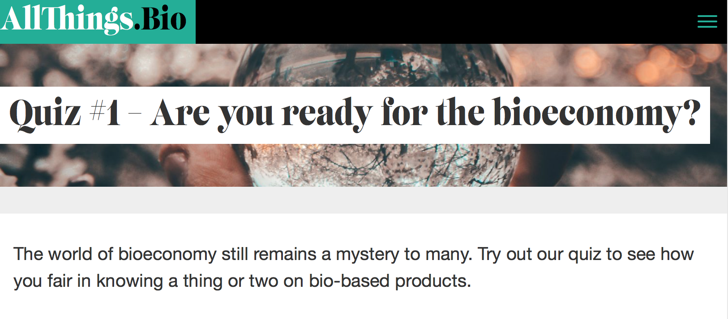
Bioeconomy Quiz
http://www.allthings.bio/quiz/are-you-ready-for-the-bioeconomy/
Notes:
Interactive quiz with 6 questions about the bioeconomy. User can see if answer is right or wrong right away and explanation is provided, plus explore every question's concept by clicking on "Learn more about this" link, redirecting users to other sites with in-depth information. Quiz is entertaining and informative. Questions ranges from simple ones to those which require a bit more background, so relevant to different target audiences.
This is a good way to both acquire new knowledge and test existing knowledge.
Time that will take: 6 minutes or more - depending if reading extra information.

Slide 29
Questions and Discussion
Name of presenter
Notes:
Notes to the teacher: Speaker’s name to go in the space at the bottom left of the slide. This is the final slide of the presentation. Allow time for students/participants to ask any questions.

Slide 30

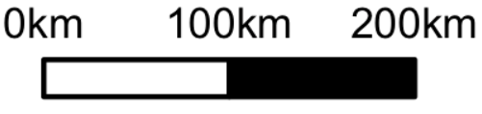
https://be-rural.eu
These educational resources were developed as part of the BE-Rural project
Bio-based strategies and roadmaps for enhanced rural and regional development in the EU (April 2019 – March 2022)
BE-Rural supports
… regional stakeholders in five countries:
Latvia: Vidzeme and Kurzeme
Poland: Szczecin and Vistula Lagoons
Romania: Covasna
Bulgaria: Stara Zagora
North Macedonia: Strumica
The goal of BE-Rural is to realise the potential of regional bio-based economies by supporting relevant actors in the participatory development of bioeconomy strategies and roadmaps
https://be-rural.eu/innovation-regions/
Notes:
BE-Rural has five innovation regions
BE-Rural will create five regional Open Innovation Platforms (OIPs) for the participatory development of bioeconomy strategies and roadmaps. The BE-Rural OIPs will be established in five regions across the EU with different biomass potentials and will be based on the regional Stakeholder Working Groups (SWGs). Within the OIPs, the main task of the SWGs will be to formulate concrete strategy or roadmap documents by engaging with different actors and opening the platform for a wide range of stakeholders in the region, including civil society organisations and citizens.
Stara Zagora, Bulgaria: This innovation region will focus on seeking new technologies for the application of essential oils and herbal plants in the cosmetics and pharmaceutical industry. The small-scale production in this area will be combined with tourism-related activities to expand the existing business status quo and potential. Ultimately, the region will establish closer relations and network between companies. Regional partner: Bulgarian Industrial Association (BIA)
Vidzeme and Kurzeme, Latvia: This region will focus on the potential of by-products of forest management (i.e. from young forest stand thinning, short rotation coppice and forestry (SRC/SRF) plantations, removing of overgrowth in abandoned agricultural lands and perennial grasses) as a source of bioenergy or biorefinery. The region will investigate the value of agroforestry systems of perennial grasses and SRC or SRF trees as grazing areas, and the production of hay or grass seeds. The potential smart use of small timber wood from young forest stand thing will be explored. Regional partner: The Latvian State Forest Research Institute (SILAVA)
Strumica, North Macedonia: The region will focus on the utilization of agricultural residues, specifically the by-production of organic materials from agricultural activities, as a source of energy for domestic and industrial purposes. The region will investigate technology options for energy conversion of biomass materials generated on agricultural fields or farms (field-based residues), as well as those generated during the processing of agricultural products (process-based residues). Regional partner: International Centre for Sustainable Development of Energy, Water and Environment Systems (SDEWES-Skopje)
Szczecin Lagoon and Vistula Lagoon, Poland: This region will focus on small-scale fisheries, specifically on the sustainable use of currently underused and low-value fish species located in two lagoons. The region will investigate small-scale technology options that can be applied to utilize low-value fish species as products for human consumption. Regional partner: The National Marine Fisheries Research Institute (NMFRI)
Covasna, Romania: The region will focus on addressing fragmented value chains and implementing the circular economy concept within the county’s industrial sectors (i.e. wood and furniture, textiles, agro-food, mechanical engineering, green energy). The region will investigate the development potential of underused biomass (plant matter and wood waste) and it implication on societal challenges (e.g., rural unemployment or marginalised communities). This will be done within a local development business model based on a small-scale technology option ensuring the autonomous energy supply for civil and industrial needs. Regional partner: Institute for Economic Forecasting (IPE)
Source: BE-Rural (2020), Innovation regions, available at: https://be-rural.eu/innovation-regions/

