Slide 1

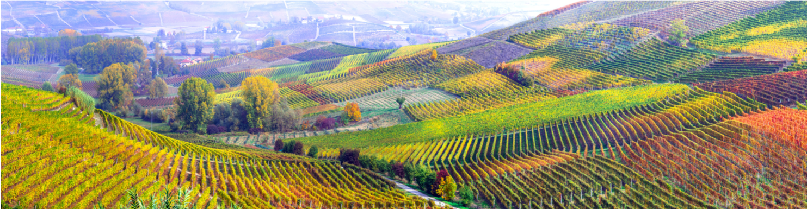
Key Principles of the Circular Economy and links to the Bioeconomy
Name of presenter
Notes:
Notes to the teacher: Teacher’s name to go in the space at the bottom left of the slide. You can edit this slide to introduce the topic. This presentation is designed to introduce the circular economy concept. You can see the outline of the presentation in the next slide with the justifications on why the slides are structured the way they are.
Most of the earlier slides up to slide number 12 should be quite basic and easy to understand. Starting from slide 13, the contents might be a little bit more challenging to grasp the concept and fully appreciate. Target audience can be secondary, high school students, colleges and university students.
Excluding the video, this first slide and the outline slide, there are 26 slides – so these slides should take between 26 and 52 minutes to present, depending of amount of explanation.
The video is 3 minutes an 48 seconds long.

Slide 2
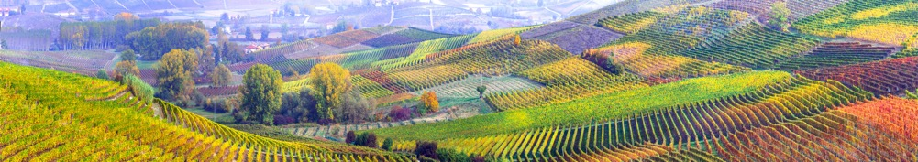
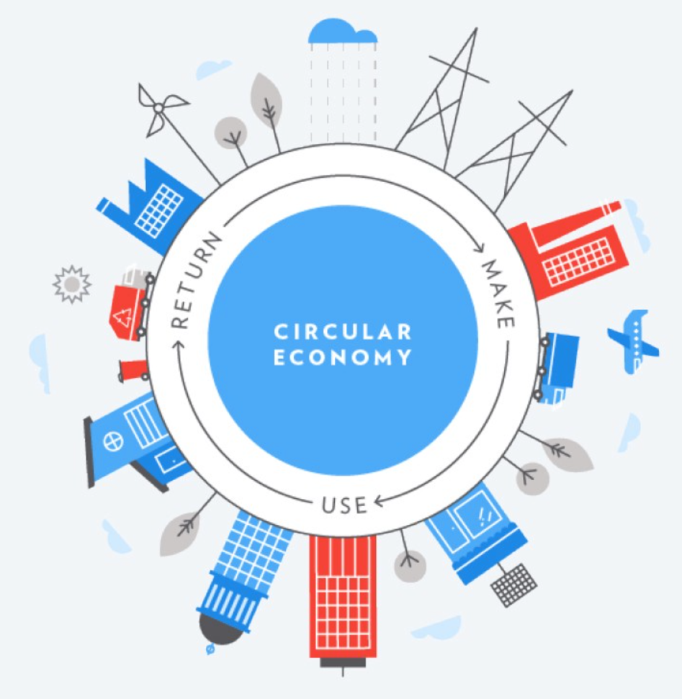
Outline
Outline
Quiz on Waste Statistics
Linear Economy
Finite Resources
Circular Economy
Circular Business Models
Barriers to Circular Economy
Conclusion
Notes:
Notes to teacher on how to present slide
This slide shows the outline of the contents for this presentation on circular economy.
1. It will start with a small quiz on waste statistics. There are four questions regarding food wastes, textile wastes, electronic wastes and plastic waste.
2. Then, linear economy would be introduced as one of the underlying problems causing these wastes.
3. Brief overview on finite resources would be provided to illustrate that the current linear system cannot be sustained.
4. Then, circular economy would be introduced as a system change to solve some of the pressing problems created by linear economy.
5. Five circular business models would be introduced as ways to incorporate circular economy in the way business operates.
6. Finally, barriers to circular economy would be introduced as to why the circular business models have yet to become mainstream business models.
The circular economy is considered as a system solution to tackle some of the most pressing global challenges created by a linear economy. Hence, it would be great if the learners know and understand first what the linear economy is, its associated problems, the underlying causes and future challenges before introducing the solution which is a circular economy. This way, the audience would fully appreciate the explanation of circular economy, its purpose, how it can be implemented and what is hindering its progress. The structure of the slides was designed based on this thought.
Image used: https://uxplanet.org/the-rise-of-the-circular-economy-8fdfc0a18ca5

Slide 3
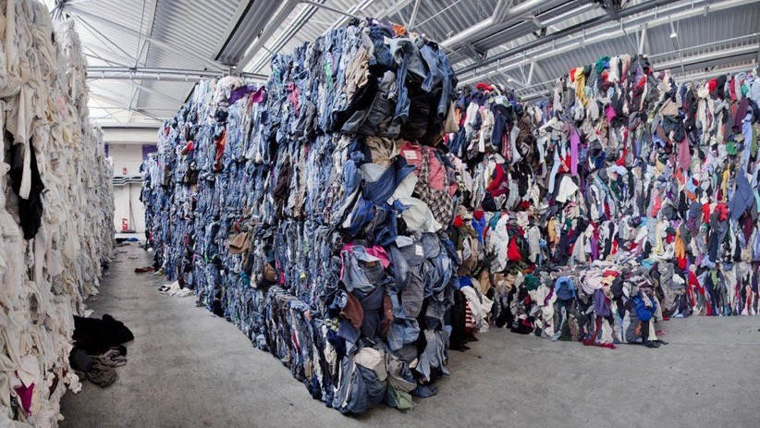
Quiz on Wastes
1. How much of the textile wastes is being landfilled or incinerated globally? (EMF, 2017)
One garbage truck equivalent every one hour
One garbage truck equivalent every one minute
One garbage truck equivalent every one second
Outline
Quiz on Waste Statistics
Linear Economy
Finite Resources
Circular Economy
Circular Business Models
Barriers to Circular Economy
Conclusion
Notes:
Notes to teacher on how to present slide
This slide asks the first question of the quiz. Instead of giving away a few statistics, you can make the students think a little bit. This way, they would remember the figure better compared to just giving away the statistic. Hence, a quiz was chosen to highlight the statistics of four very common wastes (Fashion & textiles, electronic, food and plastic wastes) in our daily life, before introducing a linear economy. Correct answer is c. One garbage truck load of textile wastes every one second.
Maybe you can make use of mentimeter to conduct the quiz in the class to make it more fun, interactive and engaging. If this is not an option, you can try to get all students to engage by asking for a show of hand for each option A, B or C, instead of waiting for just one student to voice out the answer.
Key links for further information
This quiz is based on the information from the report called “A new textile economy: Redesigning fashion’s future” by Ellen MacArthur Foundation.
Report could be found in https://www.ellenmacarthurfoundation.org/publications/a-new-textiles-economy-redesigning-fashions-future
Correct answer is c. One garbage truck load of textile wastes every one second.
Image Link: https://ichef.bbci.co.uk/news/976/cpsprodpb/49F7/production/_102753981_hm_soex0372.jpg

Slide 4
Quiz on Wastes
1. How much of the textile wastes is being landfilled or incinerated globally? (EMF, 2017)
One garbage truck equivalent every one hour
One garbage truck equivalent every one minute
One garbage truck equivalent every one second
Outline
Quiz on Waste Statistics
Linear Economy
Finite Resources
Circular Economy
Circular Business Models
Barriers to Circular Economy
Conclusion
Notes:
Notes to teacher on how to present slide
This slide asks the first question of the quiz. Instead of giving away a few statistics, you can make the students think a little bit. This way, they would remember the figure better compared to just giving away the statistic. Hence, a quiz was chosen to highlight the statistics of four very common wastes (Fashion & textiles, electronic, food and plastic wastes) in our daily life, before introducing a linear economy. Correct answer is c. One garbage truck load of textile wastes every one second.
Maybe you can make use of mentimeter to conduct the quiz in the class to make it more fun, interactive and engaging. If this is not an option, you can try to get all students to engage by asking for a show of hand for each option A, B or C, instead of waiting for just one student to voice out the answer.
Key links for further information
This quiz is based on the information from the report called “A new textile economy: Redesigning fashion’s future” by Ellen MacArthur Foundation.
Report could be found in https://www.ellenmacarthurfoundation.org/publications/a-new-textiles-economy-redesigning-fashions-future
Correct answer is c. One garbage truck load of textile wastes every one second.
Image Link: https://ichef.bbci.co.uk/news/976/cpsprodpb/49F7/production/_102753981_hm_soex0372.jpg

Slide 5
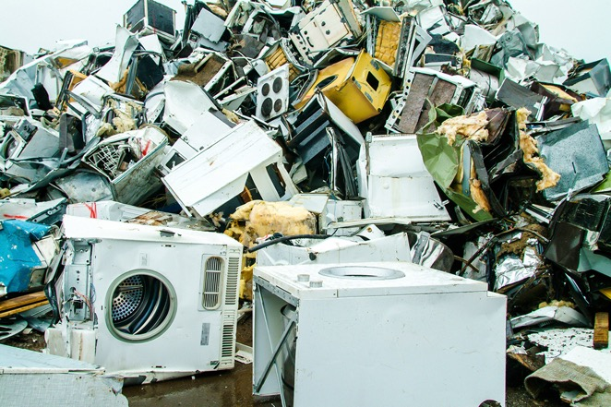
Quiz on Wastes
2. What is the approximate annual volume of global electronic wastes in 2016? (WEF, 2017)
4.7 million tonnes (equivalent in weight of 450 Eiffel Towers)
44.7 million tonnes (equivalent in weight of 4,500 Eiffel Towers)
444.7 million tonnes (equivalent in weight of 45,000 Eiffel Towers)
Outline
Quiz on Waste Statistics
Linear Economy
Finite Resources
Circular Economy
Circular Business Models
Barriers to Circular Economy
Conclusion
Notes:
Notes to teacher on how to present slide
This slide provides a second question of the quiz. This is based on electronic waste, which is also a very common waste in our daily lives.
This quiz is based on the information from the report called “A New Circular Vision for Electronics: Time for a Global Reboot” by World Economic Forum.
Key links for further information
Report could be found in http://www3.weforum.org/docs/WEF_A_New_Circular_Vision_for_Electronics.pdf
The answer is b – 44.7 million tonnes (4,500 Eiffel towers equivalent in weight)
Image Link: https://upload.wikimedia.org/wikipedia/commons/thumb/2/2f/Skyscrapercompare-with-eiffel.svg/1200px-Skyscrapercompare-with-eiffel.svg.png
https://content.internetretailing.net/AcuCustom/Sitename/DAM/043/White_goods_scrap_AdobeStock_257612304.jpeg

Slide 6
Quiz on Wastes
2. What is the approximate annual volume of global electronic wastes in 2016? (WEF, 2017)
4.7 million tonnes (equivalent in weight of 450 Eiffel Towers)
44.7 million tonnes (equivalent in weight of 4,500 Eiffel Towers)
444.7 million tonnes (equivalent in weight of 45,000 Eiffel Towers)
Outline
Quiz on Waste Statistics
Linear Economy
Finite Resources
Circular Economy
Circular Business Models
Barriers to Circular Economy
Conclusion
Notes:
Notes to teacher on how to present slide
This slide provides a second question of the quiz. This is based on electronic waste, which is also a very common waste in our daily lives.
This quiz is based on the information from the report called “A New Circular Vision for Electronics: Time for a Global Reboot” by World Economic Forum.
Key links for further information
Report could be found in http://www3.weforum.org/docs/WEF_A_New_Circular_Vision_for_Electronics.pdf
The answer is b – 44.7 million tonnes (4,500 Eiffel towers equivalent in weight)
Image Link: https://upload.wikimedia.org/wikipedia/commons/thumb/2/2f/Skyscrapercompare-with-eiffel.svg/1200px-Skyscrapercompare-with-eiffel.svg.png
https://content.internetretailing.net/AcuCustom/Sitename/DAM/043/White_goods_scrap_AdobeStock_257612304.jpeg

Slide 7
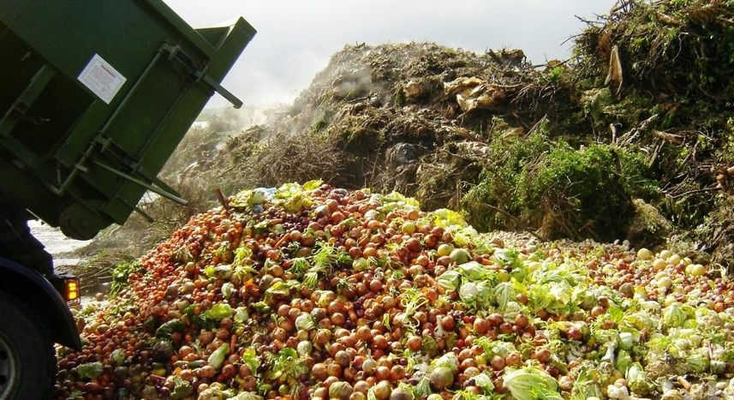
Quiz on Wastes
3. What is the estimated annual volume of food waste globally? (FAO, 2011)
1.3 billion tonnes (one-third of the food produced)
2 billion tonnes (half of the food produced)
2.6 billion tonnes (two-third of the food produced)
Outline
Quiz on Waste Statistics
Linear Economy
Finite Resources
Circular Economy
Circular Business Models
Barriers to Circular Economy
Conclusion
Notes:
Notes to teacher on how to present slide
This quiz is based on the information from the report called “Global Food Loss and Food Waste” by Food and Agriculture Organisations of the United Nations.
The answer is a – 1.3 billion tonnes (one-third of the food produced)
Key links for further information
Report could be found in http://www.fao.org/3/a-i2697e.pdf
Image Link: https://greenblueorg.s3.amazonaws.com/smm/wp-content/uploads/2017/05/Food-Scraps-1024x792.png
https://www.adamsmith.org/blog/proof-perfect-that-supermarket-food-waste-is-not-a-problem

Slide 8
Quiz on Wastes
3. What is the estimated annual volume of food waste globally? (FAO, 2011)
1.3 billion tonnes (one-third of the food produced)
2 billion tonnes (half of the food produced)
2.6 billion tonnes (two-third of the food produced)
Outline
Quiz on Waste Statistics
Linear Economy
Finite Resources
Circular Economy
Circular Business Models
Barriers to Circular Economy
Conclusion
Notes:
Notes to teacher on how to present slide
This quiz is based on the information from the report called “Global Food Loss and Food Waste” by Food and Agriculture Organisations of the United Nations.
The answer is a – 1.3 billion tonnes (one-third of the food produced)
Key links for further information
Report could be found in http://www.fao.org/3/a-i2697e.pdf
Image Link: https://greenblueorg.s3.amazonaws.com/smm/wp-content/uploads/2017/05/Food-Scraps-1024x792.png
https://www.adamsmith.org/blog/proof-perfect-that-supermarket-food-waste-is-not-a-problem

Slide 9
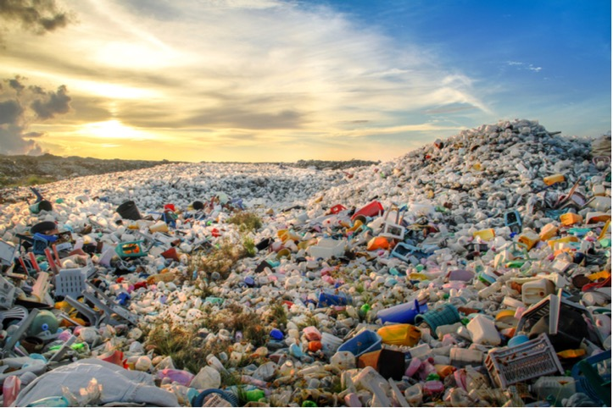
Quiz on Wastes
4. How much plastic waste is produced globally every year? Hint – It is close to the weight of entire human population. (UN Environment, 2015)
200 million tonnes
300 million tonnes
500 million tonnes
Outline
Quiz on Waste Statistics
Linear Economy
Finite Resources
Circular Economy
Circular Business Models
Barriers to Circular Economy
Conclusion
Notes:
Notes to teacher on how to present slide
This slide is the final question of the quiz, based on plastic waste statistic. The answer is b. 300 million tonnes of plastic waste.
These are four very common wastes in our daily lives – food waste, clothing and textile wastes, plastic wastes and electronic wastes. You can try to link it to the next slide on linear economy. Linear economy (the unsustainable production and consumption) is the cause of these wastes of precious resources.
Key links for further information
Statistics was obtained from this interactive infographic on plastic waste statistics from UN Environment - https://www.unenvironment.org/interactive/beat-plastic-pollution/
Image link: https://www.packaging-gateway.com/wp-content/uploads/sites/2/2019/05/Plastic-waste-mountain.jpg
Floating plastic bag - https://static1.squarespace.com/static/5a3798f32aeba55a92e8d1ee/5b6069a48a922d3f43c62e2c/5b714b0521c67c133d171761/1548083313212/_98802366_bigblue.00_44_51_12.still008.jpg?format=1500w

Slide 10
Quiz on Wastes
4. How much plastic waste is produced globally every year? Hint – It is close to the weight of entire human population. (UN Environment, 2015)
200 million tonnes
300 million tonnes
500 million tonnes
Outline
Quiz on Waste Statistics
Linear Economy
Finite Resources
Circular Economy
Circular Business Models
Barriers to Circular Economy
Conclusion
Notes:
Notes to teacher on how to present slide
This slides is for the final question of the quiz, based on plastic waste statistic. The answer is b. 300 million tonnes of plastic waste.
These are four very common wastes in our daily lives – food waste, clothing and textile wastes, plastic wastes and electronic wastes. You can try to link it to the next slide on linear economy. Linear economy (the unsustainable production and consumption) is the cause of these wastes of precious resources.
Key links for further information
Statistics was obtained from this interactive infographic on plastic waste statistics from UN Environment - https://www.unenvironment.org/interactive/beat-plastic-pollution/
Image link: https://www.packaging-gateway.com/wp-content/uploads/sites/2/2019/05/Plastic-waste-mountain.jpg
Floating plastic bag - https://static1.squarespace.com/static/5a3798f32aeba55a92e8d1ee/5b6069a48a922d3f43c62e2c/5b714b0521c67c133d171761/1548083313212/_98802366_bigblue.00_44_51_12.still008.jpg?format=1500w

Slide 11
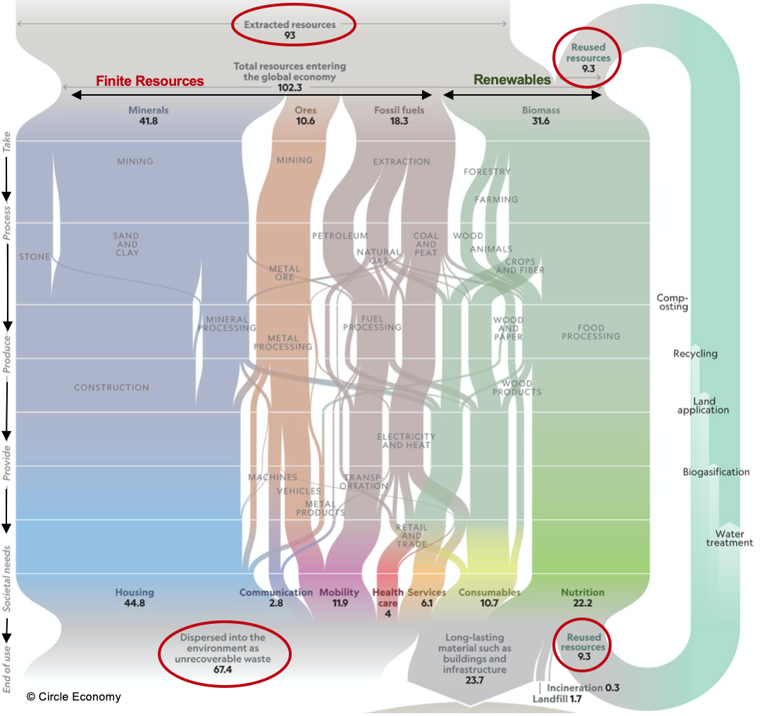
Take
Linear Economy
Take – Make – Waste
In 2015, about 93 billion tons of virgin raw materials extracted annually (91% of resources used)
Almost 70% resource use are from finite resources
Only 9.3 billion tonnes (9%) are in the loop
About 68% of input raw materials becomes unrecoverable waste and either landfilled or incinerated
Make
Waste
Source: (Circle Economy, cited in National Geographic, 2020)
Notes:
Notes to teacher on how to present slide
This slide was included to link up to the challenging waste problems introduced earlier and to the circular economy solution which consider waste reduction as one of its principles in later slides. X-ray of the global economy was included to illustrate a linear economy concept and how waste is a big part of this system by providing statistics. You may spend longer time to explain the diagram as the text and figures are relatively small to properly see from the back of the class. Hence, you can point at the key figures and text on the diagram to make your points.
You can explain the underlying cause of those wastes is due to the fact that we are operating in a linear system where we take the materials out of the ground as if there is no limit, to make the products, just to throw them away when we no longer want. This unsustainable production and consumption practices is fuelling the waste economy. You can explain the key figures circled in red.
The image has small lettering but it can be displayed or printed in a larger format and can be the basis for a class discussion. It can also be deleted for a younger audience.
Key links for further information
You may read a very good article where this diagram and information are extracted from. It can be found via link https://www.nationalgeographic.com/magazine/2020/03/how-a-circular-economy-could-save-the-world-feature/
Image used: https://www.nationalgeographic.com/magazine/2020/03/how-a-circular-economy-could-save-the-world-feature/

Slide 12
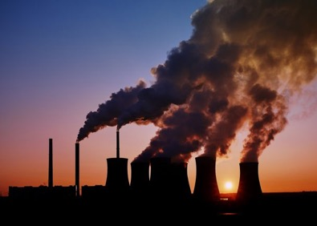
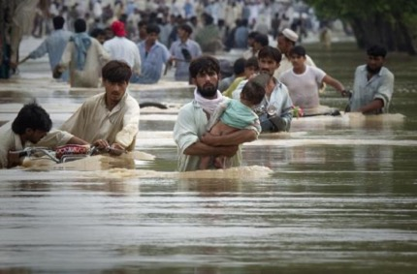
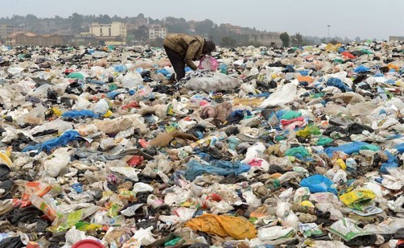
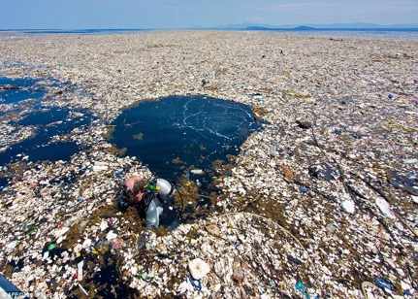
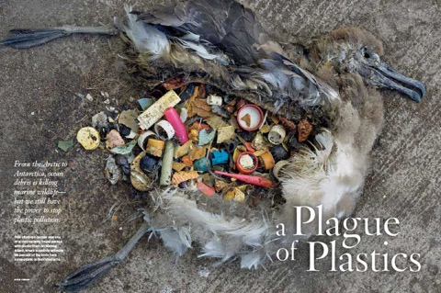
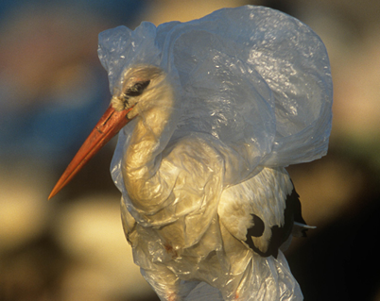
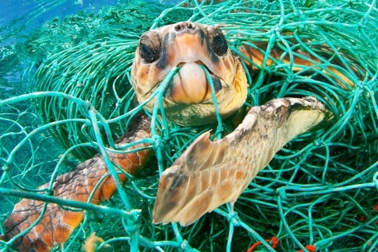
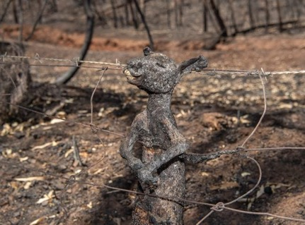
Linear Economy
Problems of Linear Economy
Depletion of natural resources
Environmental pollutions & climate change
Damages caused to ecosystem & biodiversity
Economic disadvantages
Notes:
Notes to teacher on how to present slide
In this slide, you can talk about how the linear economy (take-make-waste system and mindset) is putting a strain on the finite natural resources because it assumes a constant supply of natural resources. The linear economy could be linked to a lot of environmental problems as well. All stages of “take-make-dispose” mindset affect ecosystem. Extraction and processing of raw materials and manufacturing of the products lead to high energy and water consumption, and disruption of the natural systems of forests and lakes. Emission of toxic substances, discharge of wastewater, and greenhouse gases during manufacturing harms the land, water bodies, the atmosphere. Eventually, when these products are discarded, the land space is taken up and the toxic substances are also leaked into the soil and some leaked into the waterways and the seas and oceans.
All these negative environmental impacts have effect on both humans and animals – uncontrollable forest fires, frequent flooding, plastic soup in the oceans, plastic pollution impacts on animals, etc. Not just social or environmental impacts, it also have economic disadvantages - raw material price fluctuation, problems for those businesses with reliance on critical raw materials such as indium and chromium, interdependence of raw materials and global trade in such a way that scarcity of one material could have wide spread impacts on the prices and availability of other materials.
Key links for further information
https://kenniskaarten.hetgroenebrein.nl/en/knowledge-map-circular-economy/ce-disadvantages-linear-economy/
Links for Images used:
CO2 emission: https://www.psychologicalscience.org/news/releases/polluted-air-may-pollute-our-morality.html
Flood in Pakistan - https://cache.boston.com/resize/bonzai-fba/Globe_Photo/2010/07/30/1280548279_2291/539w.jpg
Forest fire in Australia - https://cdn.cnn.com/cnnnext/dam/assets/191220111759-01-australia-bushfire-1219-super-169.jpg
Plastic waste - https://sustyvibes.com/psp-operators-disdain-visionscapes-attempts-waste-management/
Plastic soup - https://www.dailymail.co.uk/news/article-5114157/Idyllic-Caribbean-island-ruined-rubbish.html
Dead albatross full of plastics - https://www.nwf.org/Home/Magazines/National-Wildlife/2019/June-July/Conservation/Ocean-Plastic
Tangled tortoise in fishing net -https://www.worldwildlife.org/initiatives/plastics
Bird tangled in plastic bag - https://www.wwf.org.au/news/blogs/how-many-birds-die-from-plastic-pollution#gs.l2kr3d
Dead kangaroo due to Australia fire - https://i.redd.it/a6f0ias9kg841.jpg

Slide 13
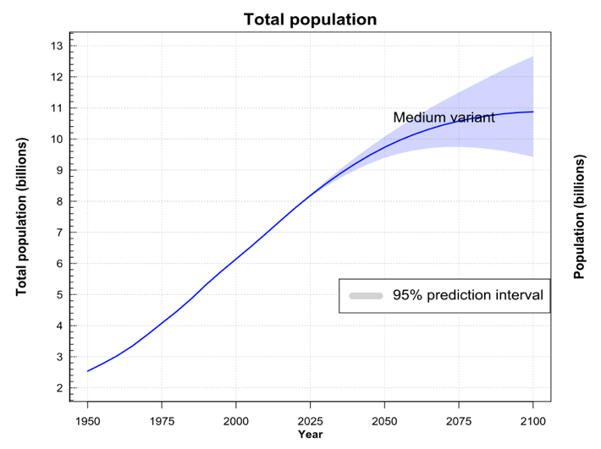
Finite Resources
Finite Resources
Metals and minerals
Fossil fuels
Ecosystems
Outline
Quiz on Waste Statistics
Linear Economy
Finite Resources
Circular Economy
Circular Business Models
Barriers to Circular Economy
Conclusion
Source: UN (2019), BBC (2012)
Notes:
Notes to teacher on how to present slide
Here, you can briefly explain about the finite resources such as metals, minerals, fossil fuels and ecosystems. At the same time, the population is growing and it is expected to grow by another 2 billions by 2050 (graph on the left). There is also a growing middle class population which is the major contributor to the throwaway culture. More population means more demands for products, hence more extraction of raw materials and more production. However, the resources are depleting. You can take a few examples from the stock check graph and their respective remaining years to explain to the students. Try to spend some time to explain the stock check graph as the texts are small for the students to see properly. Even though the figures could not be exact, the main point you want to highlight is that the stock is decreasing and unlikely to be able to sustain the demand of a growing population.
The “Stock Check” image has small lettering but it can be displayed or printed in a larger format and can be the basis for a class discussion.
Links for images used:
Stock check - https://www.bbc.com/future/article/20120618-global-resources-stock-check
Population growth -https://population.un.org/wpp/Graphs/DemographicProfiles/Line/900
https://population.un.org/wpp/Graphs/1_Demographic%20Profiles/World.pdf

Slide 14
Circular Economy
Circular Economy
“An economy that … aims to keep products, components, and materials at their highest utility and value at all times” by Ellen MacArthur Foundation
An economic system that valorizes waste and the continual use of resources. It uses repair, reuse, sharing, refurbishment, remanufacturing and recycling to create a close-loop system, minimizing the use of resource inputs and reducing the creation of waste, pollution and carbon emissions (modified from Geissdoerfer et al, 2017).
Source: (Ellen MacArthur Foundation, 2013)
Notes:
Notes to teacher on how to present slide
This slide introduces the circular economy. Circular economy concept has become more popular during the past decade, as the system solution to some of the most pressing problems of the linear economy. You can read up the report provided in the link below to understand more about the circular economy and the butterfly diagram mentioned here.
The butterfly diagram is extremely important. It does have small lettering but it can be displayed or printed in a larger format and can be the basis for a class discussion.
The picture on the right is the butterfly diagram to illustrate how technological and biological nutrient-based products and materials cycle through the system in the circular economy.
The products, components and materials are kept in the economy through repair, reuse, remanufacturing and recycling, where recycling is the least preferable.
Power of inner circle - On the technical side, the tighter the circles are, the larger the savings should be in the embedded costs in terms of material, labour, energy, capital and of the associated externalities such as GHG emissions, water or toxic substances.
Power of circling longer - A second core value creation potential stems from keeping products, components, and materials in use longer within the circular economy, through consecutive cycles or by spending more time within a cycle.
Power of cascaded uses (on biological side) - In the cascades, the arbitrage value creation potential is rooted in the lower marginal costs of reusing the cascading materials as a substitute for virgin material inflows and their embedded costs (labour, energy, material) as well as externalities against the marginal costs of bringing the material back into a repurposed use.
Key links for further information
https://www.ellenmacarthurfoundation.org/assets/downloads/publications/Ellen-MacArthur-Foundation-Towards-the-Circular-Economy-vol.1.pdf
Geissdoerfer, M., Savaget, P., Bocken, N., & Hultink, E. (2017). The Circular Economy – A new sustainability paradigm?. Journal of Cleaner Production, 143 (1), 757-768.
Mayumi, K., & Giampietro, M. (2019). Reconsidering “Circular Economy” in Terms of Irreversible Evolution of Economic Activity. Romanian Journal of Economic Forecasting, 22(2), 197-207.
Images used: Ellen MacArthur Foundation

Slide 15
Circular Economy
Principles of Circular Economy
Take
Design out waste and pollution
Keep products and materials in use
Regenerate natural systems
Make
Waste
Source: Ellen MacArthur Foundation
Notes:
Notes to teacher on how to present slide
This slide introduces three CE Principles and their relevant explanations below are extracted from EMF to give further information and assist understanding.
Design out waste – A circular economy reveals and designs out the negative impacts of economic activity that cause damage to human health and natural systems. This includes the release of greenhouse gases and hazardous substances, the pollution of air, land, and water, as well as structural waste such as traffic congestion. The biological and technical components (or nutrients) to make the products, and the products are designed by intension to fit within a biological or technical materials cycle, designed for disassembly and refurbishment. Technical nutrients—polymers, alloys, and other man-made materials are designed to be used again with minimal energy and highest quality retention. (whereas recycling as commonly understood results in a reduction in quality and feeds back into the process as a crude feedstock). The biological nutrients are non-toxic and can be simply composted.
Keep products and materials in use – A circular economy favours activities that preserve value in the form of energy, labour, and materials. This means designing for durability, reuse, remanufacturing, and recycling to keep products, components, and materials circulating in the economy. Circular systems make effective use of bio-based materials by encouraging many different uses for them as they cycle between the economy and natural systems.
Regenerate natural system – A circular economy avoids the use of non-renewable resources and preserves or enhances renewable ones, for instance by returning valuable nutrients to the soil to support regeneration, or using renewable energy as opposed to relying on fossil fuels.
Key links for further information
Link for more information - https://www.ellenmacarthurfoundation.org/explore/the-circular-economy-in-detail
https://www.ellenmacarthurfoundation.org/assets/downloads/publications/Ellen-MacArthur-Foundation-Towards-the-Circular-Economy-vol.1.pdf
Images used: Ellen MacArthur Foundation

Slide 16
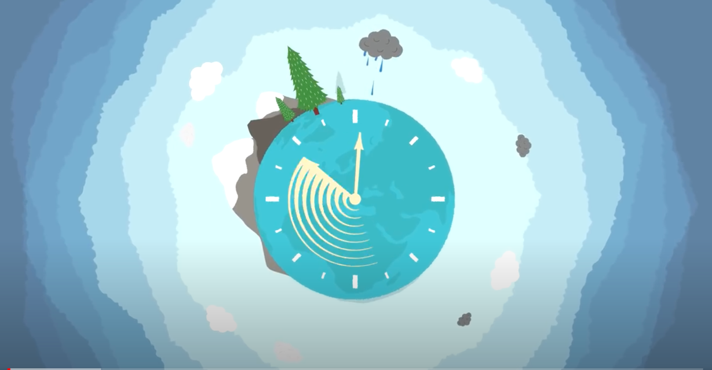
Circular Economy
Rethinking Progress: The Circular Economy
Short video (3.48 minutes) by Ellen MacArthur Foundation
Video Link: https://www.youtube.com/watch?v=zCRKvDyyHmI
Outline
Quiz on Waste Statistics
Linear Economy
Finite Resources
Circular Economy
Circular Business Models
Barriers to Circular Economy
Conclusion
Notes:
Notes to teacher on how to present slide
This video was published by Ellen MacArthur Foundation. This is a very good video that explains a linear economy, the problems of a linear economy, a circular economy, what inspires the circular economy concept, what the circular business models are like and how they could be implemented in real world. This would be a very inspiring video for your students. After watching the video together with the students, you can ask a few questions to discuss with the students. For example, what problems of a linear economy can you identify in their daily life or at home? What other negative impacts does the linear economy have apart from a waste of resources? The video introduces about licensing a washing machine for use at home instead of buying, other other products can you imaging using in this model?
Key links for further information
Video Link: https://www.youtube.com/watch?v=zCRKvDyyHmI

Slide 17
Circular Business Models
Five Circular Business Models
1. Circular Supplies
  Replace conventional virgin raw materials inputs with bio-based, renewable, recyclable OR biodegradable materials
  Reduce pressures on limited virgin raw materials
  E.g. Vollebak produces T-shirt made from pulped eucalyptus, beech and algae which biodegrade in 12 weeks
Outline
Quiz on Waste Statistics
Linear Economy
Finite Resources
Circular Economy
Circular Business Models
Barriers to Circular Economy
Conclusion
Source: Accenture (2014), OECD (2018)
Notes:
Notes to teacher on how to present slide
This slide introduces the first circular business model which is circular supplies. Circular Supplies: this business models basically tries to replace traditional single-lifecycle inputs / virgin raw materials inputs with bio-based materials which are fully renewable, recyclable or biodegradable. Hence, it aims to reduce demand for virgin resource extraction in the long run.
Only one example is provided here as there are more company examples adopting this business cycle in the workshop materials.
Company example – this company Vollebak makes biodegradable t-shirt made from pulped eucalyptus, beech from sustainably managed forests and algae grown in bioreactors. The t-shirt is fully biodegradable in just 12 weeks. It solves the waste problem, the reliance on fossil fuels for petrochemicals to make synthetic fibres.
Key links for further information
https://www.accenture.com/t20150523t053139__w__/us-en/_acnmedia/accenture/conversion-assets/dotcom/documents/global/pdf/strategy_6/accenture-circular-advantage-innovative-business-models-technologies-value-growth.pdf
https://thecirculars.org/content/resources/Accenture-Waste-Wealth-Exec-Sum-FINAL.pdf
https://www.oecd.org/environment/waste/policy-highlights-business-models-for-the-circular-economy.pdf
For case study company example: https://www.vollebak.com/product/plant-and-algae-t-shirt/
Image used: https://dyk8bhziazfed.cloudfront.net/wp-content/uploads/2019/08/plant-and-algaet-300-1376-1376x776.jpg

Slide 18
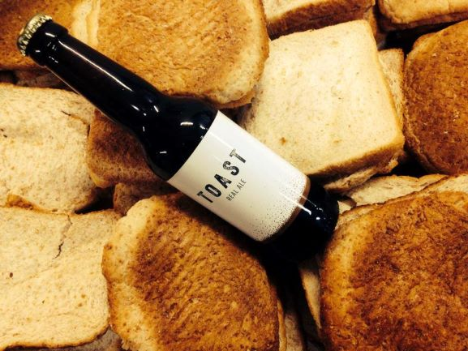
Circular Business Models
Five Circular Business Models
2. Resource Recovery and Recycling
  Recover and reuse of resources or energy from discarded wastes or by-products
  Valorise wastes and by-products by giving a second life and by reusing them to make a new product
  E.g. Toast Ale – Bread waste to Beer
Outline
Quiz on Waste Statistics
Linear Economy
Finite Resources
Circular Economy
Circular Business Models
Barriers to Circular Economy
Conclusion
Source: Accenture (2014), OECD (2018)
Interesting, in Latvia (and also Poland) traditionally bread was processed into "kvass" (a drink similar do beer, still quite popular in Latvia, Poland and some other Eastern European countries). Which shows that looking for innovation is often worth returning to tradition.
Notes:
Notes to teacher on how to present slide
This slide introduce a second business model. Resource recovery and recycling models basically reuse the resources and energy from waste materials or by-products of other industry. Industrial symbiosis is a good example for this model.Hence, this material diverts wastes from landfills, where they have been normally disposed off. It also displace the extraction and processing of virgin natural resources. It valorise the waste and by-products by giving a second life. Normally, these inputs are being repurposed or transformed to a totally different type of products.
Case example: Toast Ale - In UK alone, about 44% of all bread produced was thrown away into bin. In order to tackle food waste problem, this UK company collects the bread waste from bakeries, delis and so on to divert them from landfills and give a second life as a beer. These surplus breads can be incorporated into the normal brewing processes together with the usual ingredients of malted barley, hops, yeast and water without the need for any new technology, by simply replacing up to one third of the required malted barley amount.
Key links for further information
https://www.accenture.com/t20150523t053139__w__/us-en/_acnmedia/accenture/conversion-assets/dotcom/documents/global/pdf/strategy_6/accenture-circular-advantage-innovative-business-models-technologies-value-growth.pdf
https://thecirculars.org/content/resources/Accenture-Waste-Wealth-Exec-Sum-FINAL.pdf
https://www.oecd.org/environment/waste/policy-highlights-business-models-for-the-circular-economy.pdf
For case study company example: https://www.ellenmacarthurfoundation.org/case-studies/brewing-beer-from-surplus-bread
https://www.toastale.com
Image used: https://www.iamrenew.com/wp-content/uploads/2019/07/Toast-Ale-Banner.jpg

Slide 19
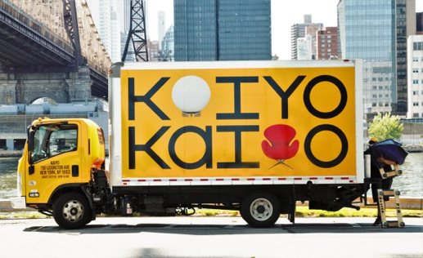
Circular Business Models
Five Circular Business Models
3. Product Life Extension
  Extend working lifecycle of the existing products by repairing, upgrading, remanufacturing and reselling
  Slows the resource extraction, flow of materials through economy and waste generation
  For example, Kaiyo repairs and resell the unwanted furniture to new buyers and share profit with previous owners
Outline
Quiz on Waste Statistics
Linear Economy
Finite Resources
Circular Economy
Circular Business Models
Barriers to Circular Economy
Conclusion
Source: Accenture (2014), OECD (2018)
Notes:
Notes to teacher on how to present slide
This third model extends the productive lifetime of the products and components by repairing, remanufacturing, upgrading and reselling. Hence, it slows the flow of constituent materials through the economy, and reduce the rate of resource extraction and waste generation.
Company example: Kaiyo is an online marketplace that aims to save the unwanted high-quality durable furniture from landfills and keep them in productive use for as long as possible. This platform allows the owners, workers or students on the move who no longer want some pieces of their furniture to recoup some values, instead of simply disposing which could also be costly. The furniture owners could contact Kaiyo who will review the furniture, collect it from the owner, clean and repair if necessary, list it on the website, store it in their warehouses for free of charge until it sells and deliver them to the buyers. Kaiyo will be responsible for all the necessary work to get the most value out of the unwanted furniture and it pays the donors a commission of up to 40% once those items are sold. The buyers also benefits from great discounts on high-quality furniture with appropriate conditions such as “like new, excellent, gently used, fair etc”. Kaiyo will take care of delivery and setting up the furniture.
Key links for further information
More information on the description and explanation of this business model could be found in:
https://www.accenture.com/t20150523t053139__w__/us-en/_acnmedia/accenture/conversion-assets/dotcom/documents/global/pdf/strategy_6/accenture-circular-advantage-innovative-business-models-technologies-value-growth.pdf
https://thecirculars.org/content/resources/Accenture-Waste-Wealth-Exec-Sum-FINAL.pdf
https://www.oecd.org/environment/waste/policy-highlights-business-models-for-the-circular-economy.pdf
For case study company example: https://www.ellenmacarthurfoundation.org/case-studies/the-final-stop-for-quality-furniture
https://kaiyo.com/how-it-works#do-you-allow-local-pickups
Image used: https://moneydotcomvip.files.wordpress.com/2019/09/aklnwpua.jpeg?quality=85

Slide 20
Circular Business Models
Five Circular Business Models
4. Sharing Economy
  Enable sharing of under-utilised products and assets
  Reduce demand for new products and raw materials input
  For example, Spinlister - a peer-to-peer sharing platform that allows bike owners to list their bikes available for renting and renters to search for a bike to rent in whatever area they are in.
Outline
Quiz on Waste Statistics
Linear Economy
Finite Resources
Circular Economy
Circular Business Models
Barriers to Circular Economy
Conclusion
Source: Accenture (2014), OECD (2018)
Notes:
Notes to teacher on how to present slide
Sharing Platforms helps increased utilization rate of less-frequently-used products by making possible shared use/access/ownership. Hence, it eliminates the need to buy more products and therefore reduce demand for new products and their embedded raw materials.
Case example: Spinlister is a peer-to-peer sharing platform that allows bike owners to list their bikes available for renting and renters to search for a bike to rent in whatever area they are in by city, zip code, available date and ride types. Its primary market is bikes with listing in 63 countries. However, they are also expanding into other markets, enabling sharing of surfboards, Stand up Paddle boards (SUPs), ski equipment and snowboards etc. The company also offers coverages for damages and theft protection in selected areas for a fee. Bike owners could make some money by sharing their underutilised bikes, and travellers and active people could get the flexibility of having access to nearby bikes located throughout different cities when they need.
Key links for further information:
More information on the description and explanation of this business model could be found in:
https://www.accenture.com/t20150523t053139__w__/us-en/_acnmedia/accenture/conversion-assets/dotcom/documents/global/pdf/strategy_6/accenture-circular-advantage-innovative-business-models-technologies-value-growth.pdf
https://thecirculars.org/content/resources/Accenture-Waste-Wealth-Exec-Sum-FINAL.pdf
https://www.oecd.org/environment/waste/policy-highlights-business-models-for-the-circular-economy.pdf
Image used: https://www.netted.net/wp-content/uploads/sites/14/2015/02/Spinlister_1000x563_2.6.15.png

Slide 21
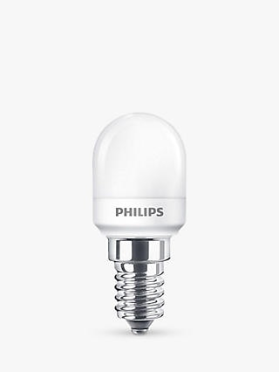
Circular Business Models
Five Circular Business Models
5. Product as a Service
  Offer product access services and retain ownership of the products
  Customers don’t need to buy but use it through lease or pay-per-use arrangements
  Promotes sparing use of natural resources
  For example, Philips provides ‘pay-per-lux’ lighting services to the business customers who wants to purchase light, but not the associated lighting infrastructure.
Outline
Quiz on Waste Statistics
Linear Economy
Finite Resources
Circular Economy
Circular Business Models
Barriers to Circular Economy
Conclusion
Source: Accenture (2014), OECD (2018)
Notes:
Notes to teacher on how to present slide
This is product service system models, where services rather than products are marketed, improve incentives for green product design and more efficient product use, thereby promoting a more sparing use of natural resources. Customers do not need to spend upfront cost to purchase the products they might use very rarely, instead they can lease them through subscription or one-off rental arrangement.
Case example: Philips provides ‘pay-per-lux’ lighting services to the business customers who wants to purchase light, but not the associated lighting infrastructure. Philips retains the ownership and is responsible for designs, installation, operation, monitoring, maintenance, upgrades and recovery throughout the lifecycle. It incorporates the use of the natural light resources in a more effective way, motion sensor and LED lighting technology with better performance, longer life and energy efficiency. Customers do not need to invest upfront and own the lighting infrastructure which eventually needs to be discarded for replacement. Instead, they just need to pay for the optimal amount of light they require and use. This arrangement could also result in receiving better services, as the light provider has incentives to provide long-lasting lighting infrastructure.
Key links for further information
More information on the description and explanation of this business model could be found in:
https://www.accenture.com/t20150523t053139__w__/us-en/_acnmedia/accenture/conversion-assets/dotcom/documents/global/pdf/strategy_6/accenture-circular-advantage-innovative-business-models-technologies-value-growth.pdf
https://thecirculars.org/content/resources/Accenture-Waste-Wealth-Exec-Sum-FINAL.pdf
https://www.oecd.org/environment/waste/policy-highlights-business-models-for-the-circular-economy.pdf
Images used: https://johnlewis.scene7.com/is/image/JohnLewis/237006205?$rsp-plp-port-320$

Slide 22
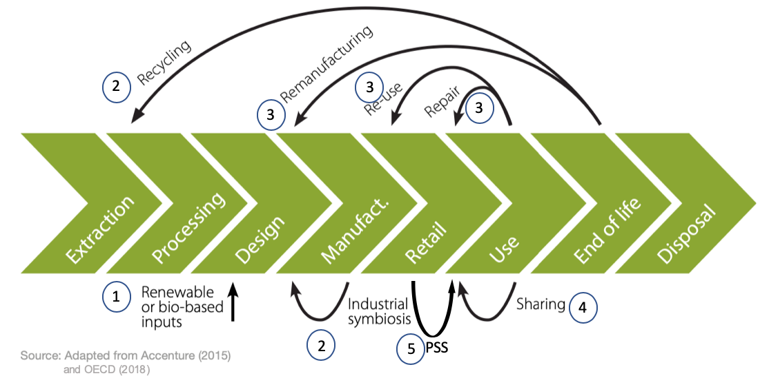
Circular Business Models
Five Circular Business Models
Circular Supplies (renewable bio-based inputs)
Resource Recovery and Recycling (wastes, by-products, industrial symbiosis)
Product Life Extension (reuse, repair, remanufacturing, etc)
Sharing Platforms
Product as a service
Linked to Bioeconomy
Outline
Quiz on Waste Statistics
Linear Economy
Finite Resources
Circular Economy
Circular Business Models
Barriers to Circular Economy
Conclusion
Notes:
Notes to teacher on how to present slide
You can provide the summary of what you have talked about so far on 5 circular business models. You can explain that first and second models are linked to bioeconomy as well, since circular supplies primarily use bio-based renewable inputs and the waste/ by products for recovery and recycling models could be from forestry, agriculture or fishery. All these models try to reduce the pressures on the limited virgin resources, hence less need for extraction of new finite resources and also try to eliminate the waste generation.
So distinction between circular various circular business models could be clear in theory. However, it is not very clear cut in reality. Some companies adopt a combinations of business models. For example, in product as a service system, the company retains the ownership of the products, which they could repair and remanufacture at some points in the future.
You should also explain that circular business models operate in different parts of value chain. You can explain about where each of those business models could occur along the value chain as per the diagram. Circular business models, by closing resource loops and by slowing and narrowing resource flows, can reduce the environmental footprint of economic production and consumption.
Key links for further information
https://www.oecd.org/environment/waste/policy-highlights-business-models-for-the-circular-economy.pdf
Image used: https://www.oecd.org/environment/waste/policy-highlights-business-models-for-the-circular-economy.pdf

Slide 23

What is the bioeconomy?
European Bioeconomy Strategy
The European Commission is taking steps towards a sustainable bioeconomy and has a bioeconomy strategy to promote the bioeconomy and to avoid reaching ecological limits.
The Bioeconomy…
Is the production of goods, services, or energy from biological material as the main resource.
Is strongly linked to sustainability as biodegradable resources are often used and waste is often completely designed out of the system.
Can avoid the depletion of resources for future generations and protect the stability of the planet.
Notes:
Notes to teacher: Explain to class that in order to take steps towards sustainability and the avoidance of reaching ecological limits the bioeconomy is very important. The bioeconomy is the production of goods, services, or energy from biological material as the main resource. This is strongly linked to sustainability as biodegradable resources are often used and waste is often completely designed out of the system. This can avoid the depletion of resources for future generations and protect the stability of the planet. The European Commission is taking steps towards a sustainable bioeconomy. Turning waste into valuable resources and creating incentives to help retailers and consumers cut food waste. The European Commission has a bioeconomy strategy to promote the bioeconomy and avoid reaching ecological limits.
European Commission (2018), A sustainable Bioeconomy for Europe: strengthening the connection between economy, society and the environment. Updated Bioeconomy Strategy. Directorate-General for Research and Innovation, available at: https://ec.europa.eu/research/bioeconomy/pdf/ec_bioeconomy_strategy_2018.pdf accessed: 22 May 2020].
Explain as well that to try and tackle the issues surrounding ecological limits: National and international bodies have specific guidelines. An example of this is the European Commission’s 2018 publication; ‘A new bioeconomy strategy for a sustainable Europe.’ Further information available at: https://ec.europa.eu/commission/news/new-bioeconomy-strategy-sustainable-europe-2018-oct-11-0_en
See slides “What is the Bioeconomy? Opportunities, challenges and solutions” for information on:
Bioeconomy – links to SDGs and climate change, and bioeconomy resources
The transition to a bioeconomy is complex
Biodiversity assessment
Direct, indirect and cumulative impacts
What are ‘impacts and need for Environmental Impact Assessment (EIA) and/or Strategic Environmental Assessment (SEA).
Net positive outcomes, enhancement and the mitigation hierarchy
Example: the impacts of biofuels

Slide 24

Barriers to Circular Economy
Cultural
Technological
Linear Economy
Circular Economy
Outline
Quiz on Waste Statistics
Linear Economy
Finite Resources
Circular Economy
Circular Business Models
Barriers to Circular Economy
Conclusion
Market
Regulatory
Source: Kirchherr, et al (2017)
Notes:
Notes to teacher on how to present slide
Here in this slide, you can explain that although there are a lot of benefits of the circular economy, this system has not been widely adopted yet. You can introduce 4 types of barriers. The following four slides will provide a few examples for each category of barriers to explain further.
Key links for further information
Breaking the Barriers to the Circular Economy Research conducted by Deloitte and Utrecht University
https://www2.deloitte.com/nl/nl/pages/risk/articles/breaking-the-barriers-to-the-circular-economy.html
Kirchherr, J.,Piscicelli, L., Bour, R.,Kostense-Smit, E., Muller, J., Huibrechtse-Truijens, A., Hekkert, M.P. (2018): Barriers to the Circular Economy: Evidence From the European Union (EU). Ecological Economics, 150: 264-272.

Slide 25
Barriers to Circular Economy
Cultural
Linear Economy
Circular Economy
Outline
Quiz on Waste Statistics
Linear Economy
Finite Resources
Circular Economy
Circular Business Models
Barriers to Circular Economy
Conclusion
Culture and mindset issues
Lack of awareness or interests
Difficulty for the whole supply chain to be circular
Source: Kirchherr, et al (2017)
Notes:
Notes to teacher on how to present slide
This slide provides examples of cultural barriers towards circular economy. You may read the two reports mentioned below to gain more understanding to explain to your students.
Key links for further information
Breaking the Barriers to the Circular Economy Research conducted by Deloitte and Utrecht University
https://www.google.com/url?sa=t&rct=j&q=&esrc=s&source=web&cd=1&ved=2ahUKEwisqZHmtPDnAhVxsHEKHUoQDkQQFjAAegQIBBAB&url=https%3A%2F%2Fwww.uu.nl%2Fen%2Ffiles%2Fbreaking-the-barriers-to-the-circular-economy-white-paperwebpdf&usg=AOvVaw2M-WxHA-NmggfQvhQiwlyF
Kirchherr, J.,Piscicelli, L., Bour, R.,Kostense-Smit, E., Muller, J., Huibrechtse-Truijens, A., Hekkert, M.P. (2018): Barriers to the Circular Economy: Evidence From the European Union (EU). Ecological Economics, 150: 264-272.

Slide 26
Barriers to Circular Economy
Technological
Linear Economy
Circular Economy
Outline
Quiz on Waste Statistics
Linear Economy
Finite Resources
Circular Economy
Circular Business Models
Barriers to Circular Economy
Conclusion
Lacking proven technologies
Circular designs
Ability to make high-quality remanufactured products
Lack of data
Source: Kirchherr, et al (2017)
Notes:
Notes to teacher on how to present slide
This slide provides examples of technological barriers towards circular economy. You may read the two reports mentioned below to gain more understanding to explain to your students.
Key links for further information
Breaking the Barriers to the Circular Economy Research conducted by Deloitte and Utrecht University
https://www.google.com/url?sa=t&rct=j&q=&esrc=s&source=web&cd=1&ved=2ahUKEwisqZHmtPDnAhVxsHEKHUoQDkQQFjAAegQIBBAB&url=https%3A%2F%2Fwww.uu.nl%2Fen%2Ffiles%2Fbreaking-the-barriers-to-the-circular-economy-white-paperwebpdf&usg=AOvVaw2M-WxHA-NmggfQvhQiwlyF
Kirchherr, J.,Piscicelli, L., Bour, R.,Kostense-Smit, E., Muller, J., Huibrechtse-Truijens, A., Hekkert, M.P. (2018): Barriers to the Circular Economy: Evidence From the European Union (EU). Ecological Economics, 150: 264-272.

Slide 27
Barriers to Circular Economy
Lack of economic viability
Low price of virginal materials
High upfront investment costs
Steep learning curves
Limited funding
Linear Economy
Circular Economy
Outline
Quiz on Waste Statistics
Linear Economy
Finite Resources
Circular Economy
Circular Business Models
Barriers to Circular Economy
Conclusion
Market
Source: Kirchherr, et al (2017)
Notes:
Notes to teacher on how to present slide
This slide provides examples of market barriers towards circular economy. You may read the two reports mentioned below to gain more understanding to explain to your students.
Key links for further information
Breaking the Barriers to the Circular Economy Research conducted by Deloitte and Utrecht University
https://www.google.com/url?sa=t&rct=j&q=&esrc=s&source=web&cd=1&ved=2ahUKEwisqZHmtPDnAhVxsHEKHUoQDkQQFjAAegQIBBAB&url=https%3A%2F%2Fwww.uu.nl%2Fen%2Ffiles%2Fbreaking-the-barriers-to-the-circular-economy-white-paperwebpdf&usg=AOvVaw2M-WxHA-NmggfQvhQiwlyF
Kirchherr, J.,Piscicelli, L., Bour, R.,Kostense-Smit, E., Muller, J., Huibrechtse-Truijens, A., Hekkert, M.P. (2018): Barriers to the Circular Economy: Evidence From the European Union (EU). Ecological Economics, 150: 264-272.

Slide 28
Barriers to Circular Economy
Lack of policies to support circular economy transition
Obstructing laws and regulations
Limited circular procurement
Lack of global consensus
Linear Economy
Circular Economy
Outline
Quiz on Waste Statistics
Linear Economy
Finite Resources
Circular Economy
Circular Business Models
Barriers to Circular Economy
Conclusion
Regulatory
Source: Kirchherr, et al (2017)
Notes:
Notes to teacher on how to present slide
This slide provides examples of regulatory barriers towards circular economy. You may read the two reports mentioned below to gain more understanding to explain to your students.
Key links for further information
Breaking the Barriers to the Circular Economy Research conducted by Deloitte and Utrecht University
https://www.google.com/url?sa=t&rct=j&q=&esrc=s&source=web&cd=1&ved=2ahUKEwisqZHmtPDnAhVxsHEKHUoQDkQQFjAAegQIBBAB&url=https%3A%2F%2Fwww.uu.nl%2Fen%2Ffiles%2Fbreaking-the-barriers-to-the-circular-economy-white-paperwebpdf&usg=AOvVaw2M-WxHA-NmggfQvhQiwlyF
Kirchherr, J.,Piscicelli, L., Bour, R.,Kostense-Smit, E., Muller, J., Huibrechtse-Truijens, A., Hekkert, M.P. (2018): Barriers to the Circular Economy: Evidence From the European Union (EU). Ecological Economics, 150: 264-272.

Slide 29
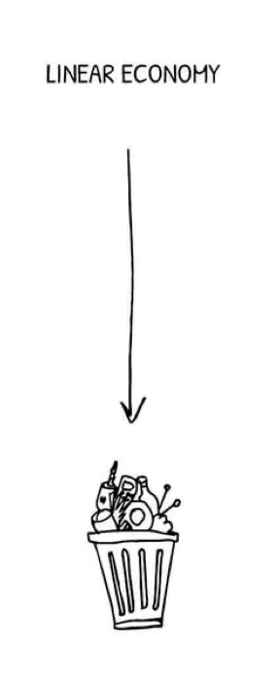
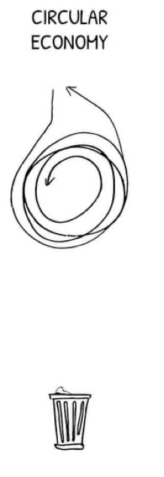
Conclusion
Conclusion
What is the Circular Economy
Three Principles of Circular Economy
Five Circular Business Models
Four Barriers to Transition to Circular Economy
Outline
Quiz on Waste Statistics
Linear Economy
Finite Resources
Circular Economy
Circular Business Models
Barriers to Circular Economy
Conclusion
Notes:
Notes to teacher on how to present slide
You can give a summary of the key points you have covered to conclude the presentation.
Image used: https://community.materialtrader.com/cms/wp-content/uploads/2019/02/linear-vs-recycling-vs-circular-economy-doodle.jpg

Slide 30
Questions and Discussion
Name of presenter
Notes:
Notes to the teacher: Speaker’s name to go in the space at the bottom left of the slide. This is the final slide of the presentation. Allow time for students/participants to ask any questions.

Slide 31
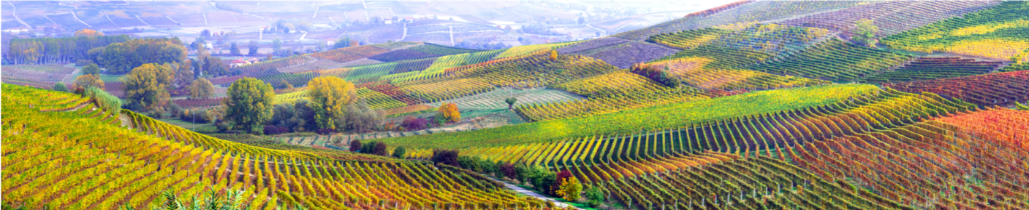


https://be-rural.eu
These educational resources were developed as part of the BE-Rural project
Bio-based strategies and roadmaps for enhanced rural and regional development in the EU (April 2019 – March 2022)
BE-Rural supports
… regional stakeholders in five countries:
Latvia: Vidzeme and Kurzeme
Poland: Szczecin and Vistula Lagoons
Romania: Covasna
Bulgaria: Stara Zagora
North Macedonia: Strumica
The goal of BE-Rural is to realise the potential of regional bio-based economies by supporting relevant actors in the participatory development of bioeconomy strategies and roadmaps
https://be-rural.eu/innovation-regions/
Notes:
BE-Rural has five innovation regions
BE-Rural will create five regional Open Innovation Platforms (OIPs) for the participatory development of bioeconomy strategies and roadmaps. The BE-Rural OIPs will be established in five regions across the EU with different biomass potentials and will be based on the regional Stakeholder Working Groups (SWGs). Within the OIPs, the main task of the SWGs will be to formulate concrete strategy or roadmap documents by engaging with different actors and opening the platform for a wide range of stakeholders in the region, including civil society organisations and citizens.
Stara Zagora, Bulgaria: This innovation region will focus on seeking new technologies for the application of essential oils and herbal plants in the cosmetics and pharmaceutical industry. The small-scale production in this area will be combined with tourism-related activities to expand the existing business status quo and potential. Ultimately, the region will establish closer relations and network between companies. Regional partner: Bulgarian Industrial Association (BIA)
Vidzeme and Kurzeme, Latvia: This region will focus on the potential of by-products of forest management (i.e. from young forest stand thinning, short rotation coppice and forestry (SRC/SRF) plantations, removing of overgrowth in abandoned agricultural lands and perennial grasses) as a source of bioenergy or biorefinery. The region will investigate the value of agroforestry systems of perennial grasses and SRC or SRF trees as grazing areas, and the production of hay or grass seeds. The potential smart use of small timber wood from young forest stand thing will be explored. Regional partner: The Latvian State Forest Research Institute (SILAVA)
Strumica, North Macedonia: The region will focus on the utilization of agricultural residues, specifically the by-production of organic materials from agricultural activities, as a source of energy for domestic and industrial purposes. The region will investigate technology options for energy conversion of biomass materials generated on agricultural fields or farms (field-based residues), as well as those generated during the processing of agricultural products (process-based residues). Regional partner: International Centre for Sustainable Development of Energy, Water and Environment Systems (SDEWES-Skopje)
Szczecin Lagoon and Vistula Lagoon, Poland: This region will focus on small-scale fisheries, specifically on the sustainable use of currently underused and low-value fish species located in two lagoons. The region will investigate small-scale technology options that can be applied to utilize low-value fish species as products for human consumption. Regional partner: The National Marine Fisheries Research Institute (NMFRI)
Covasna, Romania: The region will focus on addressing fragmented value chains and implementing the circular economy concept within the county’s industrial sectors (i.e. wood and furniture, textiles, agro-food, mechanical engineering, green energy). The region will investigate the development potential of underused biomass (plant matter and wood waste) and it implication on societal challenges (e.g., rural unemployment or marginalised communities). This will be done within a local development business model based on a small-scale technology option ensuring the autonomous energy supply for civil and industrial needs. Regional partner: Institute for Economic Forecasting (IPE)
Source: BE-Rural (2020), Innovation regions, available at: https://be-rural.eu/innovation-regions/

